Slide 1
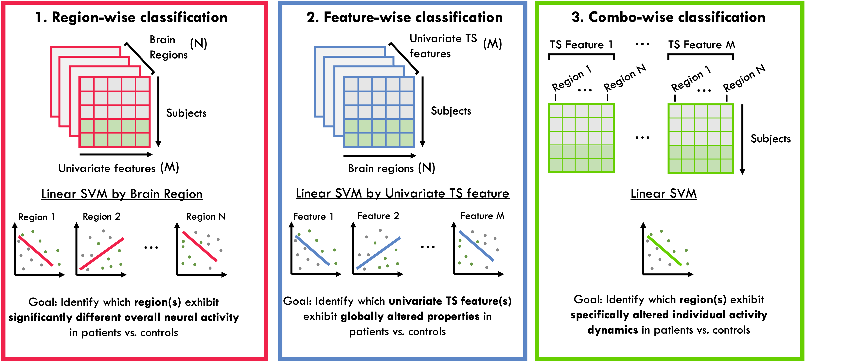
Figure S1
A
B
C

Slide 2
1. Region-wise classification
2. Feature-wise classification
3. Combo-wise classification
Brain
Regions
(N)
Univariate TS features
(M)
TS Feature 1
…
TS Feature M
Region 1
Region N
Region 1
Region N
…
…
Subjects
Subjects
…
Subjects
(M)
(N)
Univariate features
Brain regions
Linear SVM by Brain Region
Linear SVM by Univariate TS feature
Linear SVM
Region 1
Region 2
Region N
Feature 1
Feature 2
Feature M
…
…
Goal: Identify which region(s) exhibit significantly different overall neural activity in patients vs. controls
Goal: Identify which univariate TS feature(s) exhibit globally altered properties in patients vs. controls
Goal: Identify which region(s) exhibit specifically altered individual activity dynamics in patients vs. controls

