Slide 1
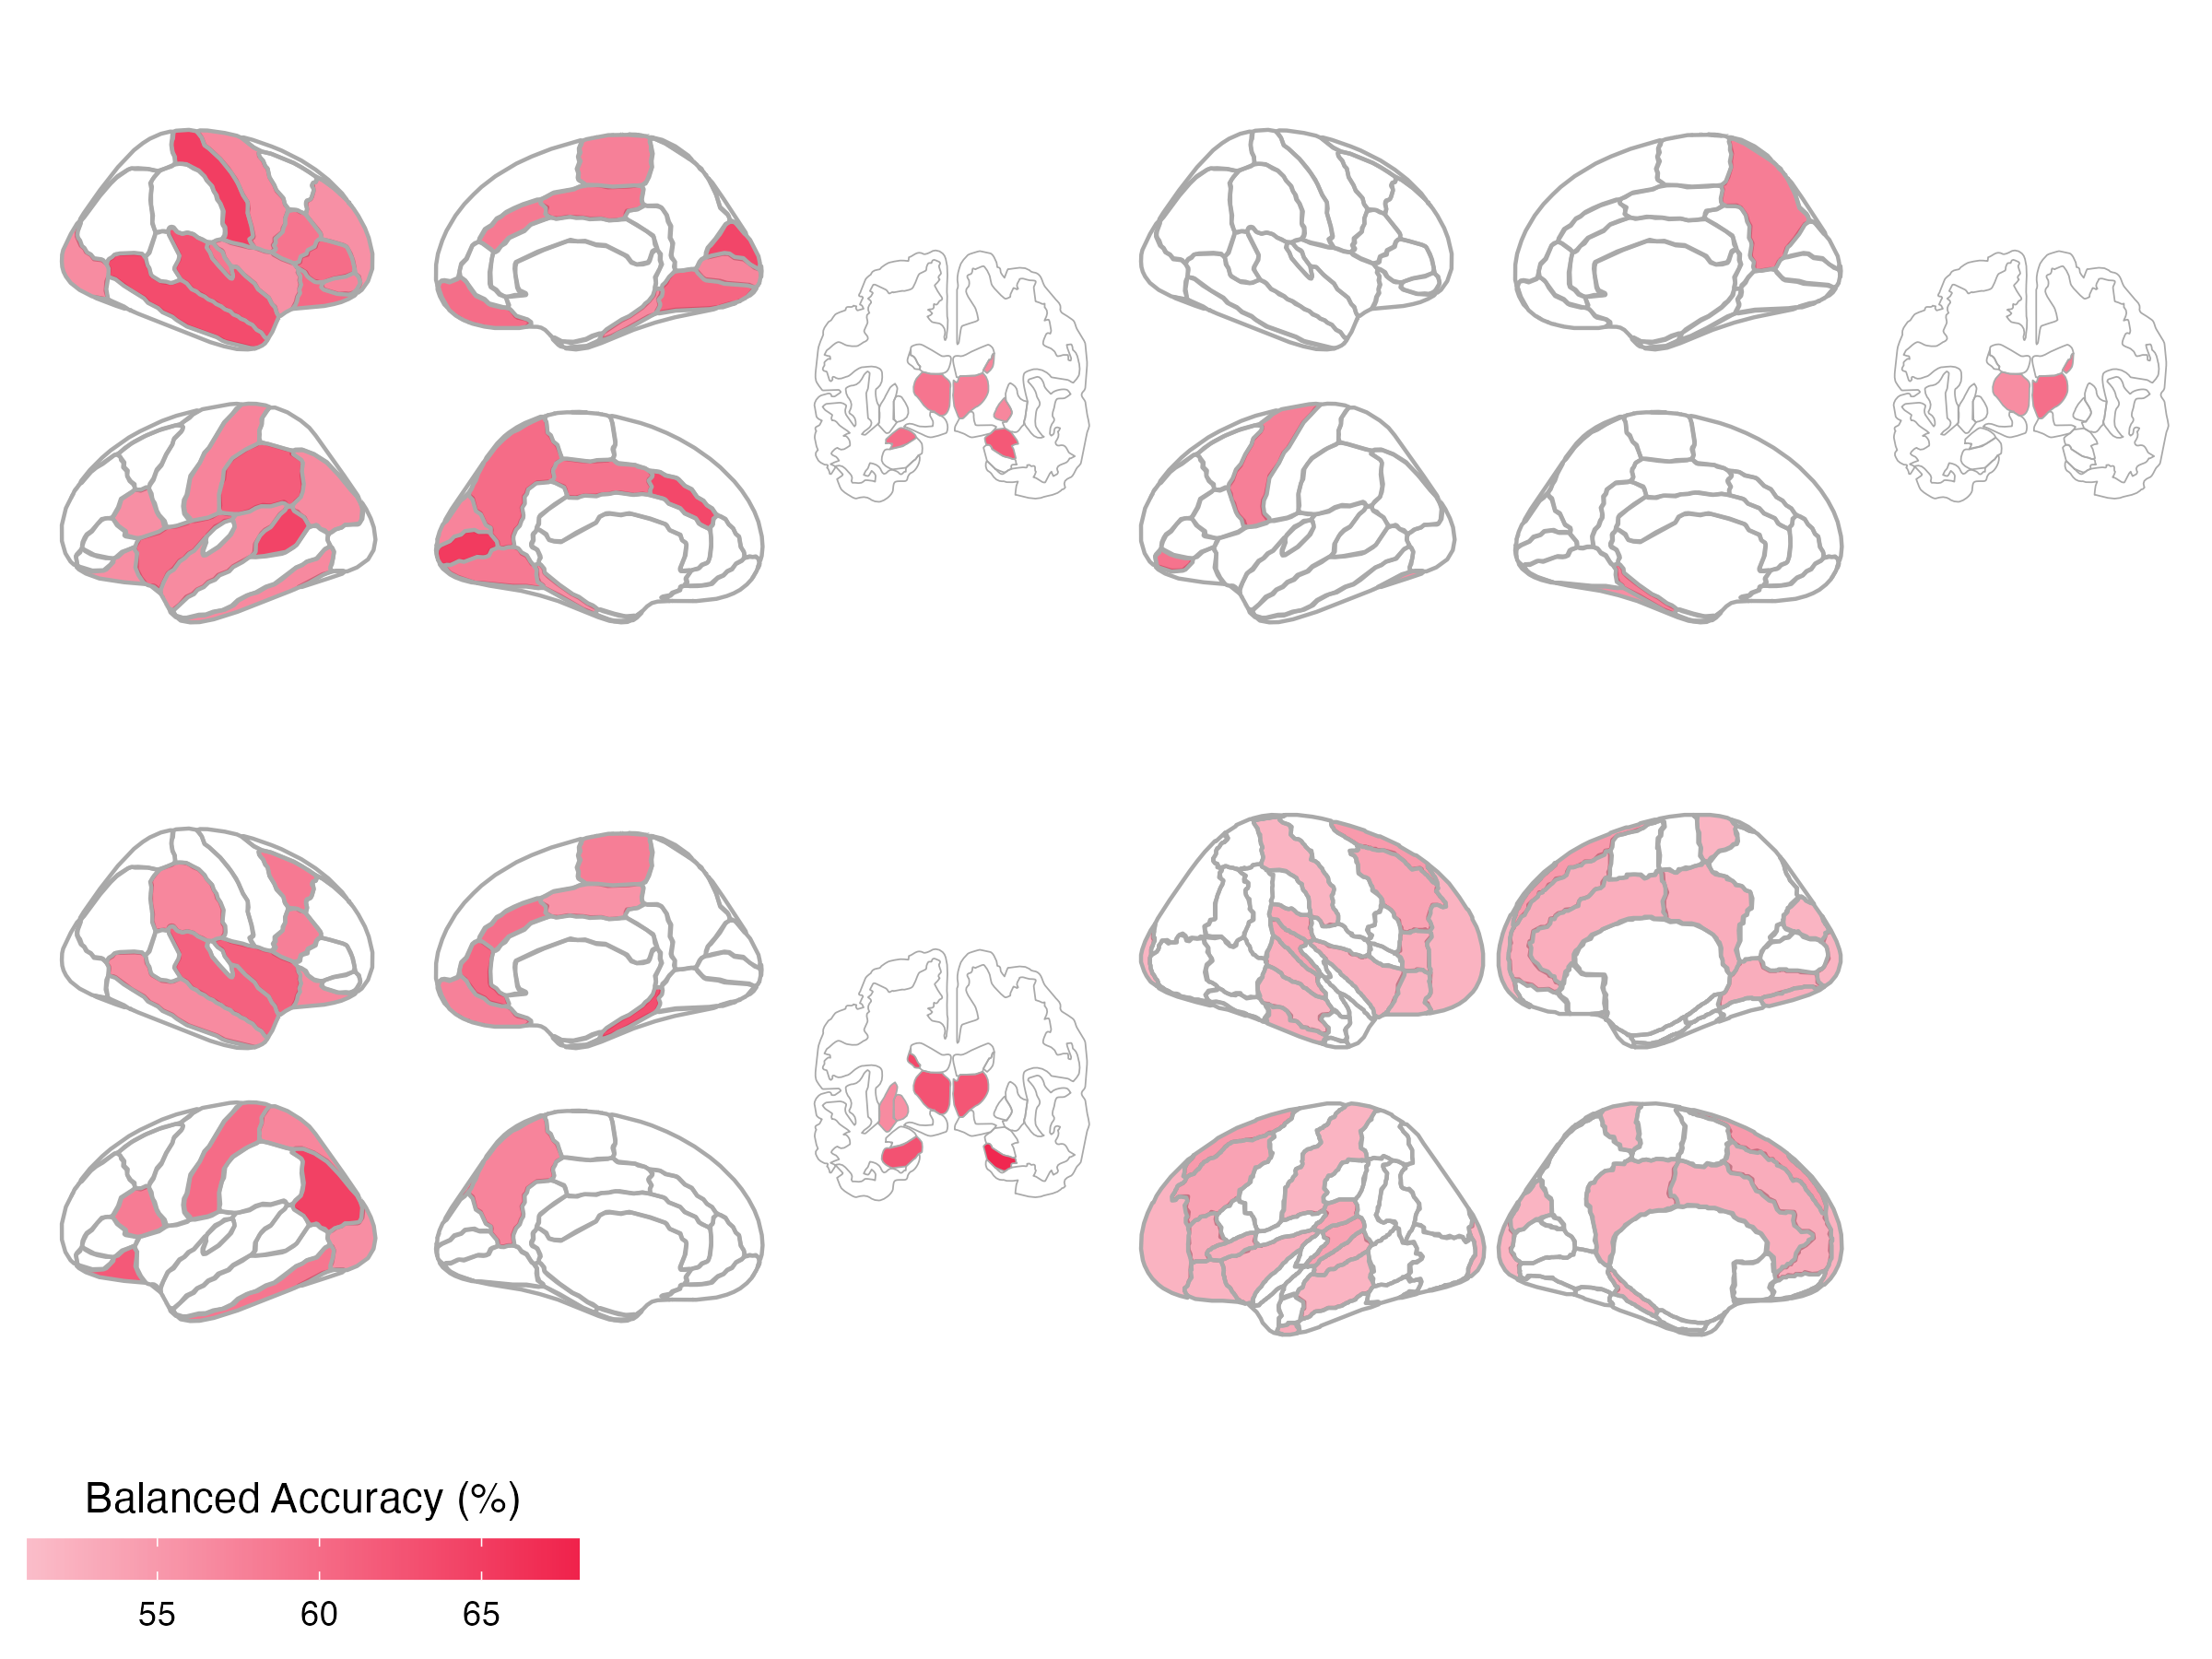


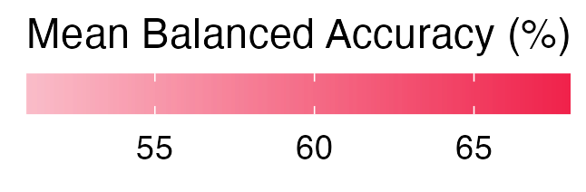
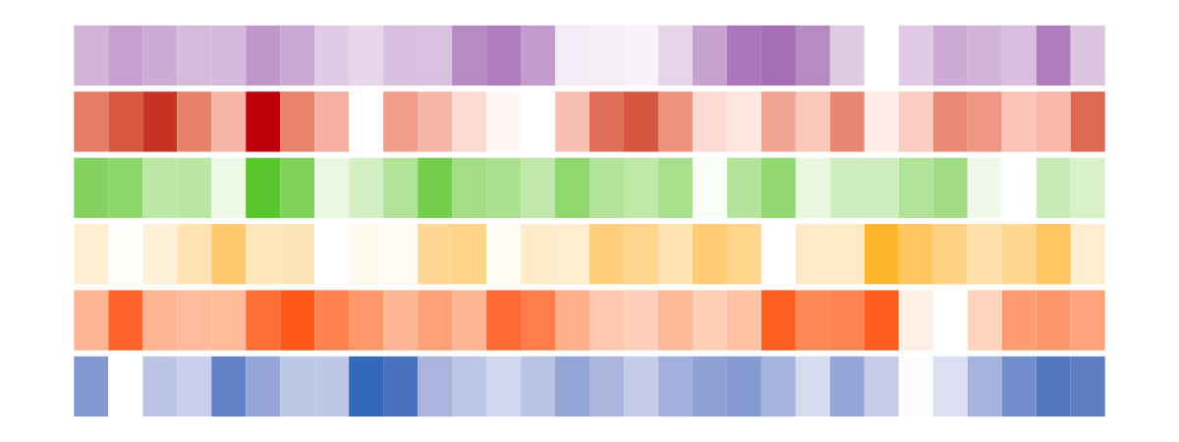
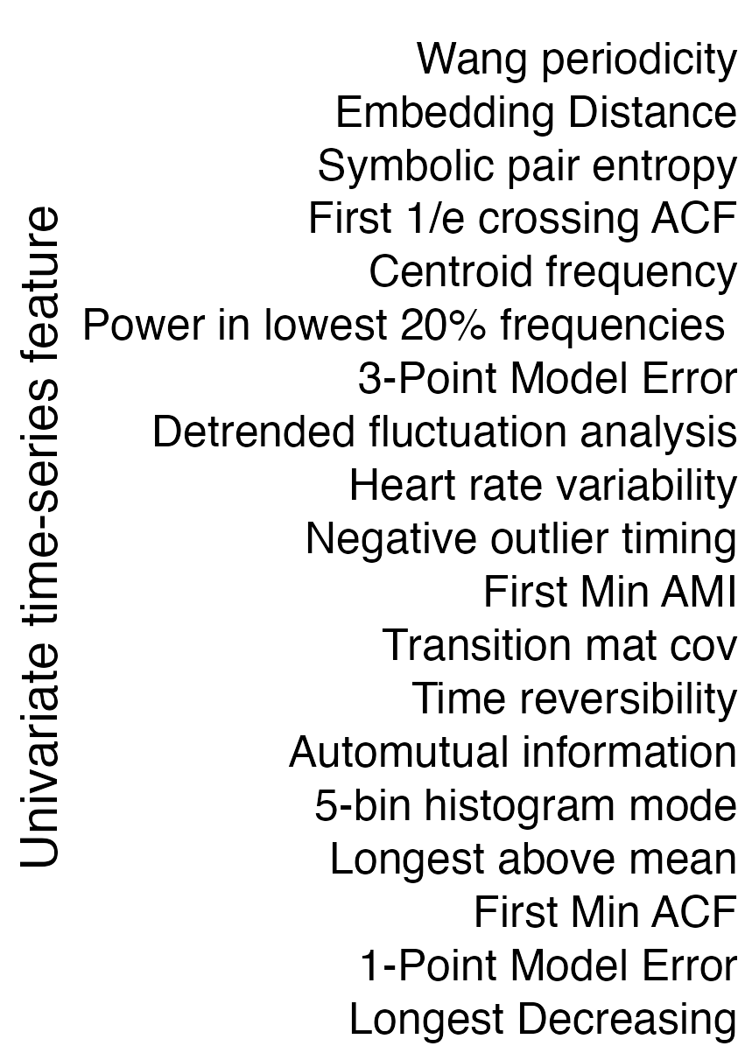
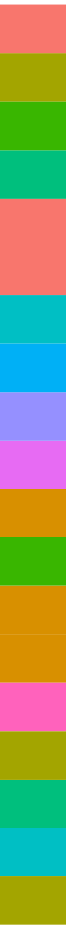
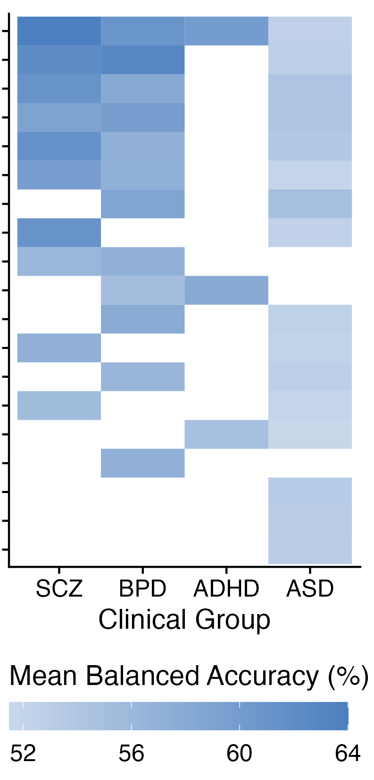
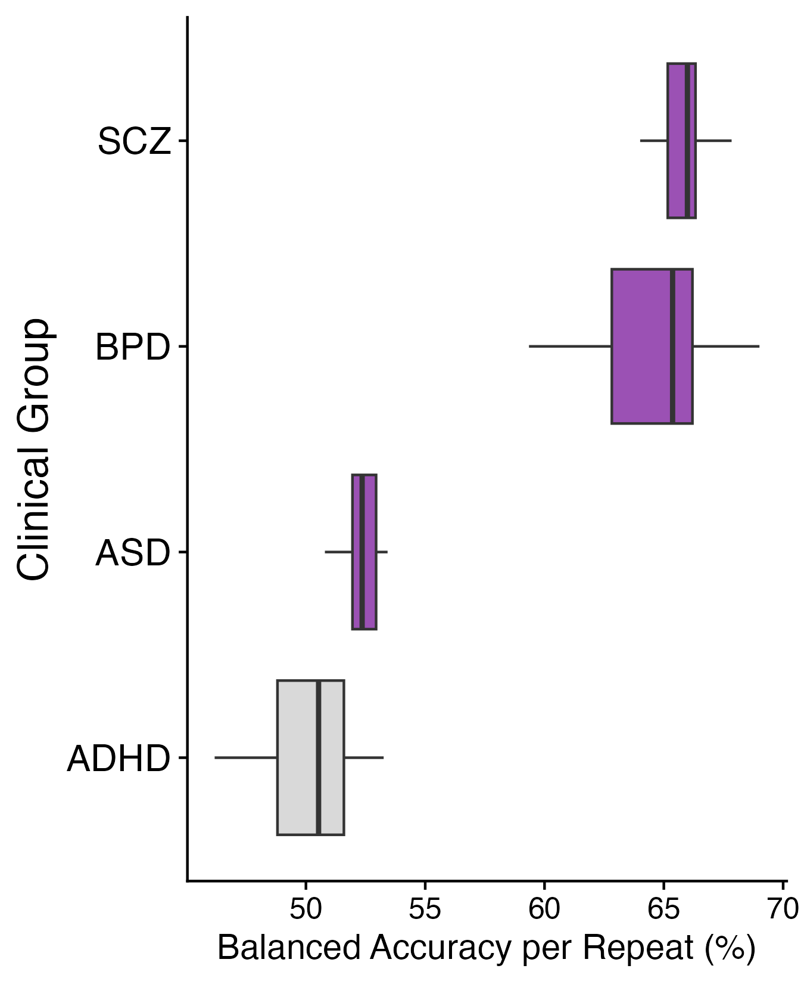
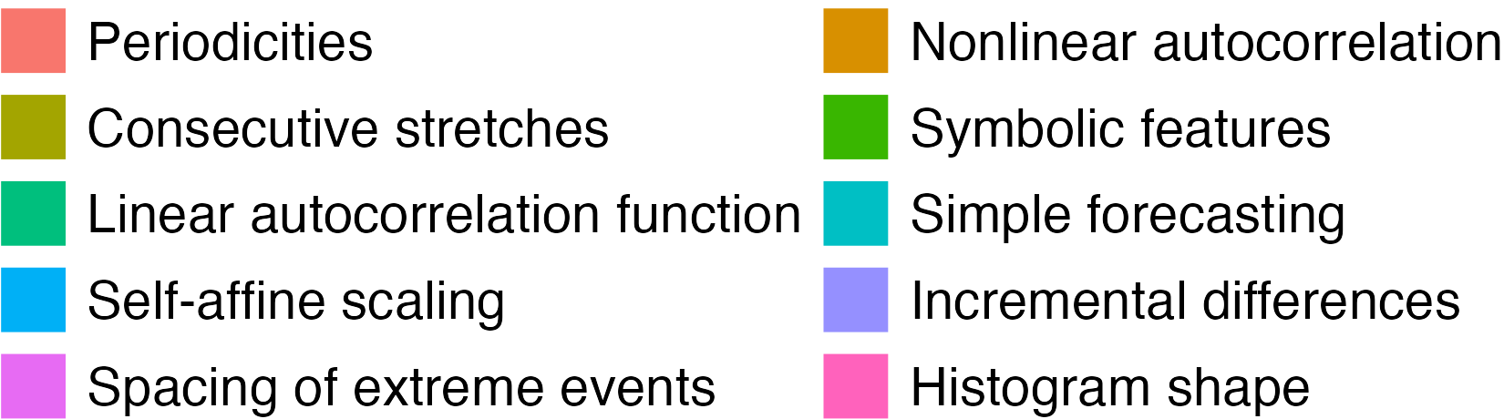

A
B
BPD
SCZ
R
43 regions
30 regions
Univariate
Figure 2
L
ADHD
ASD
10 regions
19 regions
Add supplement/figure showing point relative to null distribution, for top brain region and top feature for each group (to show significance vs non significance)
C
D
List feature with largest magnitude SVM coefficient per model
Show SVM coefficients for PD PeriodicityWang
Notes:
Figure 2. Univariate time-series feature classification results.

