Slide 1
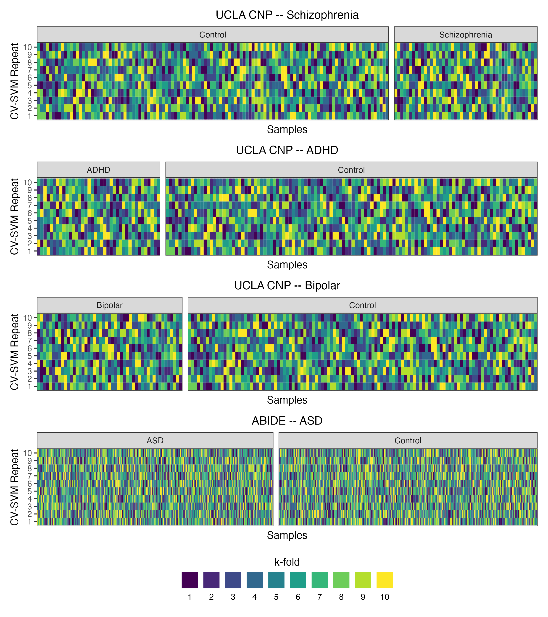
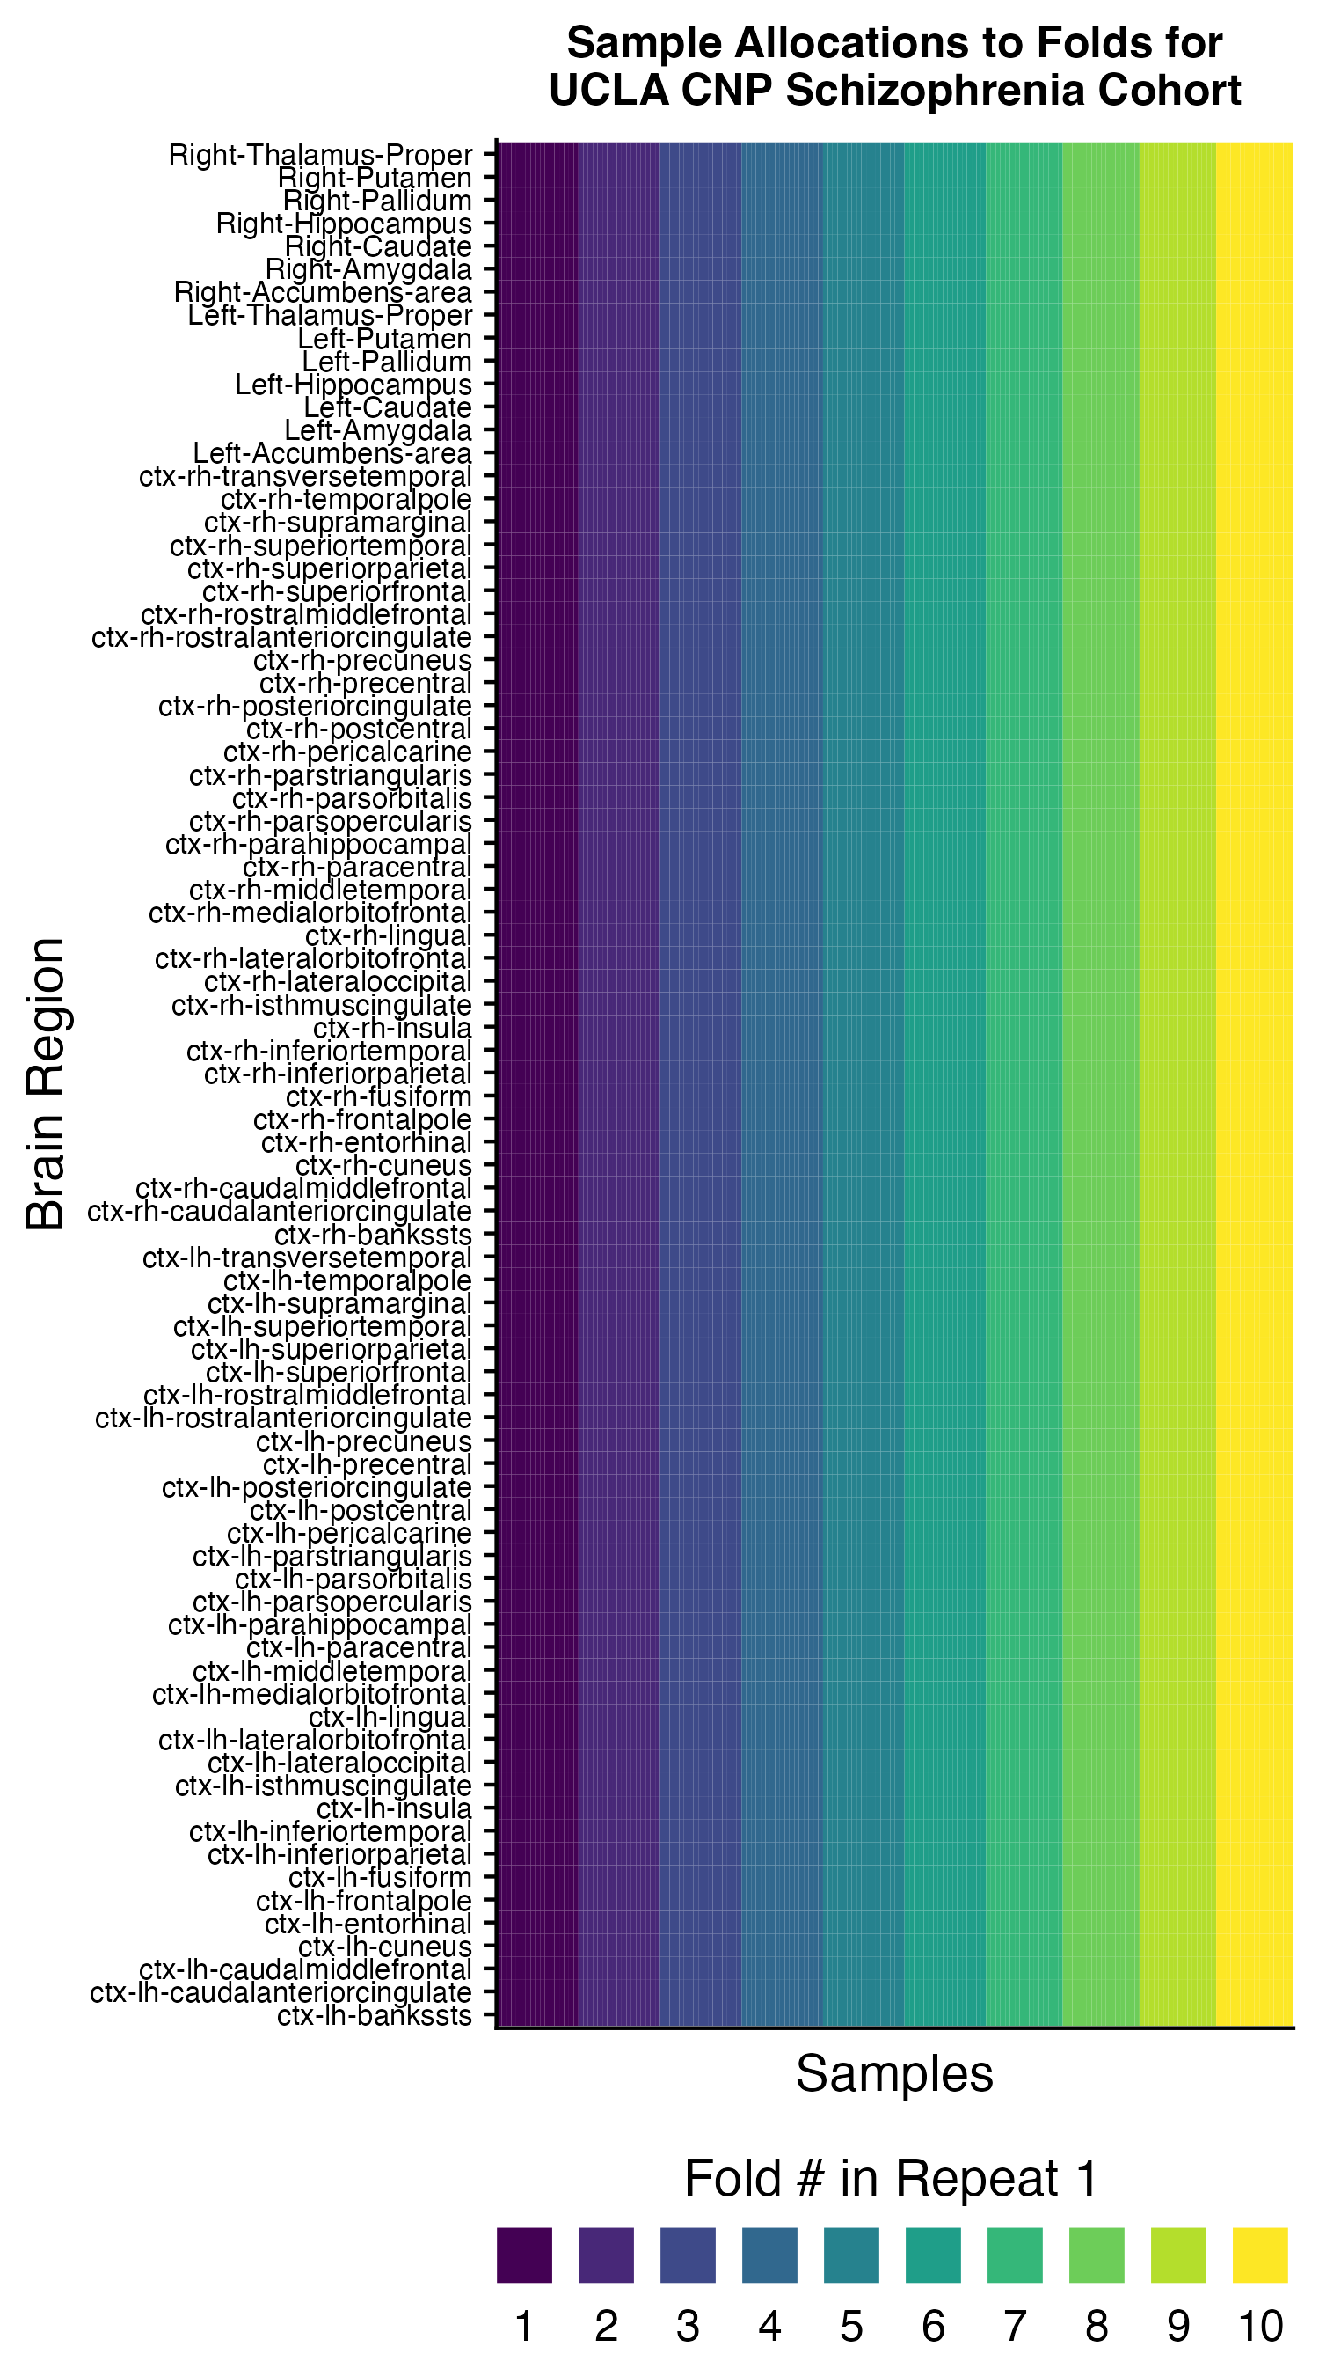
Figure S6
A
Study | Comparison group | % control subjects overall | Mean % controls across all folds/repeats | SD % controls across all folds/repeats | Min % controls across all folds/repeats | Max % controls across all folds/repeats
UCLA CNP | Schizophrenia | 71.1 | 71.1 | 2.1 | 68.8 | 75
UCLA CNP | ADHD | 75.2 | 75.2 | 1.7 | 73.3 | 80
UCLA CNP | Bipolar | 70.7 | 70.7 | 1.7 | 68.8 | 75
ABIDE | ASD | 52.3 | 52.3 | 0.3 | 52.2 | 53
B
C

