Slide 1
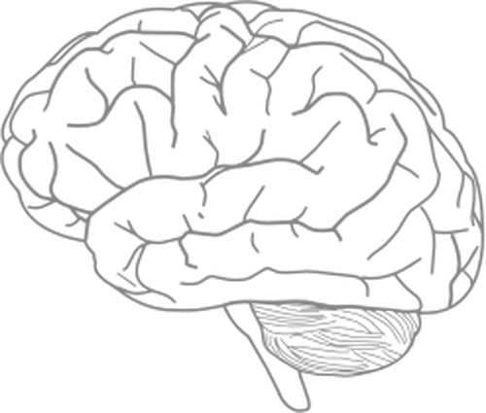
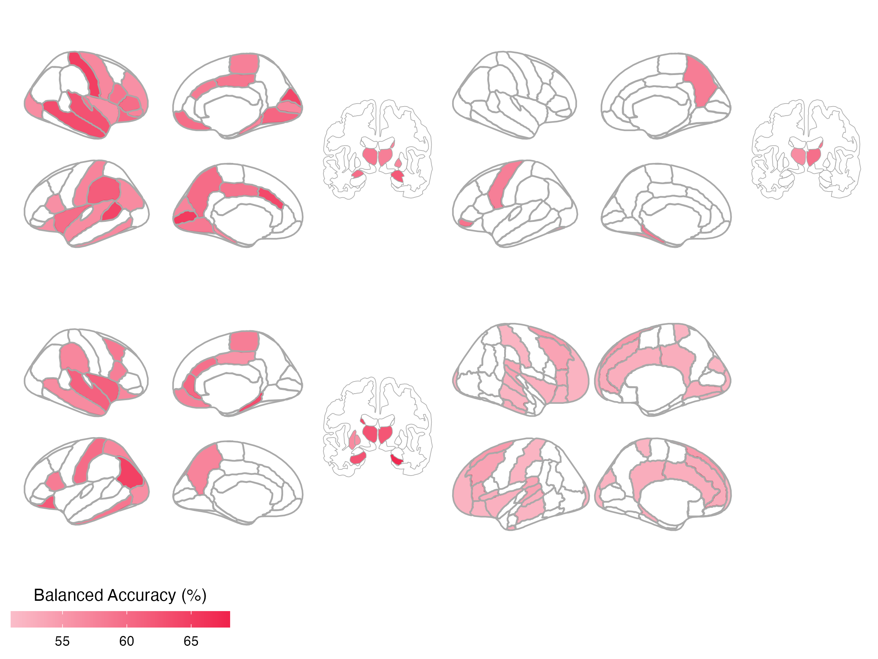
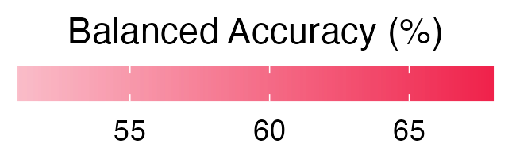

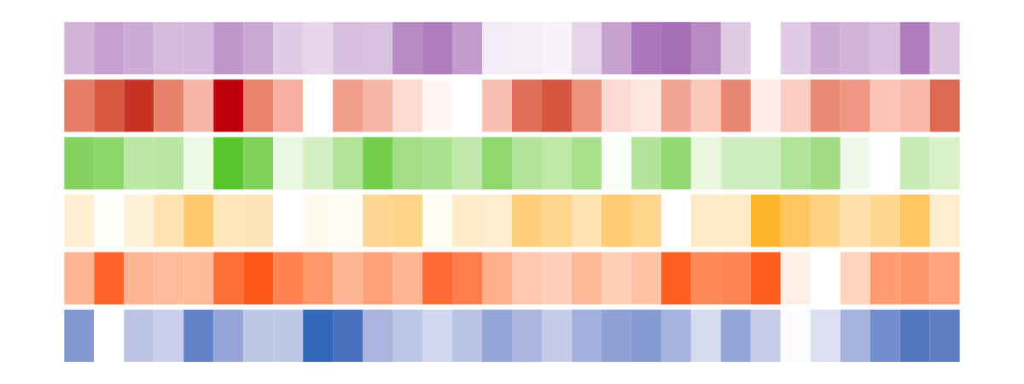
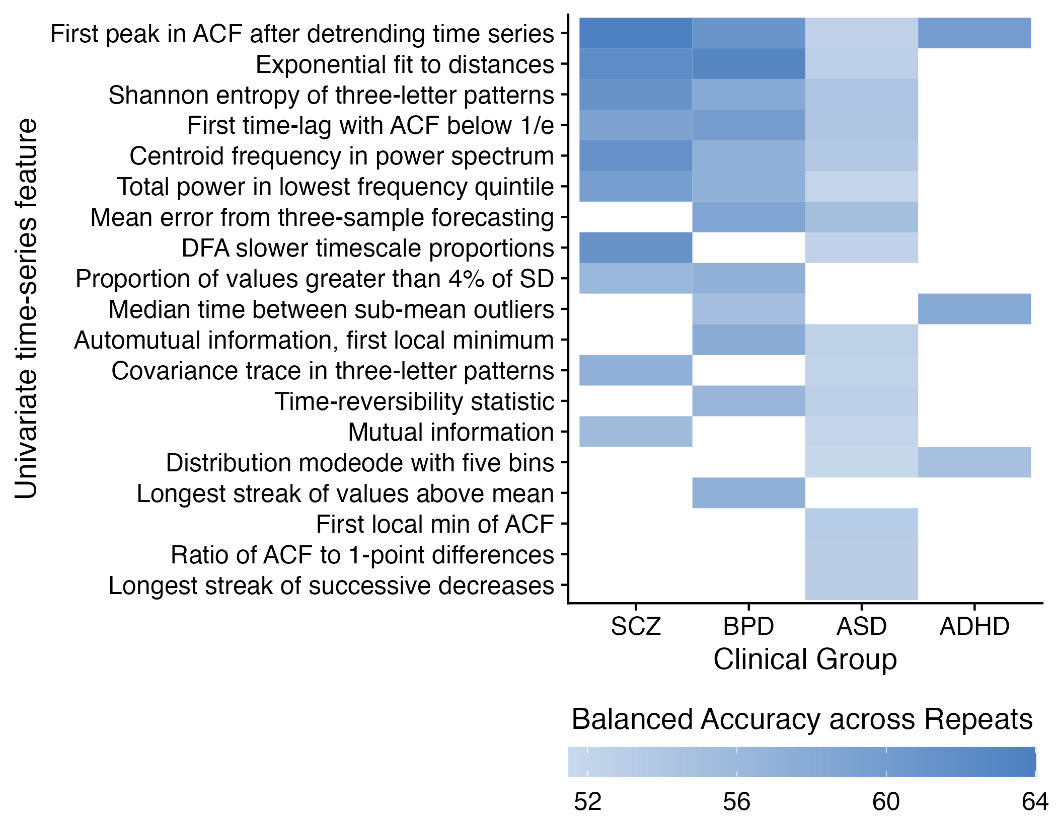
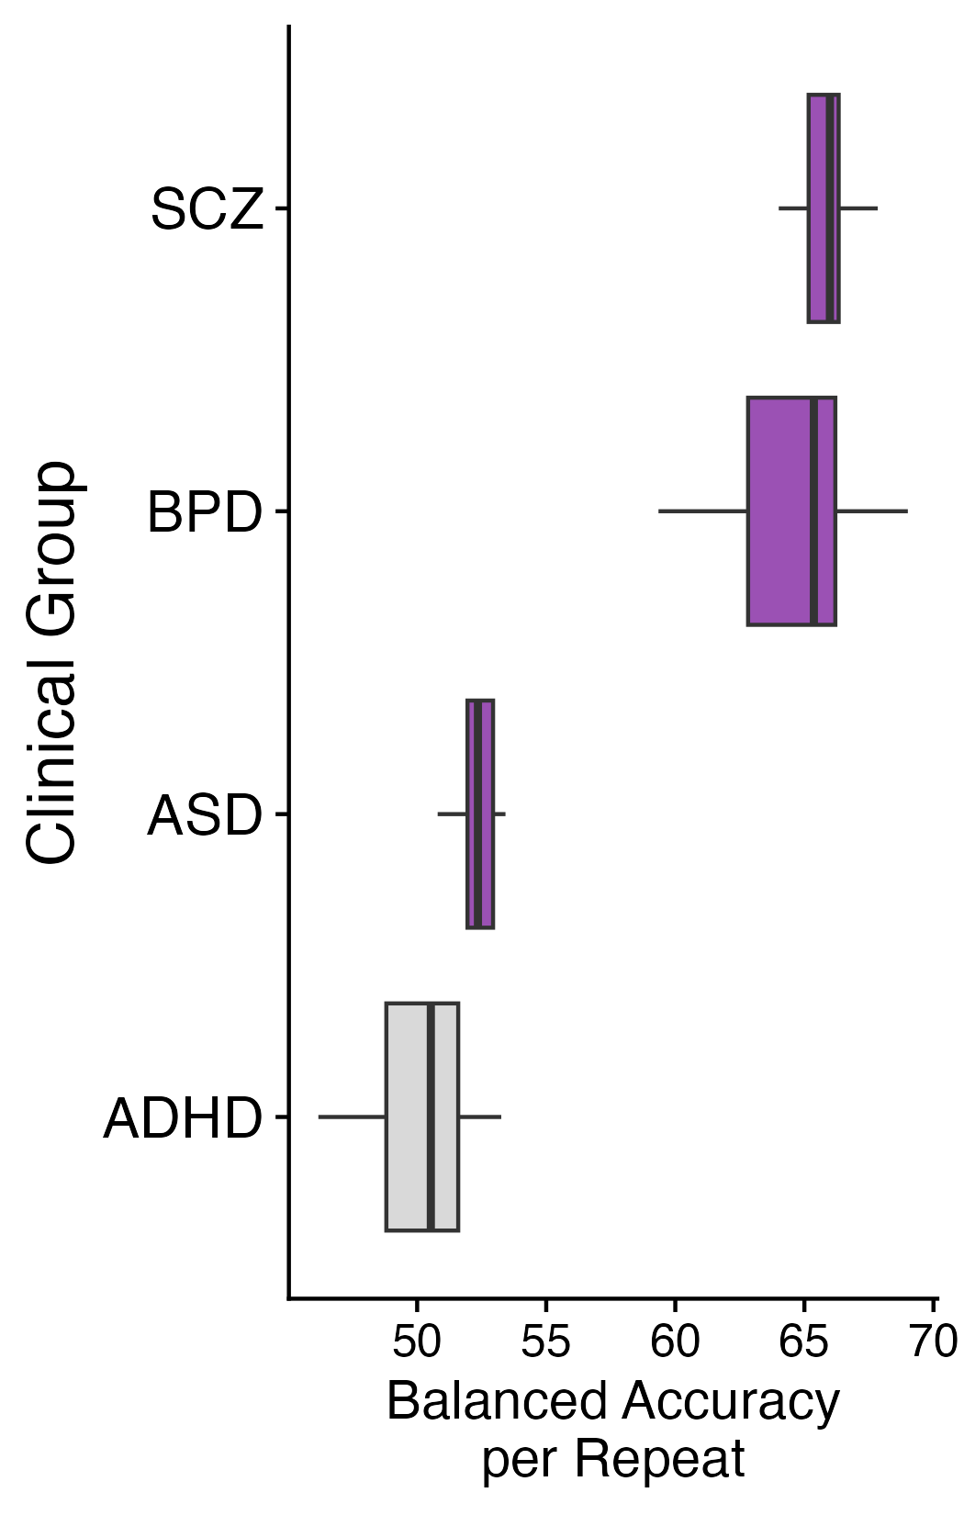

A
B
SCZ
ADHD
R
43 regions
10 regions
Univariate
Figure 2
L
BPD
ASD
30 regions
19 regions
Add supplement/figure showing point relative to null distribution, for top brain region and top feature for each group (to show significance vs non significance)
C
D
Notes:
Figure 2. Univariate time-series feature classification results.

