Slide 1
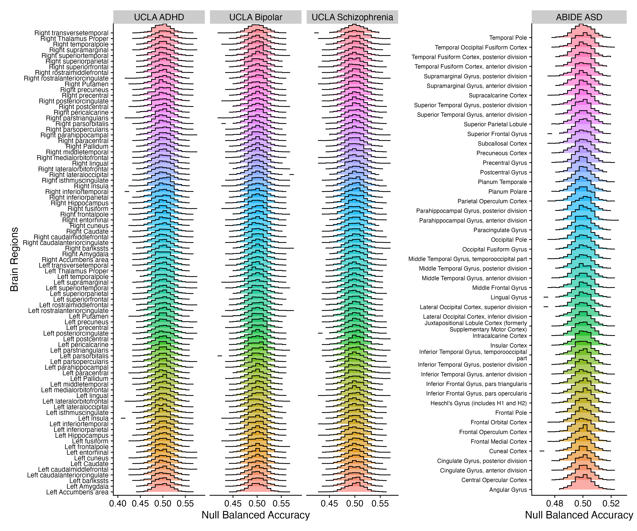

Slide 2
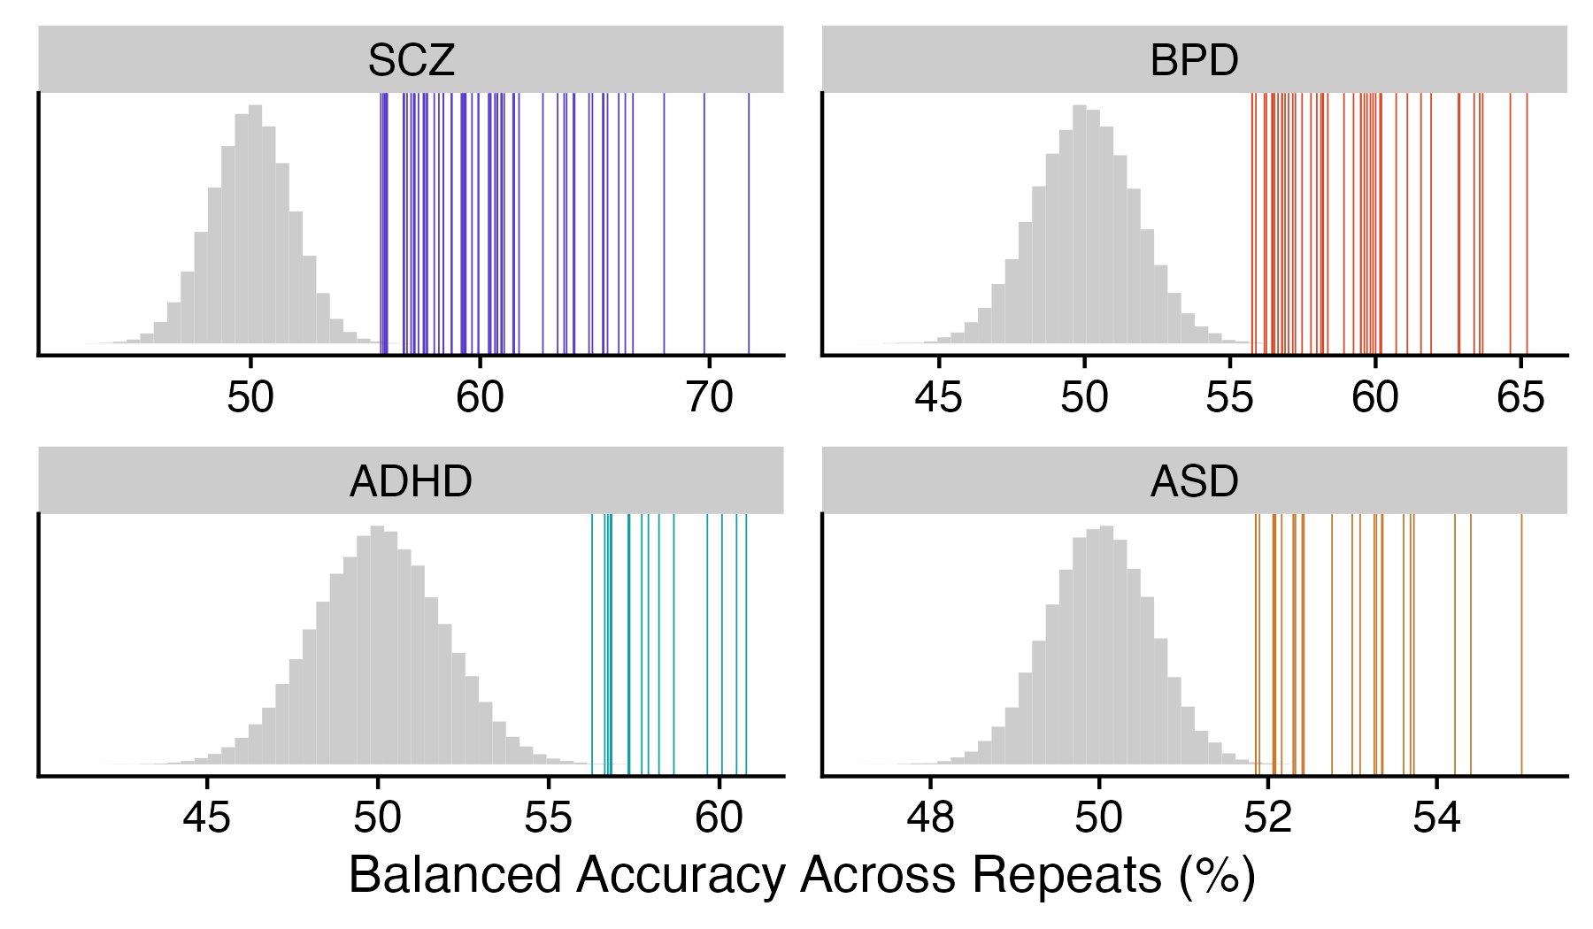
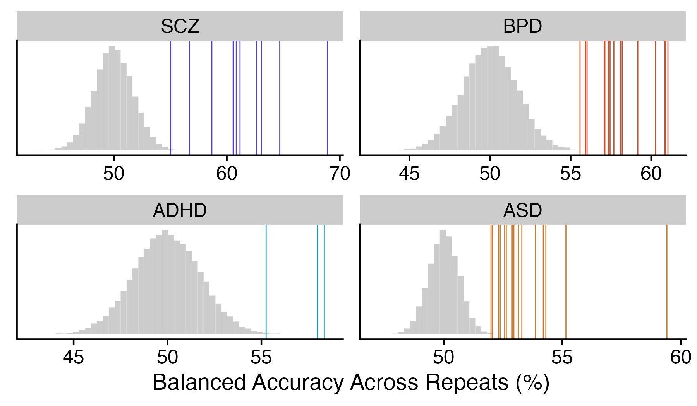
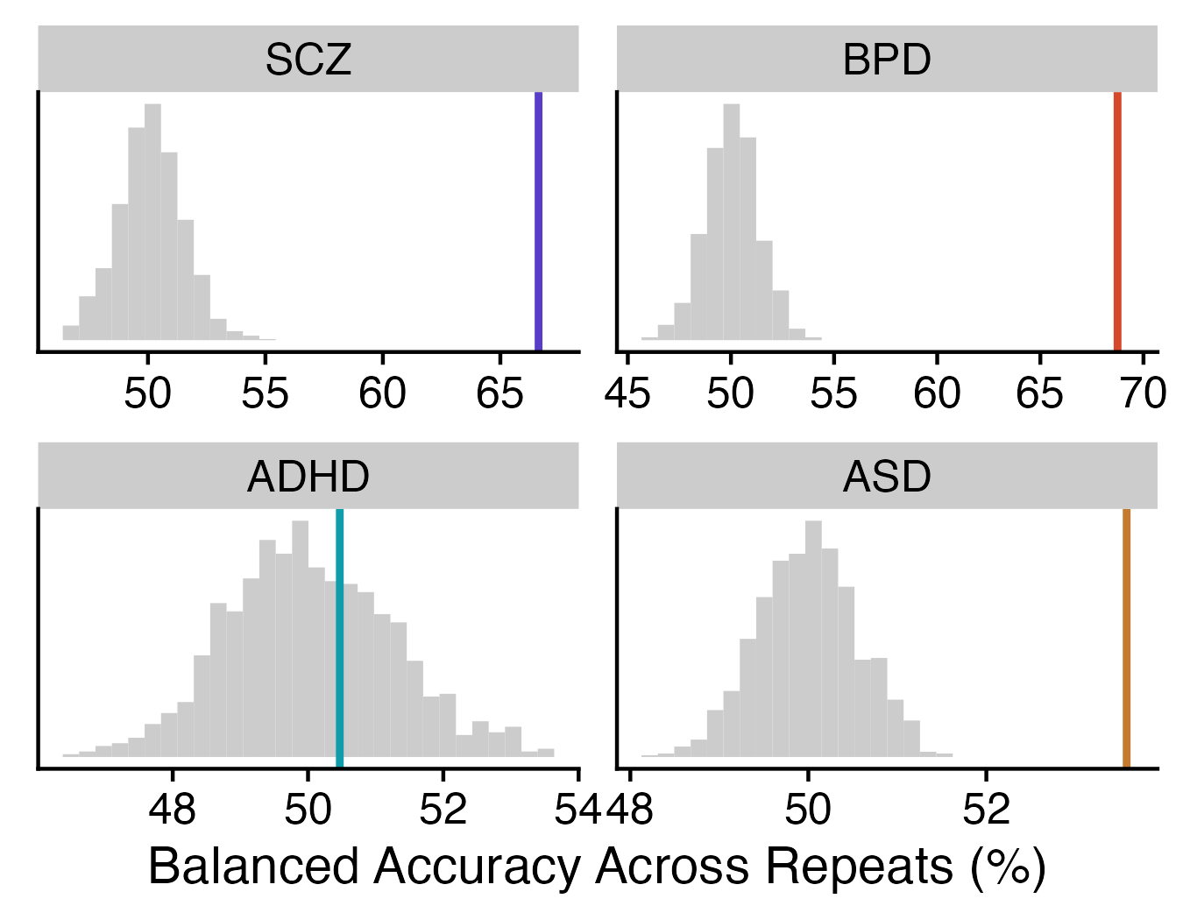
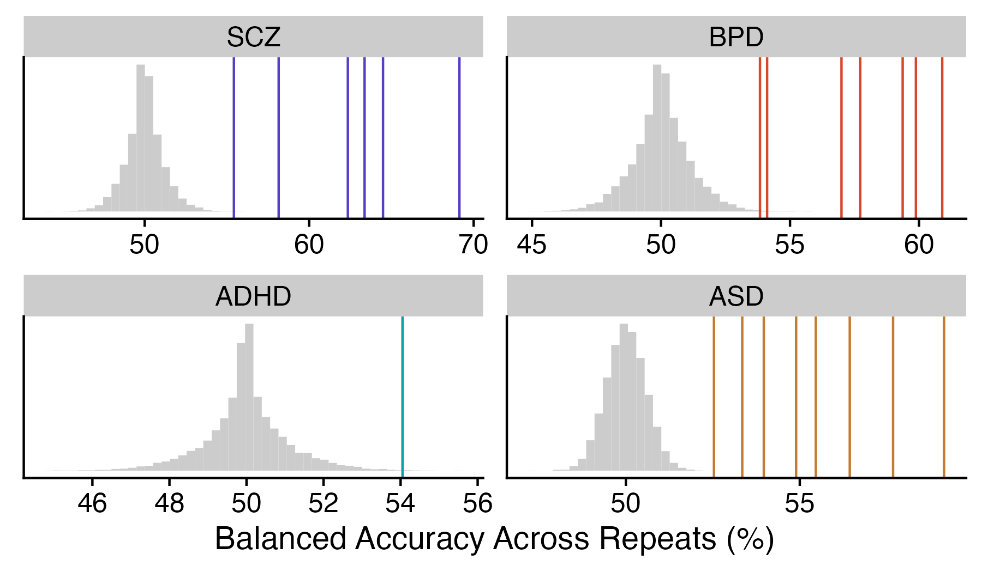
A
Univariate region-wise
B
Univariate feature-wise
C
Univariate region × feature
Null balanced accuracy distribution
Statistically significant balanced accuracies
D
Pairwise SPI-wise
Add pairwise combination results

