Slide 1
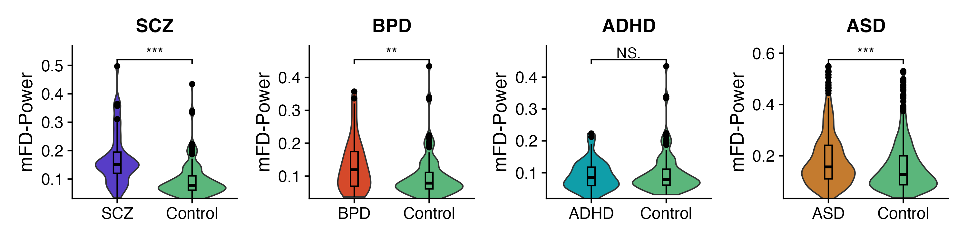
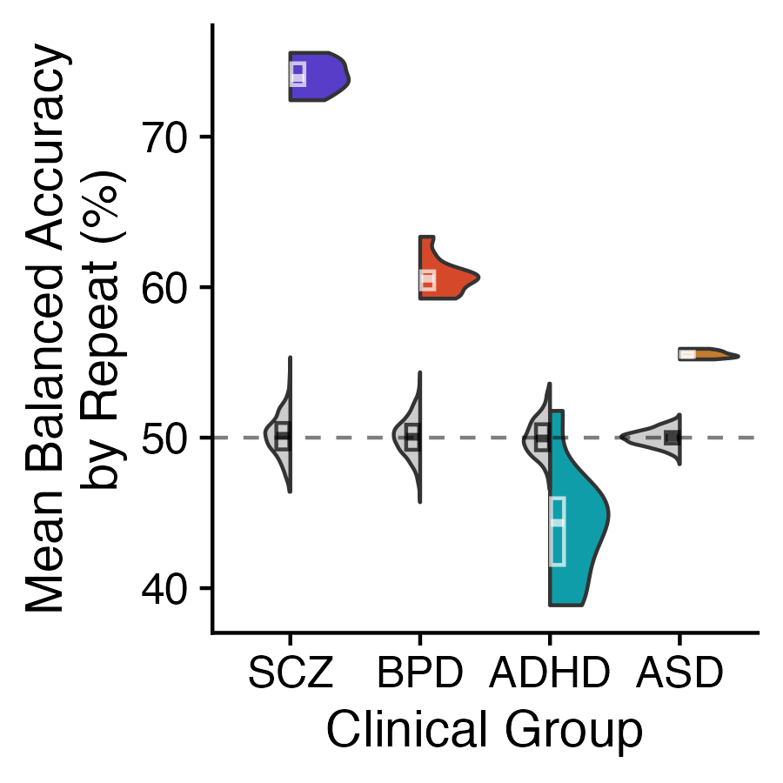
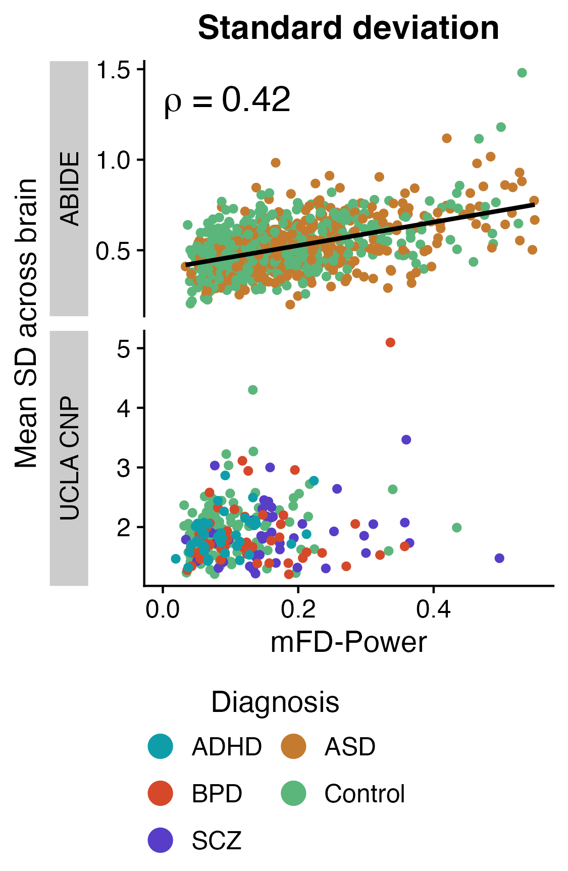
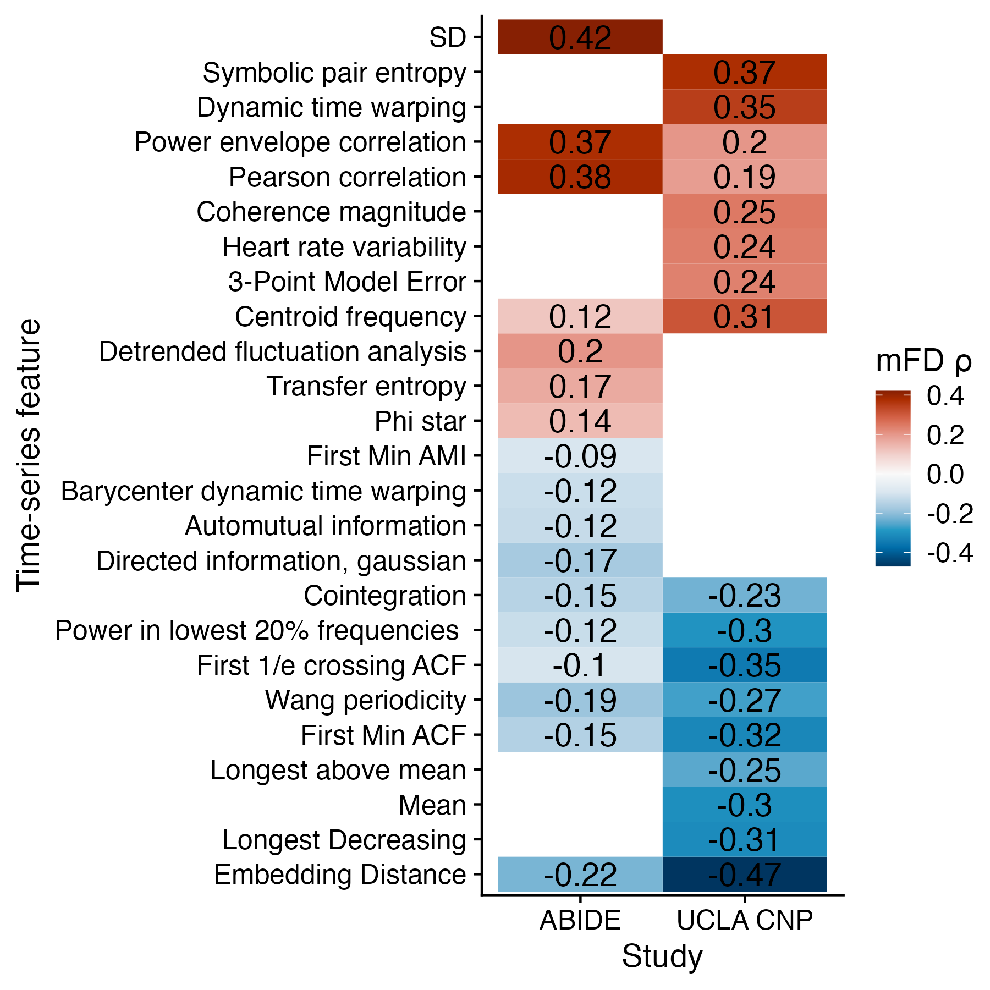
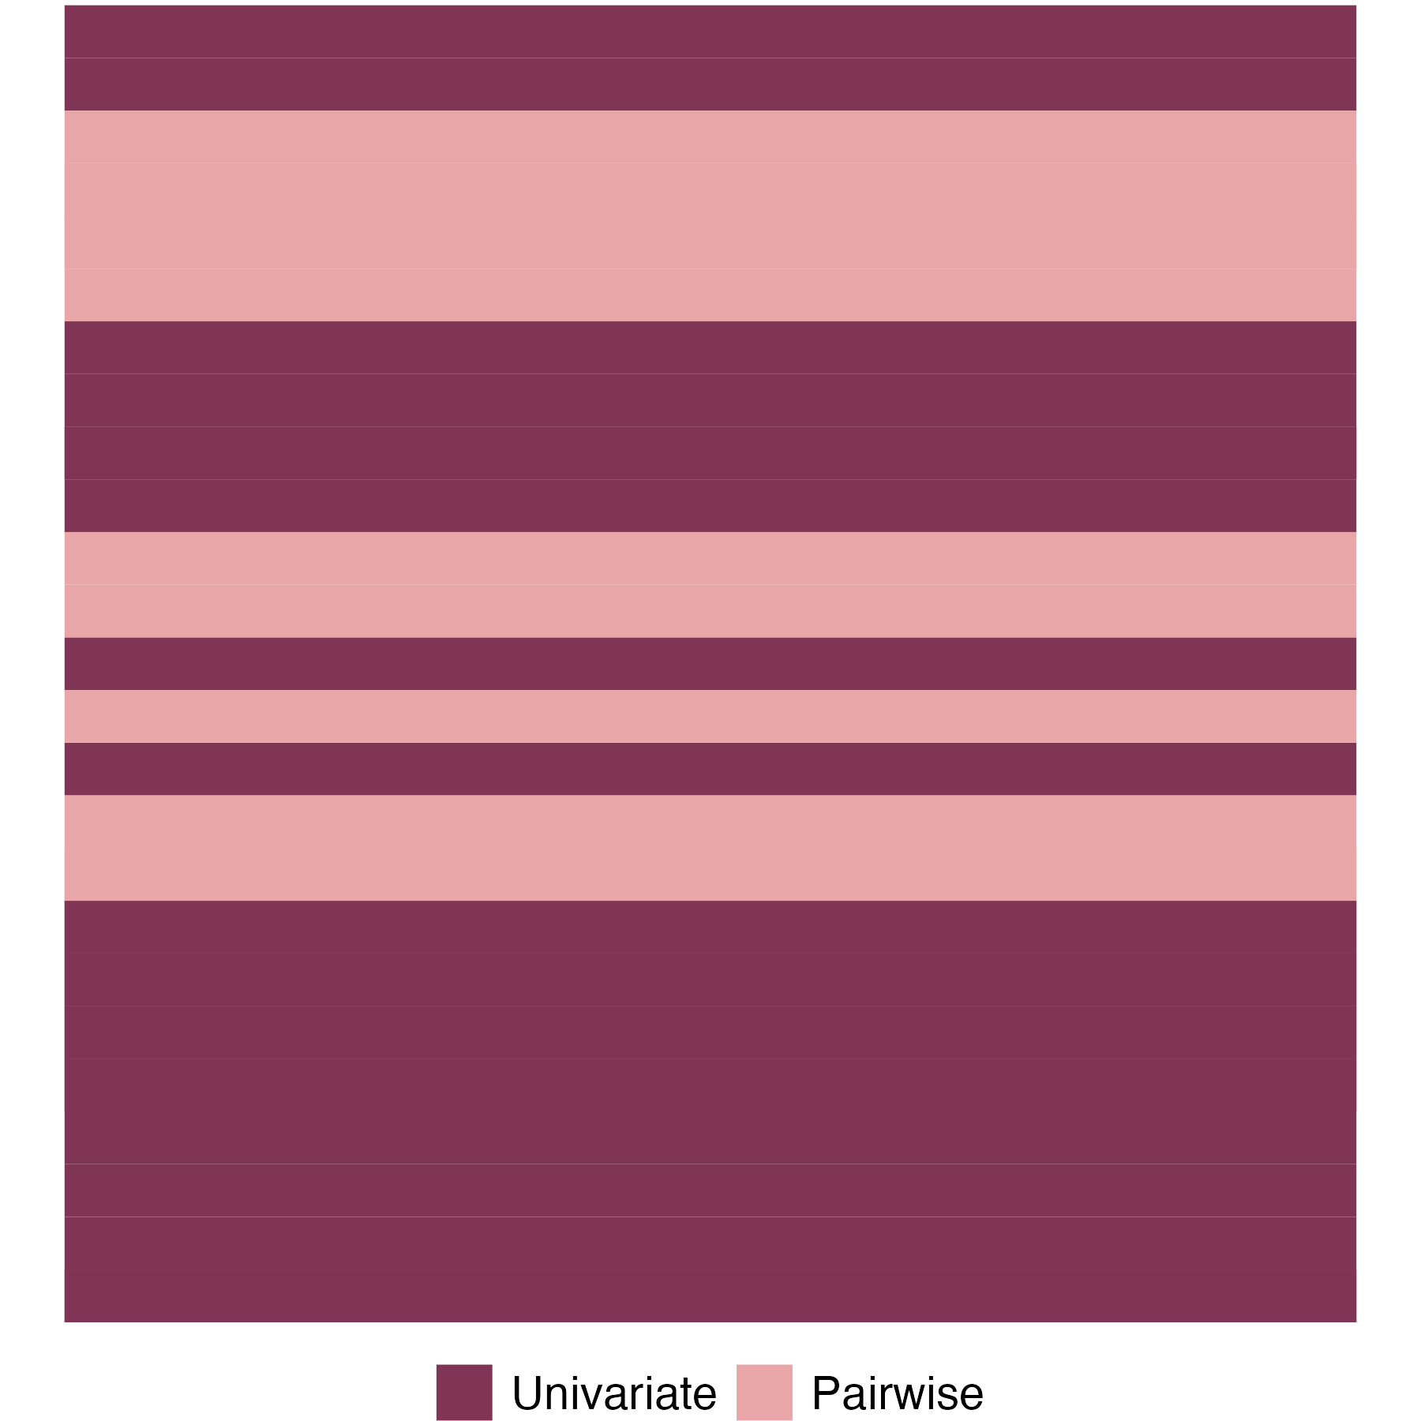
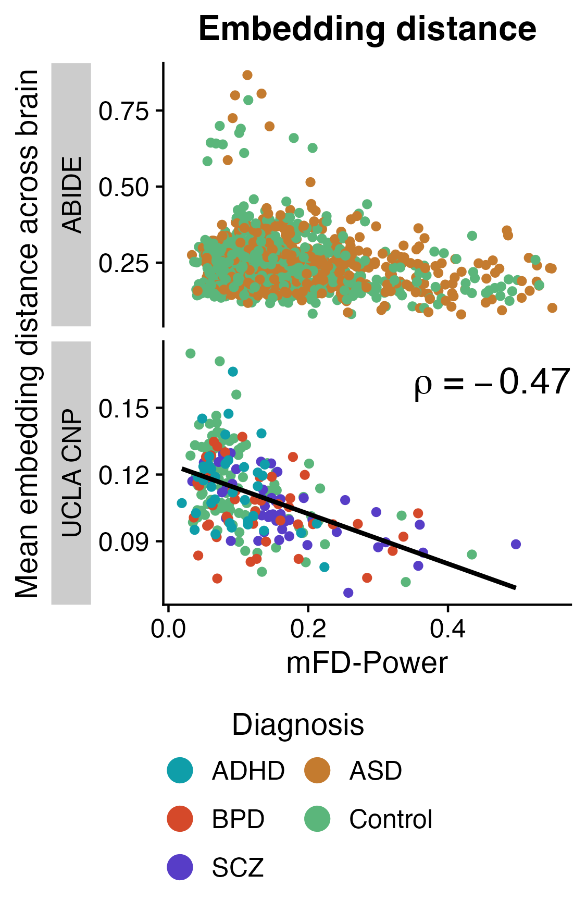
A
B
C
D
E
Notes:
Fractional displacement (FD) in the SCZ cohort.
A: Distribution of FD values between control (green) and schizophrenia (grey) participants. The Wilcoxon rank sum test with continuity correction indicated a significant difference between the groups (p < 1e-07).
B: Effect of setting a maximum FD threshold on number of participants retained (upper) and percentage of participants retained per group (lower). The gray section covers the range of FD values examined in Figure S1C.
C: Balanced accuracy values from linear SVM performed with 10-repeat 10-fold CV using movement data only (red), univariate TS features from the top-performing brain region (right postcentral gyrus, green), and the full suite of combined univariate features and brain regions (blue). Shaded regions indicate +/- 1 SD across 10 repeats per method.

