Slide 1
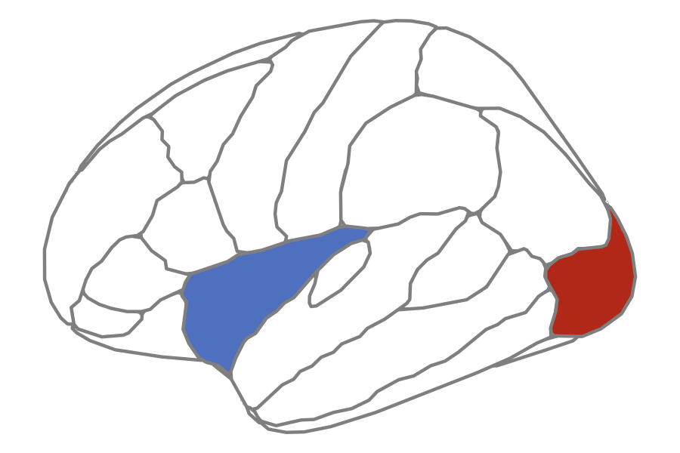

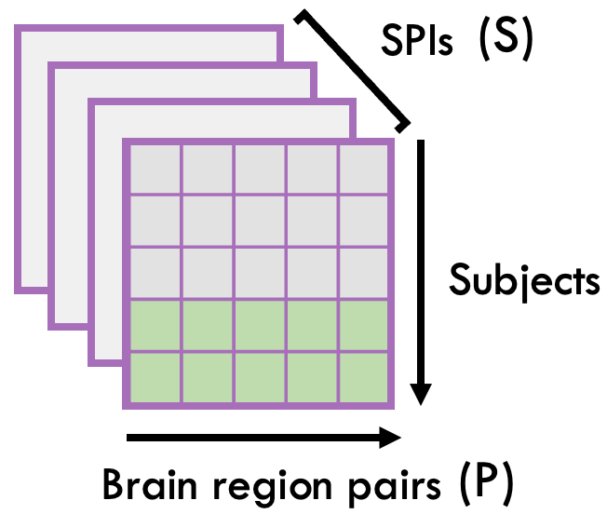
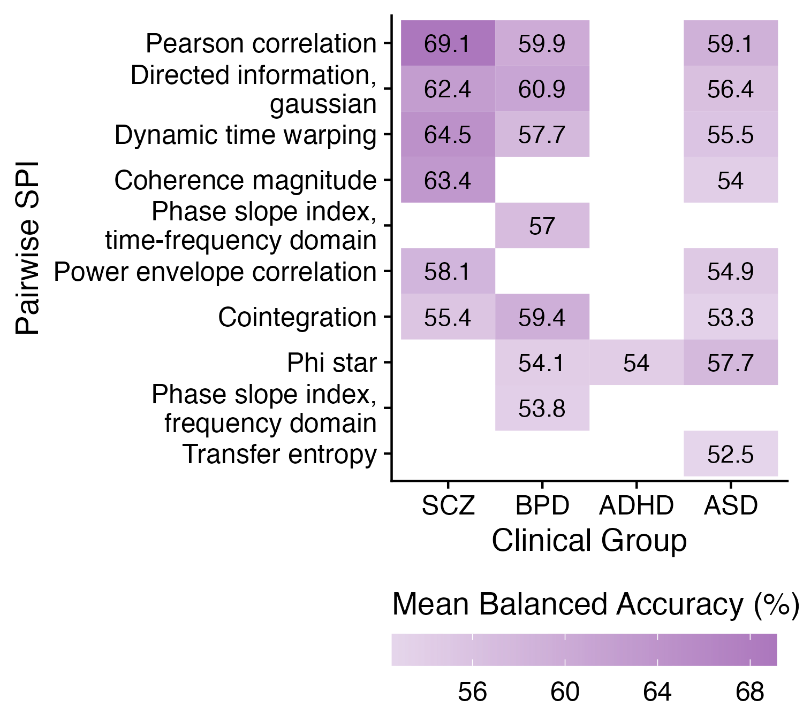
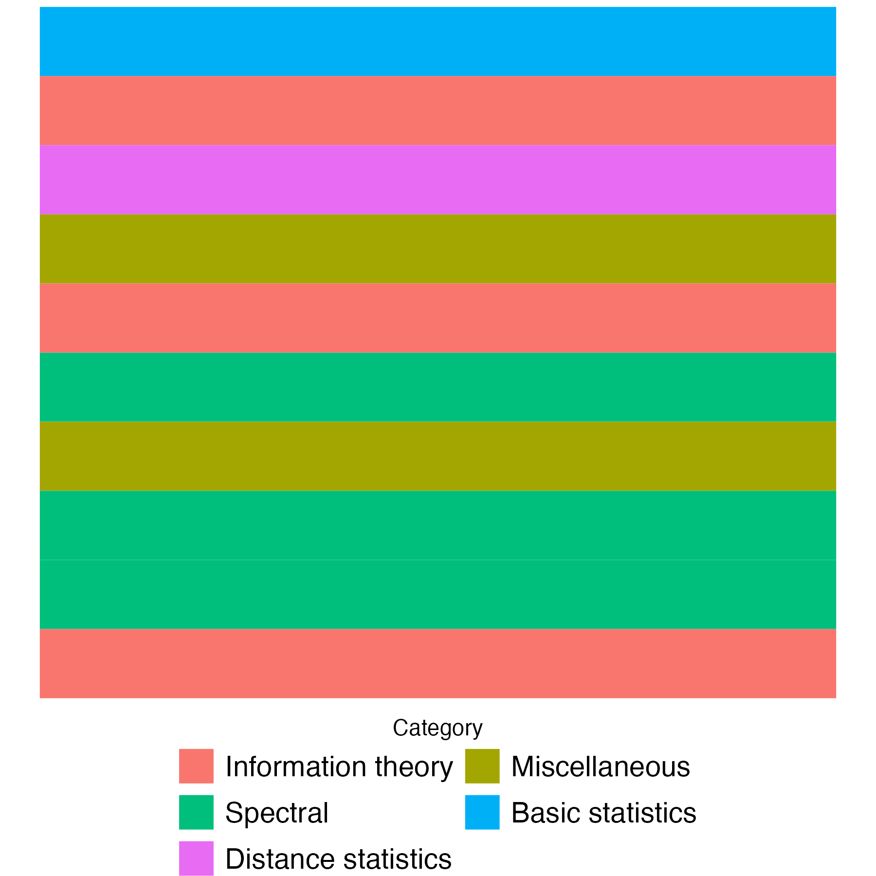
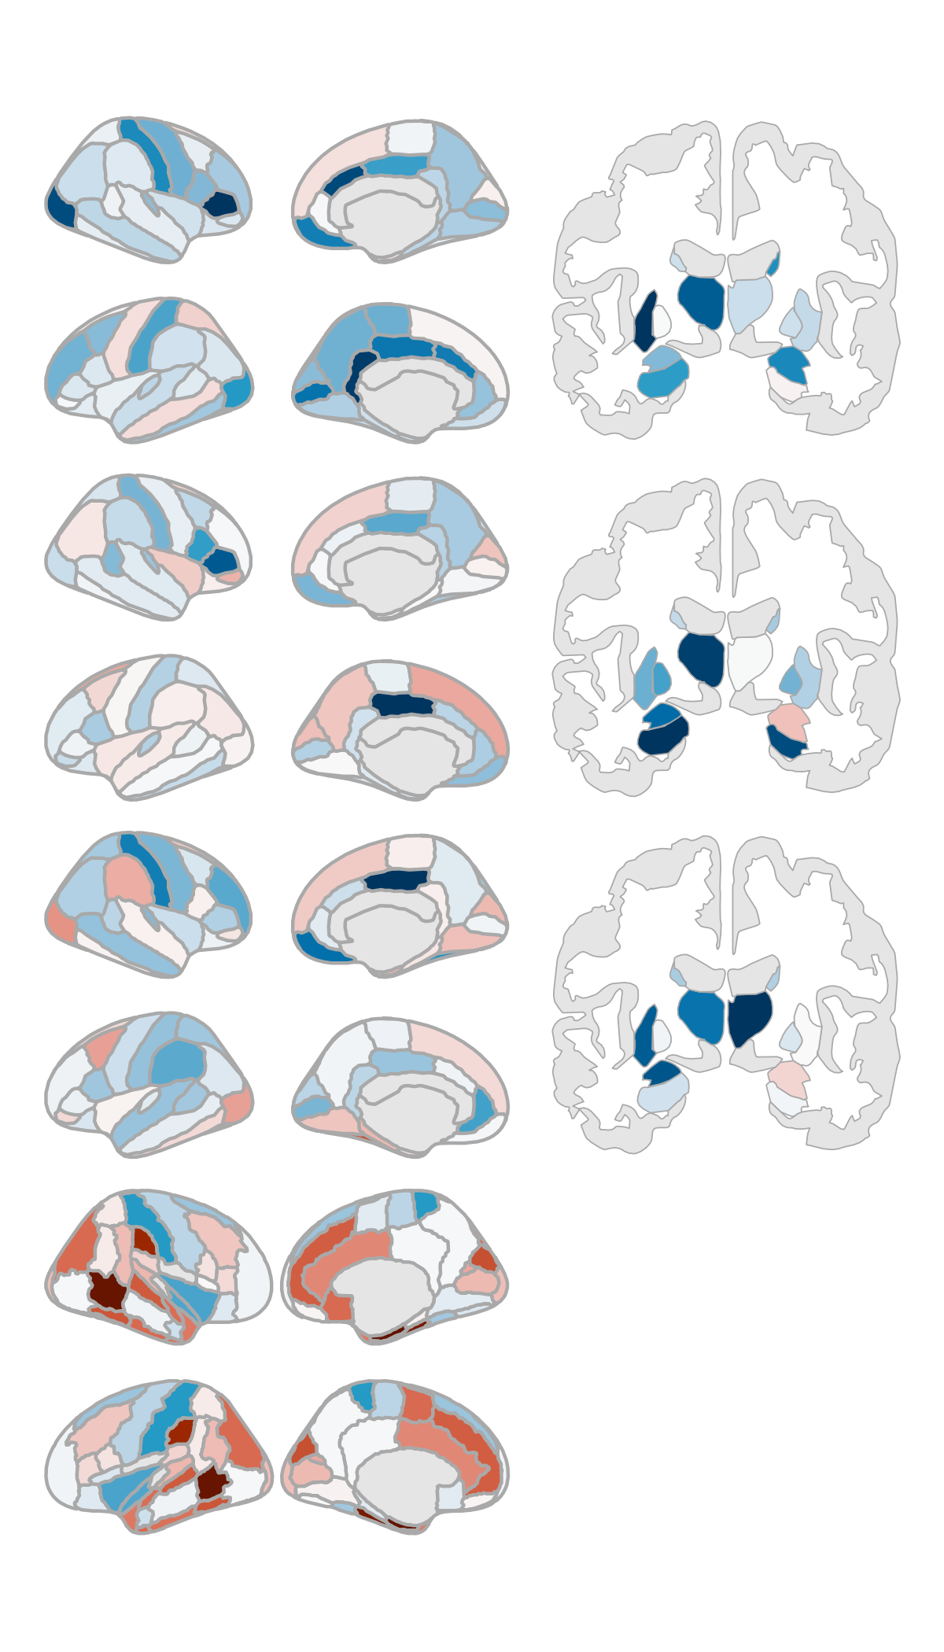
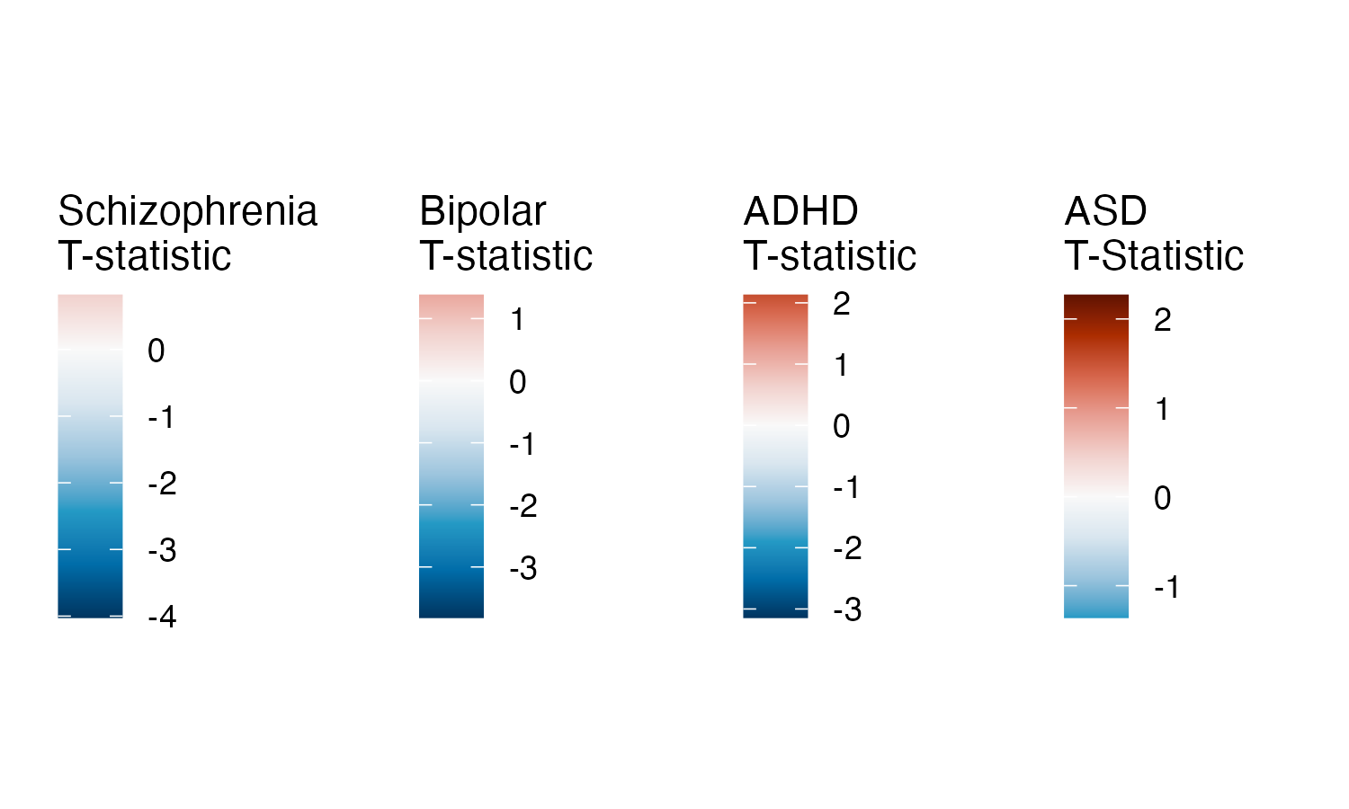


A
SPI 1
SPI 1
Repeat for all 14 SPIs
SPIs
Linear SVM
B
C
Notes:
Figure 2. Univariate classification results for ASD and schizophrenia. A: Results from region-based classification analysis. For ASD, the bilateral superior frontal gyrus yielded a statistically significant balanced accuracy (55.95 +/- 0.52, p=4.58e-04, BH-adjusted p=2.20e-02). For schizophrenia, the all yielded significant balanced classification accuracies. right postcentral gyrus (67.23 +/- 2.49, p=1.00e-03, BH-adjusted p=4.07e-02), right amygdala (66.82 +/- 2.12, p=1.32e-03, BH-adjusted p=4.07e-02), and left banks of the superior temporal sulcus (66.64 +/- 1.97, p=1.49e-03, BH-adjusted p=4.07e-02)

Slide 2
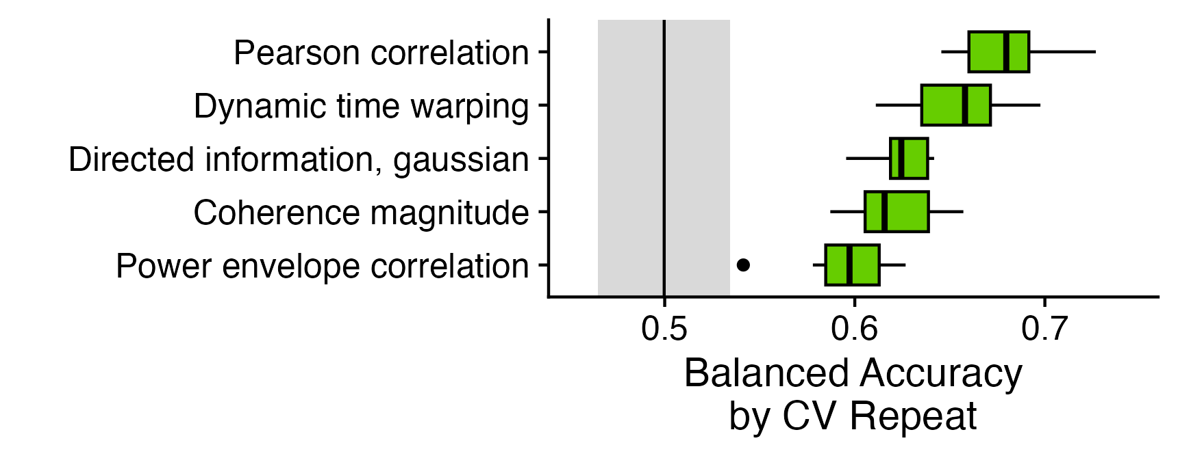
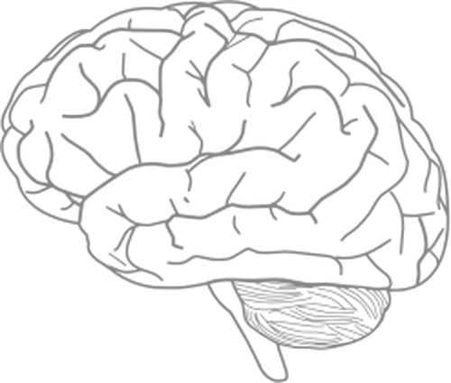

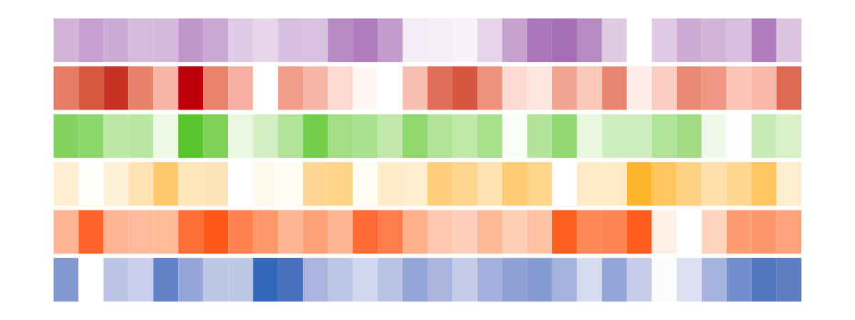
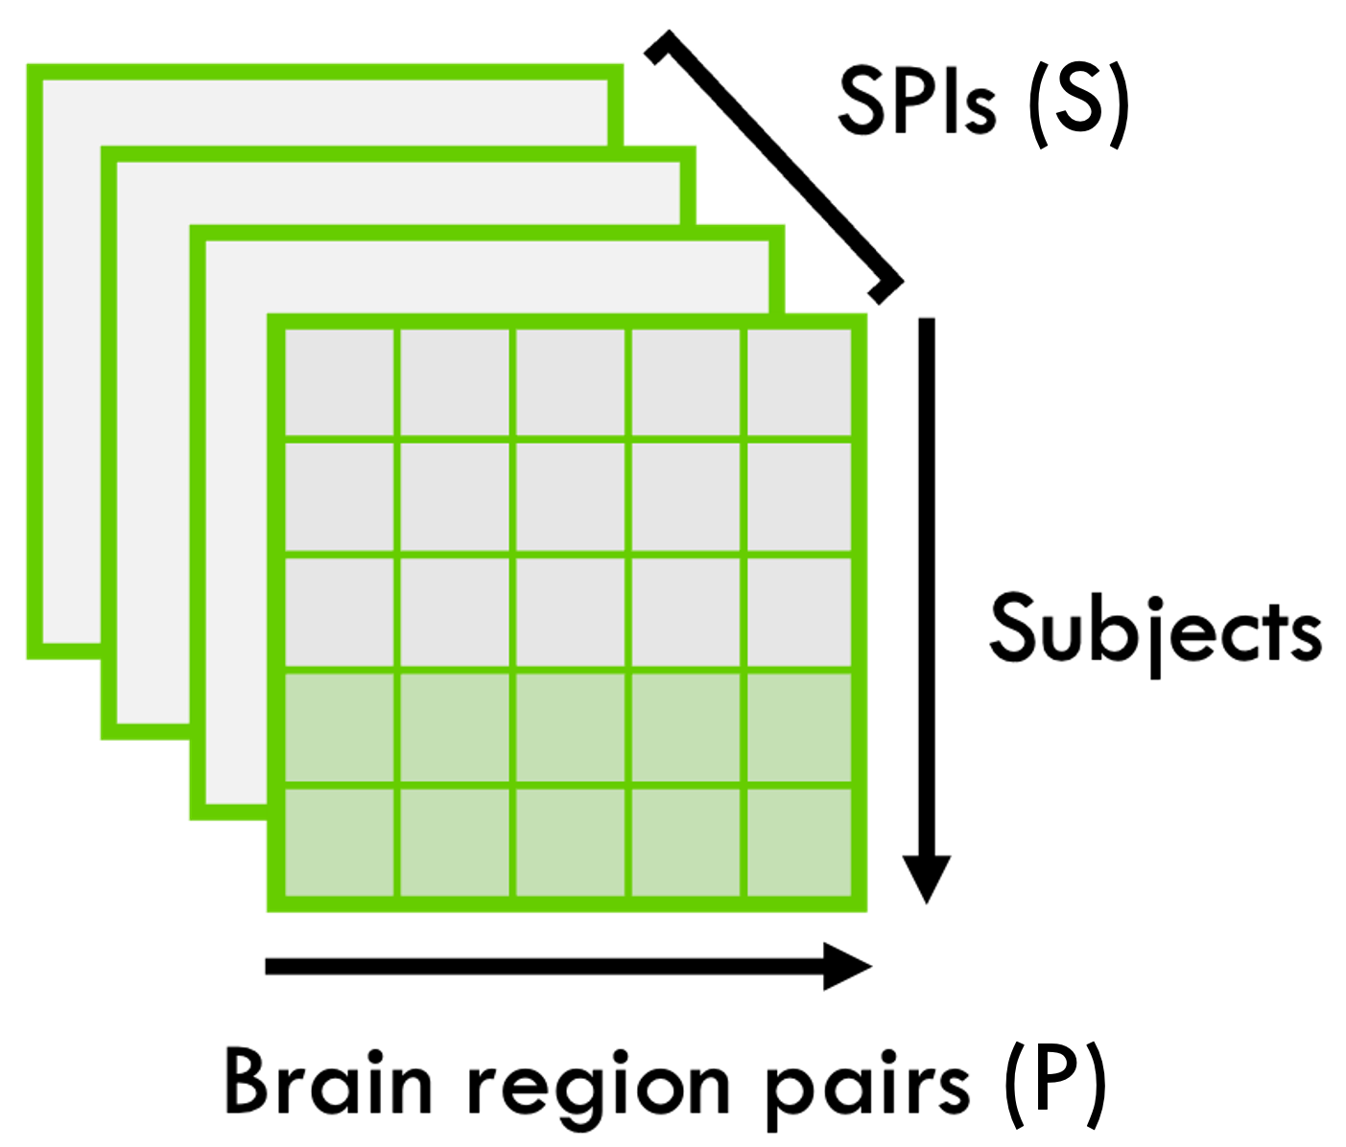
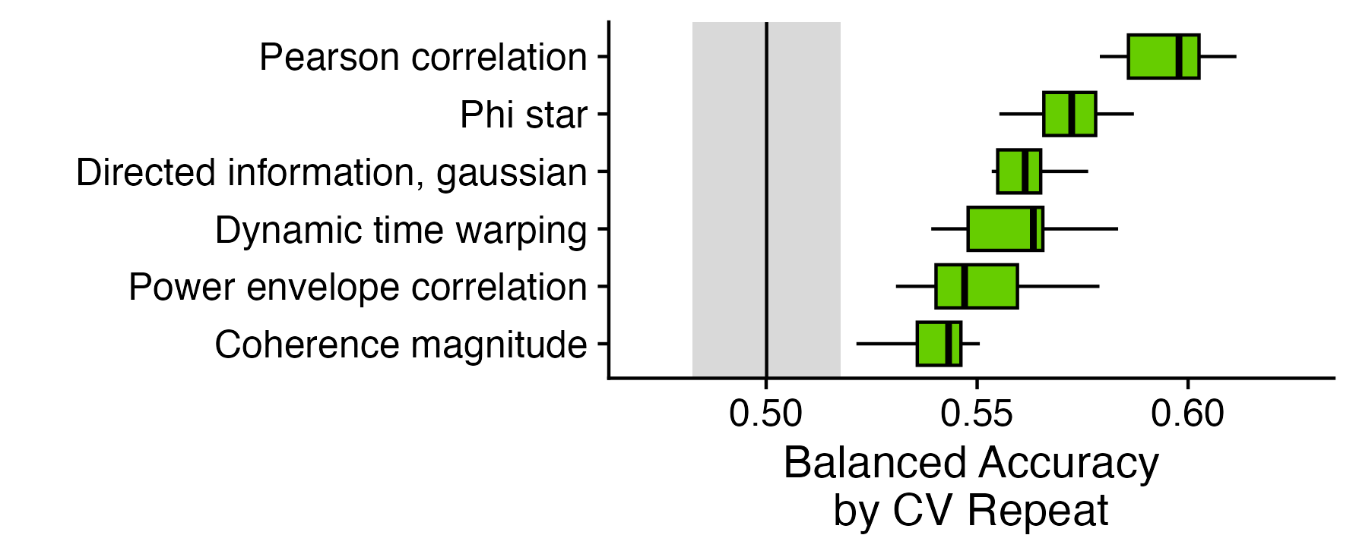


Figure 3
Bivariate
Schizophrenia
Nulls should be 1000x of 10-repeat 10-fold CV, where each point in the histogram is one value from the 10-fold 10-repeat shuffled dataset
ASD
Try adding all pairwise combinations
Notes:
Figure 2. Univariate classification results for ASD and schizophrenia. A: Results from region-based classification analysis. For ASD, the bilateral superior frontal gyrus yielded a statistically significant balanced accuracy (55.95 +/- 0.52, p=4.58e-04, BH-adjusted p=2.20e-02). For schizophrenia, the all yielded significant balanced classification accuracies. right postcentral gyrus (67.23 +/- 2.49, p=1.00e-03, BH-adjusted p=4.07e-02), right amygdala (66.82 +/- 2.12, p=1.32e-03, BH-adjusted p=4.07e-02), and left banks of the superior temporal sulcus (66.64 +/- 1.97, p=1.49e-03, BH-adjusted p=4.07e-02)

