Slide 1
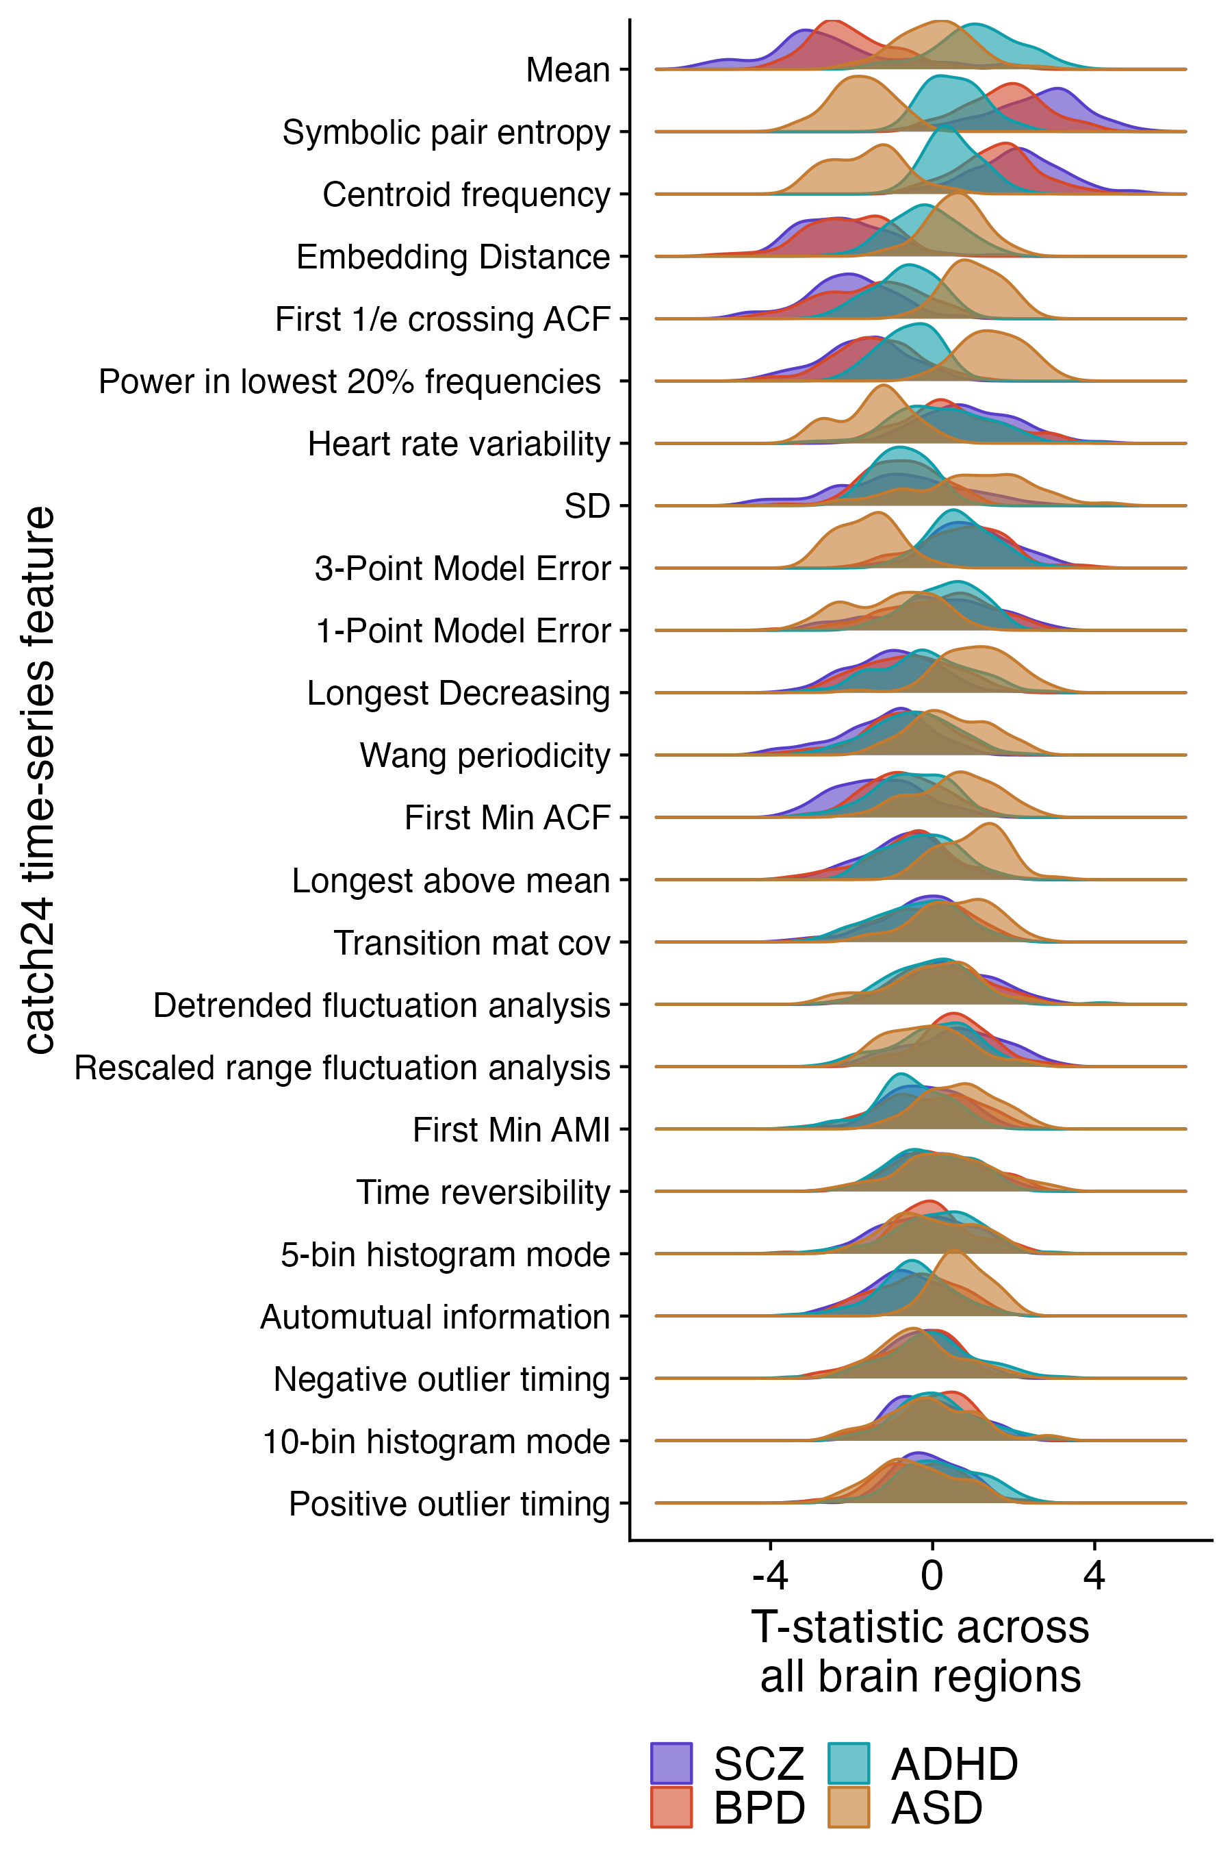
A
B
Repeat A for all pyspi features

