Slide 1


Slide 2
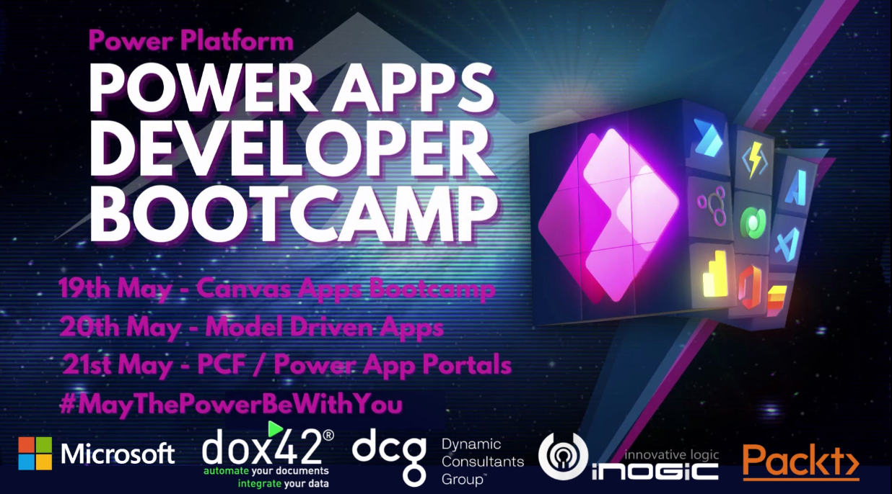

Slide 3
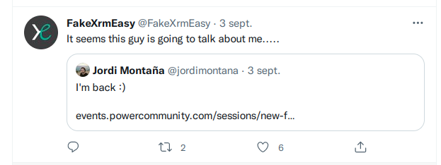

Contact details
Jordi Montaña
jordi@dynamicsvalue.com
https://www.linkedin.com/in/jordimontana/
@jordimontana
@FakeXrmEasy

Slide 4
History
2014
2015
2017
2020-2022
Nov 24: First version of FakeXrmEasy is published v1.x | Founded DynamicsValue company | Got MVP Awards: 2017 2018 Participated in many CRM Saturdays around the world | FakeXrmEasy v2.x / v3.x
https://dynamicsvalue.com

Slide 5
Agenda
History / Stats
Why? / Research Study
Roadmap / New Pipeline Simulation Features
Demo
Unit Testing Azure Functions against Dataverse
Plugin Unit Tests
Spectacular thing never seen before!!
Q & A
https://dynamicsvalue.com

Slide 6
Stats
7 years
1.5M+ Downloads (~ 20% of all CRM SDK downloads)
252+ GitHub Stars
168+ Forks
70+ Countries
https://dynamicsvalue.com

Slide 7
Stats
Used in multi-million dollar projects
Been mentioned in books
Appeared as a skill in job alerts
Appeared as a skill on LinkedIn profiles
Used to deliver training courses
Wide range of industries
https://dynamicsvalue.com

Slide 8
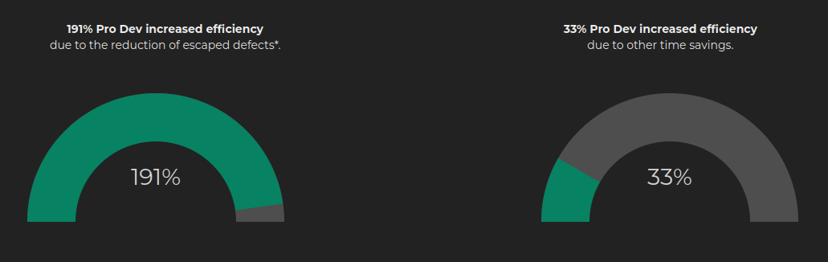
Why / Research Study
https://dynamicsvalue.com/white-paper
https://dynamicsvalue.com

Slide 9
Roadmap
v1.x
v2.x
v3.x
.Plugins CodeActivities .Net Applications Full .NET Framework - “ Deprecated” mode | - Full .NET framework Depends on XrmTooling / CrmSdk.CoreAssemblies - Supports server side development, for which DataverseClient is not intended - Might also be ideal for On-Prem customers | - .net core only Package that depends on DataverseClient (1.0.0 soon in June!! pls follow Natraj!) - Supports DataverseClient specific functionality (i.e. IOrganizationServiceAsync2)
DataverseClient: https://www.nuget.org/packages?q=microsoft.powerplatform.cds.client
https://dynamicsvalue.com

Slide 10
Which one should I use… ?
Component / App Type | Recommended version
Plugins, Workflow CodeActivities, Azure Functions v1 runtime, or any other CrmServiceClient app Any client applications in .net core 3.1, including: Bespoke web portals, Azure Functions v3 / v4 runtime… *Azure Functions v4 runtime targets .net 6 however ServiceClient still has .netcore 3.1 as baseline | 2.x 3.x
https://dynamicsvalue.com

Slide 11
What’s new in v2.x / v3.x
New middleware architecture almost identical between 2.x and 3.x
https://github.com/DynamicsValue/fake-xrm-easy
.net core support
Sonar Quality Gates
Refactoring / restructuring of packages:
FakeXrmEasy.Abstractions
FakeXrmEasy.Core
FakeXrmEasy.Messages.*
FakeXrmEasy.Plugins
FakeXrmEasy.CodeActivities (v2.x and windows only)
Powershell & GitHub Actions Build
https://dynamicsvalue.com

Slide 12
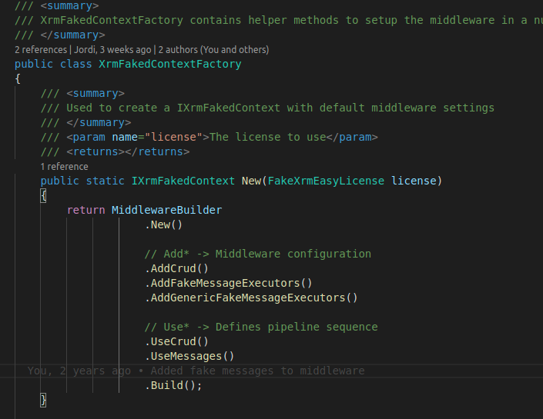
New Middleware
Previously in v1.x there was one message execution per OrganizationRequest
Now OrganizationRequests go through a configurable pipeline execution
https://dynamicsvalue.com

Slide 13
Middleware
Middleware: Add** steps add properties to the IxrmFakedContext that are needed to then “Use” these steps
Use*** methods define the pipeline sequence
https://dynamicsvalue.com

Slide 14
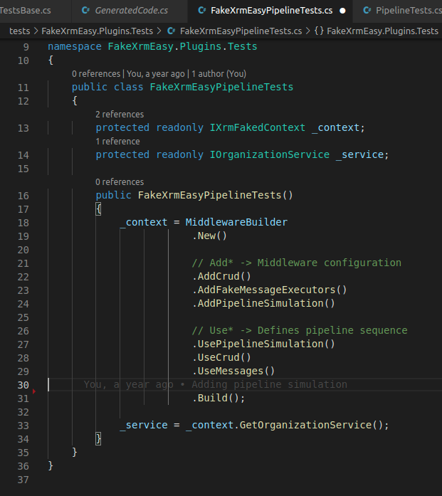
Middleware (II)
Pipeline Simulation example
https://dynamicsvalue.com

Slide 15
Pipeline enhancements
PreValidation
_context.RegisterPluginStep<ValidatePipelinePlugin, Contact>("Update", ProcessingStepStage.Prevalidation, ProcessingStepMode.Synchronous);
Filtering attributes
_context.RegisterPluginStep<ValidatePipelinePlugin, Account>("Update", ProcessingStepStage.Preoperation, ProcessingStepMode.Synchronous, filteringAttributes: new string[] { "name" });
https://dynamicsvalue.github.io/fake-xrm-easy-docs/releases/2x/2.1.0/
https://dynamicsvalue.com

Slide 16
Pipeline enhancements
Plugin Step Images
string registeredPreImageName = "PreImage";
PluginImageDefinition preImageDefinition = new PluginImageDefinition(registeredPreImageName, ProcessingStepImageType.PreImage);
_context.RegisterPluginStep<EntityImagesInPluginPipeline>("Update", registeredImages: new PluginImageDefinition[] { preImageDefinition });
Plugin Step Sequence
_context.RegisterPluginStep<FollowupPlugin2>(requestName, stage, mode, rank: 2);
_context.RegisterPluginStep<FollowupPlugin>(requestName, stage, mode, rank: 1);
https://dynamicsvalue.github.io/fake-xrm-easy-docs/releases/2x/2.1.0/
https://dynamicsvalue.com

Slide 17
Pipeline enhancements
Plugin Step Images
string registeredPreImageName = "PreImage";
PluginImageDefinition preImageDefinition = new PluginImageDefinition(registeredPreImageName, ProcessingStepImageType.PreImage);
_context.RegisterPluginStep<EntityImagesInPluginPipeline>("Update", registeredImages: new PluginImageDefinition[] { preImageDefinition });
Plugin Step Sequence
_context.RegisterPluginStep<FollowupPlugin2>(requestName, stage, mode, rank: 2);
_context.RegisterPluginStep<FollowupPlugin>(requestName, stage, mode, rank: 1);
https://dynamicsvalue.github.io/fake-xrm-easy-docs/releases/2x/2.1.0/
https://dynamicsvalue.com

Slide 18
Pipeline enhancements
Validation of Plugin Registrations
- Upsert only supported for some OOB messages.
- Some messages available to some entities
- Combinations of Create/Update/Delete and Pre/Post and Pre/Post images
Plugin Step Auditing
var pluginStepAudit = _context.GetPluginStepAudit();
var stepsAudit = pluginStepAudit.CreateQuery().ToList();
Assert.Single(stepsAudit);
var auditedStep = stepsAudit[0];
Assert.Equal("Create", auditedStep.MessageName);
Assert.Equal(stage, auditedStep.Stage);
Assert.Equal(typeof(AccountNumberPlugin), auditedStep.PluginAssemblyType);
https://dynamicsvalue.com

Slide 19
DEMO: Scenario
Service bus
Az Function to Create Contact
Dataverse (create)
FollowUp Plugin (task)
http
https://dynamicsvalue.com

Slide 20
Recap
Unit Testing is a fundamental aspect of the ALM story
ProDev increased efficiency
Develop & debug locally many, without hitting an actual Dataverse environment
v1.x is deprecated and in maintenance mode
Use v2.x for server-side development on Windows
Use v3.x for client-side dev in .net core 3.1
The slides of this demo as well as the code samples, can be found here:
https://github.com/DynamicsValue/power-apps-bootcamp-2022-05
https://dynamicsvalue.com

Slide 21
Thanks for your time …
¿any questions?
https://dynamicsvalue.com

Slide 22
Main Title
Section

Slide 23
Header
Text 1
Text 2
Text 3

