Slide 1

20th June 2020
TDD: Getting Started with FakeXrmEasy
1

Slide 2







Jordi Montaña
jordi@dynamicsvalue.com
@jordimontana
@jordimontana82
Author of #FakeXrmEasy
https://www.linkedin.com/in/jordimontana/
Getting Started with FakeXrmEasy
2

Slide 3






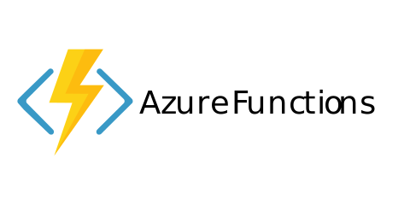
#UnlimitedPower!
Cross-platform dev
Please check previous session!
Containerisation / Orchestration
https://github.com/DynamicsValue/power-platform-dev-saturday
Serverless
.net core 3.1
https://github.com/microsoft/PowerPlatform-CdsServiceClient (alpha release… you’ve been warned)
What’s new in FakeXrmEasy v2.x
3

Slide 4
Why...
...Unit Testing?
What’s new in FakeXrmEasy v2.x
4

Slide 5

Why...
...Fixing a bug in
Production...
What’s new in FakeXrmEasy v2.x
5

Slide 6
Proactive as opposed to Reactive
Automated regression testing
Key Part of DevOps lifecycle: we can’t deploy fast without continuous automated testing…
Before any other test automation phases (Integration, UI, …)
* Bring issues closer to devs (us), where they’re easier and more cost efficient to fix
Why...
...Unit Testing?
What’s new in FakeXrmEasy v2.x
6

Slide 7




What is FakeXrmEasy?
https://github.com/jordimontana82/fake-xrm-easy
OSS Framework
182 Stars
142 forks
Aimed at developers using .net and Power Platform / CDS, MIT licensed
Forks are like “copies” of the project
46 contributors
5+ Years
800k downloads
Who submitted at least 1 Pull Request
Started back in November 2014… time flies
Not too bad for a “low code” platform :)
What’s new in v2.x of FakeXrmEasy
7

Slide 8
Mocks already implemented
Data driven, dev friendly tests
Easier to refactor (less tech debt)
Consistent across dev teams
Faster than UI / Integration tests
=> Huge time savings
Why...
...FakeXrmEasy?
https://dynamicsvalue.com/blog/whats-the-total-cost-of-a-software-bug
https://dynamicsvalue.com/blog/fake-xrm-easy-versus-other-frameworks
What’s new in FakeXrmEasy v2.x
8

Slide 9
FakeXrmEasy Overview
IOrganizationService
FakeItEasy
In-Memory DB (Dictionaries)
What’s new in FakeXrmEasy v2.x
9

Slide 10
FakeXrmEasy Overview II
CRUD
Query Engine
OrgSvcMessages
In-Memory DB (Dictionaries)
10

Slide 11
FakeXrmEasy Overview II
CRM LINQ
QueryByAttribute
FetchXml
QueryExpression
LINQ
In-Memory DB (Dictionaries)
What’s new in FakeXrmEasy v2.x
11

Slide 12
Getting Started with FakeXrmEasy
DEMO
https://github.com/DynamicsValue/power-platform-devops-saturday
What’s new in FakeXrmEasy v2.x
12

Slide 13
Q & A?
What’s new in FakeXrmEasy v2.x
13

Slide 14
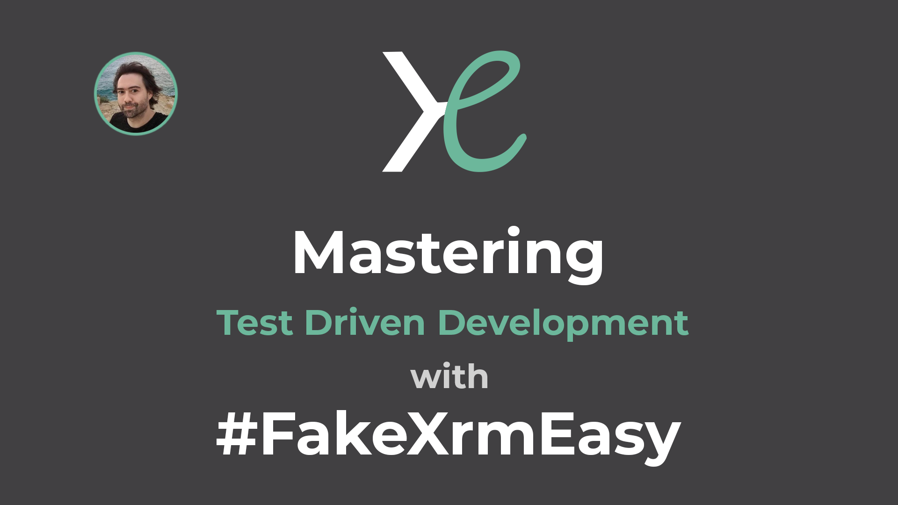
New Course coming!
https://forms.gle/n97oC1LsZgPGmrWh7
What’s new in FakeXrmEasy v2.x
14

Slide 15
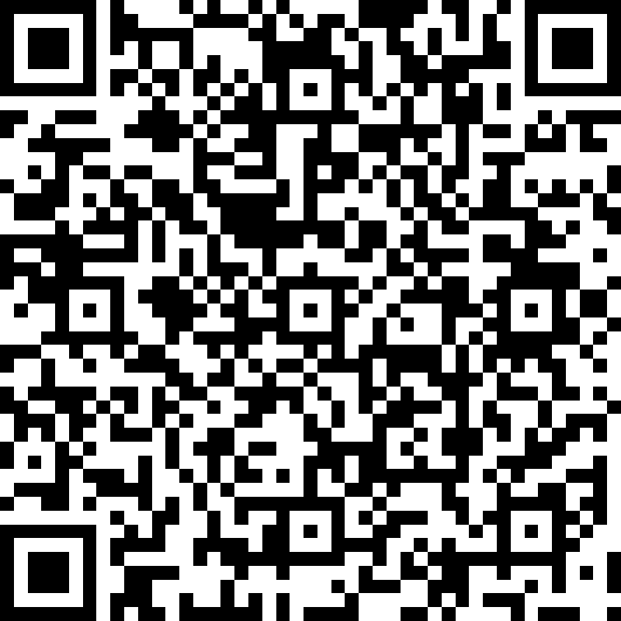
20th June 2020
THANK YOU!
Fill out survey: https://bit.ly/2A9VfiY

