Slide 1

Data Analysis Report on Sales and Pricing Trends
DynamisHub

Slide 2

Key points
Sales Overview
Pricing Analysis
Forecast Sales Evaluation

Slide 3
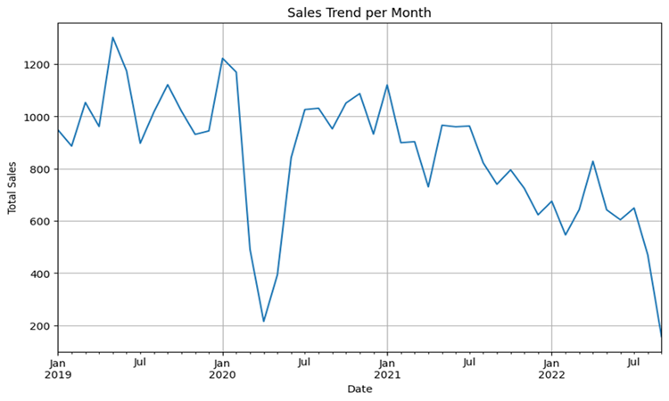
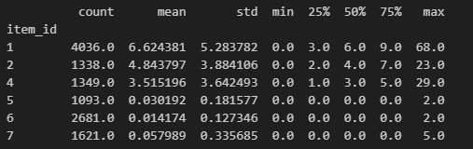
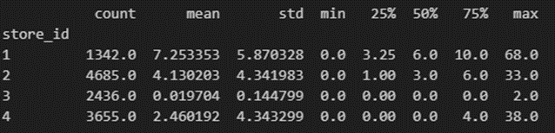
Sales trends and summary statistics
This linechart illustrates the sales trend per month from January 2019 to July 2022, highlighting significant fluctuations over the period. The graph reveals a peak in sales around mid-2020, followed by a steady decline. Additionally, we analyze sales data by item and store, detailing metrics such as count, mean, and standard deviation. The tables show variability in sales performance across different items and stores, providing key insights for targeted sales strategies.

Slide 4
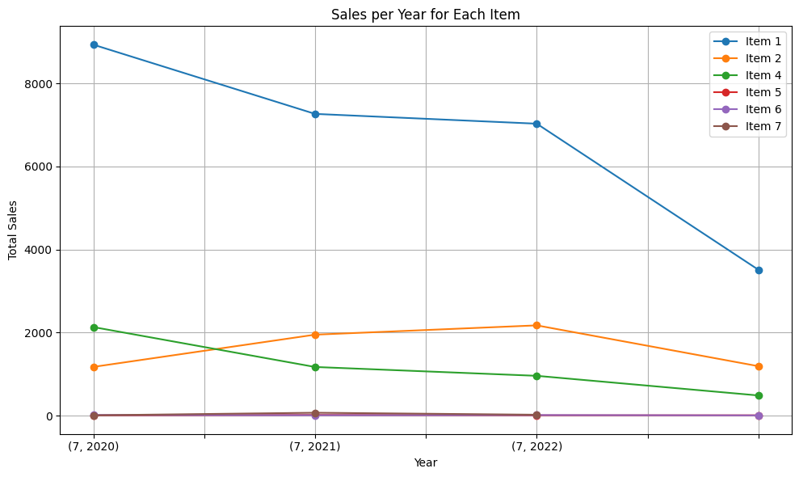
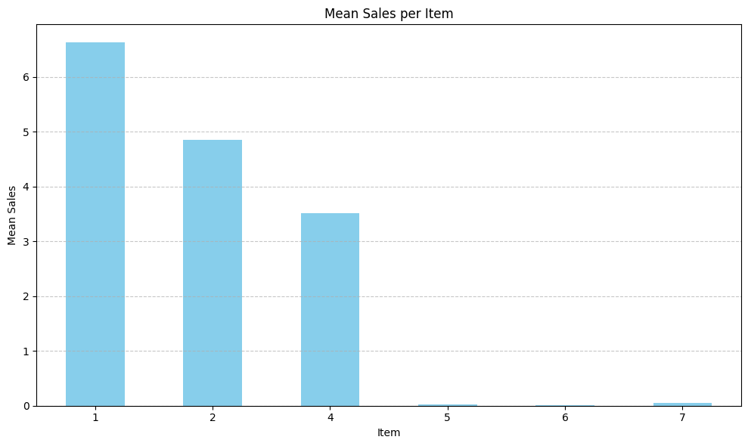
Sales analysis by item
This line graph presents a detailed analysis of sales per year for each item from July 2020 to July 2022, showcasing distinct trends in item performance. It also at the top demonstrates a significant decline in sales for Item 1, whereas the sales figures for Items 2, 4, 5, 6, and 7 show relative stability over the same period. The histogram below provides a comparison of average sales per item, highlighting Item 1 as initially the highest seller but experiencing a sharp decrease over time. These insights are crucial for understanding sales dynamics and guiding inventory decisions.

Slide 5
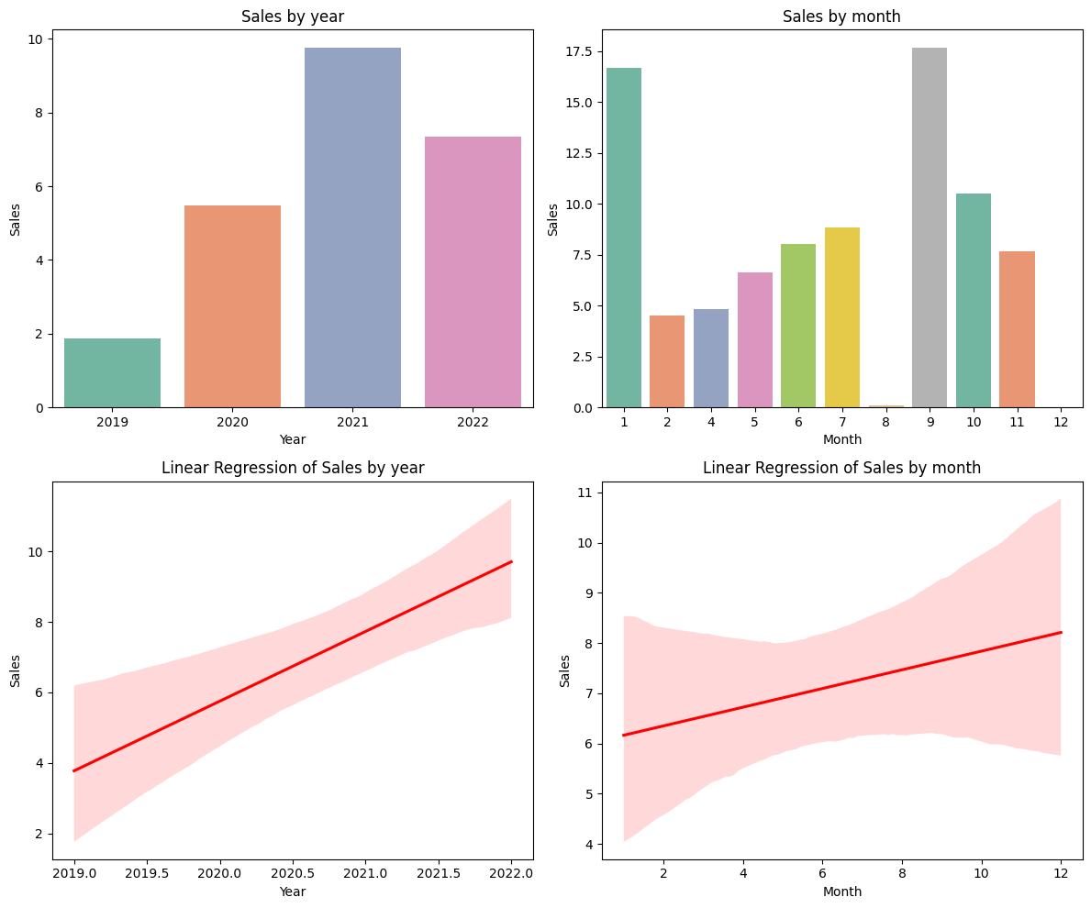
Sales by month and year
This visualization displays sales data both annually and monthly, alongside their respective linear regression analyses. The bar charts show that sales have generally increased each year from 2019 through 2022, with a notable peak in 2021. Monthly sales data reveals significant variations, with the highest sales occurring in January and the lowest in November. The linear regression plots underscore these trends, highlighting a steady increase in annual sales and a variable, yet generally upward, trend in monthly sales. These analyses assist in predicting future sales patterns and planning accordingly.

Slide 6
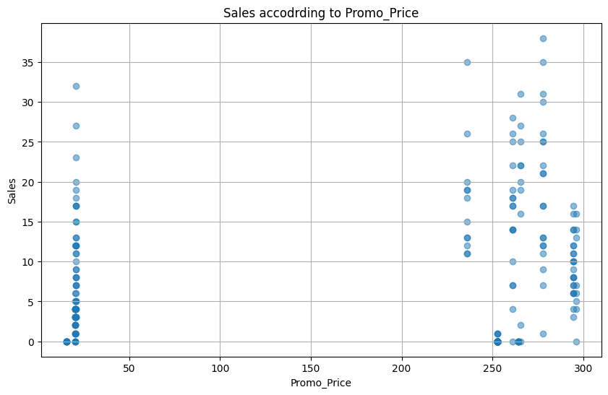
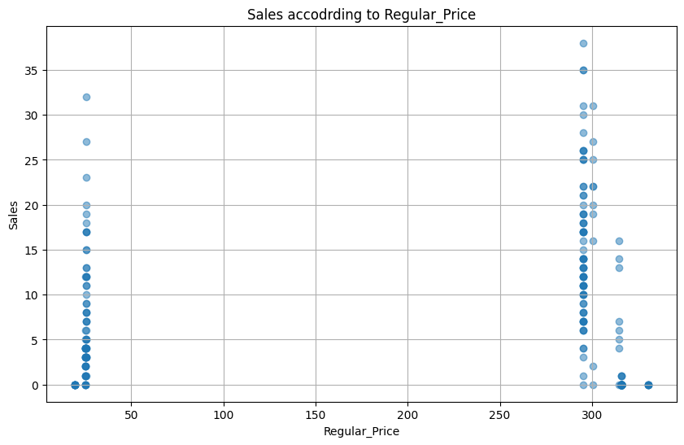
Pricing analysis according to sales
These scatter plots illustrate the relationship between sales volume and pricing strategies. The top chart shows sales according to promotional prices, revealing a concentration of higher sales volumes at certain higher price points, particularly near 250. Conversely, the bottom chart details sales in relation to regular prices, with noticeable clusters of higher sales occurring at price points around 250 as well. These visualizations suggest that certain price levels, regardless of being promotional or regular, are optimal for maximizing sales, indicating key price points that attract customers and drive sales.

Slide 7
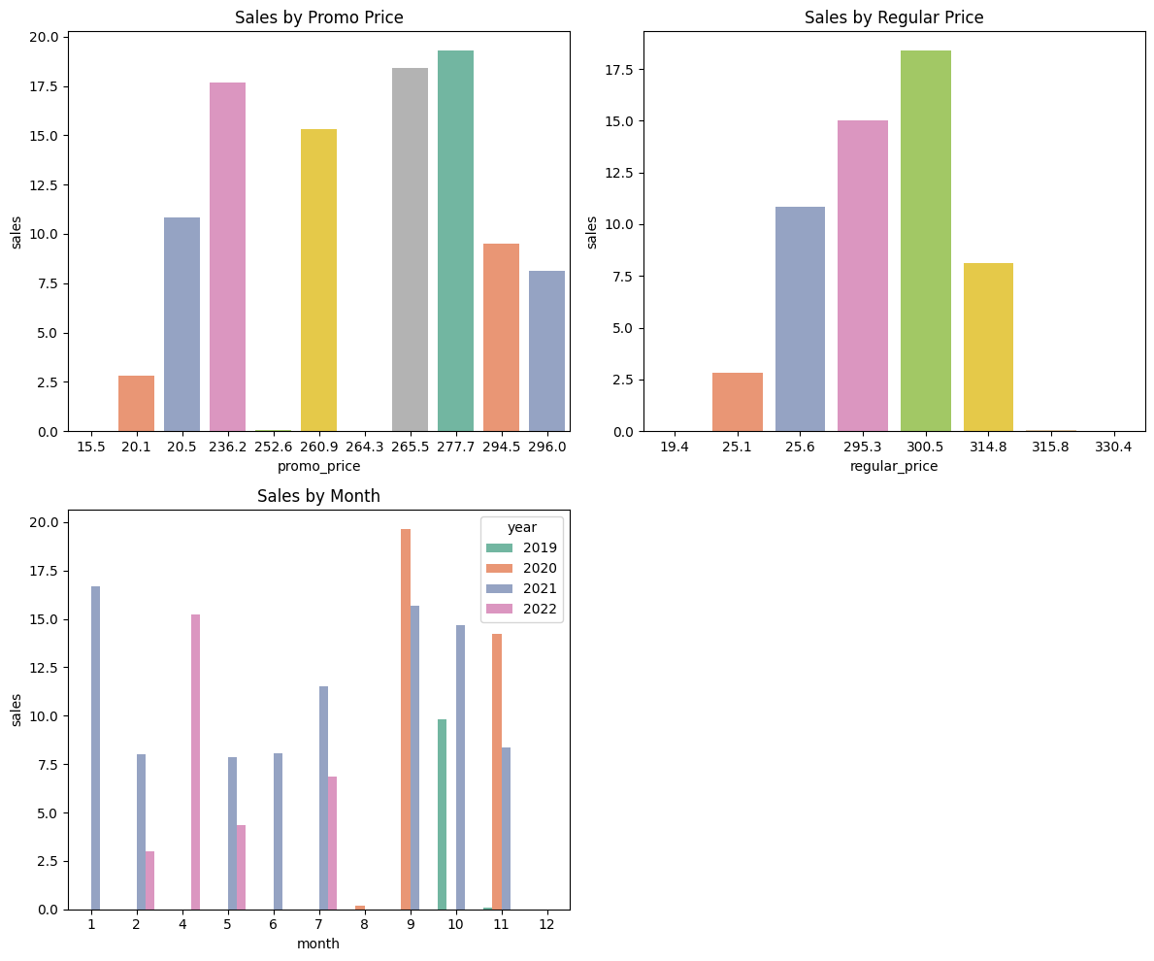
Pricing analysis according to sales
This slide visualizes sales performance influenced by different pricing strategies and monthly variations across four years. The first two bar charts compare sales at various promotional and regular price points, showing peaks at certain price levels that appear to optimize sales, notably around 265 and 300. The third chart tracks monthly sales from 2019 to 2022, highlighting seasonal peaks and trends, such as high sales in early summer and end-of-year periods. These insights are crucial for adjusting pricing strategies and anticipating seasonal sales fluctuations

Slide 8
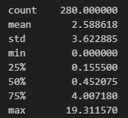
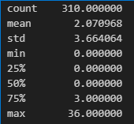
Forecast evaluation
These data summaries provided illustrate key differences in the forecast and actual sales metrics. The forecast data, with 310 observations, shows a mean of approximately 2.08 units and a high variability, as indicated by a standard deviation of 3.66. Notably, 50% of forecasted data points are zeros, suggesting periods of inactivity or no sales, yet the maximum spikes up to 36 units. In contrast, the actual sales data consists of 280 observations with a slightly higher average sales figure of approximately 2.59 units. The standard deviation here is also substantial at 3.62, indicating similar variability as the forecast. The distribution of sales is more continuous, evidenced by 50% of the values being about 0.45 units, and the maximum sale reaching 19.31 units, which is significantly lower than the forecast's maximum.
Forecast Summary
Sales Summary for May 2022

Slide 9

Forecast evaluation
The predictive model's performance metrics, with an R-squared of approximately 0.298 and a Mean Squared Error of 15.87, indicate a moderate fit. This suggests the model captures some underlying patterns but might not fully account for all variabilities or potential anomalies in the data.
Overall, while both datasets exhibit high variability, actual sales tend to be more evenly distributed than forecasted sales, which include a significant number of zero-sales periods. The model's predictive accuracy, as gauged by the MSE and R-squared values, suggests room for improvement in capturing the full dynamics of sales activities.

Slide 10
Recommendations
Refine the forecasting model by including market trends, seasonal variations, and promotional activities to better align predictions with actual sales.
Implement robust outlier management and anomaly detection to improve the stability and accuracy of the forecast model.
Conduct a deeper analysis of periods with zero sales to understand underlying factors and adjust the forecasting strategy accordingly.
Regularly review and recalibrate the forecasting model based on ongoing sales data and market conditions to maintain relevance and accuracy.

Slide 11

Thank you

