Slide 1
Website Modernization & Digital Enhancement Proposal
Presented by Lionel Raseemela
Platform Engineer Intern at IBM
7 November 2025

Slide 2
Introduction
Who am I:
- Software & Platform Engineer Intern at IBM
- BSc Computer Science graduate (Nelson Mandela University)
- Passionate about digital transformation and UI modernization
Why I Reached Out:
- To present a modern, responsive redesign of Munsoft’s website that aligns with your brand and improves user experience.

Slide 3
Problem Statement
Current Munsoft website:
- Outdated design and layout
- Limited mobile responsiveness, broken elements
- Navigation and UX challenges
- Lack of engaging visuals and interactivity.

Slide 4
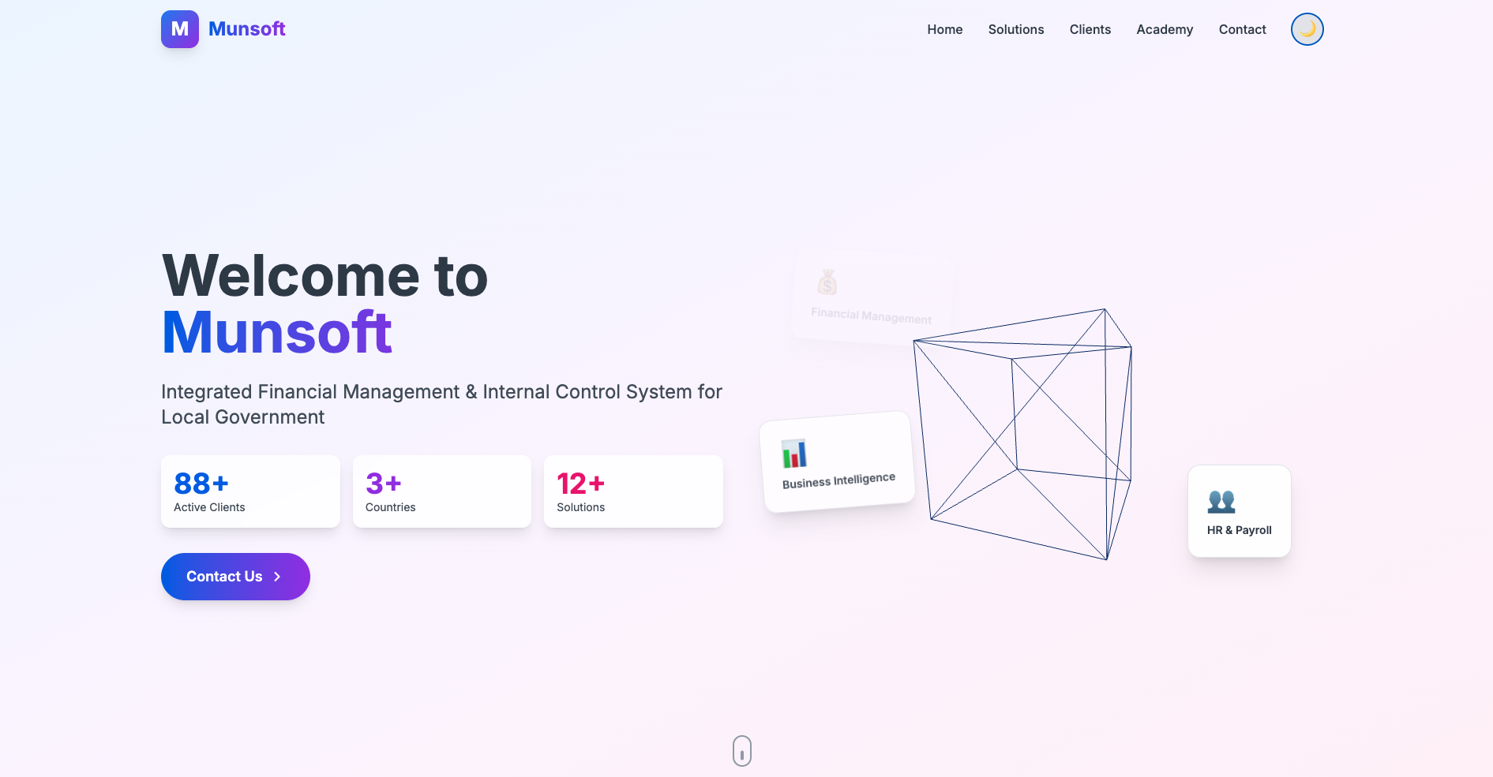
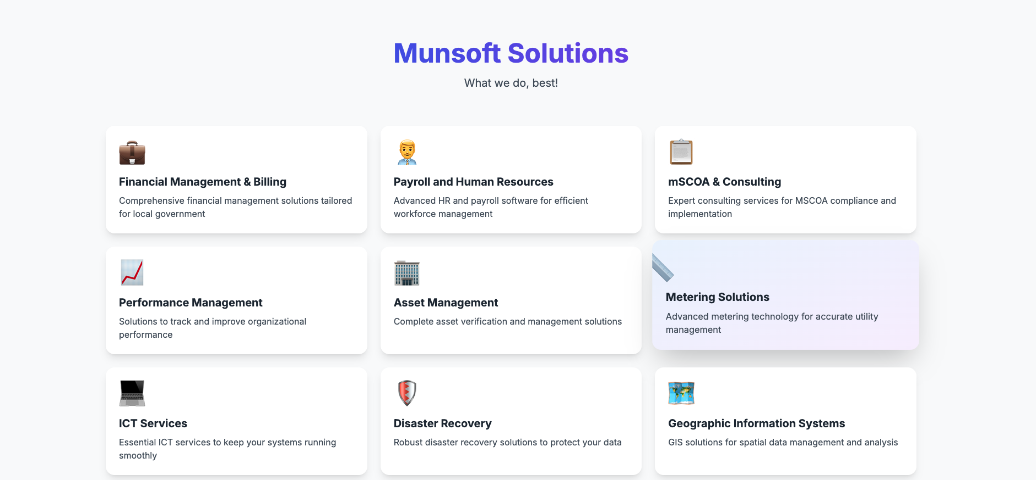
The Prototype
Live Demo: Munsoft-Website-Prototype
Key Features:
- Clean, modern UI
- Fully responsive and mobile-friendly
- Improved accessibility
- Enhanced content structure
- Light & Dark mode integration

Slide 5
Value to Munsoft
- Modern, user-friendly website aligned with 2025 standards
- Improved customer engagement and accessibility
- Opportunity to integrate AI and smart dashboards
- Collaborative and flexible development approach.

Slide 6
Proposed Collaboration Options
Option A – Purchase the Website (Once-off Sale):
- Deliver the full production-ready version, including codebase and deployment support.
- Suggested Price: R7,500
- Payment: 50% upfront deposit (R3,750), 50% after delivery.
Option B – Ongoing Partnership (Contract Basis):
- Collaborate on digital enhancements and AI-powered dashboards.
- Monthly Retainer: R5,000
- First month’s payment upfront (R5,000) as project retainer.
Open for other options to make Munsoft’s dream a reality

Slide 7
Questions & Answers

Slide 8
Thank You!

Slide 9
Contacts
Email: lraseemela@gmail.com
Phone: 0729003705
LinkedIn: https://www.linkedin.com/in/lionel-raseemela-46090ab9/
Website: https://hackerwithdrip.github.io/lionel-portfolio/

