Slide 1
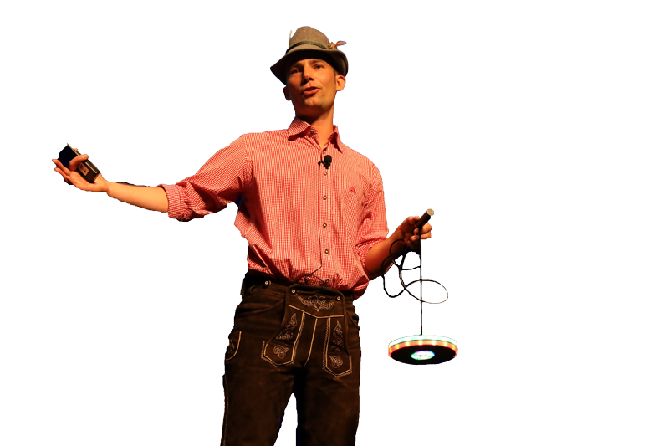






Building an Unbreakable Delivery Pipeline
Shift-Left, Shift-Right, Self-Healing / Auto-Remediation
Based on: https://github.com/Dynatrace/AWSDevOpsTutorial
Followed by live Q&A:
  Part of: http://bit.ly/onlineperfclinic
  Get Dynatrace SaaS Trial: http://bit.ly/dtsaastrial
  Listen to PurePerformance: http://bit.ly/pureperf
Andreas Grabner, Dynatrace
@grabnerandi

Slide 2
PRE-REQUISITS
Dynatrace SaaS & AWS Account

Slide 3
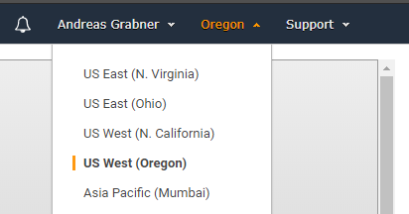
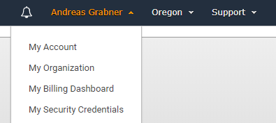
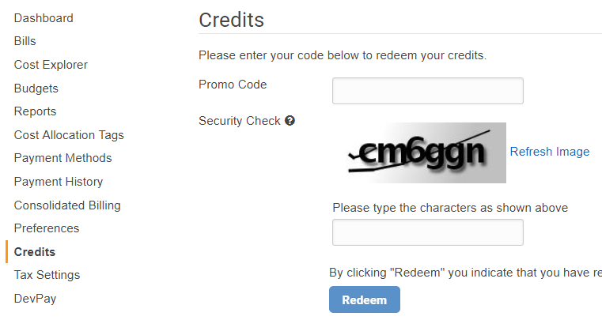
Prerequisites: AWS with Dynatrace
Download: https://github.com/Dynatrace/AWSDevOpsTutorial
Login to your AWS Account: http://aws.amazon.com
  Validate and remember your default region
Now to go My Billings Dashboard and redeem your AWS Voucher
Login to: https://TENANT.sprint.dynatracelabs.com
  Login with your student it on your card
#3
#1
#2
#4

Slide 4
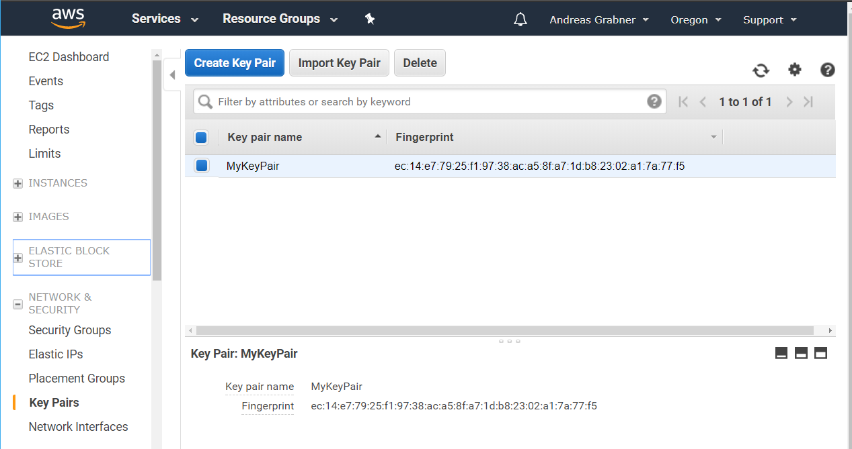
#1 - Prerequisites Sanity Check: AWS
Create EC2 Key Pair
  Go to EC2 – Pich Region Oregon
  Click on Key Pair
  Create a new Pair
  Store the .pem file

Slide 5

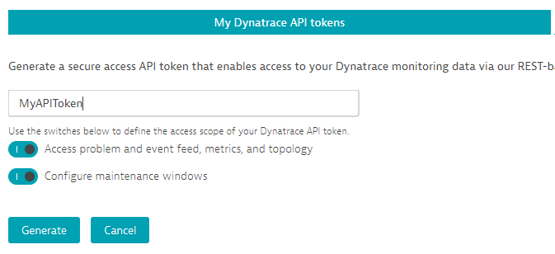

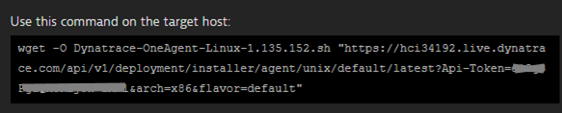
#2 - Prerequisites Sanity Check: Dynatrace
Login to your Dynatrace SaaS Trial we just gave you: http://signin.dynatrace.com
  Make note of your Dynatrace Tenant URL
Create an API Token. Make note of that Token
Make note of the Agent Script Download URL (NOT INCLUDING QUOTES) for your Tenant
  Go to https://<YOURTENANT>.live.dynatrace.com/#install/agentlinux

Slide 6
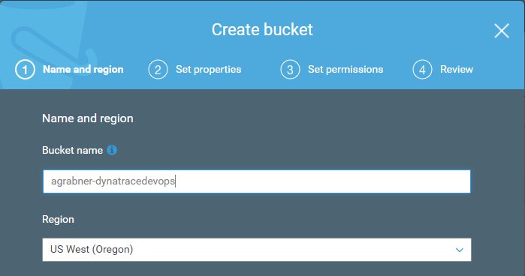
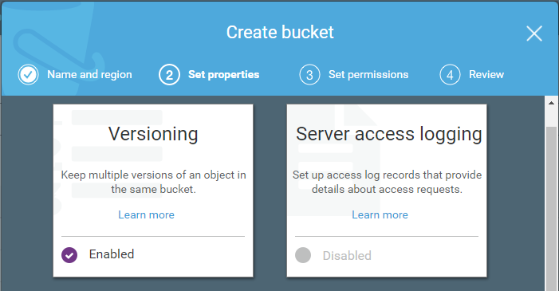
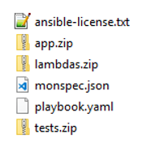
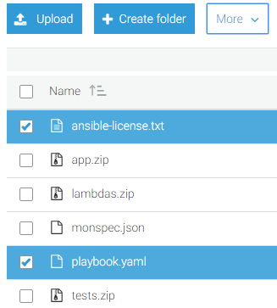
Before we get started – we need to copy some files
#1: Create a new S3 Bucket in your AWS Account with the name: <yourlastname>-dynatracedevops
#2: Upload all files (including lambda subfolder) from your C:\DynatraceAWSDevOps\copytos3 to this Bucket!
<yourname>-dynatracedevops
Pick your default region!
Enable Versioning
Make “ansible-license.txt” + “playbook.yaml” public:
Click “More -> Make public”
Drag & Drop
or Upload

Slide 7
Launching our Environment
Our CloudFormation Template will create a Staging and Production Linux server, a Pipeline that deploys a Node.js Microservice in Staging and then Production and a set of Lambda functions to link Pipeline with Dynatrace

Slide 8
#1 Launching the CloudFormation Stack
What is CloudFormation?
  A declarative way to define AWS Resources, e.g: EC2, CodeDeploy, CodePipeline, Lambda, Roles, ELBs, …
  Learn more about CloudFormation: https://docs.aws.amazon.com/AWSCloudFormation/latest/UserGuide
Our Steps
  In your AWS Console browse to the CloudFormation Service

Slide 9
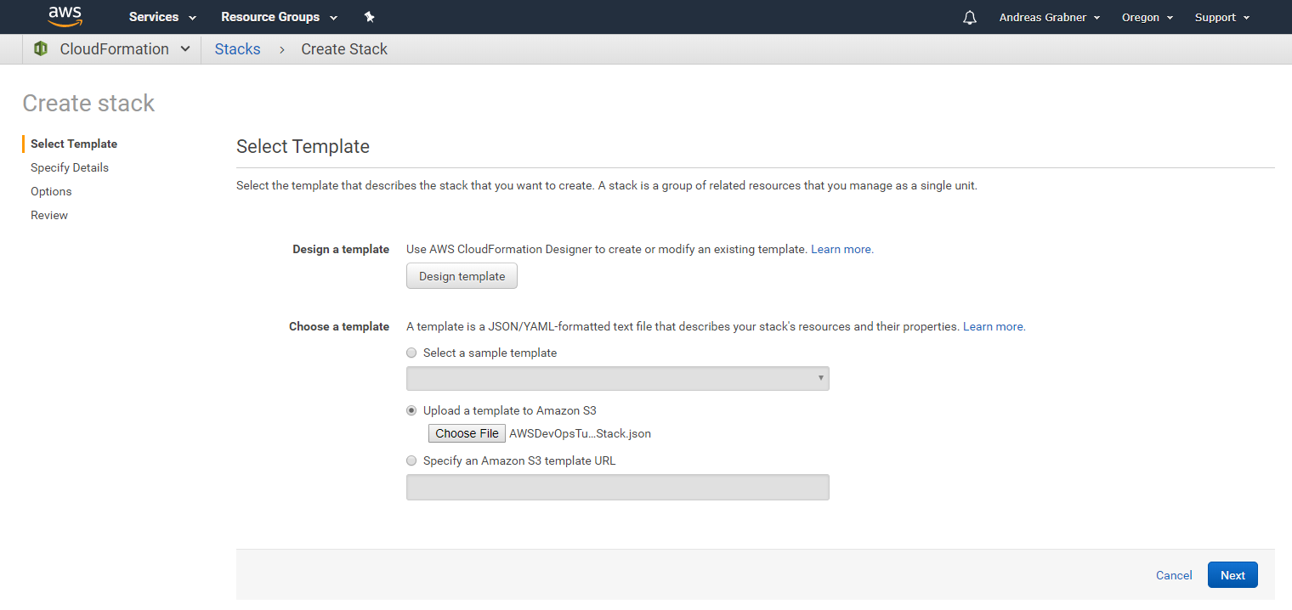
#2 Launching the CloudFormation Stack: Upload Template
#1 Your region
#2 Upload the AWSDevOpos…json
#3

Slide 10
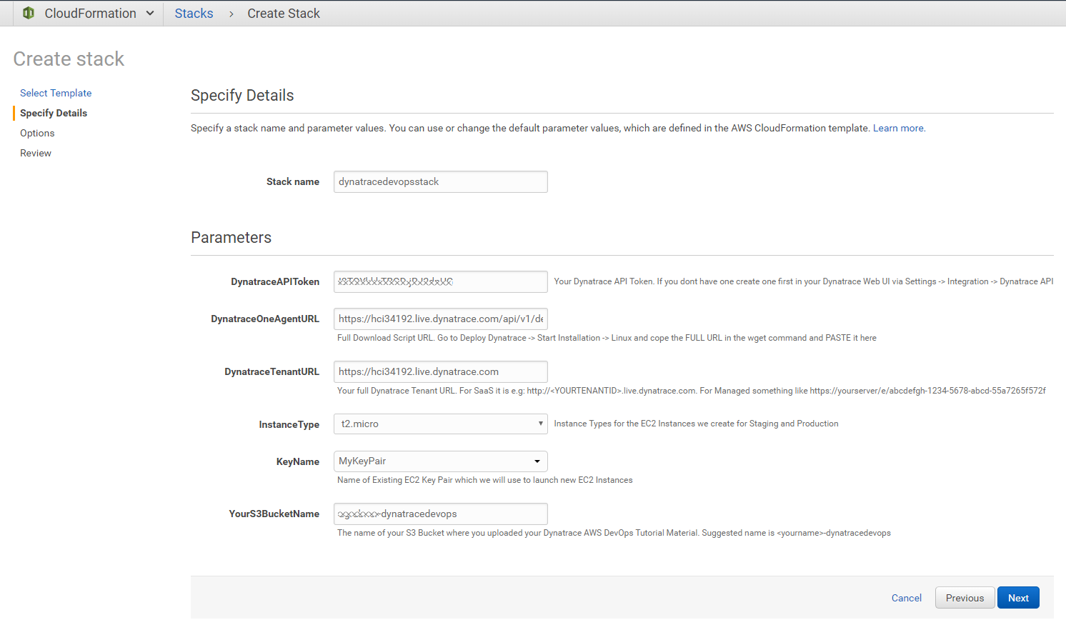
#3 Launching the CloudFormation Stack: Filling in the details
Any name, e.g: dynatracedevops
Your Dynatrace API Token
The OneAgent Linux Download link
Your Dynatrace Tenant URL
Your AWS EC2 Key Pair
<yourname>-dynatracedevops
Next

Slide 11
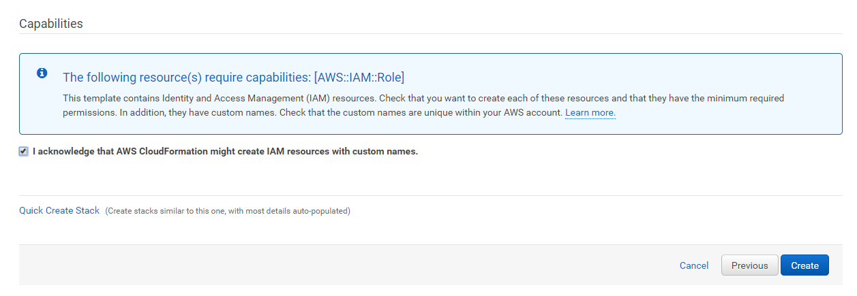
#4 Launching the CloudFormation Stack: Confirm and Create!
#1 Confirm
#2

Slide 12
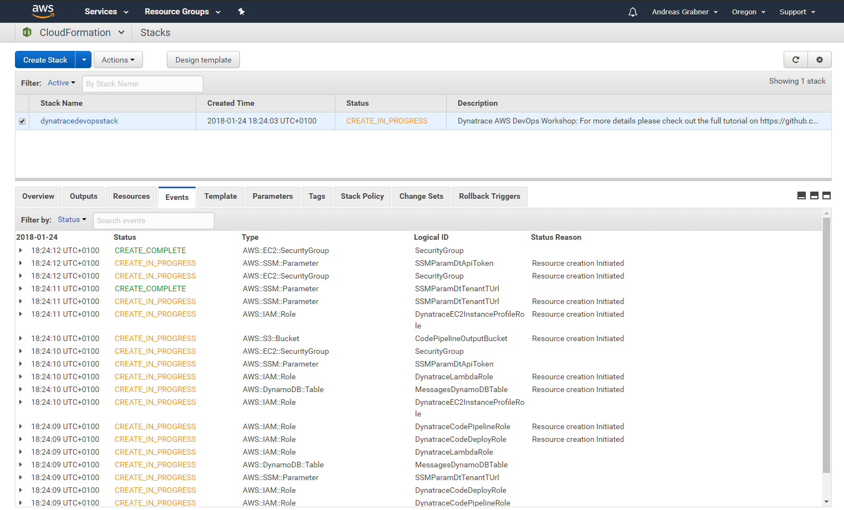
#5 Launching the CloudFormation Stack: Follow Events during Creation!
Watch as AWS Resources get created

Slide 13
THE BIG PICTURE
What we are going to do today!

Slide 14












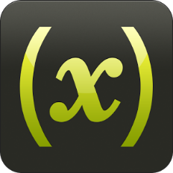




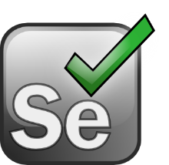










Shift-Left: Break Pipeline Earlier
Shift-Right: Tags, Deploys, Events
Dev
Perf/Test
Ops
Biz
Actionable Feedback Loops
Path to NoOps: Self-Healing, …
Notes:
But there is more than production! There is more we can do throughout the whole DevOps Toolchain

Slide 15

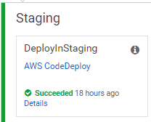
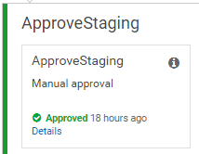
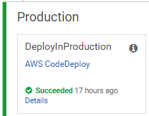
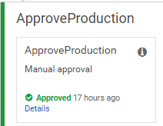







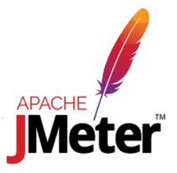

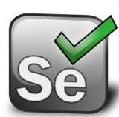
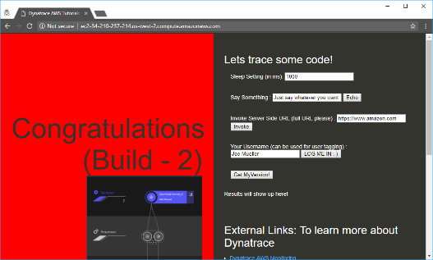
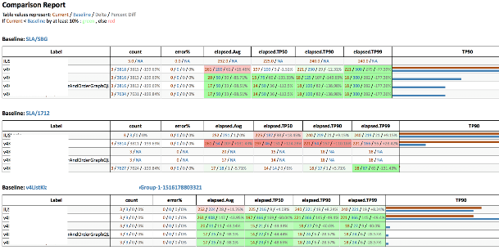
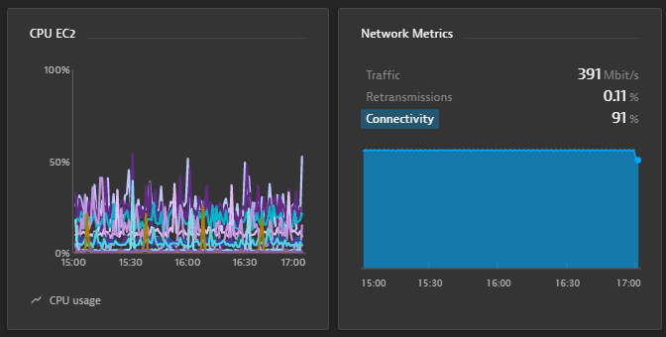
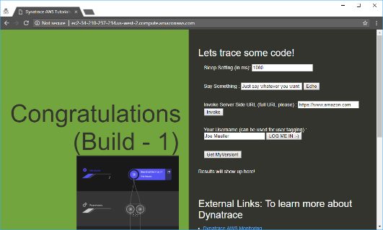
https://github.com/Dynatrace/AWSDevOpsTutorial
AppTeam
Users
AWS CodeDeploy
AWS CodeDeploy
Manual Approval
Manual Approval
Manual Rollback
AWS EC2 (Tag=Staging)
AWS EC2 (Tag=Production)

Slide 16
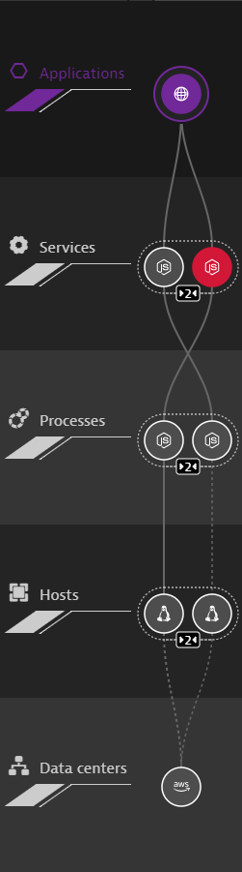
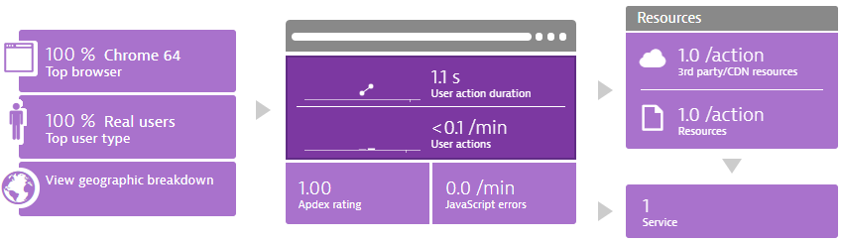
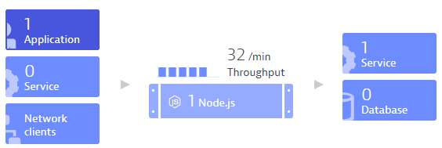
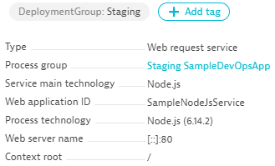




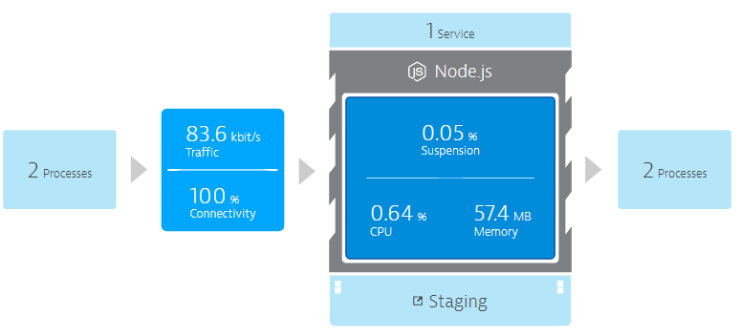
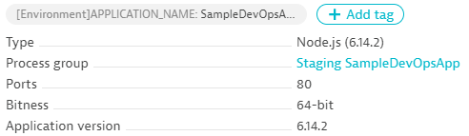


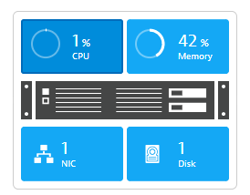


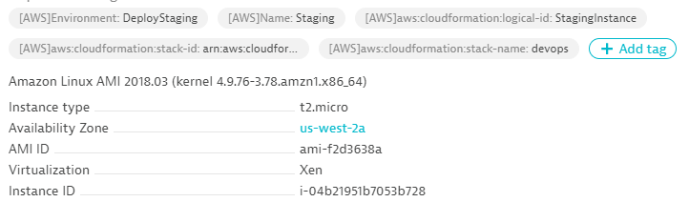


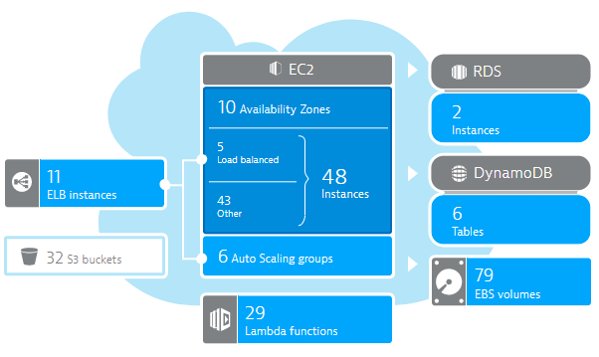
DT_TAGS=APP_NAME=Sample
DT_CUSTOM_PROPS=Staging
DT_CLUSTER_ID=MyNodeJs
launchApp.sh
User Data:
wget OneAgent.sh
./OneAgent.sh
AWS EC2 (Tag=Staging)
CloudWatch

Slide 17
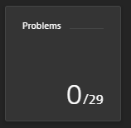
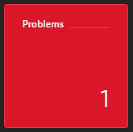

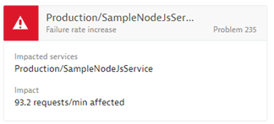
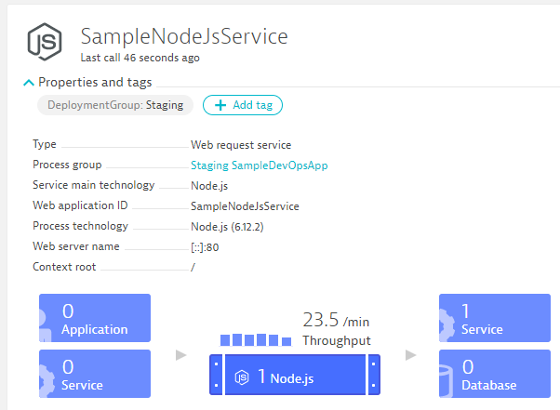
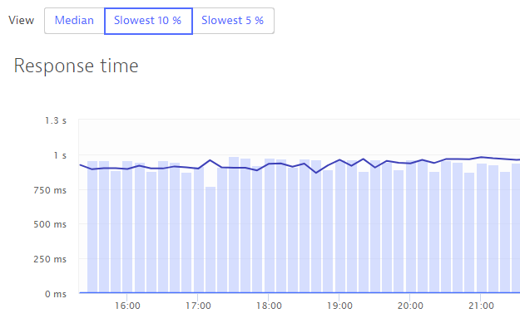
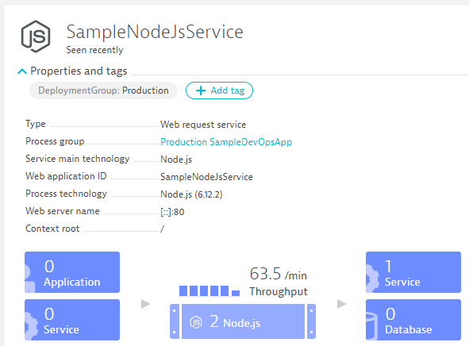
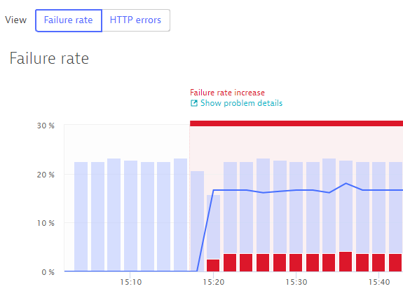

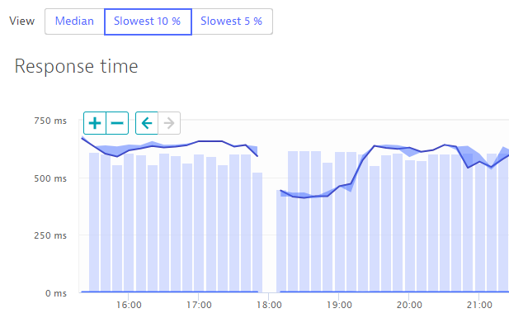
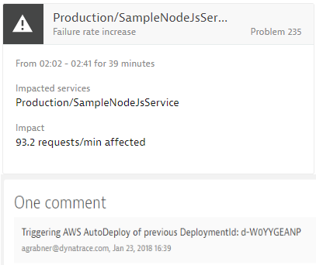
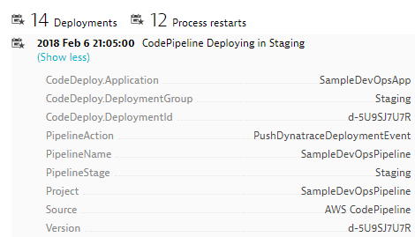
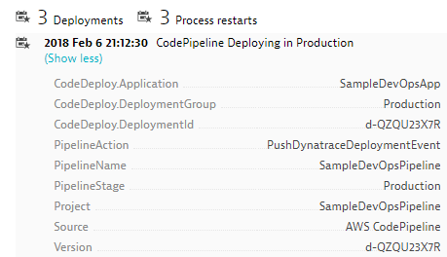
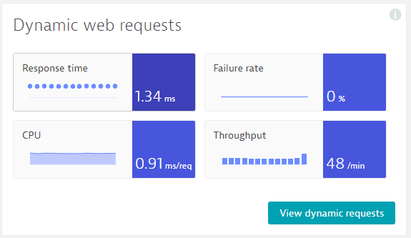
https://github.com/Dynatrace/AWSDevOpsTutorial
Self-Healed
Auto-Approve!
Auto-Approve!
Auto-Reject!
Auto-Reject!
pushDynatraceDeploymentEvent
Pushes Deployment Info to Dynatrace Entities
validateBuildDynatraceWorker
Compares Builds and Approves/Rejects Pipeline
pushDynatraceDeploymentEvent
Pushes Deployment Info to Dynatrace Entities
validateBuildDynatraceWorker
Validates Production and Approves/Rejects Pipeline
Build 6
Production
handleDynatraceProblemNotification
Executes Auto-Remediating Actions, e.g: Rollback
Build 7
Production

Slide 18
Explore our environment
The CloudFormation template did most of the work already

Slide 19
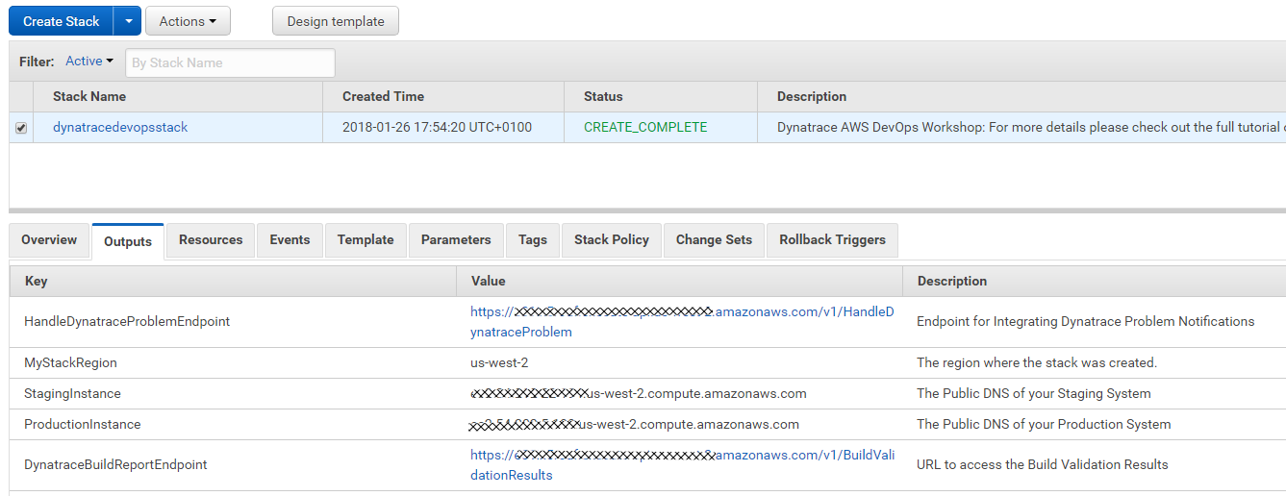
Our CloudFormation Template should be DONE by now!
#1 Once COMPLETE
#2 Check Outputs!
Will need these links later
Remember how to get here or copy them to local file

Slide 20
Our CloudFormation Template Created the following
2 EC2 Instances
  1 that will run Staging and 1 that will run Production version of your app
  Both EC2 Instance have a Dynatrace OneAgent installed sending data to your Dynatrace Tenant
AWS CodeDeploy
  4 Deployment Configurations for our Sample App
AWS CodePipeline
  A Pipeline with Source, Staging, Approval and Production stages
Several AWS Lambda Functions
  Implement Dynatrace Automation Steps in our Pipeline, provide access to build results, handle Dynatrace Problem notification …
AWS User Roles and Policies
  Allowing CodePipeline, CodeDeploy and Lambda to access other resources
System Manager Properties for DT_TENANT, DT_TOKEN, DT_BUILD_REPORT_URL

Slide 21
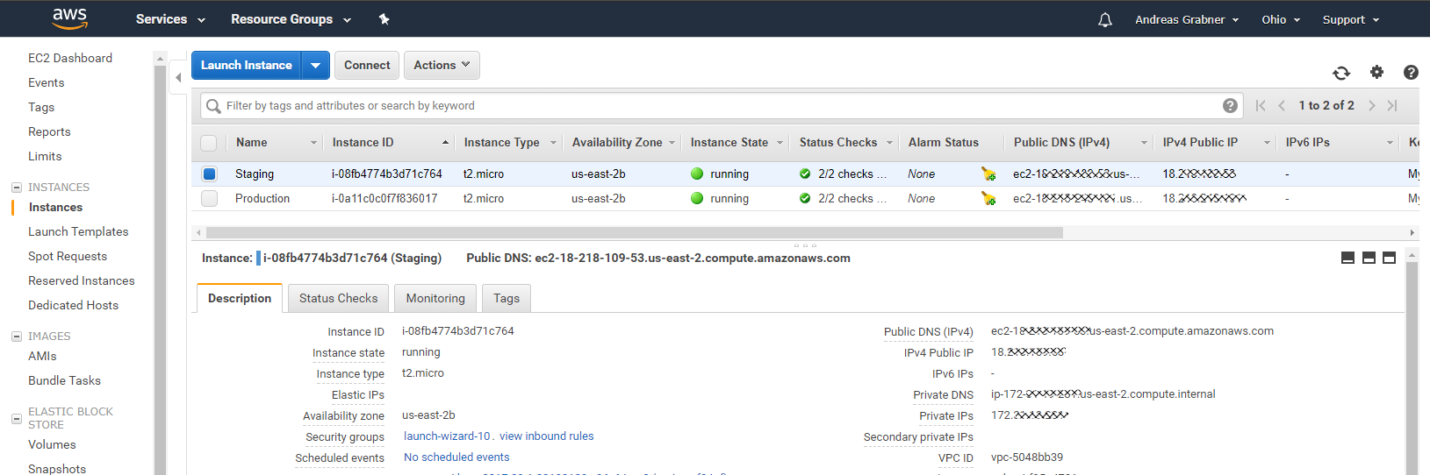
Explore our 2 EC2 Instances: Staging & Production
#1 Remote Connect for Troubleshooting
#3 AWS Name
& InstanceID’s
#2 Your Public DNS and IPs
#4 Automatically executed script!
UserData (not complete – check it out in the EC2 Web UI)
#1: Install Dynatrace OneAgent
yum update -y
yum install ruby wget -y
wget -O Dynatrace-OneAgent-Linux.sh "{{DynatraceOneAgentURL}}
sudo /bin/sh Dynatrace-OneAgent-Linux.sh APP_LOG_CONTENT_ACCESS=1
#2: Install Depending Software, e.g: httpd, nodejs, pm2
…
#3: Launch dummy PM2 App to pass Env Variables to OneAgent -> Trick to get Vars into Web UI
export DT_CUSTOM_PROP=DEPLOYMENT_GROUP_NAME=GROUP_NAME APPLICATION_NAME=APP_NAME
echo "console.log('dummy app run');" >> testapp.js
pm2 start testapp.js &> pm2start.log
#4: Install AWS CodeDeploy Agent and run CFN Update
…

Slide 22


In Dynatrace Web UI: View Hosts and Validate monitored EC2 Instances
#1 If Dynatrace AWS CloudWatch Integration is configured you see EC2 Instance Name, otherwise EC2 Instance ID
#2 Click on a Host! FullStack Monitoring Dettails of each EC2 Instance

Slide 23


Explore AWS CodePipeline: First run already on its way but will FAIL!
#1 Open the SampleDevOpsPipeline
#2 Pipeline checks out Source,
SourceTests and Monspec from S3
#3 Uses CodeDeploy to deploy Node.js App on Staging EC2 with DT_TAGS, DT_X Env Variables
#7 FAILS: Because of Missing Tags in Dynatrace!
#5 Pushes Deployment Info to special tagged Dynatrace entities. Will FAIL!
#4 CodeDeploy also starts tests on the same machine

Slide 24




What does AWS CodeDeploy do during Deployment?
#1 Copies to EC2 & Extracts
#2 Executes start_server.sh:
export DT_TAGS=APPLICATION_NAME=$APPLICATION_NAME
export DT_CUSTOM_PROP="DEPLOYMENT_ID=$DEPLOYMENT_ID DEPLOYMENT_GROUP_NAME=$DEPLOYMENT_GROUP_NAME APPLICATION_NAME=$APPLICATION_NAME“
export DT_CLUSTER_ID="$DEPLOYMENT_GROUP_NAME $APPLICATION_NAME“
pm2 start app.js &> pm2start.log
#2 DT_CLUSTER_ID
#2 DT_TAGS
#2 DT_CUSTOM_PROP

Slide 25




What does PushDynatraceDeploymentInfo do? And WHY can it FAIL?
Monspec (Monitoring as Code)
"SampleJSonService" : {
"etype": "SERVICE",
"environments" : {
"Staging" : {
"tags" : [
{
"context": "CONTEXTLESS",
"key": "DeploymentGroup",
"value": "Staging"
}
]
},
"Production" : {
"tags" : [
{
"context": "CONTEXTLESS",
"key": "DeploymentGroup",
"value": "Production"
}
]
}
},
pushDynatraceDeploymentEvent
Pulls Information from Monspec
Dynatrace Events REST API
Pushes Event for Entities with Tag DeploymentGroup:Staging

Slide 26

Configure Service Tagging Rules to Automatically apply Staging vs Production Tags
#2 – Call the Tag “DeploymentGroup”
#3 – For Services
#4– Tag Value comes from our Process Environment Variable
#5 – Only apply rule if env variable exists
#1

Slide 27


Lets Run the Pipeline Again: Should run through without a problem
#1 Click on “Release change”
#2 All should be green!
#3 Click on “Review”
#4 Lets Manually Approve it!

Slide 28

Lets Explore our Application in Staging: Not a Web UI Masterpiece – but it works ☺
In your Browser: http://YOURPUBLICDNSFORSTAGINGEC2INSTANCE.amazonaws.com

Slide 29

Explore our Services in Dynatrace: Everything Monitored, Everything Tagged
#1: Default Service Name from package.json
#2 Our DeploymentGroup tag
#3 Our Deployment Event
Crated by pushDynatraceDeploymentEvent

Slide 30


Same CodeDeploy scripts used for Staging & Production: We can validate in Dynatrace!
CodeDeploy runs start_server.sh during deployment:
export DT_TAGS=APPLICATION_NAME=$APPLICATION_NAME
export DT_CUSTOM_PROP="DEPLOYMENT_ID=$DEPLOYMENT_ID DEPLOYMENT_GROUP_NAME=$DEPLOYMENT_GROUP_NAME APPLICATION_NAME=$APPLICATION_NAME“
export DT_CLUSTER_ID="$DEPLOYMENT_GROUP_NAME $APPLICATION_NAME“
pm2 start app.js &> pm2start.log
Staging
Production
CodeDeploy runs stop_server.sh during cleanup:
pm2 stop all &> pm2stop.log
pm2 delete all &> pm2delete.log

Slide 31

CodeDeploy also used to deploy a “Load Test”: Very Simple – I Know ☺
start_loadtest.sh:
rm -f ./endloadtest.txt &> loadtest.log
nohup ./loadtest.sh >/dev/null 2>&1 &
Test Runs until this file exists
loadtest.sh:
while [ ! -f ./endloadtest.txt ];
Do
curl -s "http://localhost/"
curl -s "http://localhost/version"
curl -s "http://localhost/api/echo?text=This is from a testing script"
curl -s "http://localhost/api/invoke?url=http://www.dynatrace.com"
done;
stop_loadtest.sh:
echo "stop test" >> ./endloadtest.txt

Slide 32
Behind the Scenes: Deployment
Shift-Right: Version Information, Tags, Meta Data, …

Slide 33








Shift-Right: Tags, Deployments & Events
Release
Automation
Dynatrace Automation
API, CLI, Auto-Detection
Dynatrace Smartscape
docker run –e DT_TAGS=BLUE
dtcli tag srv CartServicev2 GREEN
dtcli evt push pg tomcat1 desc=JVMMemIncr hint=+100MB
dtcli evt push host .*demo version=123 source={code_deploy}

Slide 34
@ Deployment: Passing Meta Data to launched processes
AWS CodeDeploy executes script during deployment:
export DT_TAGS=APPLICATION_NAME=$APPLICATION_NAME
export DT_CUSTOM_PROP="DEPLOYMENT_ID=$DEPLOYMENT_ID DEPLOYMENT_GROUP_NAME=$DEPLOYMENT_GROUP_NAME APPLICATION_NAME=$APPLICATION_NAME“
export DT_CLUSTER_ID="$DEPLOYMENT_GROUP_NAME $APPLICATION_NAME“
pm2 start app.js &> pm2start.log
#2 DT_CLUSTER_ID
#2 DT_TAGS
#2 DT_CUSTOM_PROP

Slide 35


@ Deployment: Converting Process Meta Data to Tags on Services!
Via Tagging Rule

Slide 36


@ Deployment: Converting Process Meta Data to Tags on Services!
Via Tagging Rule

Slide 37
Automated Tag Rules: Define ONCE in Dynatrace!
#2 – Call the Tag “DeploymentGroup”
#3 – For Services
#4– Tag Value comes from our Process Environment Variable
#5 – Only apply rule if env variable exists
#1

Slide 38



@Deployment: Pass Deployment Information to Deployed Entities
+ CodeDeploy Information from same Stage
Dynatrace Events REST API
pushDynatraceDeploymentEvent
Pushes CodePipeline Info to Dynatrace

Slide 39

Monitoring as Code (Monspec): Define Services and their Environments as Code
Monspec (Monitoring as Code)
"SampleJSonService" : {
"etype": "SERVICE",
"environments" : {
"Staging" : {
"tags" : [
{
"context": "CONTEXTLESS",
"key": "DeploymentGroup",
"value": "Staging"
}
]
},
"Production" : {
"tags" : [
{
"context": "CONTEXTLESS",
"key": "DeploymentGroup",
"value": "Production"
}
]
}
},
pushDynatraceDeploymentEvent
Pulls Tag Information from Monspec
Dynatrace Events REST API
Pushes Event for Entities with Tag DeploymentGroup:Staging

Slide 40
Behind the Scenes: Approval Stage
Shift-Left: Automate Metric Comparison to Validate Build

Slide 41


Inspired by Continuous Performance Teams @ Dynatrace, Intuit, REI, PayPal …
“Performance Signature” for Build Nov 16
“Performance Signature” for Build Nov 17
“Performance Signature” for every Build
“Multiple Metrics” compared to prev Timeframe
Simple Regression Detection
per Metric

Slide 42


Monitoring as Code: Compare Metrics of Services of Different Environments/Builds
Entity: SampleJSonService
Different Metrics
Environment: Staging
Tag: DeploymentGroup:Staging
Environment: Production
Tag: DeploymentGroup:Production
Metrics: ResponseTime (Avg)
Metrics: ResponseTime(Max) < 10s
Metrics: FailureRate(Avg)
Metrics: ResponseCount
Factor: 90% Less vs Production
Different Comparisons
Compare: StagingToProduction
Source: Staging; Compare: Prod
Factor: Staging = 10% Slower
Compare: StagingToProdYesterday
Source: Staging; Compare: Prod
Factor: 10%, Timeshift: 86400s
Compare: StagingToStagingLastHour
Source: Staging; Compare: Staging
Factor: 0; Timeshift: 3600s
Compare: StageToStageYesterday
Source: Staging; Compare: Staging
Factor: 0; Timeshift: 86400s
Pipeline Run: Validate Build with StagingToProduction
Source (Staging): 1.64ms
Environment: Staging
Environment: Production
Compare (Production): 1.41ms
Threshold (+10%): 1.56ms
Status: VIOLATION

Slide 43

Automate the Comparison: Trigger it for each Build and keep track of status!
Comparisons
Entity
Metrics
Environment
Good Build
Good Build
Good Build
Bad Build
Bad Build
Bad Build
Good Build
Bad Build

Slide 44



@Approval: Automating Build Validation into your CodePipeline
Invoke
RegisterStagingValidation
AWS Lambda
registerDynatraceBuildValidation
StagingToProduction,5,ApproveStaging
Monspec

Slide 45




@Approval: Automating Build Validation into your CodePipeline
Monspec from S3
Build Validation Request Item
Pipeline Information
Monspec
Timestamp + Timeframe
Comparison Definition Name
Action Name to Approve / Reject
Staging: Register Build Validation!
Adds Item
registerDynatraceBuildValidation
Adds Build Validation Request
Updates Build Validation Request
Updated Monspec
Updated Status
Approves/Rejects IF “In Progress” & if RegisterBuildValidation was called with that Action Name
triggers
validateBuildDynatraceWork
CloudWatch Events
(e.g: 1min)
Dynatrace Entities & Timeseries REST API
Resolves Tags and gets list of Entities
Queries Metrics for these Entities

Slide 46


@Approval: Automating Build Validation into your CodePipeline

Slide 47

@Approval: Automating Build Validation into your CodePipeline
Open in Browser: http://YOURAPIGATEWAY.amazonaws.com/v1/BuildValidationResults

Slide 48
Monitoring as Code: The Full Picture
monspec.json
{
"SampleJSonService" : {
"etype": "SERVICE", // "Options are SERVICE, APPLICATION, HOST, PROCESS_GROUP_INSTANCE"
"name": "SampleNodeJsService",
"environments" : {
"Staging" : {
"tags" : [
{
"context": "CONTEXTLESS",
"key": "DeploymentGroup",
"value": "Staging"
}
]
},
"Production" : {
"tags" : [
{
"context": "CONTEXTLESS",
"key": "DeploymentGroup",
"value": "Production"
}
]
}
},
Entity: What Entity do we want to validate?
Environments: Tell us how we can detect these entities in Dynatrace

Slide 49
Monitoring as Code: The Full Picture
Comparision: Which environments do we compare and how!
monspec.json
{
"SampleJSonService" : {
...
"comparisons" : [
{
"name" : "StagingToProduction",
"source" : "Staging",
"compare" : "Production",
"scalefactorperc" : {
"default": 10,
"com.dynatrace.builtin:service.requestspermin" : 90
},
"shiftcomparetimeframe" : 0,
"shiftsourcetimeframe" : 0,
},
{
"name" : "StagingToProductionYesterday",
"source" : "Staging",
"compare" : "Production",
"scalefactorperc" : {
"default": 10,
"com.dynatrace.builtin:service.requestspermin" : 90
},
"shiftsourcetimeframe" : 0,
"shiftcomparetimeframe" : 86400
}
monspec.json
{
"SampleJSonService" : {
...
"comparisons" : [
{
"name" : "StagingToStagingLastHour",
"source" : "Staging",
"compare" : "Staging",
"scalefactorperc" : { "default": 0},
"shiftsourcetimeframe" : 0,
"shiftcomparetimeframe" : 3600
},
{
"name" : "ProductionToProductionLastH",
"source" : "Production",
"compare" : "Production",
"scalefactorperc" : { "default": 0},
"shiftsourcetimeframe" : 0,
"shiftcomparetimeframe" : 3600
}
],

Slide 50
Monitoring as Code: The Full Picture
monspec.json
{
"SampleJSonService" : {
...
"perfsignature" : [
{
"timeseries" : "com.dynatrace.builtin:service.responsetime",
"aggregate" : "avg", // min, max, avg, sum, median, count, percentile
"validate" : "upper", // upper or lower
// "upperlimit" : 100, // Optional: Can be used to define a FIXED THRESHOLD
// "lowerlimit" : 50, // Optional: Can be used to define a FIXED THRESHOLD
},
{
"timeseries" : "com.dynatrace.builtin:service.responsetime",
"aggregate" : “p90"
},
{
"timeseries" : "com.dynatrace.builtin:service.failurerate",
"aggregate" : "avg"
},
{
"timeseries" : "com.dynatrace.builtin:service.requestspermin",
"aggregate" : "count",
“validate" : "lower"
}
],
Metrics: Which Metrics, Aggregation, Upper/Lower Boundaries

Slide 51
Behind the Scenes: Self-Healing
Smart Remediation Action based on AI-Detected Problems

Slide 52










Path to NoOps: Better and Smarter Auto-Remediation, Self-Healing, …
?Escalate at 2AM?
…
Auto Mitigate!
…
?
1
CPU Exhausted? Add a new service instance!
2
High Garbage Collection? Adjust/Revert Memory Settings!
4
3
Issue with BLUE only? Switch back to GREEN!
4
Hung threads? Restart Service!
Update Dev Tickets
3
?
Impact Mitigated?
2
Mark Bad Commits
5
Still ongoing? Initiate Rollback!
1
Escalate
5
?
Still ongoing?

Slide 53


Automated Rollbacks with AWS Lambda and AWS CodeDeploy
#1: Push Deployment Information, e.g: CodeDeploy DeploymentId
#3
Uses Dynatrace Events API
to pull CUSTOM_DEPLOYMENT events
#2: Calling Lambda via API Gateway
#4: Redeploy previous revision
handleDynatraceProblemNotification
#5: Push comment to Dynatrace

Slide 54
Simulating Different “Bad” Builds
Application looks for Env variable BUILD_NUMBER during startup. Allowed values, 1, 2, 3, 4
Build Number | Behavior
1 | No Problem
2 | 50% of requests return HTTP 500
3 | No Problem
4 | Staging OK. 10% Requests fail in Production
To Deploy a different build:
  From appbuilds_readytodeploy\app_buildX.zip rename to app.zip
  Upload app.zip and overwrite existing app.zip in your S3 bucket
  In your AWS CodePipeline click on “Release change”

Slide 55
Additional Features to Explore
Service Naming Rules, Log Based Events, …

Slide 56
Additional Features to Explore: Nicer Service Names

Slide 57

Service Naming Rules: Distinguish services between Staging and Production
#2
#3
DEPLOYMENT_GROUP_NAME/Detected ServiceName
#1
Only when DEPLOYMENT_GROUP_NAME exists

Slide 58

Log Rule Events: Automated Problem Detection based on custom Log Messages
#1 Define a Name
#2 Create Log Problem if we have more than 0 occurences
#3 Select log file from Production and Staging
#4 Save

Slide 59

Log Rule Events: Automated Problem Detection based on custom Log Messages
#1 Browse to /api/causeerror
That should open a problem ticket!

Slide 60
Additional Resources & Reminders
Get your Dynatrace SaaS or Managed Trial: http://bit.ly/dtsaastrial
Meetups, User Groups, Workshops: We are happy to present!
  All listed here: https://www.dynatrace.com/company/events/
  February: Montreal (QC), NYC Meetup, …
  March: Atlanta (GA), Columbus (OH), Cincinnati (OH), BTOES, DevOps Days LA, …
  April: Denver (CO), Minneapolis (MN), www.devone.at (Linz, Austria), …
Online Training Material
  Dynatrace University: http://university.dynatrace.com
  Dynatrace FullStack YouTube Playlist: http://bit.ly/oneagenttutorials
  Dynatrace Coffee Breaks: http://dynatrace.ai/coffeebreak
  Dynatrace Power Demos: https://www.dynatrace.com/demos/
Sample Applications, Tutorials & more
  easyTravel: http://bit.ly/dteasytravel
  AWS Tutorial w Sample Apps: https://github.com/Dynatrace/AWSMonitoringTutorials
  Dynatrace CLI: https://github.com/Dynatrace/dynatrace-cli
PurePerformance Podcast: http://bit.ly/pureperf

