Slide 1
Quality of Service in the Internet
Tor Skeie
Based also on foils by
Knut Øvsthus (Høgskolen i Bergen) and Carsten Griwodz (IFI)

Slide 2
Outline
Current solution
The IntServ and RSVP framework
The DiffServ framework
Combing DiffServ and RSVP (IntServ)
Summary
Notes:
As an outline of the precentation I would like to start by giving a short introduction to the topology field of interconnection network, as well as associated routing functionality including how to handle the deadlock problem – I will start with regular topologies and move into irregular networks as an upcoming trend.
Then I will go on giving an introduction to the up*/down* routing algorithm considered as the state-of-the art routing algorithm of irregular networks, and which also our laod balancing concept is based on.
This brings us to a presentation of the load balancing concept .
The orginal up*/down* algorithm is distributed in nature – I will also show that the load balancding algorithm hold the same property.
Then I will present some simulation results that show significant improvement in throughput compared to traditional up*/down* routing.
Finally, a conclusion will be given.

Slide 3
What is QoS?
”QoS is the measure of how good a service is, as presented to the user. It is expressed in user understandable language and manifests itself in a number of parameters, all of which have either subjective or objective values.”
      RACE D510, in: F.Fluckige
The ability of the network to give some level of guarantees on its performance to connections, or sets of connections.
  Bandwidth (Mb/sec)
  Latency (milliseconds)
  Packet loss (percent)
  Variance in latency (jitter)
  …

Slide 4
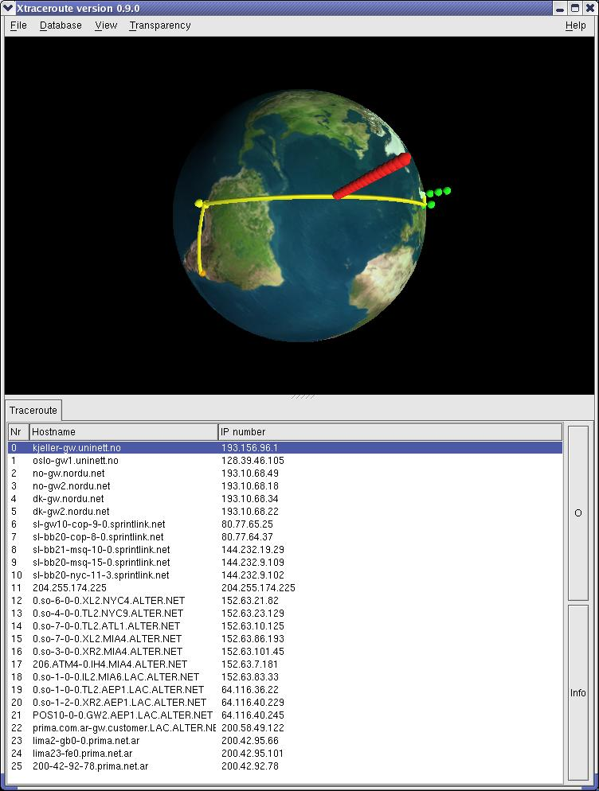
Why QoS?
”The demand for multimedia communication and the success of IETF audio/videocast will soon create an urgent requirement for resource reservation and control in the Internet.”
RE: ftp://ftp.isi.edu/int-serv/int-serv.mail
IntServ focused on real-time audio and video multicasting services.

Slide 5
Tasks in QoS management
Specification
  Set of QoS parameters differs
  Type (throughput, delay, jitter, …)
  Value/range of value
(Perceptual QoS)
User
(User QoS)
low, medium, high quality
media quality / media relation
throughput, delay, …
throughput, delay, …
Application
Operating System
(System QoS)
(Application QoS)
Application Subsystem
(Transport QoS)
Transport Subsystem
(Network QoS)
Networking System
QoS translation and distribution
QoS negotiation
  Admission control and policing
Resource allocation
Traffic control
  Packet Scheduling, classifying
QoS monitoring
Source: Tom Kristensen

Slide 6
IP overlay architecture
IP-link
C.b
B.a
A.a
C
b
A.c
c
a
a
b
a
B
d
c
b
A

Slide 7
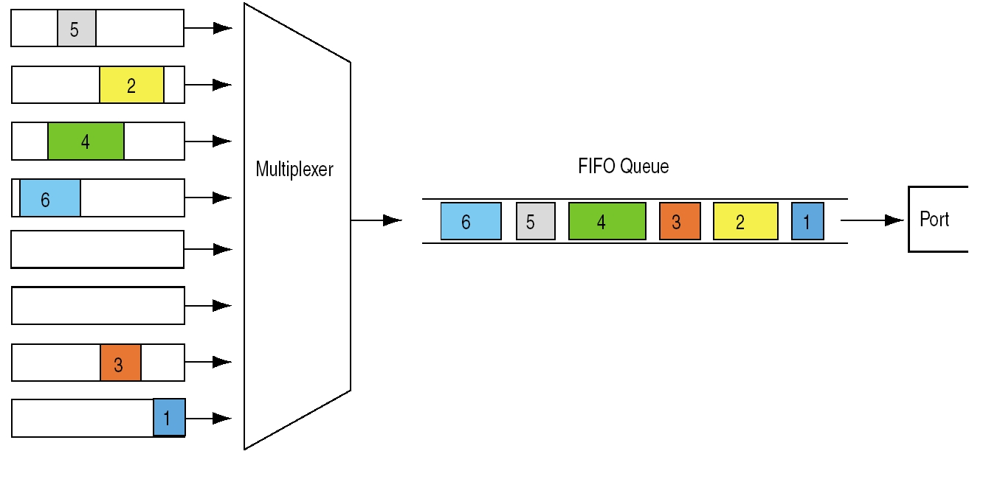
Current Best Effort (BE)
Adopted from www.juniper.net

Slide 8
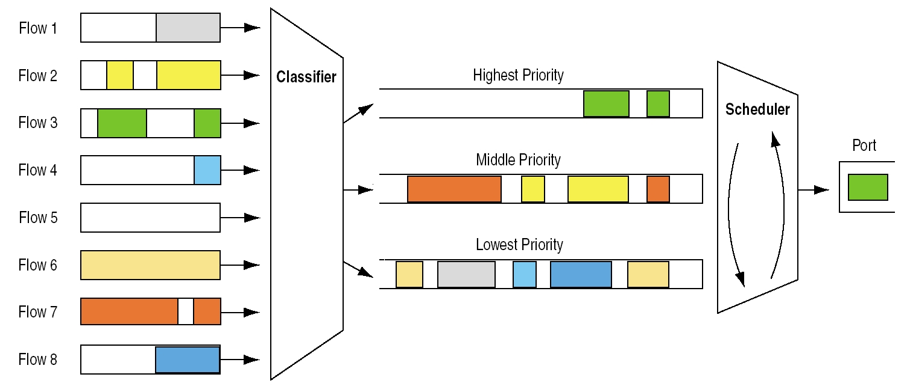
Separation of traffic flows
Similar to classifying
letters as ”A”, ”B”, or ”C”
Adopted from www.juniper.net

Slide 9
IETF concepts for Internet QoS
Best Effort (BE) and IntServ (Integrated Services) are two extremes.
  BE per-packet, IntServ per flow.
  DiffServ (Differentiated Services) per class, as aggregated flows.
IntServ
Increasing Cost
DiffServ
BE
Increasing Complexity

Slide 10
Integrated Services (IntServ)
Framework developed by IETF (RFC 1633)
Goal:
  Efficient Internet support for applications which require service guarantees
  Fulfill demands of multipoint, real-time applications for small and large group communication
  IntServ is based on per flow admission control and reservation
  RSVP (RFC 2205) is used as the reservation protocol relying on IP multicast
The IntServ/RSVP concept has scalability problems
  Necessity of per flow reservations/signaling in order to achieve strict guarantees
Notes:
The multicasts of IETF meetings across the Internet have formed a large-scale experiment in sending digitized voice and video through a packet-switched infrastructure. These highly-visible experiments have depended upon three enabling technologies. (1) Many modern workstations now come equipped with built-in multimedia hardware, including audio codecs and video frame-grabbers, and the necessary video gear is now inexpensive. (2) IP multicasting, which is not yet generally available in commercial routers, is being provided by the MBONE, a temporary "multicast backbone". (3) Highly-sophisticated digital audio and video applications have been developed.
These experiments also showed that an important technical element is still missing: real-time applications often do not work well across the Internet because of variable queueing delays and congestion losses. The Internet, as originally conceived, offers only a very simple quality of service (QoS), point-to-point best-effort data delivery. Before real-time applications such as remote video, multimedia conferencing, visualization, and virtual reality can be broadly used, the Internet infrastructure must be modified to support real-time QoS, which provides some control over end-to-end packet delays. This extension must be designed from the beginning for multicasting; simply generalizing from the unicast (point-to-point) case does not work.
In addition to this assumption of common infrastructure, we adopt a unified protocol stack model, employing a single internet-layer protocol for both real-time and non-real-time service. Thus, we propose to use the existing internet-layer protocol (e.g., IP or CLNP) for real-time data. Another approach would be to add a new real-time protocol in the internet layer [ST2-90]. Our unified stack approach provides economy of mechanism, and it allows us to fold controlled link-sharing in easily. It also handles the problem of partial coverage, i.e., allowing interoperation between IS-capable Internet systems and systems that have not been extended, without the complexity of tunneling.

Slide 11
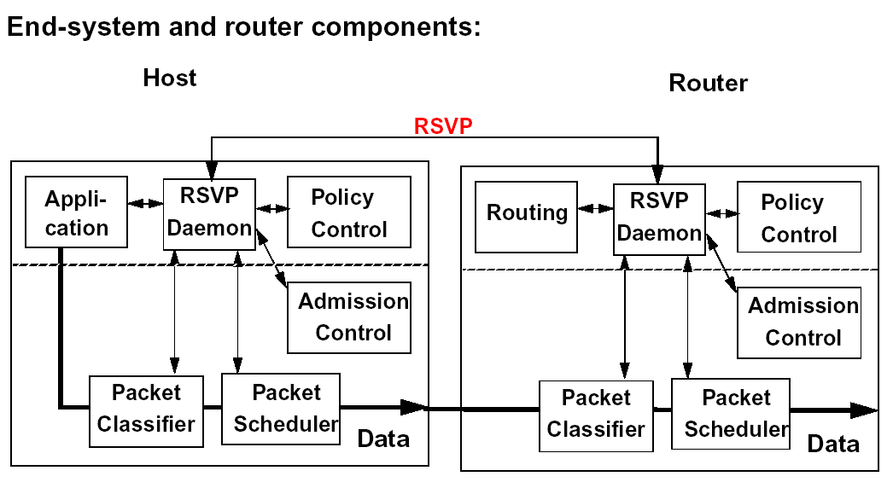
IntServ - Components
Admission control: implements the decision algorithm that a router or host uses to determine whether a new flow can be granted the requested QoS without impacting earlier guarantees.
Packet scheduler: manages the forwarding of different packets streams using a set of queues and perhaps other mechanisms like timers
Classifier: for the purpose of traffic control each incoming packet must be mapped into some class; all packets in the same class get the same treatment from the scheduler
Policy control: determines whether the user has administrative permission to make the reservation
Notes:
We propose a reference implementation framework to realize the IS model. This framework includes five components: the packet scheduler, the admission control routine, the classifier, policy control, and the reservation setup protocol.
Traffic control in turn is implemented by three components: the packet scheduler, the classifier, admission and policy control.
The packet scheduler manages the forwarding of different packet streams using a set of queues and perhaps other mechanisms like timers. The packet scheduler must be implemented at the point where packets are queued; this is the output driver level of a typical operating system, and corresponds to the link layer protocol. The details of the scheduling algorithm may be specific to the particular output medium. For example, the output driver will need to invoke the appropriate link-layer controls when interfacing to a network technology that has an internal bandwidth allocation mechanism.
For the purpose of traffic control (and accounting), each incoming packet must be mapped into some class; all packets in the same class get the same treatment from the packet scheduler. This mapping is performed by the classifier. Choice of a class may be based upon the contents of the existing packet header(s) and/or some additional classification number added to each packet. For example, backbone routers may choose to map many flows into a few aggregated classes, while routers nearer the periphery, where there is much less aggregation, may use a separate class for each flow.
Admission control implements the decision algorithm that a router or host uses to determine whether a new flow can be granted the requested QoS without impacting earlier guarantees. Admission control is invoked at each node to make a local accept/reject decision, at the time a host requests a real-time service along some path through the Internet.
Since it implies that some users are getting privileged service, resource reservation will need enforcement of policy and administrative controls. This in turn will lead to two kinds of authentication requirements: authentication of users who make reservation requests, and authentication of packets that use the reserved resources.

Slide 12
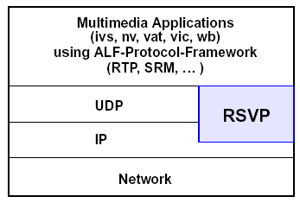
The RSVP Protocol
RSVP: Resource ReSerVation Protocol
  RFC2205 (September 1997)
  Part of Integrated Services (IntServ) framework of IETF
Contains:
  Only protocol elements for control and reservations
  Not for data transfer
Companion protocol to IP:
  Controls how IP sends a packet
  Resource reservation support
Notes:
This document defines RSVP, a resource reservation setup protocol designed for an integrated services Internet [RSVP93, RFC 1633]. The RSVP protocol is used by a host to request specific qualities of service from the network for particular application data streams or flows. RSVP is also used by routers to deliver quality-of-service (QoS) requests to all nodes along the path(s) of the flows and to establish and maintain state to provide the requested service. RSVP requests will generally result in resources being reserved in each node along the data path. RSVP requests resources for simplex flows, i.e., it requests resources in only one direction. Therefore, RSVP treats a sender as logically distinct from a receiver, although the same application process may act as both a sender and a receiver at the same time. RSVP operates on top of IPv4 or IPv6, occupying the place of a transport protocol in the protocol stack. However, RSVP does not transport application data but is rather an Internet control protocol, like ICMP, IGMP, or routing protocols. Like the implementations of routing and management protocols, an implementation of RSVP will typically execute in the background.
RSVP is not itself a routing protocol; RSVP is designed to operate with current and future unicast and multicast routing protocols. An RSVP process consults the local routing database(s) to obtain routes. In the multicast case, for example, a host sends IGMP messages to join a multicast group and then sends RSVP messages to reserve resources along the delivery path(s) of that group. Routing protocols determine where packets get forwarded; RSVP is only concerned with the QoS of those packets that are forwarded in accordance with routing

Slide 13
RSVP Attributes (Goals)
RSVP makes resource reservations for both unicast and multicast applications
RSVP adapts dynamically to changing group membership as well as changing routes
RSVP is simplex, i.e. makes reservations for unidirectional data flows
RSVP is receiver-oriented
RSVP maintains “soft” state in routers and hosts
RSVP provides several reservation styles for various applications
RSVP supports both IPv4 and IPv6
Notes:
In summary, RSVP has the following attributes:
RSVP makes resource reservations for both unicast and many-to- many multicast applications, adapting dynamically to changing group membership as well as to changing routes.
RSVP is simplex, i.e., it makes reservations for unidirectional data flows.
RSVP is receiver-oriented, i.e., the receiver of a data flow initiates and maintains the resource reservation used for that flow.
RSVP maintains "soft" state in routers and hosts, providing graceful support for dynamic membership changes and automatic adaptation to routing changes.
RSVP is not a routing protocol but depends upon present and future routing protocols.
RSVP transports and maintains traffic control and policy control parameters that are opaque to RSVP.
RSVP provides several reservation models or "styles" (defined below) to fit a variety of applications.
RSVP provides transparent operation through routers that do not support it.
RSVP supports both IPv4 and IPv6.

Slide 14
Hard State vs. Soft State
Hard state:
  Connection setup
  Network is responsible for availability and actuality of state inside network
  Error handling mechanisms for reliability necessary inside network
  Network components relatively complex
Soft state:
  Endsystems are responsible for availability and actuality of state inside network
  Endsystems must periodically refresh reservation state
  Route changes
  Next refresh message creates reservation state on new route
  No reservation in meantime
  Network components relatively simple
Notes:
There are two different possible styles for reservation setup protocols, the "hard state" (HS) approach (also called "connection-oriented"), and the "soft state" (SS) approach (also called "connectionless"). In both approaches, multicast distribution is performed using flow-specific state in each router along the path. Under the HS approach, this state is created and deleted in a fully deterministic manner by cooperation among the routers. Once a host requests a session, the "network" takes responsibility for creating and later destroying the necessary state. ST-II is an example of the HS approach [ST2-90]. Since management of HS session state is completely deterministic, the HS setup protocol must be reliable, with acknowledgments and retransmissions. In order to achieve deterministic cleanup of state after a failure, there must be some mechanism to detect failures, i.e., an "up/down" protocol. The router upstream (towards the source) from a failure takes responsibility for rebuilding the necessary state on the router(s) along an alternate route.
RSVP takes the SS approach, which regards the reservation state as cached information that is installed and periodically refreshed by the end hosts. Unused state is timed out by the routers. If the route changes, the refresh messages automatically install the necessary state along the new route. The SS approach was chosen to obtain the simplicity and robustness that have been demonstrated by connectionless protocols such as IP [Clark88].

Slide 15
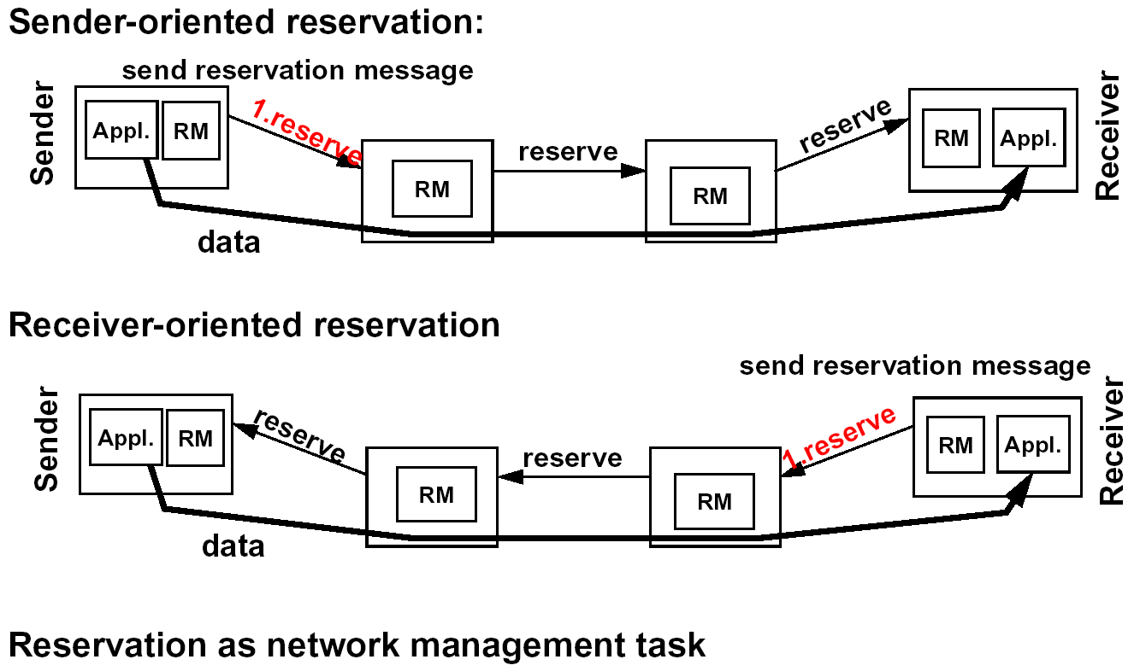
Reservation Directions - Comparison
Sender oriented – sender initiates reservation setup:
Sender must know target addresses
Sender has knowledge about participating receivers
Can lead to substantial management workload at sender if many receivers
Scalability restricted to small-to-medium size receiver groups
Receiver oriented – receiver initiates reservation setup:
Receivers need information about flow characteristics for effective reservations
Advertisement before reservation
Receiver must know flow ’addresses’
Sender has no knowledge of participating receivers
Notes:
An important design question is whether senders or receivers should have responsibility for initiating reservations. A sender knows the qualities of the traffic stream it can send, while a receiver knows what it wants to (or can) receive. Perhaps the most obvious choice is to let the sender initiate the reservation. However, this scales poorly for large, dynamic multicast delivery trees and for heterogeneous receivers.
Both of these scaling problems are solved by making the receiver responsible for initiating a reservation. Receiver initiation handles heterogeneous receivers easily; each receiver simply asks for a reservation appropriate to itself, and any differences among reservations from different receivers are resolved ("merged") within the network by RSVP. Receiver initiation is also consisent with IP multicast, in which a multicast group is created implicitly by receivers joining it.
Although receiver-initiated reservation is the natural choice for multicast sessions, the justification for receiver initiateion may appear weaker for unicast sessions, where the sender may be the logical session initiator. However, we expect that every realtime application will have its higher- level signalling and control protocol, and this protocol can be used to signal the receiver to initiate a reservation (and perhaps indicate the flowspec to be used). For simplicity and economy, a setup protocol should support only one direction of initiation, and, and receiver initiation appears to us to be the clear winner.
RSVP uses receiver-initiation of rservations [RSVP93b].

Slide 16
RSVP Reservation Procedure
”Agents” reserve network resources along the subnet leading toward the receiver and then use the path state to propagate the reservation request toward the group sender.
A reservation consists of two distinct components – flowSpec and filterSpec
1. Each receiver must first join a multicast group (outside the scope of RSVP)
2. PATH message is sent to the members of the group (marked in red)
sender
router
router
receiver
router
receiver
Each receiver initiates its own reservation request sending RESV message stating its QoS needs
receiver
Notes:
Creating reservation state
Source:
Multicasts data flows
Sends PATH message periodically
PATH message contains (Prev. hop IP, FilterSpec, Tspec, [AdSpec])
Receiver:
Joins multicast group (this process is decoupled from RSVP)
Receives PATH messages
Determines own QoS requirements (using received TSpec)
Sends RESV message back to sender using path established by PATH message
RESV message contains (FlowDesc, ReservationStyle, …)
PATH message indicating session parameters (sent to complete group)
Reservation message (RESV) from receivers to sender
Use route defined through PATH messages
Receiver-initiated reservation
Routers reserve resources based on RESV messages
Maintaining reservation state
Periodic refresh of ‘soft-state’ via transmission of
PATH message from senders
RESV message from receivers
Reservations are only valid for a certain time and will timeout if a refresh is not received
Source not restricted from transmitting data at any time
Packets may go across unreserved routes
Forwarding protocol must be aware of relation between packets and reserved resourcesPaths and/or reservations can be explicitly torn down by teardown messages

Slide 17
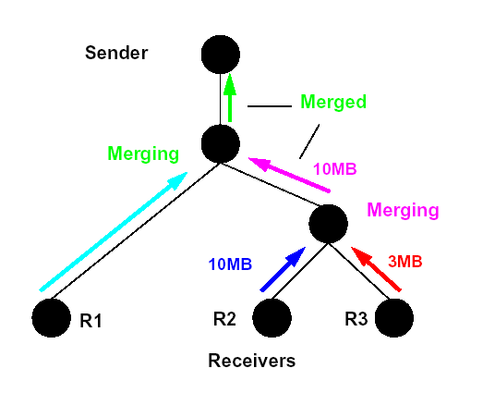
RSVP Messages Merging
Depending on the reservation style in use several RESV messages can be merged when traveling towards sender
For WF and SE style the amount of resources reserved is the largest of the received requests
For FF style it is the sum of all resources requested
PATH messages are also merged so no more than one message is sent down a link during each refresh period

Slide 18
RSVP Reservation Styles
Wildcard Filter Style
  Any source can deploy a wild card reservation – intended for audio conferencing
Shared Filter Style
  Specifies a shared group of senders that can use the reservation – can be changed during lifetime assuming that sufficient resources are allocated for worst case scenario
Fixed Filter Style
  A dedicated (separate) reservation for each source – cannot be changed during its lifetime
 | Reservations
Sender selection | Distinct | Shared
Explicit | Fixed filter (FF) | Shared explicit (SE)
Wildcard | NA | Wildcard filter (WF)

Slide 19
Wildcard Filter
Incoming
interface
S1
R1
a
c
S2
b
d
R2
S3
Outgoing
interface
R3
Si = sender i
Ri = recevicer i
Sends | Reserves | Receives
WF(* {4B}) on a | * {4B} on c | WF(* {4B}) on c
WF(* {4B}) on b | * {3B} on d | WF(* {3B}) and WF(* {2B}) on d

Slide 20
Shared Filter
Incoming
interface
S1
R1
a
c
S2
b
d
R2
S3
Outgoing
interface
R3
Si = sender i
Ri = recevicer i
Sends | Reserves | Receives
SE(S1{3B}) on a | (S1,S2){B} on c | SE((S1,S2){B}) on c
SE((S2,S3){3B}) on b | (S1,S2,S3){3B} on d | SE((S1,S3){3B}) and SE(S2{2B}) on d

Slide 21
History of Differentiated Services
Second attempt to support Quality of Service
IETF (Internet Engineering Task Force) started the work developing DiffServ July 1997 which by two years later culminated in the key description documents:
  RFC 2474 - Definition of the Differentiated Service Field (DS Field) in the IPv4 and IPv6 Headers
  RFC 2475 - An Architecture for Differentiated Services

Slide 22
Motivation and goals for DiffServ
“The scalability of RSVP is the problem to be solved”
“High reliable IP service is the key target”
“Low-delay service is also important”
“The core network mechanism should allow the implementation of any imaginable service”
“Simplicity - the overall system or parts of it should not rely on signalling of individual flows”
“No QoS requirements are exchanged between source and destination”

Slide 23
Considerations of QoS
There are three customer/network service categories:
Quantitative service:
  packet-loss ratio should (always) be less than 5%
Qualitative service:
  packet-loss ratio should be moderate, which could mean that it is less than 5% most of the time, but during busy hours it can be higher
Relative service:
  packet-loss ratio of this traffic class should be smaller than that of any other traffic class with lower importance
DiffServ belongs more or less to the relative model
  with the possible exception of one service class with high quality

Slide 24
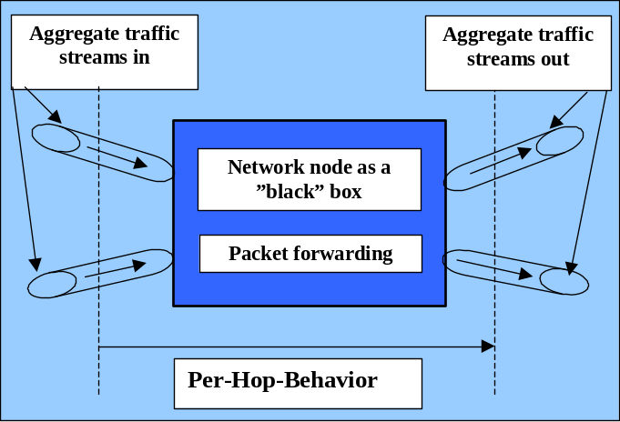
Differentiated Services - DiffServ
DiffServ divides traffic into a small number of groups called forwarding classes.
Each packet is encoded according to the forwarding class.
Each forwarding class represents a predefined forwarding treatment in terms of drop priority and bandwidth allocation – this behavior is defined by a PHB (Per-Hop-Behavior).
PHB is the means by which a node allocates resources to aggregated flows, but it more difficult to see how this allows constructing predictable services.

Slide 25
DiffServ fits the need of ISPs
For the ISPs to deploy QoS, they have to spend money to upgrade routers, management and operations.
  There is no guarantee of increased revenues.
If ISP could deploy QoS mechanisms, but only turn them on for applications they sell, they can price the service.
DiffServ can be implemented gradually (compared to IntServ).
DiffServ fits to ISPs need for differentiating costumers

Slide 26
DiffServ architecture
customer network
customer network
SLA
SLA
Boundary node
Boundary node
Interior node
Interior node
Interior node
Interior node
Boundary node
Boundary node
customer network
SLA
SLA
customer network
SLA – Service Level Agreement

Slide 27
Traffic Classification & Conditioning
Boundary node
Meter
Classifier
Marker
Shaper/
Dropper
Note, however, that there is no ”rule” for classification – it is up to the network provider.
Traffic conditioning

Slide 28


Metering
Service classes use token bucket to police a packet flow:
  Packets need a token to be forwarded
  Each router has a b-sized bucket with tokens: if bucket is empty, one must wait
  New tokens are generated at a rate r and added: if bucket is full (little traffic), the token is deleted
  The token generation rate r serves
  to limit the long term average rate
  The bucket size b serves to limit the
  maximum burst size
token generation
bucket
token wait queue
Source: Carsten Griwodz

Slide 29
Traffic Shaping
In stead of re-marking a packet to a lower level, an alternative is to shape the traffic flow in such a way that re-marking/dropping is not necessary
Shaping is something done to reduce traffic variations, and by that means improve the treatment inside the network
It is not clear at all whether it is practical to delay packets to smooth a traffic process - the delay may have implications in other areas of the network (only local benefit)
Traffic shaping of a MPEG-coded video stream
bit rate
4.0
3.0
2.0
1.0
0.0
original
shaped
time

Slide 30
Interior Nodes
Classification and conditioning are typically done at the boundary of the networks.
Core routers have a high number of flows.
High bandwidth (compared to edge nodes)
Main tasks:
  Queuing
  Forwarding
customer network
customer network
Boundary node
Boundary node
Interior node
Interior node
Interior node
Interior node
Boundary node
Boundary node
customer network
customer network

Slide 31
Queuing Schemes
Target for quality differentiation of CBQ
Class-Based-Queuing (CBQ)
The idea is that a group of users should not utilize the whole capacity even though the application they are using needs high quality
It is not possible to state that the packet-loss ratio in Class 1 is always lower than in Class 2
Without additional traffic controlling mechanisms (admission control) CBQ will behave as a relative QoS model
Delay variation
pr node (ms)
1
Class 1
10
Class 2
Class 3
100
1
10⁻⁴
10⁻⁸
Packet loss
ratio

Slide 32
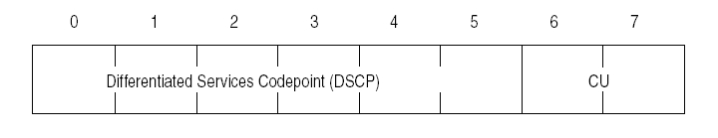
Per-Hop Behaviors (PHBs)
Externally observed forwarding treatments at a single node are described by the PHB.
Each PHB is represented by a 6-bit Differentiated Service codepoint (DSCP).
PHBs are the basic building blocks for resource allocation to receive the same forwarding treatment.
ToS – field in IPv4

Slide 33
DiffServ Codepoint (DSCP) to Select PHB
Boundary router:
use header fields to lookup right DSCP and mark packet
interior routers
Interior router:
use PHB according to
DSCP to forward packet
fast and scalable due
to simple interior routers

Slide 34
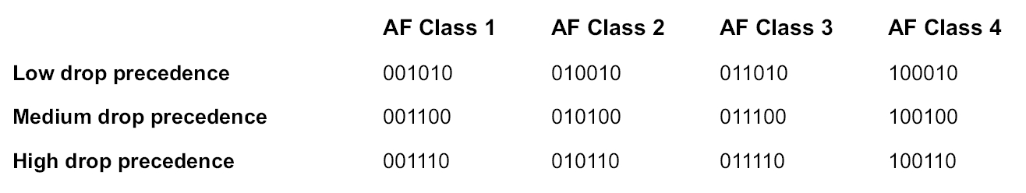
Assured Forwarding (AF) PHB
Four forwarding classes are defined, within each class three drop precedences are specified
Each class is allocated a minimum amount of buffer and bandwidth.
Drop precedence is used for selecting which packet to drop during congestion.

Slide 35
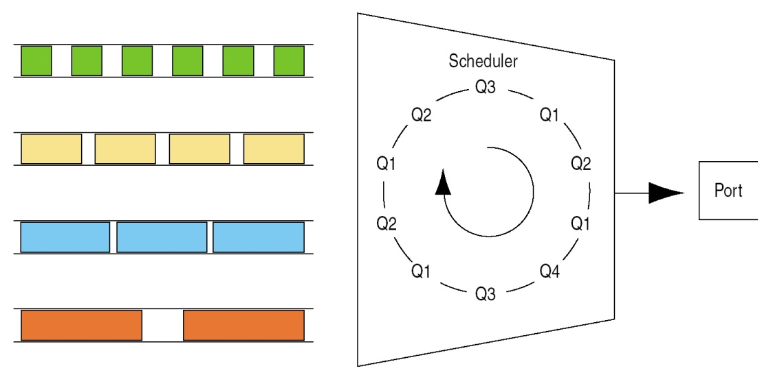
AF PHB – implementation example
Four AF classes,
min. bandwidth of 2, 4, 8, and 16 Mbps
WFQ – implementation with four queues and a scheduler with weights 1, 2, 4, and 8.
Each queue should have three drop precedences.
WFQ – Weighted Fair Queuing
Adopted from www.juniper.net

Slide 36
Packet dropping
Random Early Detection (RED)
The idea behind RED is to drop packets even before the buffer becomes full to control the incoming bit rates
In principle, under a certain queue length (load level), all packets are accepted. As buffer starts to fill up packets are dropped
It is desirable that only one packet per flow is dropped and that drops do not occur exactly at the same time
RED was introduced to alleviate the shortcomings of pure FIFO queuing effect on TCP traffic
Packet discarding
probability
1
Tail dropping
When buffer
Is full
0
Queue length
RED
region

Slide 37
Packet dropping
Packet discarding
probability
RED with Several Levels of Importance
The RED concept can be generalized to handle several levels of importance
The thresholds of dropping are based on probabilistic discarding function
RED is also recommended for the dominant service class of the Internet- that is, for best-effort with a majority of flows using TCP congestion control
1
Tail dropping,
lower level
Tail dropping,
higher level
RED,
lower
level
RED,
higher
level
0
Load level
RED
regions

Slide 38
Expedited Forwarding (EF) PHB
In EF PHB the departure rate from any DiffServ node must equal or exceed a configurable rate.
Guarantee - independent of the intensity of any other traffic.
EF is designed to provide
  low delay
  low jitter
  assured bandwidth
  low loss
Definition similar to AF PHB. However: implicitly assumed that EF traffic can preempt other traffic.

Slide 39
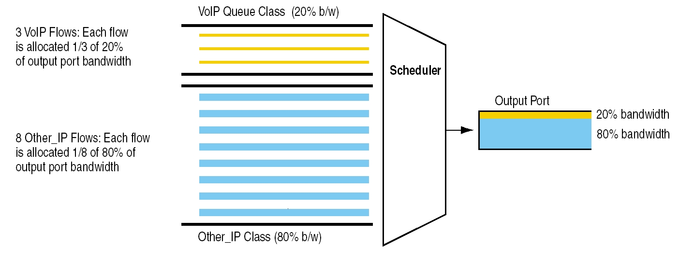
EF PHB – An example
Adopted from www.juniper.net

Slide 40
Admission control is necessary to avoid degrading the QoS of existing flows
The “traditional” approach (e.g., IntServ):
Explicitly check for sufficient resources at each router along the path (using RSVP).
  Problem: Scalability
By not actively involving the core routers in the admission process, the scalability problem can be avoided, e.g.:
  Bandwidth Brokers (BB)
  Endpoint admission control

Slide 41
Combing DiffServ with RSVP
Customer Network 1
ISP – Internet Service Provider
Customer Network 2
2
3
4
CN1-BB
ISP1-BB
CN2-BB
7
6
6
ER1
BR1
BR2
ER2
1
12
5
8,9
10
11
13
14
Host S
CORE ROUTER
Host D
BB: Bandwidth Broker – admission control unit
BR: Boundary Router
ER: Edge Router

Slide 42
Summary
QoS control is an essential element of multimedia networking and future convergence
IntServ – RSVP
  Flow aware QoS concept relying on admission control and reservations
  Scalability problems due to the per flow signalling and reservation
DiffServ
  Gradual implementation
  Fits with the needs of ISPs
But, still we do not have much experience with deployment of Internet QoS …

