Slide 1
V-Menu
Team Two

Slide 2

TEAM Members
Matthew Boyette – Lead Developer
David Hughes – Lead Designer
William Mejia – Developer
Demetrius Myers – Developer
Slaven Popadic – Developer

Slide 3
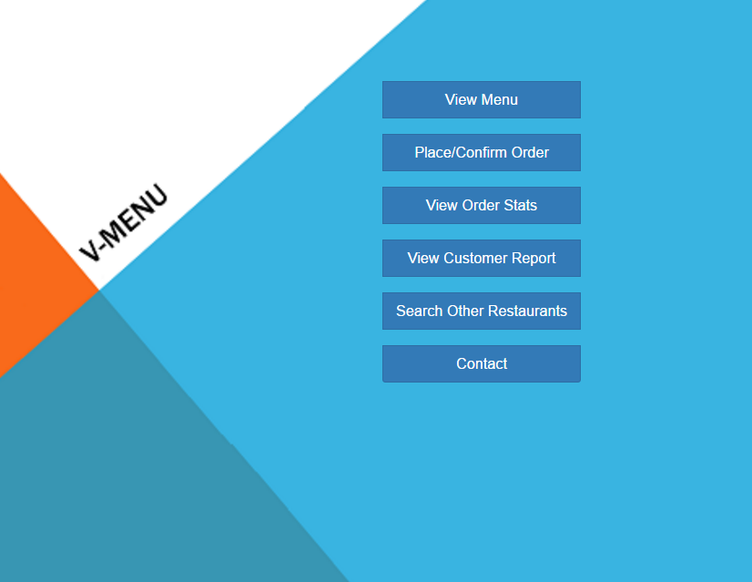

Slide 4
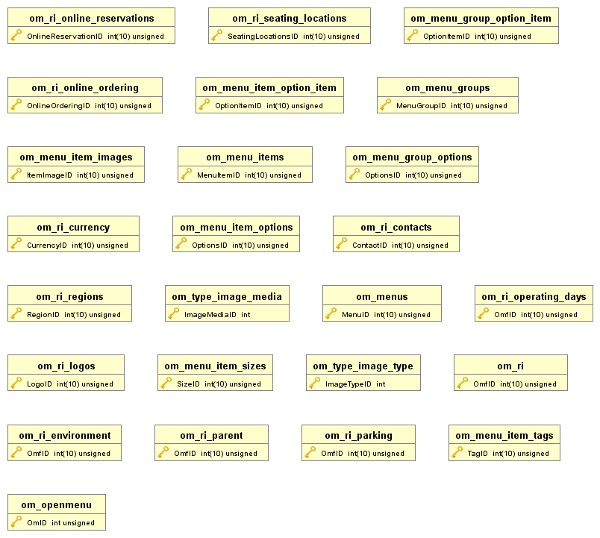

Slide 5
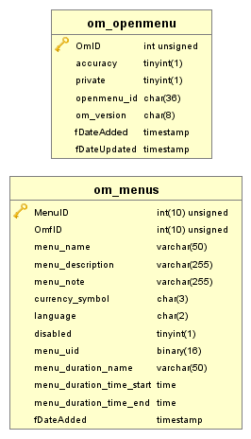

Slide 6
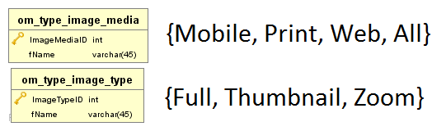

Slide 7
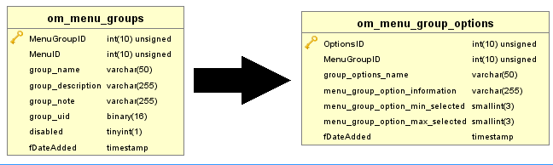
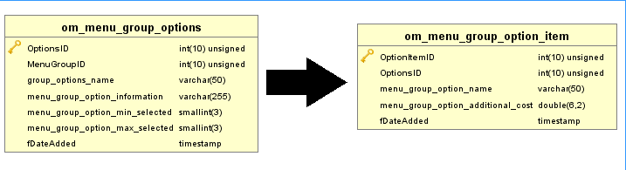

Slide 8
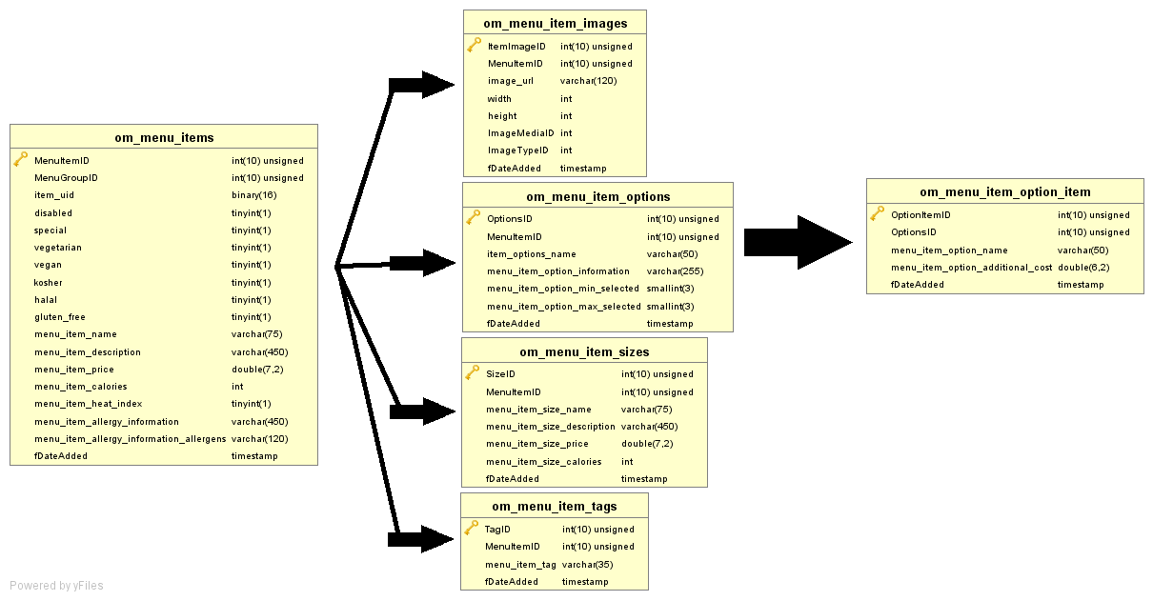

Slide 9
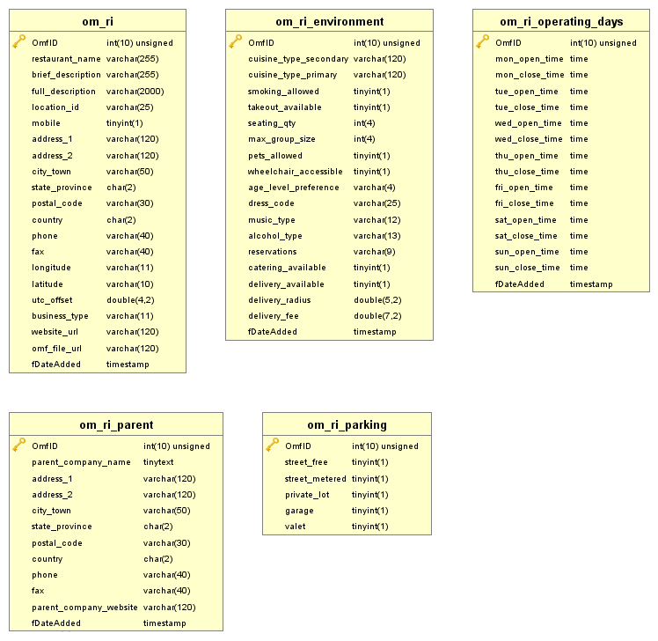

Slide 10
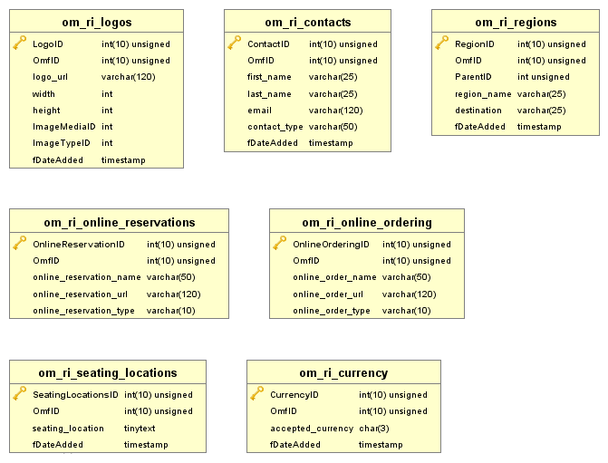

Slide 11
Trade Offs
-Need wireless access to use application
-Sacrifice in performance in favor of updates
-Potential lack of IT personal
-Single-pointed failure
-Investment

Slide 12


