Slide 1
V-Menu
Team Two

Slide 2

TEAM Members
Matthew Boyette – Lead Developer
David Hughes – Lead Designer
William Mejia – Developer
Demetrius Myers – Developer
Slaven Popadic – Developer

Slide 3

Why v-menu
Convenience
Speed
Control
Customer Satisfaction
Efficient
Modern
Privacy

Slide 4
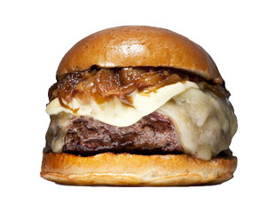
Convenience & Speed
Your order history is available to you and you can simply
reorder your favorite item in a couple of clicks !!
Fast and easy
for
Customers
And
Staff

Slide 5

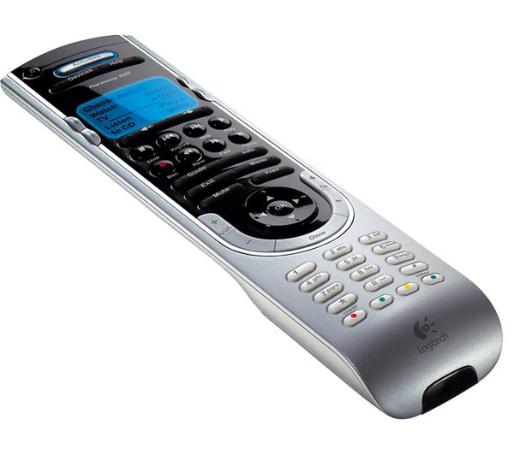
Control & customer satisfaction
The customer is in full control of the order and ordering process

Slide 6
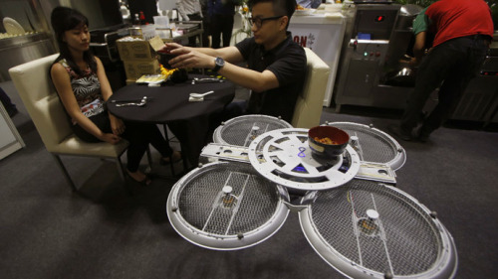
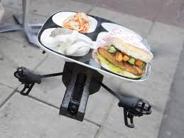
Efficient & modern
A system that is able to move efficiently with the times.
Drone servers?

