Slide 1
SQL to XML Converter
MATTHEW BOYETTE, ERIC GURVITZ,
MERRILLEE PALMER, TERRY SANTILLI,
JOHN SCHUMM

Slide 2
SQL to XML Conversion
SQL – Structured Query Language
Tabular data - information contained in matrix.
XML – Extensible Markup Language
Tags/Values - information contained in hierarchical entities.
SQL is great for working with data, but XML is better suited for long-term storage. XML is often used as a transport format in configuration files and inter-process communication.

Slide 3
XML Paradigm
Use of tags
Each entry must contain both a start and end tag
Ex: <StudentName> Harry Potter </StudentName>
Well Formed Grammar
Case Sensitive

Slide 4
Multiple Platform Support
We support two relational database systems.
Oracle
Used the JAG database and table from Assignment 5 for testing.
MySQL
Also maintained by Oracle. Free and open source. Other compatible open source derivatives include MariaDB.
Recreated JAG database and Faculty table from Assignment 5 for testing.
Table names are case sensitive.
You can switch between the two modes seamlessly and easily during program execution. You can also provide a customer server address, port, database name, username, and password. All of the relevant global program settings can be altered at runtime.

Slide 5
Assumptions
Query may or may not be in valid SQL
Renaming using AS is valid SQL
+ is used for compression
< and > are used to denote grouping

Slide 6
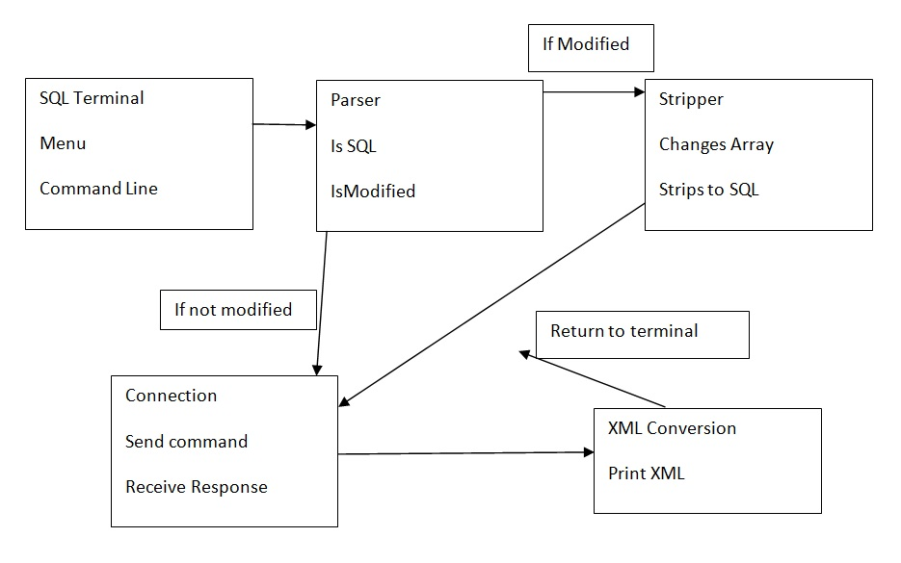
Approach

Slide 7
Classes and Methods
SQL Terminal
Utility
Stripper
Language Converter
PL SQL 2 XML Converter
Selected Element/ Listener
Table Listener
Server Settings

Slide 8
DTD
Document Type Definition
File that describes the XML elements
Defines Syntax rules
Defined valid XML tags

Slide 9
Lexer/Parser
ANTLR v4.5.3 - Another Tool for Language Recognition
Java alternative to Lex/YACC .
Bottom-Up, LR(k) Parsing Algorithm
Two Grammars
Unmodified PL/SQL
Modified PL/SQL
Algorithm: parse as PL/SQL; if error, then parse as modified PL/SQL; if error, then reject input string.

Slide 10
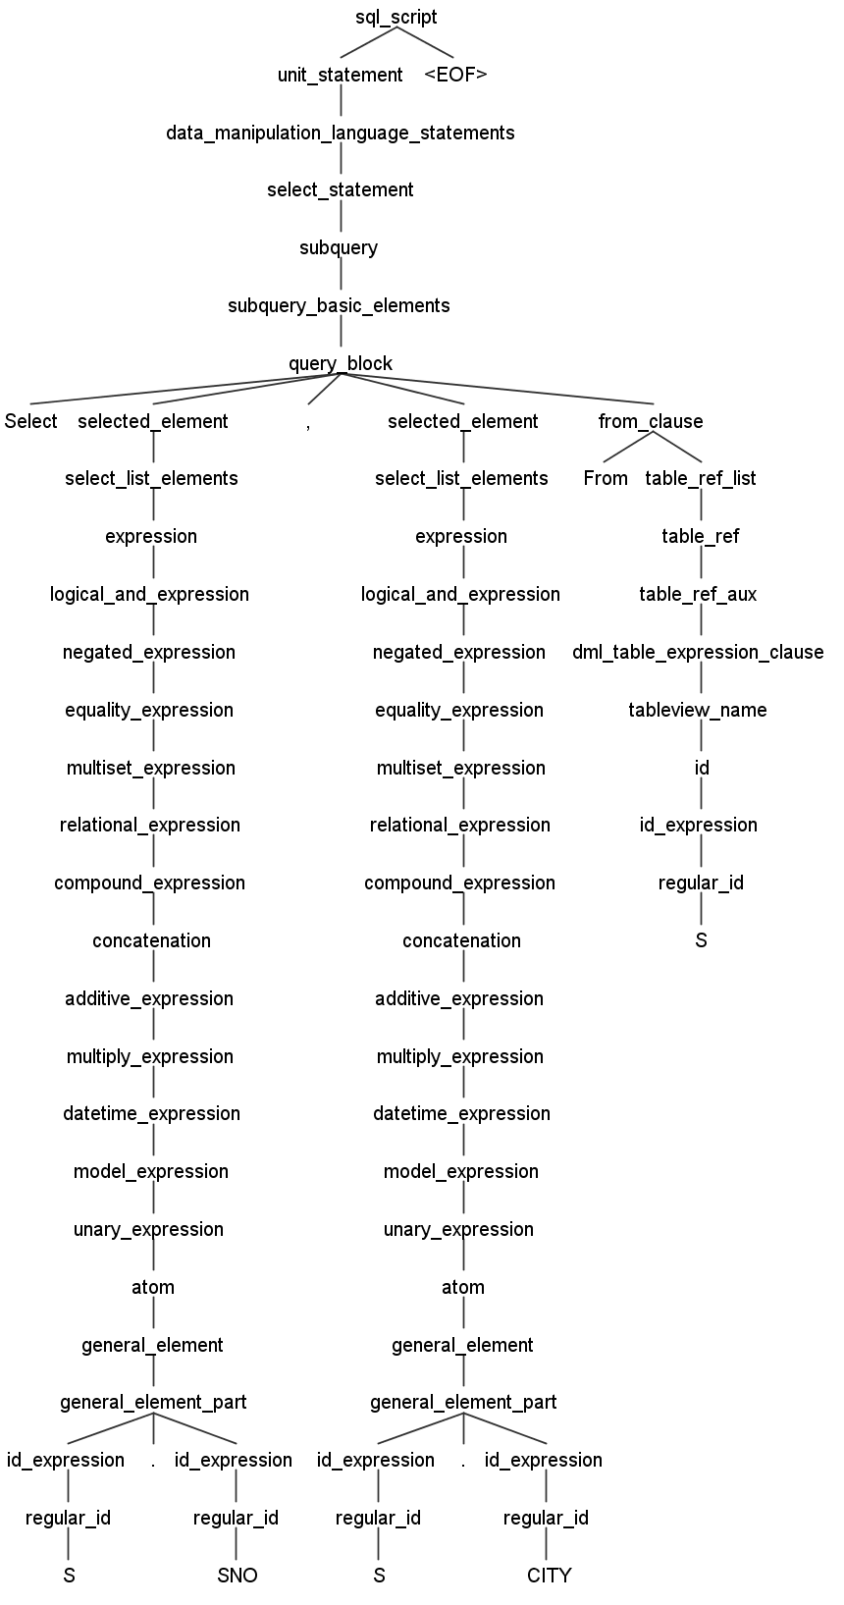
Example Query Parse Tree 1
SELECT S.SNO, S.CITY
FROM S

Slide 11
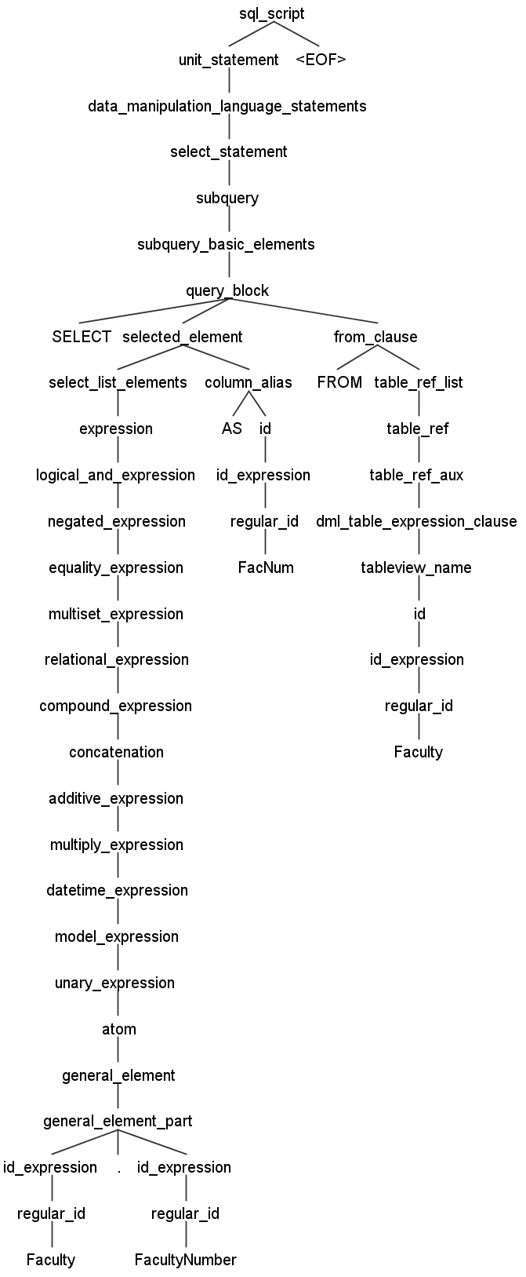
Example Query Parse Tree 2
SELECT Faculty.FacultyNumber
AS FacNum
FROM Faculty

Slide 12
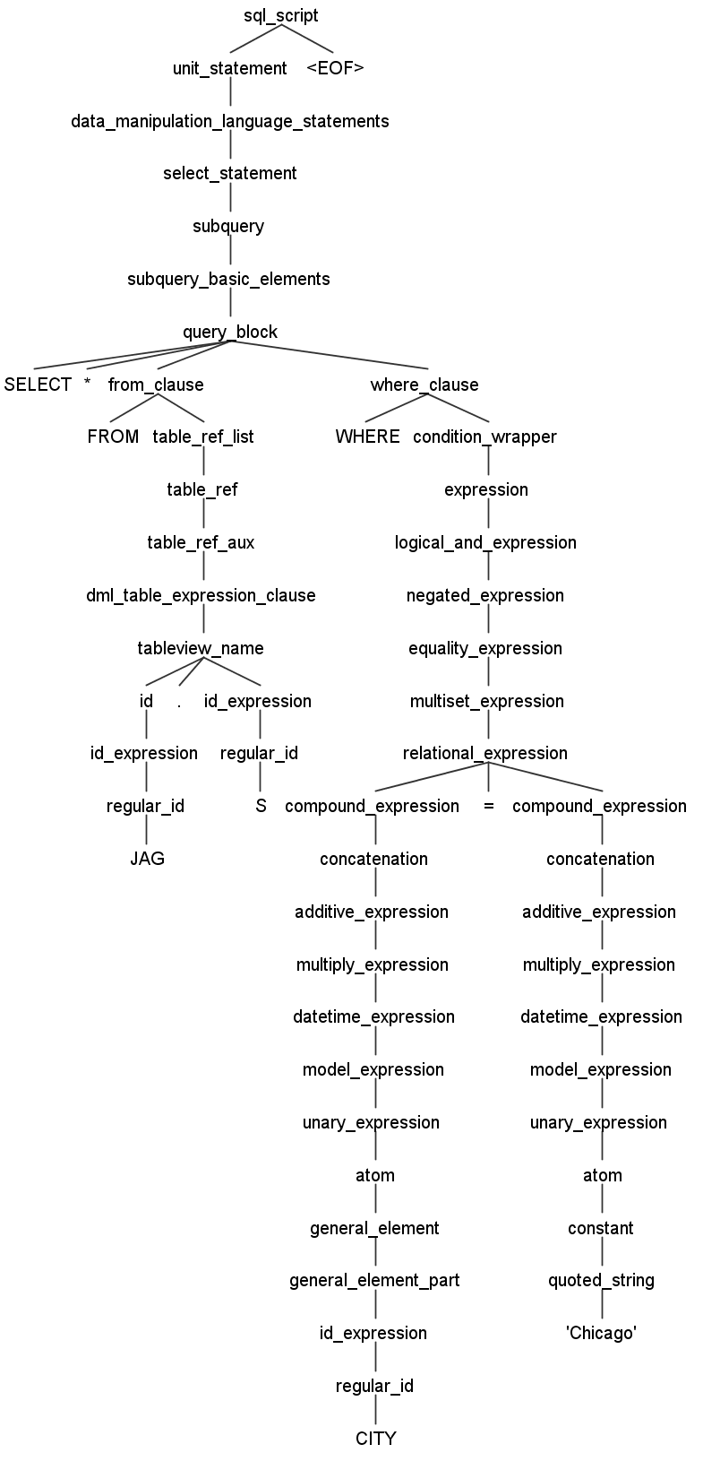
Example Query Parse Tree 3
SELECT *
FROM JAG.S
WHERE CITY = 'Chicago'

Slide 13
Software Implementation
Java
Modular approach

Slide 14
Database Connectivity
Our program connects to the database, executes the input query (which does not necessarily have to be a SELECT statement), caches the result in a CachedRowSet object, and then disconnects from the server. All remaining operations occur on cached data. When a new String is to be processed, a new object is created to handle it. For especially large tables, the XML conversion process could be lengthy. Therefore we don’t want to have to stay connected to the server the entire time.

Slide 15
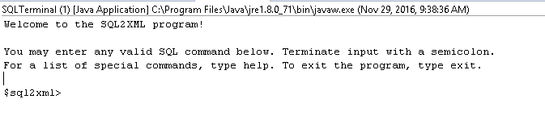
Menu Display

Slide 16
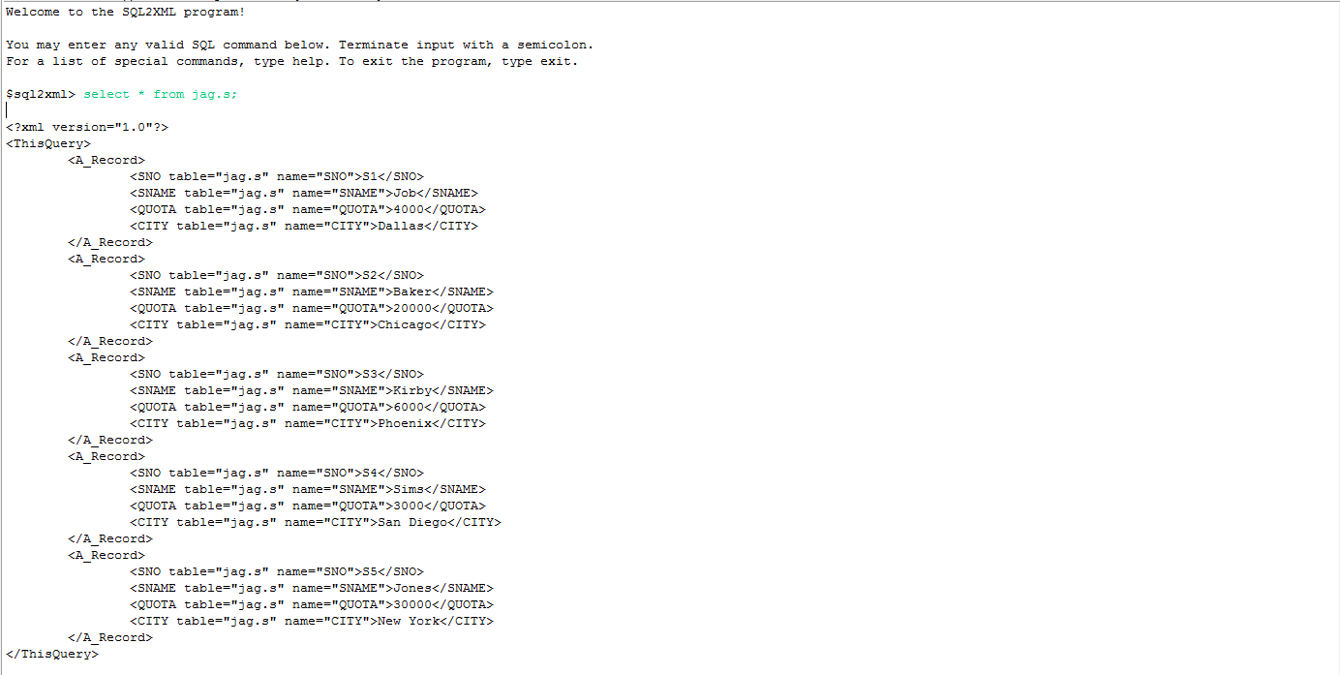
Displays and Results

