Slide 1

SCRUM LORDS

Slide 2

SONARQUBE DOCUMENTATION
SonarQube is a Code Quality Assurance tool that collects and analyses source code and generates reports on the code quality of your project. It integrates static and dynamic analysis technologies, allowing for continuous quality measurement across time. SonarQube inspects and evaluates everything from small stylistic choices to design mistakes.
This gives users with a comprehensive searchable history of the code, allowing them to evaluate where the code is going wrong and decide whether it is due to style issues, code failures, code duplication, a lack of test coverage, or too complex code.
The software analyses source code from many perspectives and drills down the code layer by layer, ranging from the module level to the class level, with each level returning metric values and data that should show problematic regions in the source code that require modification.

Slide 3
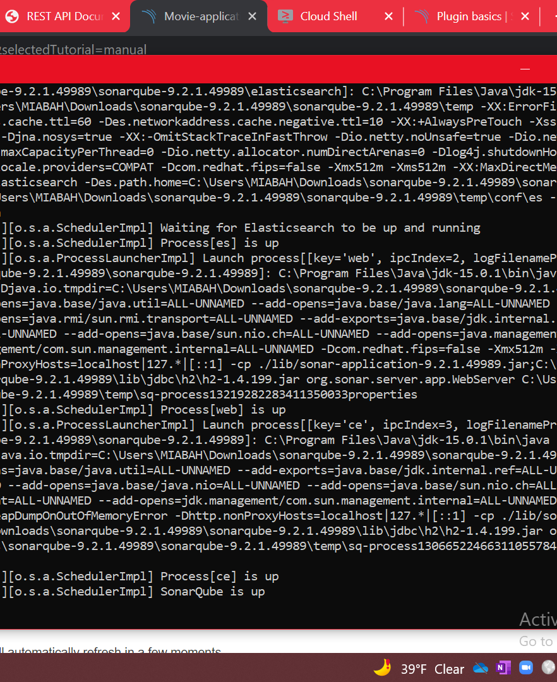
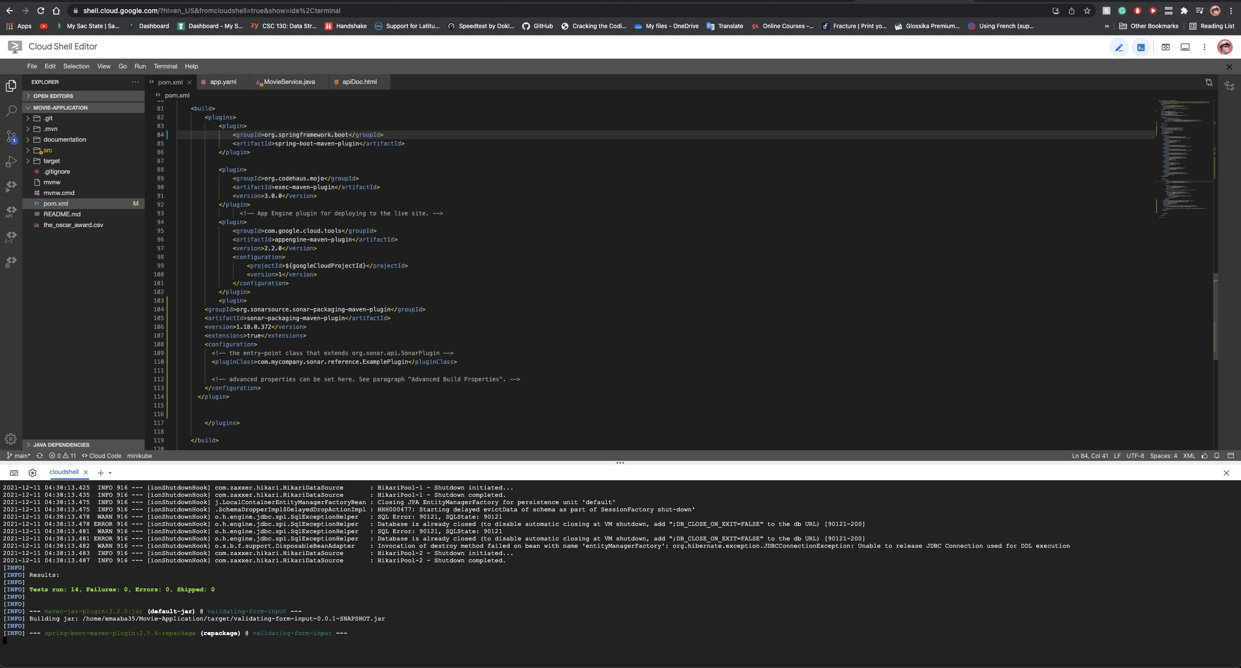
SONARQUBE
Install and Running SonarQube and Sonar-Scanner
Connectivity Sonar to local host (http://localhost:9000/)

Slide 4
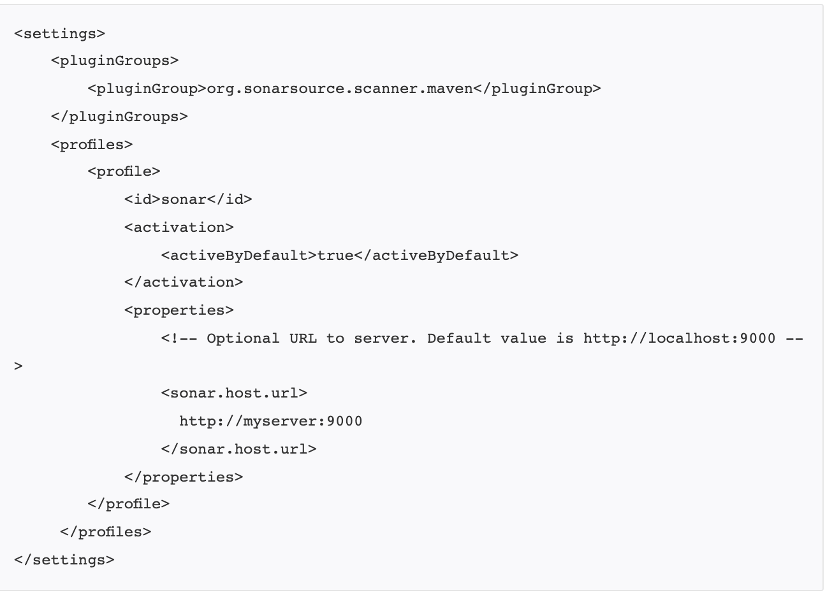
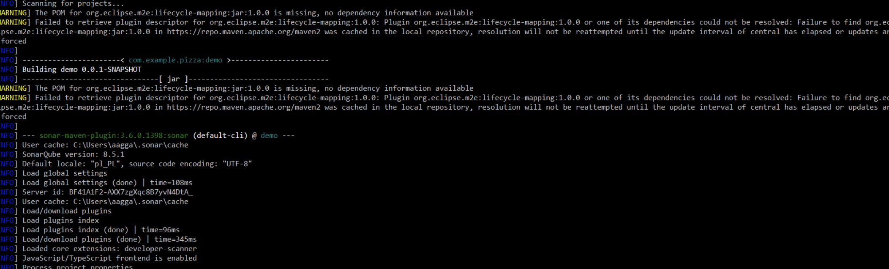
pom.xml
Sonar Running Screen Shots

