Slide 1
P300
Integrative Theory on P3a and P3b
Presented by:
Mamtha K

Slide 2
p300
P300 Signal is an event related potential(ERP),meaning that the signal is seen on a EEG as a rapid single potential change as a response to a sensory, cognitive or motor event.
It is the generation of a neuroelectric event linked to attention and memory-related operations which might be caused by brain mechanisms engaged to inhibit extraneous brain activation.
The P300 is produced by a distributed network of brain processes associated with attention and memory operations.
P300 signals could occur from the initial need to enhance focal attention during stimulus detection relative to the contents of working memory
The P300 was first reported 40 years ago.
The Signal’s peak comes an average of 300ms after or “post” the stimuli.
P300 is used to refer to the canonical ERP component, which also is called the “P3” or the more nebulous “late positive component”(LPC).
There are 2 subcomponents:
P3a
P3b

Slide 3
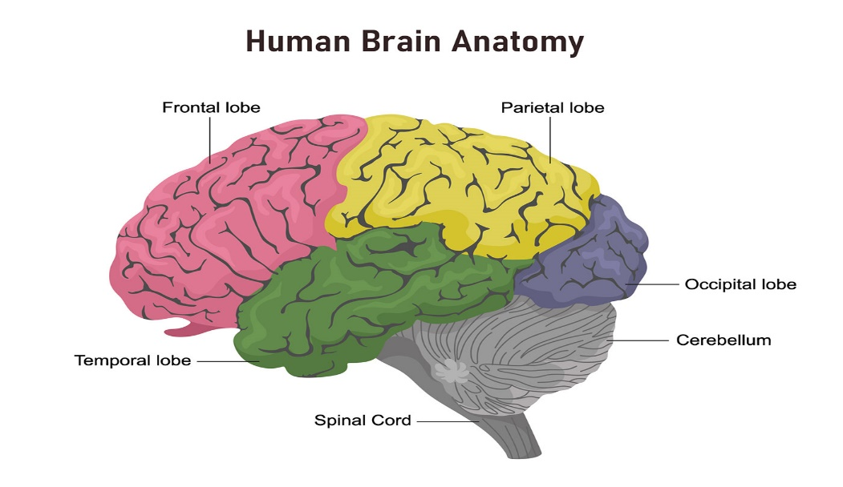
P3a originates from stimulus driven frontal focal attention and working memory mechanisms during task processing mediated by dopaminergic activity.
P3b originates from temporal-parietal activity associated with attention and appears related to subsequent memory processing where dense norepinephrine inputs are found .
Infrequent distinct tone presented in a series of frequent tones without a task can produce a positive-going waveform having a central/parietal maximum amplitude distribution and relatively short peak latency. This component was dubbed the “P3a” to distinguish it from the task-relevant “P3b” potential elicited during target stimulus processing.
Several ERPs have been reported that appear related to the P3a. These components are elicited by an infrequent distracter stimulus inserted randomly into the target/standard sequence.

Slide 4
FEW DEFINATIONS:
Amplitude (μV) is defined as the difference between the mean prestimulus baseline voltage and the largest positive-going peak of the ERP waveform within a time window (e.g., 250–500 ms, although the range can vary depending on stimulus modality, task conditions, subject age, etc.).
Latency (ms) is defined as the time from stimulus onset to the point of maximum positive amplitude within a time window.
P300 scalp distribution is defined as the amplitude change over the midline electrodes (Fz, Cz, Pz), which typically increases in magnitude from the frontal to parietal electrode sites.

Slide 5
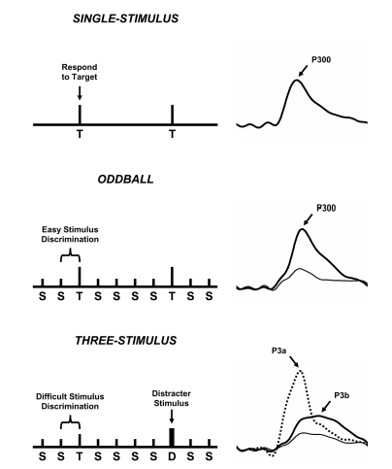
VARIANTS of ODDball task

Slide 6
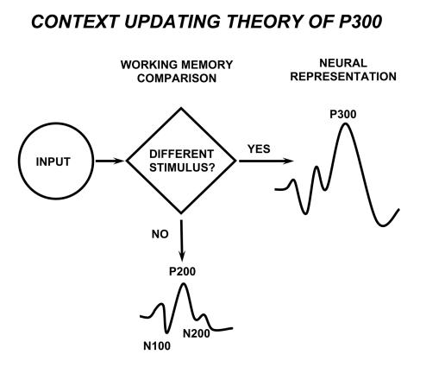
Stimuli enter the processing system and a memory comparison process is engaged that ascertains whether the current stimulus is either the same as the previous stimulus or not.
In the oddball task, whether a standard or a target stimulus was presented.
If the incoming stimulus is the same, the neural model of the stimulus environment is unchanged, and sensory evoked potentials (N100, P200, N200) are obtained after signal averaging.
If the incoming stimulus is not the same and the subject allocates attentional resources to the target, the neural representation of the stimulus environment is changed or updated, such that a P300 (P3b) potential is generated in addition to the sensory evoked potentials.

Slide 7
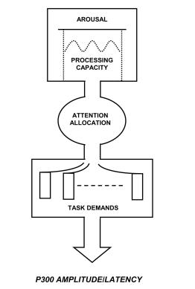
Conceptual relationship between attentional resource allocation and P300 outcomes.
The processing system is modulated by overall arousal level, which governs the amount of attention available for task performance.
When task conditions are undemanding, P300 amplitude is hypothesized to index attentional resources such that amplitude is relatively large and peak latency is relatively short.
Hence, for tasks that require greater amounts of attentional resources, P300 amplitude is smaller and peak latency is longer as processing resources are used for task performance.
Passive stimulus processing generally produces smaller P300 amplitudes than active tasks, because stimulus and non-task events engage attentional resources to reduce amplitude.
Further, trait and state arousal levels affect the availability of attention processes to modulate P300

Slide 8
Target-to-Target interval (TTI) for stimulus sequences defined by the number of nontarget (standard) stimuli that occur before the detected target.
TTI determines how quickly resources can be redirected to process target stimuli. Short intervals produce smaller P300 components than longer intervals, with TTIs of 6–8 seconds or greater eliminating probability effects.
Even when the target stimulus probability is unitary, the time between events is the primary determinant of P300 amplitude.
TTI results demonstrated that component size is small for relatively rapid stimulus presentations, whereas target stimulus items occurring at longer intervals yield maximum component amplitudes.
P300 latency is thought to index classification speed, which is proportional to the time required to detect and evaluate a target stimulus. Like P300 amplitude, component latency changes across the scalp and is shorter over frontal areas but longer over parietal areas .
Stimulus and task requirements contribute to the association between P300 latency and response time, but the strength or sensitivity of the relationship between latency and response time varies across stimulus-response compatibility and Stroop choice-response tasks.

Slide 9
Semantic-based compatibility tasks produce a larger P300 latency/response time difference compared to spatial compatibility tasks.
P300 latency has been used as a metric for timing mental events producing other ERP components .
An insightful review found that P300 timing is sensitive to both stimulus- and response related processing when responding is fast . This conclusion has evolved into the intriguing possibility that P300 may originate from the neural linkage between stimulus perception and the response to that event.
P300 peak latency is proportional to stimulus evaluation timing, is sensitive to task processing demands, and varies with individual differences in cognitive capability.

Slide 10
Test-retest correlation coefficients for oddball task P300 amplitude range from 0.50 to 0.80 and for peak latency from 0.40 to 0.70 .
P300 measures are as reliable as clinical assays, can assess cognitive capability, and are relatively inexpensive to obtain.
Neuroelectric signals are genetically transmitted.
EEG spectral characteristics are highly similar for identical twins and strong spectral power similarities are observed for biological family members .
P300 is virtually identical for pairs of monozygotic twins, less so for dyzygotic twins, and different for unrelated controls .
P300 heritability also is evidenced by biologically related family members who demonstrate significant inter-family member correlations for ERP measures.
Specific loci on the human genome have been identified that may determine ERP characteristics. These observations suggest that P300 may be a marker of disease phenotype
P300 amplitude/latency measurement reliability, genetic origins, and personality variables are important for interpreting individual ERP differences. Genetic factors strongly affect P300, and biological determinants contribute to component variability.
The neuroelectric circuit underlying P300 is a fundamental physiological attribute of individual CNS reactivity.

Slide 11
NEUROpsychology of p3a and p3b
NOVELTY P300 POTENTIAL
When perceptually novel distracters (dog barks, color forms, etc.) occur in a series of more typical (tones, letters of the alphabet, etc.) stimuli, a frontal/central P300 can be elicited with a relatively short peak latency that habituates rapidly. It is interpreted as reflecting frontal lobe activity related to the hippocampus.
With repeated stimulus presentation, novelty P300 decreases in amplitude so that it may be more directly related to the orienting response than the P3b .
NO-GO P300
The non-novel repeated stimuli (tones, letters, etc.) are used as distracters in a three-stimulus oddball, a “no-go” P300 is elicited. Subjects do not respond to the infrequent distracter and only respond to the targets .
The P300 from this type of distracter has maximum amplitude over the central/parietal areas.
The topographic distribution for this component is somewhat more central than the parietal P300 from the target stimulus. The no-go P300 has been linked to response inhibition mechanisms, although this hypothesis is debated

Slide 12
For the easy task, P300 amplitude from the distracter and target was largest over the parietal electrodes
For the difficult task, P300 from the distracter was larger than that from the target over the frontal/central electrodes.
Target and distracter amplitude was largest over the parietal electrodes for all conditions. The same outcomes were observed for auditory and visual non-novel distracter stimuli evaluated separately.
Easy discrimination tasks produced scalp topography similar to no-go P300 potentials, whereas difficult discrimination tasks produced P3a potentials that were similar to novelty P300.
The easy task yielded a central maximum distribution for the novel stimuli and a central/parietal maximum P300 potential for the non-novel stimuli—i.e., the same topography as the no-go P300.
Taken together, the findings suggest that the P3a, novelty, and no-go P300 are most likely variants of the same ERP that varies in scalp topography as a function of attentional and task demands.

Slide 13
The functional and neuropsychological origins of different P300 potentials suggest that the P3a, novelty P300, and no-go potentials elicited by distracter stimuli are variants of the same generation system. The differences among these distracter components appear to arise from variation in top-down monitoring by frontal attention mechanisms engaged to evaluate incoming stimuli. Processing of such stimulus events produces P3b activity related to context updating operations and subsequent memory storage.
P3a may be generated when such stimuli are processed if sufficient attentional focus is engaged. P3b appears to occur when subsequent attentional resources activations promote memory operations in temporal-parietal areas

Slide 14
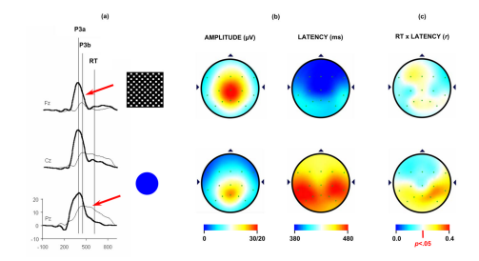
P3a and P3b data using a difficult target/standard discrimination task in a three-stimulus paradigm from 120 healthy young adults
The distracter - large black/white checkerboard square
The target - blue circle that was slightly larger than the standard blue circle

Slide 15
NEUROPHARMACOLOGY OF P300
Pharmacological studies have found dopaminergic mediation of P300 amplitude and latency.
A comprehensive review of the wide-ranging P300 neuropharmacology literature suggests that the locus-coeruleus-norepinephrine (LC-NE) system underlies parietal P300 (P3b) generation for a target detection task.
LC-NE contributes to P300 generation is consonant with attention resource allocation and arousal-related effects in humans. The topographic LC-NE activation of temporal-parietal areas also is in agreement with overall P300 characteristics.
Given that frontal/attention P3a and temporal-parietal/memory P3b origins are associated with dopaminergic and LC-NE activity, respectively, individual ERP differences for acute and chronic drug intake could be associated with specific transmitter responsivity variation

Slide 16
Figure 8 presents a schematic outline of how these processes might occur. Attentiondemanding stimuli elicit a P3a when the contents of working memory change. These events are hypothesized to initiate neural activity towards the areas associated with P3b production and subsequent memory storage. If the resultant ERP waveforms originate from inhibitory signals derived from stimulus and task processing, a major question is how P3a information is transmitted to structures used for P3b generation (suggested by the black arrows in the figure). Communication of the output from frontal attention and working memory processes to temporal/parietal activation .
. The target stimulus produces activation in both frontal and temporal/parietal areas. These patterns occur in cortical areas associated with P3a and P3b generation. W

Slide 17
NEUROELECTRIC UNDERPINNINGS OF P3A AND P3B
Conventional ERP analyses are performed in the time domain by assessing the amplitudes and latencies of prominent peaks and associating the resulting measures with information processing variables. The distinct time-scales for brain stem, middle latency, and endogenous potentials indicate that frequency is an important parameter for ERP interpretation.
Procedures such as Principal Component Analysis (PCA) and Independent Component Analysis (ICA) are based on mathematical transformations of ERP data and can be employed to separate functionally distinct events that occur simultaneously in time.
Wavelet transform (WT) is an efficient time-frequency decomposition method , which has been used on ERP signals . The major advantage of WT is its multi-resolution property that employs shorter time windows for higher frequencies and longer time windows for lower frequencies—an attribute that closely matches the structural properties of ERP signals . The variable time frequency localization method therefore takes into consideration the overlapping of ERP components and provides for the efficient analysis of the transient non-stationary ERP signals

Slide 18
EVENT RELATED DESYNCHRONISATION AND P300
Alpha suppression (or desynchronization) was first observed by Berger (1929). Phasic alpha event-related desynchronization (ERD) can be induced by sensory stimulation across modalities . Alpha ERD also occurs during cognitive processing invoked by task conditions requiring attention and memory. ERD originates from a reduction of fast non-phase-locked oscillations, whereas P300 is composed of phase-locked delta and theta-range synchronized oscillations .
Task-induced alpha frequencies have specific functional meanings: slow alpha ERD (8–10 Hz) is associated with attention and fast al.pha ERD (10–12 Hz) is associated with memory

Slide 19
ERD measures were obtained from post-stimulus late alpha power. Strong relationships between ERD and P300 (P3b) were found:
ERD onset was negatively associated with P300 amplitude—the shorter the onset time, the larger the component amplitude.
ERD onset was positively associated with P300 latency—the shorter the onset time, the shorter the component latency.
Homogenous variability for each measurement pairing was observed across subjects.
Assuming that ERD is related to neural inhibition by virtue of its desynchronization origins, P300 amplitude and latency could therefore stem from alpha-band deactivation. Whether P3a is regulated by this process is unknown, but P3b is clearly related to desynchronization of late alpha frequency EEG.
It is notable in this context that theta and alpha frequencies have been strongly linked to meditation effects—a self-induced neuroelectric inhibition (Cahn and Polich, 2006). Thus, the P300 may be the neuronal consequence of stimulus events important enough to inhibit concomitant brain activity and therefore index processes that are generated by brain mechanisms underlying various types of attention and memory operations.

Slide 20
REFERENCES
[1] Polich, John. "Updating P300: an integrative theory of P3a and P3b." Clinical neurophysiology 118, no. 10 (2007): 2128-2148.
[2] Bulat, Matvey, Alexandra Karpman, Alina Samokhina, and Alexander Panov. "Playing a P300-based BCI VR game leads to changes in cognitive functions of healthy adults." bioRxiv (2020).
[3] An Introduction to Event-Related Potentials and Their Neural Origins (Chapter 1 PDF)

Slide 21
THANK YOU!

