Slide 1
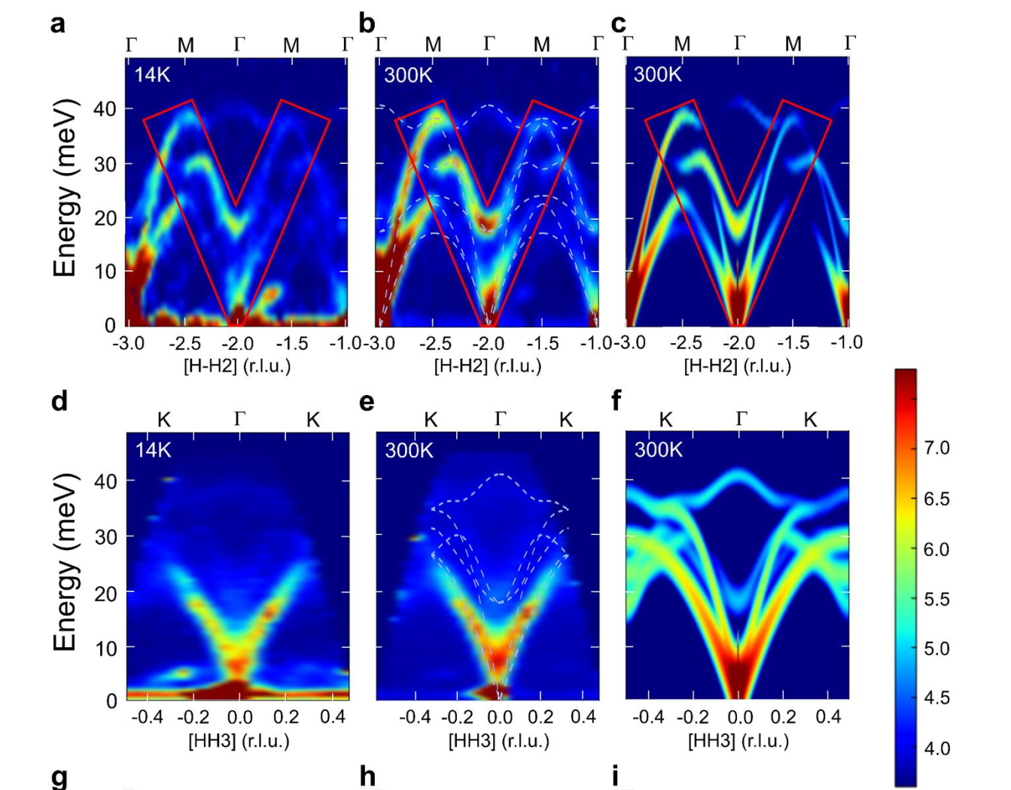
SQE-GaN原图
Twin 1
Twin 2
Twin 3
Twin 4

Slide 2
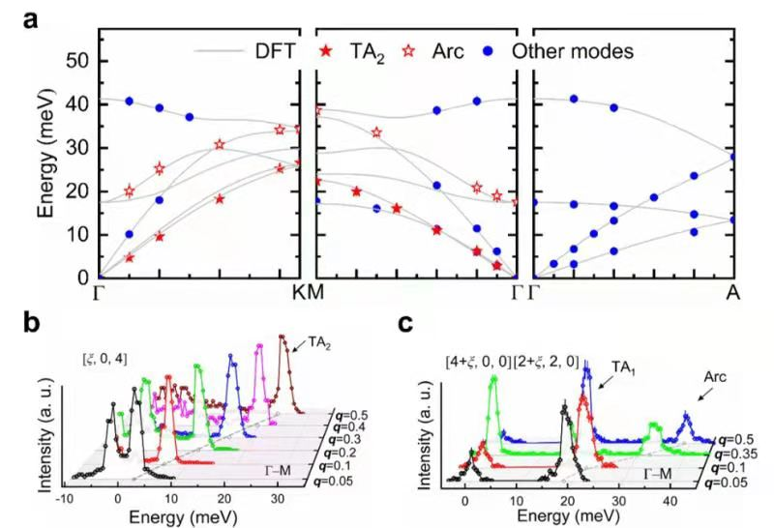
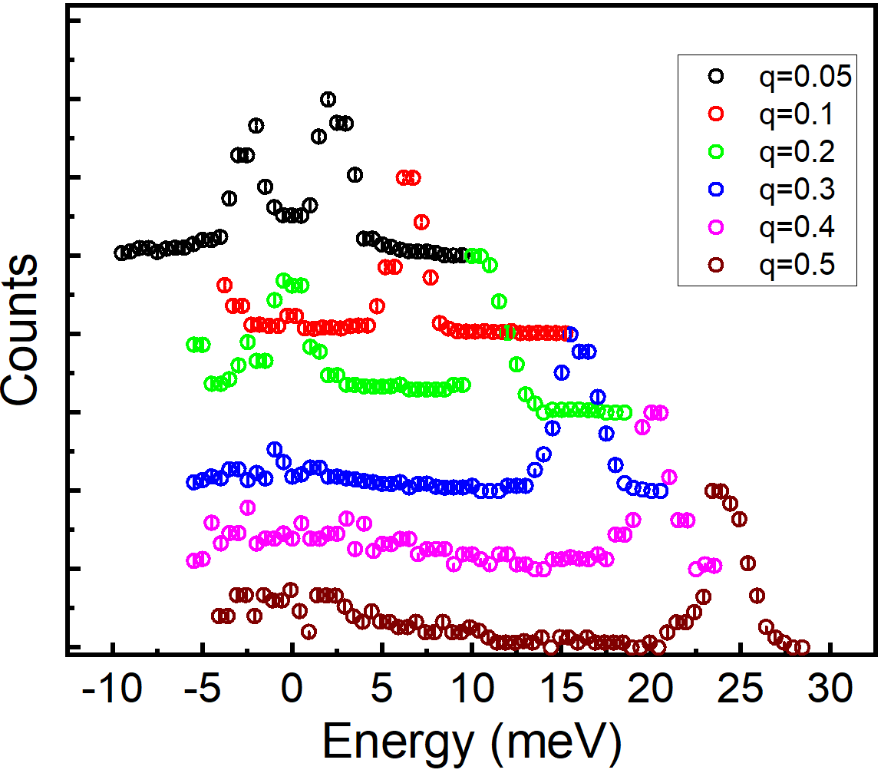
SQE-GaN原图
Twin 1
Twin 2
Twin 3
Twin 4

Slide 3
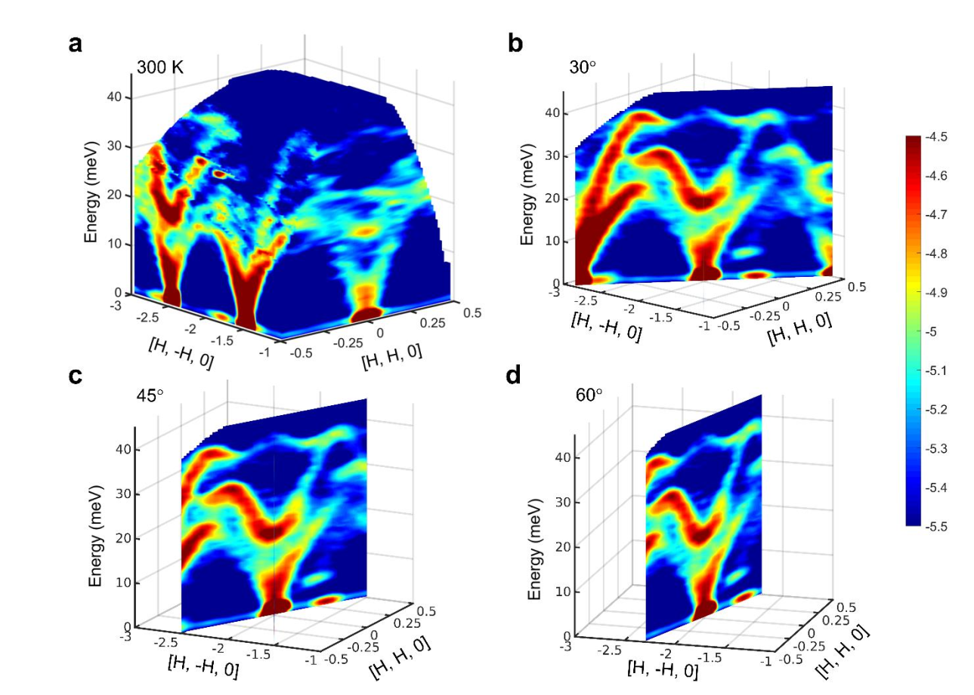
SQE-GaN原图
Twin 1
Twin 2
Twin 3
Twin 4

Slide 4
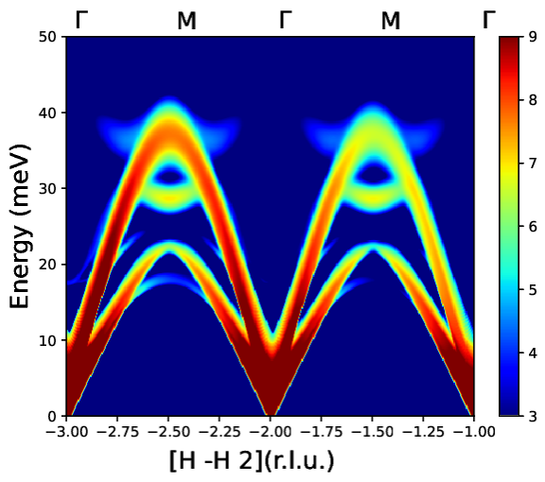
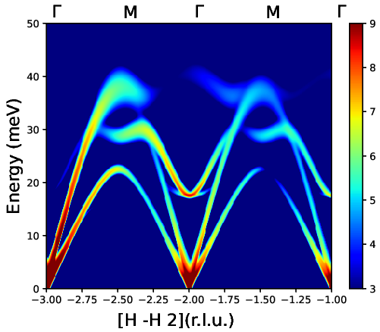
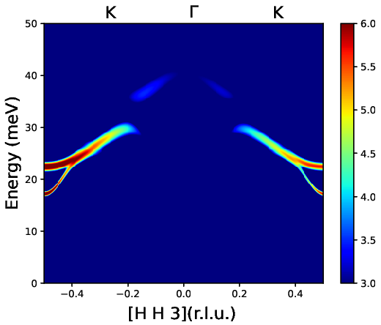
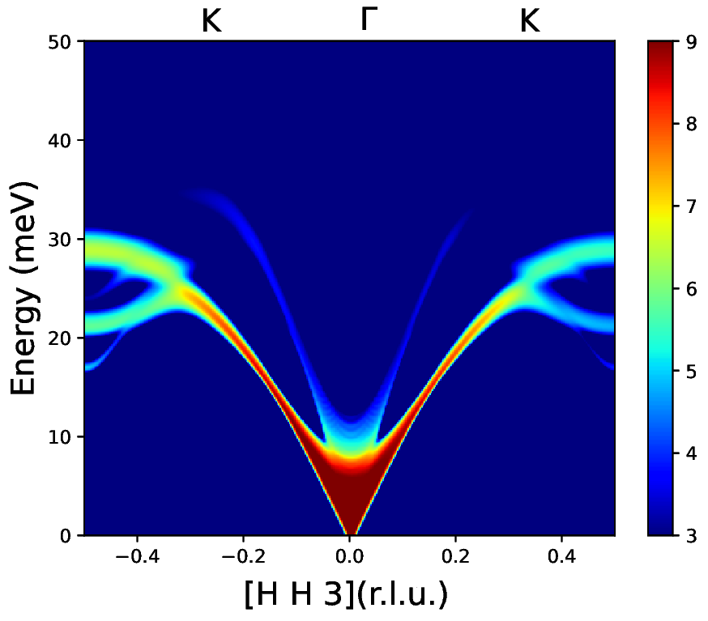
fortran
lphase=F
lphase=T
Twin 1
Twin 2
Twin 3

Slide 5
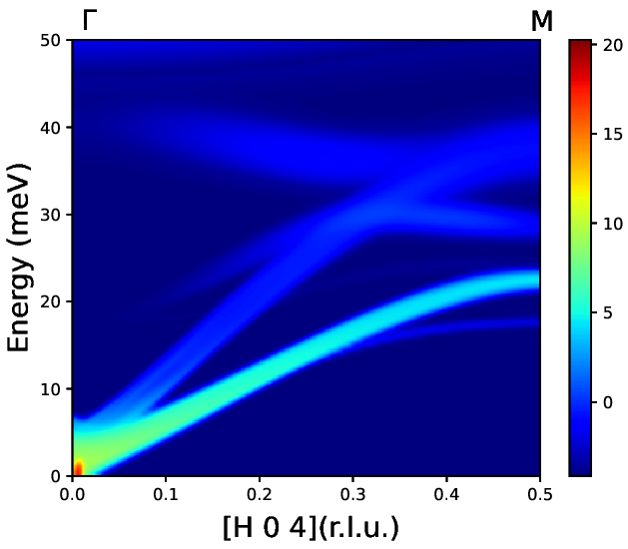
fortran
Twin 1
Twin 2
Twin 3
Twin 4

Slide 6
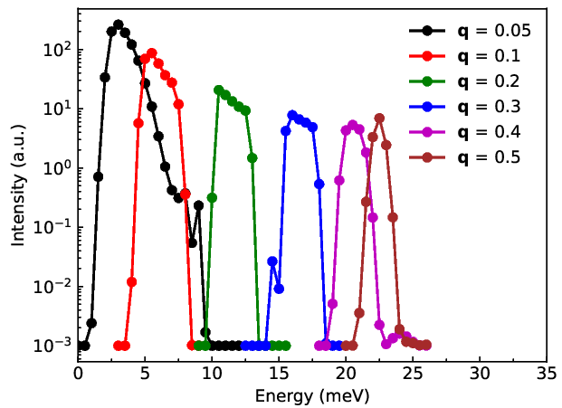
fortran
Twin 1
Twin 3

Slide 7
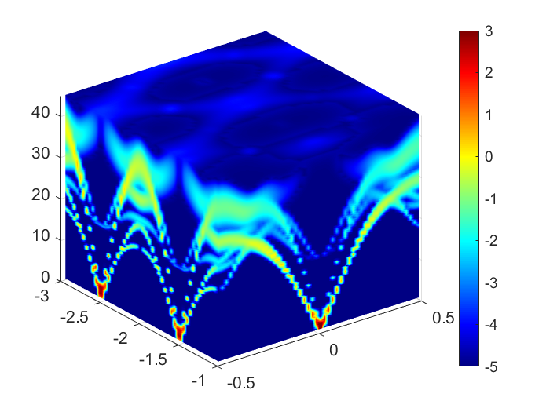
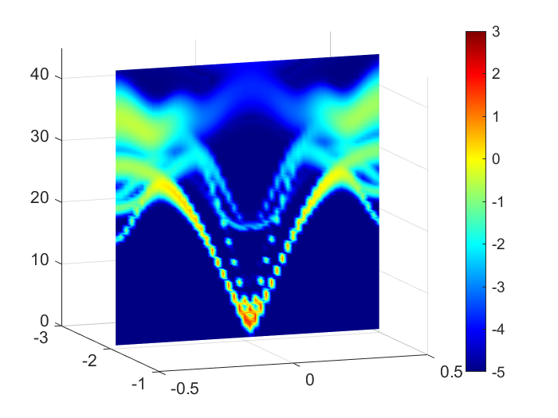
fortran+matlab
Twin 1
Twin 3
Twin 4

