Slide 1
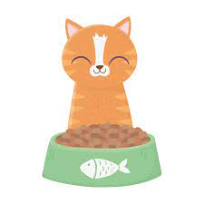
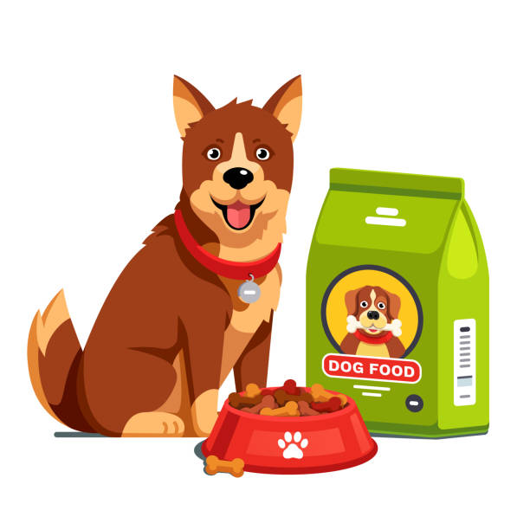
PetFeeder
Duygu Yaren Yenice 218CS2096
Arda Deniz Eryiğit 218CS2111

Slide 2
Problem Definition
Our pets sometimes have to be left alone at home. It can sometimes be difficult to meet their nutritional needs while they are alone at home. This period may be extended and the food left in the food bowl may not be completely sufficient. In particular, in a household with multiple pets and a voracious pet, food may not be enough.

Slide 3
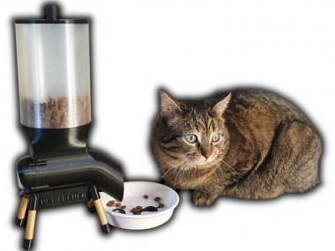
Solution

Slide 4
Solution
PetFeeder is a Wifi-controlled device to feed our pets/animals who are alone at home. After accessing the PetFeeder application, we start the device by clicking the 'Feed' button. The motor inside the device rotates and empties the food into the container as needed. In this way, we can feed our animals both inside and outside the house in a remotely controlled manner.

Slide 5
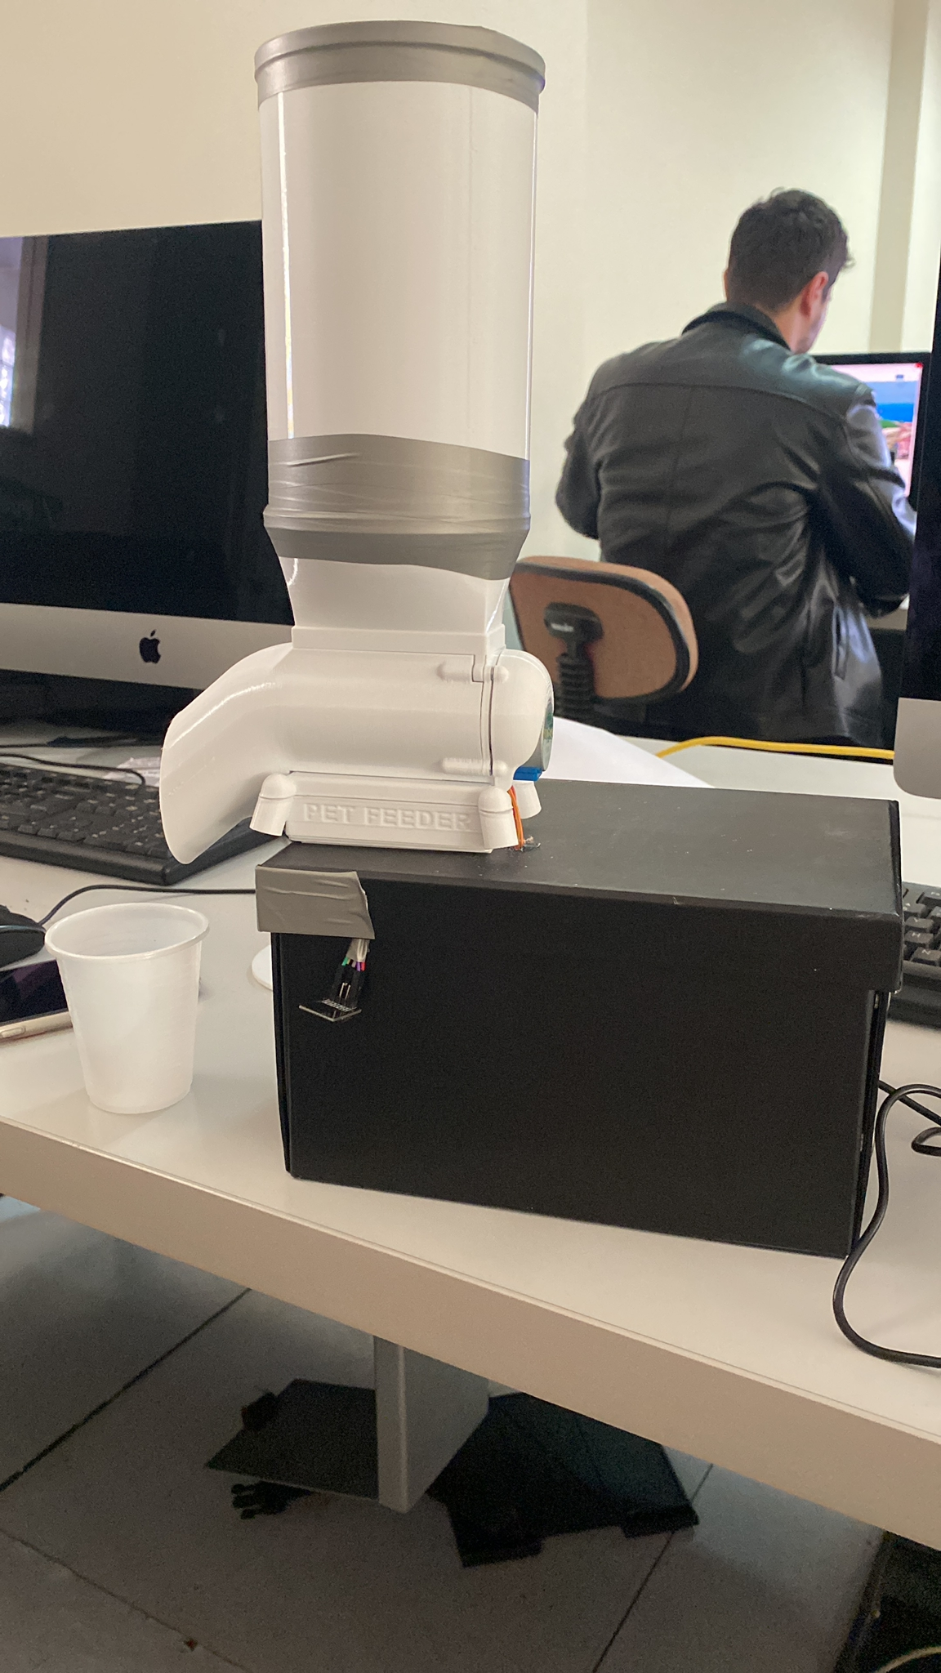
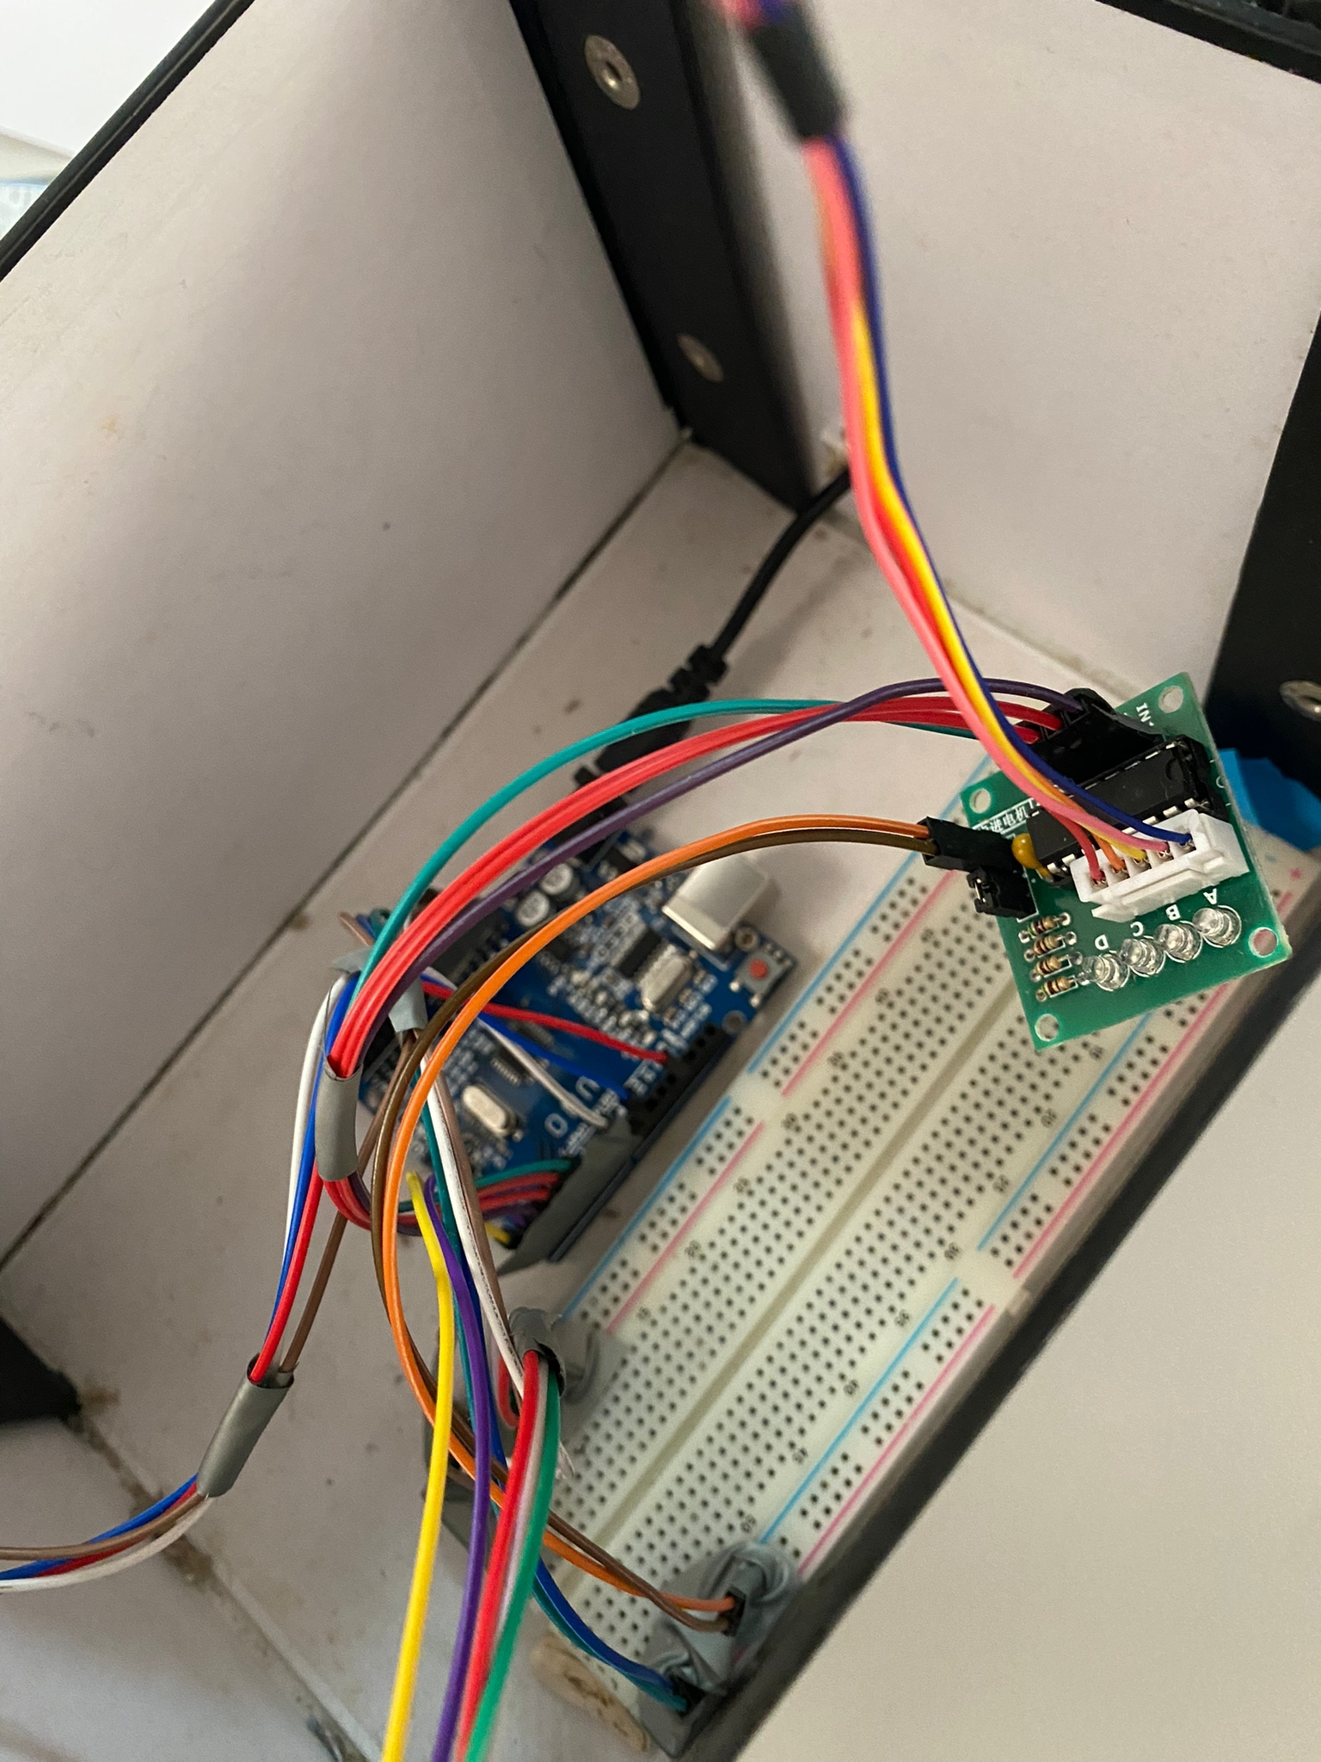
Our PetFeeder

