Slide 1

IILM UNIVERSITY
SMART CITY TRAFFIC PATTERN FORECASTING USING MACHINE LEARNING
Student Name: YASH ARVIND Enrollment Number: 25SCS1003002423 Program & Semester: B.Tech CSE (AIML) — 2nd Year, 3rd Semester Organization Name: Codec Technologies Pvt. Ltd.

Slide 2
Internship Overview
2
Organization
Duration
Mode
Codec Technologies Pvt. Ltd. Artificial Intelligence Intern
20 July 2026 – 20 August 2026 1 Month
Pan India, Hybrid Assigned project head(s)
Internship Focus
Selected Project
Foundational Artificial Intelligence and Machine Learning learning followed by practical project implementation.
Smart City Traffic Pattern Forecasting using historical traffic observations and Machine Learning.
Yash Arvind | 25SCS1003002423 | IILM University

Slide 3
Organization Profile
3
• Codec Technologies Pvt. Ltd. provided the one-month Artificial Intelligence internship. • The offer letter describes the organization as an IT and business consultancy platform operating across multiple countries. • Designation: Artificial Intelligence Intern. • Internship mode: Pan India, Hybrid. • Reporting: Assigned Project Head(s). • Program Manager named on the completion certificate: Dr. Anurag Shrivastava.
Yash Arvind | 25SCS1003002423 | IILM University

Slide 4
Project Introduction & Problem Statement
4
Problem
Proposed Approach
Traffic volume varies by hour, day, and junction. Manual estimation from historical records becomes difficult as data grows.
Use historical traffic observations and timestamp-derived features to train a regression model that forecasts vehicle counts.
Prediction Task
Junction + DateTime-derived features → Predicted Number of Vehicles
Dataset
48,120 training records • 11,808 test records • 4 junctions
Yash Arvind | 25SCS1003002423 | IILM University

Slide 5
Objectives and Scope
5
• Understand and prepare the supplied traffic dataset. • Extract useful temporal information from DateTime. • Create calendar and cyclical time features and encode junction information. • Compare regression algorithms using MAE, RMSE, and R². • Select the best-performing model and generate test predictions. • Document the implementation, results, limitations, and future improvements.
Yash Arvind | 25SCS1003002423 | IILM University

Slide 6
Dataset & Feature Engineering
6
Dataset
Calendar Features
Cyclical Features
Training: 48,120 records Test: 11,808 records Fields: DateTime Junction Vehicles ID
Year Month Day Hour Day of week Week of year Day of year Weekend indicator
Hour sine / cosine Day-of-week sine / cosine These represent repeating daily and weekly patterns.
Yash Arvind | 25SCS1003002423 | IILM University

Slide 7
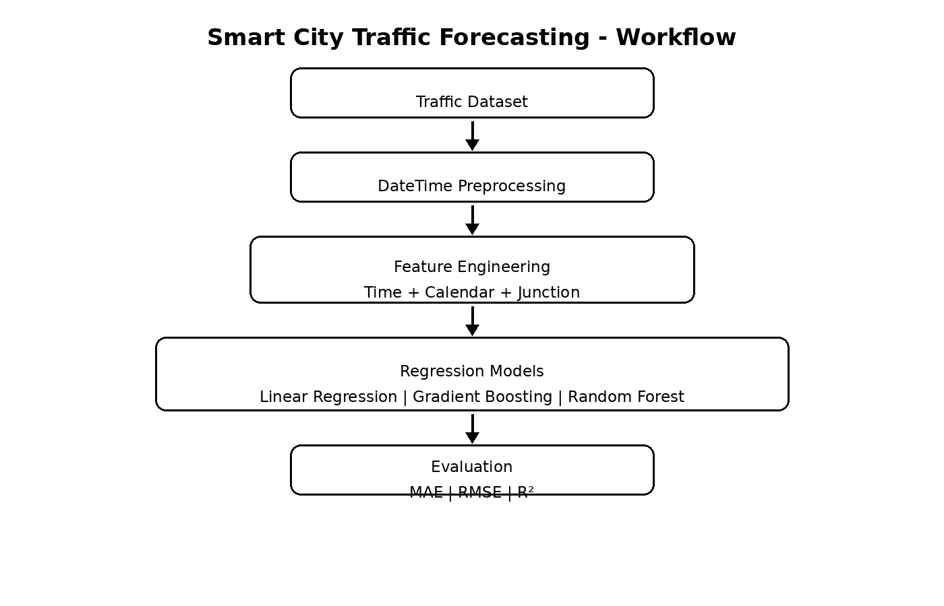
System Architecture
7
Yash Arvind | 25SCS1003002423 | IILM University

Slide 8
Methodology
8
• Data preparation — load training and test data and parse DateTime. • Feature engineering — derive calendar, weekend, and cyclical time features. • Preprocessing — encode Junction and apply a consistent ML pipeline. • Model training — Linear Regression, Gradient Boosting, and Random Forest. • Validation — final 30 days of training data used as chronological validation. • Evaluation — compare MAE, RMSE, and R², then select the best model.
Yash Arvind | 25SCS1003002423 | IILM University

Slide 9
Model Comparison
9
Model | MAE | RMSE | R²
Random Forest | 3.7753 | 6.5125 | 0.9514
Gradient Boosting | 6.4846 | 10.4628 | 0.8745
Linear Regression | 10.2147 | 15.6203 | 0.7203
Selected Model
Random Forest Regression — strongest validation performance across all three metrics.
Yash Arvind | 25SCS1003002423 | IILM University

Slide 10
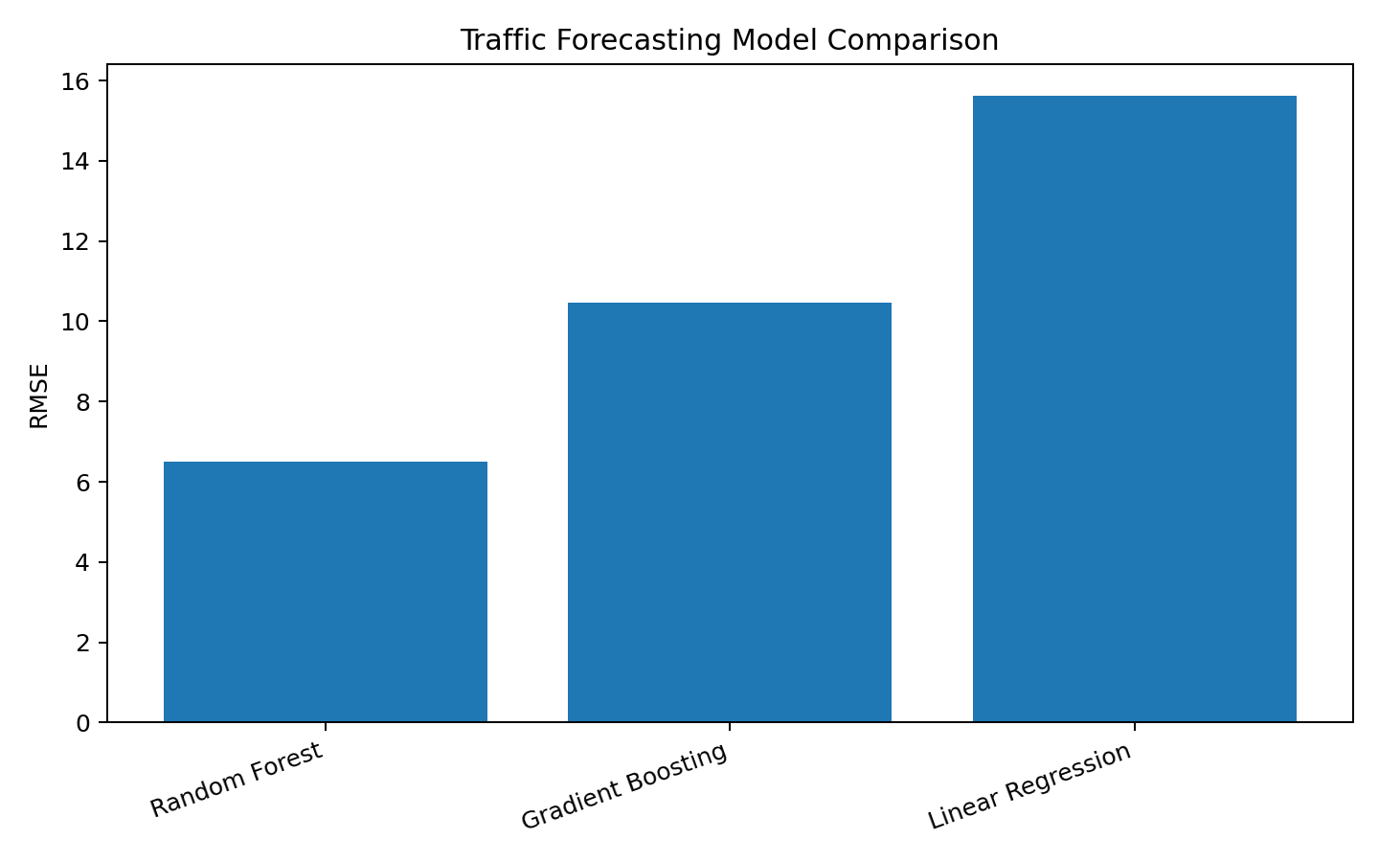
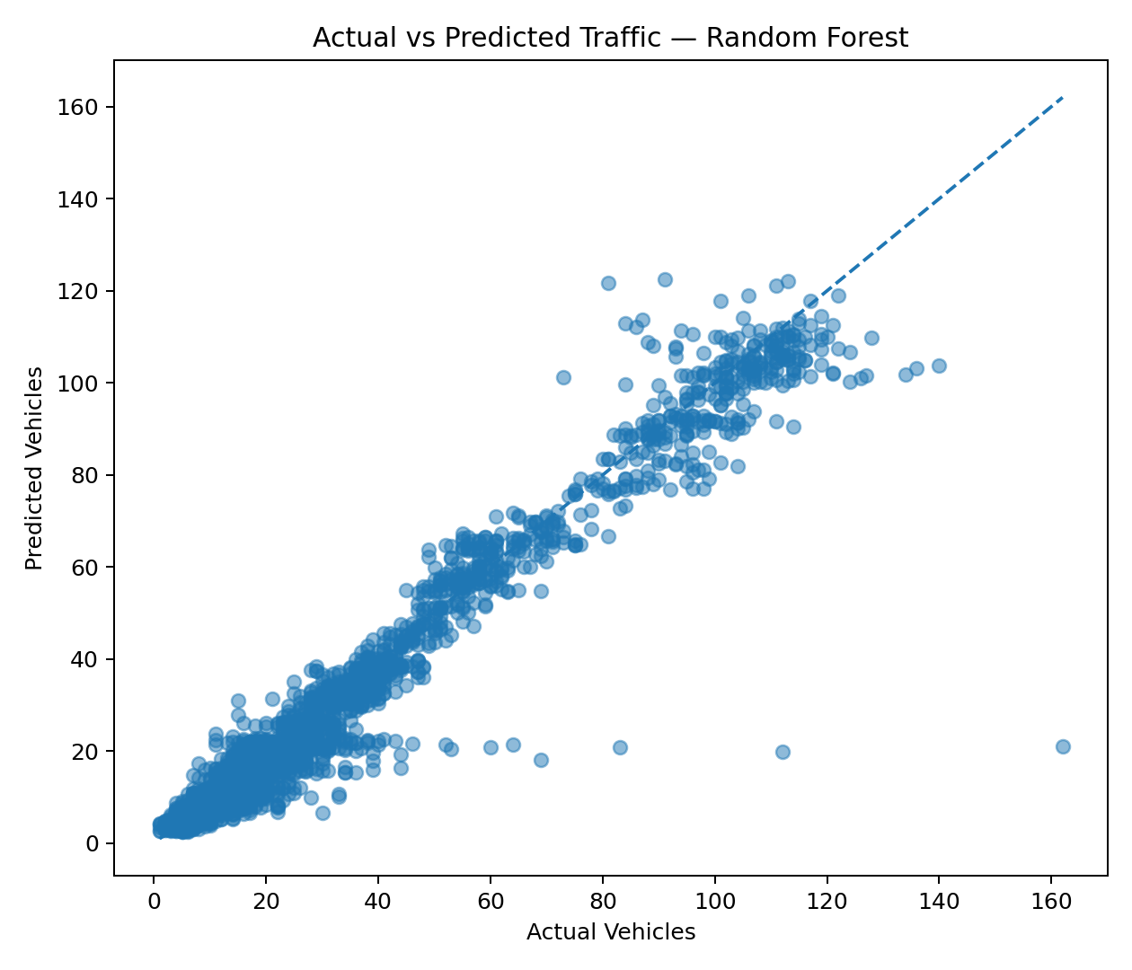
Performance Results
10
Key Result
Random Forest: MAE 3.7753 | RMSE 6.5125 | R² 0.9514
Yash Arvind | 25SCS1003002423 | IILM University

Slide 11
Implementation & Output
11
• Implemented in Python using Pandas, NumPy, Scikit-learn, and Matplotlib. • Time-based and categorical features are processed through a unified pipeline. • Random Forest was retrained on the complete training dataset after validation. • Predictions were generated for all 11,808 test records. • Code, results, visualizations, and prediction output are maintained in GitHub.
https://github.com/Dyza-CZN/Smart-City-Traffic-Forecasting
Yash Arvind | 25SCS1003002423 | IILM University

Slide 12
Learnings & Future Scope
12
Key Learnings
Future Scope
• Data preprocessing • Time-based feature engineering • Regression models • Model evaluation • Chronological validation • End-to-end ML workflow
• Add weather and event data • Include holiday information • Add traffic lag features • Explore advanced time-series models • Use larger datasets • Develop a forecasting dashboard
Yash Arvind | 25SCS1003002423 | IILM University

Slide 13
Conclusion
13
• The project developed a Machine Learning workflow for forecasting traffic volume at city junctions. • Timestamp information was transformed into useful calendar and cyclical features. • Random Forest achieved the best validation performance among the tested models. • The final model was trained on the complete training data and used to generate test predictions. • The approach can be extended with additional real-world traffic, weather, and event information.
Thank You
Yash Arvind | 25SCS1003002423 | IILM University

