Slide 1
BEng (Hons) Mechanical Engineering — Final Year Project
Aero-Opt
CFD-Based Aerodynamic Optimisation for Sustainable Engineering
Dachi Dzeria | C00290924
Supervisors: Dr Nicolas Aristokleous & Dr Christos Constantinou
Department of Aerospace & Mechanical Engineering · SETU Carlow · 23 April 2026

Slide 2
Introduction: Small L/D Gains Have Big Impact
2-3%
Modifying airfoil geometry is an easy way to influence L/D
Adjoint-based optimisation improves L/D
PyFluent can be used to automate the workflow and compare settings
of all global CO₂ emissions come from aviation [1]
Fuel burn ∝ 1 / (L/D)

Slide 3
Objectives
Optimised airfoils
4 airfoils over 5 cases
Subsonic, transonic, supersonic trials
Constant vs variable length profiles
Optimised Workflow
Automated, resource-efficient
Identify the best settings
Automate using Ansys PyFluent

Slide 4
Workflow
Coordinates
SolidWorks
SpaceClaim
airfoiltools.com
xyz curve, domain creation
naming the surfaces
mesh()
solve()
optimize()
Fluent Meshing
Initial solve
Adjoint optimisation
mesh()
solve()
optimize()
.msh.h5, log, inputs.txt
.cas/.dat, drag/lift reports, contours, mass flow, pressure plot
same as solve() + .dis, GIFs

Slide 5
Selected Cases
Case | Reference | M | Altitude | AoA | Flow Regime
NACA 0012 | N/A (symmetrical baseline) | 0.72 | 2,675 m | 1.55°
NACA 2412 | Cessna 172 [41] | 0.20 | 4,115 m | 0°
Boeing BACXXX | Boeing 747-400 [42] | 0.85 | 10,577 m | 2°
NASA SC(2)-0714 | F/A-18 Hornet cruise [43] | 0.85 | 11,582 m | 2°
NASA SC(2)-0714 | F/A-18 Hornet top speed [43] | 1.80 | 13,715 m | 0°
Transonic
Subsonic
Transonic
Transonic
Supersonic

Slide 6
Verification
Every airfoil was solved at published conditions
Mesh: max skewness <0.65, min orthogonal quality >0.1 for all runs.
Mass flow and residuals monitored
Case | L/D | Ref L/D
NACA 0012 | 43.38 | 42.22 [34]
NACA 2412 | 22.67 | 23.33 [34]
BACXXX | 6.27 | 5.29 [36]
NASA SC(2)-0714 Transonic | 11.66 | 7.82 [37]
NASA SC(2)-0714 Supersonic | 0.44 | 0.54 [37]

Slide 7
Results
Case | M | L/D Baseline | Constant Length |  | Variable Length
NACA 0012 | 0.72 | 23.18 | 33.41 | +44.16% | 48.68 | +110.04%
NACA 2412 | 0.2 | 21.89 | 46.54 | +112.65% | 55.52 | +153.67%
Boeing BACXXX | 0.85 | 6.29 | 18.65 | +196.64% | 47.67 | +658.32%
NASA SC(2)-0714 Transonic | 0.85 | 2.48 | 19.52 | +686.73% | 19.58 | +689.05%
NASA SC(2)-0714 Supersonic | 1.8 | 0.23 | 0.83 | +260.78% | 1.46 | +533.47%

Slide 8
Before and After – NACA 2412 short

Slide 9
Before and After – NACA 2412 long

Slide 10
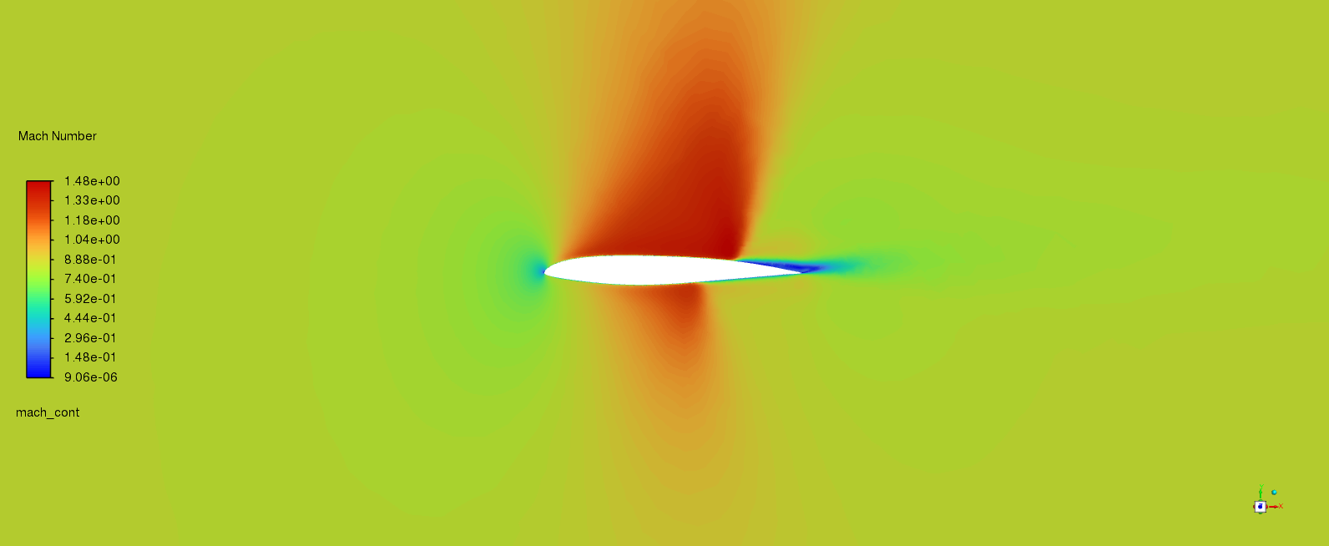
Before and After – BACXXX short

Slide 11
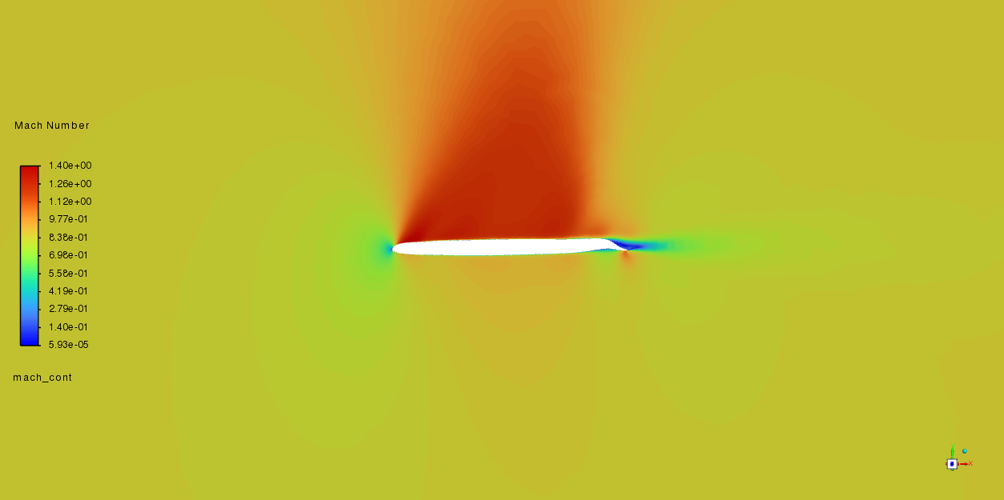
Before and After – BACXXX short

Slide 12
Before and After – BACXXX long

Slide 13
Downforce Trial

Slide 14
Projected fuel and CO₂ Savings
Cessna 172:
~20,000 in service, 100 flight-hours/year [45]
Fuel saved per flight:
13.5 kg (L/D: 46.5 instead of 21.9)
CO₂ Savings Per Year:
21,195 tonnes
Boeing 747-400:
255 in service [46], 2,000 flight-hours/year [47][48]
Fuel saved per flight:
11,785 kg (L/D: 18.6 instead of 6.3)
CO₂ Savings Per Year:
1.89 million tonnes
All flight hours are at cruise speed/altitude
Fixed boundary conditions
Fixed thrust-specific fuel capacity (TSFC) [49]
Constant L/D ratio
Single point optimisation with no structural testing

Slide 15
Ideal Solver Settings
y⁺: Mostly unaffected by first layer height unless in transonic flow conditions
Polyhedra Volume Fill: Same results as others at lower cell count/faster solve
Coupled Flow Scheme: Converged in the least number of iterations
y⁺
◊
‼
k-ω: y⁺ insensitive, handles detached flow better. Spalart-Allmaras is faster for attached flows
2D vs 3D: 2D generally shows more favourable flow conditions, good for optimisation
Global Time Step: Disabled is best. Saves only a few iterations while risking divergence
┘
T
k-ω

Slide 16
What Was Delivered and Future Work
Future Work:
Structural verification
Multi-point optimization
Experimental validation of the modified profiles
Pressure vs Density-based solver comparison
Full automation
Hyperparameter based meshing
Delivered:
L/D improved on all cases
Reduction of the transonic shock wave size [50]
Open-source PyFluent codebase
Recommendations for settings
Projected CO₂ savings

Slide 17
References
[1] I. E. Agency, “Aviation.” Accessed: Mar. 18, 2026. [Online]. Available: https://www.iea.org/energy-system/transport/aviation
[4] M. D. Guynn, “Effective L/D: A Theoretical Approach to the Measurement of Aero-Structural Efficiency in Aircraft Design,” in 15th AIAA ATIO Conference, Dallas, TX.: American Institute of Aeronautics and Astronautics (AIAA), 2015. [Online]. Available: https://ntrs.nasa.gov/api/citations/20160006027/downloads/20160006027.pdf
[5] L. J. Clancy, Aerodynamics. New York, London: Wiley; Pitman, 1978.
[7] J. D. Anderson, Fundamentals of Aerodynamics, 5th ed. New York, NY: McGraw-Hill, 2010.
[21] R. A. Minzner, K. S. W. Champion, and H. L. Pond, “The U.S. Standard Atmosphere, 1962: Equations and Tables for Facilitating Computations of Physical Properties,” National Aeronautics and Space Administration, Washington, D.C., Technical Note NASA TN D-1601, 1962. [Online]. Available: https://ntrs.nasa.gov/citations/19630003300
[22] High Mach Number Flow - Sutherland’s Law, 6.4. COMSOL, 2025. [Online]. Available: https://doc.comsol.com/6.4/docserver/#!/com.comsol.help.cfd/cfd_ug_fluidflow_high_mach.08.46.html
[27] F. M. White, “Fluid Mechanics.” Accessed: Mar. 18, 2026. [Online]. Available: http://ftp.demec.ufpr.br/disciplinas/TM240/Marchi/Bibliografia/White_2011_7ed_Fluid-Mechanics.pdf
[28] Q. Engineering, “CFD - Calculate Wall Distance.” Accessed: Mar. 18, 2026. [Online]. Available: https://www.quadco.engineering/en/know-how/cfd-calculate-wall-distance.htm

Slide 18
References
[34] S. M. M. Hasan, S. M. M. Islam, and M. Haque, “Comparison of Aerodynamic Characteristics of NACA 0012 and NACA 2412 Airfoil,” Int. J. Res. Appl. Sci. Eng. Technol., vol. 9, no. 7, Jul. 2021, doi: 10.22214/ijraset.2021.36766.
[36] A. A. M. Abdel-Raheem, P. A. S. Hanna, I. A. M. Abdel-Hameed, A. F. Abdel Gawad, and M. Melad, “Aerodynamic Study of Boeing 747-400 Airfoil,” in 4th IUGRC International Undergraduate Research Conference, Military Technical College, Cairo, Egypt, Jul. 2019. Accessed: Mar. 18, 2026. [Online]. Available: https://www.researchgate.net/publication/334826189
[37] M. Sri and M. Sri Rama Murthy, “Aerodynamic analysis of NASA SC (2) -0714 and NASA SC (2)-0414 super critical aero foils -a comparative study,” vol. 11, p. PP 15-27, Dec. 2022, doi: 10.35629/6734-11110814.
[41] “Cessna 172 Flight Simulation Data.” Accessed: Mar. 18, 2026. [Online]. Available: https://www.researchgate.net/publication/353752543_Cessna_172_Flight_Simulation_Data
[42] Stands.aero, “Boeing 747-400 Features, Specifications, and History.” Accessed: Mar. 18, 2026. [Online]. Available: https://stands.aero/blog/boeing/boeing-747-400-features-specifications-and-history/
[43] Aerospaceweb.org, “F/A-18 Super Hornet.” Accessed: Mar. 18, 2026. [Online]. Available: https://aerospaceweb.org/aircraft/fighter/f18/
[44] S. Özgen, “AE 172 Aircraft Performance: Propulsion Characteristics.” Accessed: Mar. 18, 2026. [Online]. Available: https://www.ae.metu.edu.tr/~ae172/19/lecture5.pdf
[45] A. Week, “Cessna’s 172 Still Going Strong at 65.” Accessed: Mar. 18, 2026. [Online]. Available: https://aviationweek.com/business-aviation/aircraft-propulsion/cessnas-172-still-going-strong-65

Slide 19
References
[46] S. Flying, “How Many Boeing 747s Are Left?” Accessed: Mar. 18, 2026. [Online]. Available: https://simpleflying.com/how-many-boeing-747s-left/
[47] S. Flying, “The Most Used Boeing 747s.” Accessed: Mar. 18, 2026. [Online]. Available: https://simpleflying.com/most-used-boeing-747s/
[48] Boeing, “747-400 Passenger.” Accessed: Mar. 18, 2026. [Online]. Available: https://www.boeing.com/content/dam/boeing/boeingdotcom/company/about_bca/startup/pdf/historical/747-400-passenger.pdf
[49] I. Martinez, Aerospace Engine Data. Isidoro Martinez, 2018. Accessed: Mar. 18, 2026. [Online]. Available: http://imartinez.etsiae.upm.es/~isidoro/bk3/c17/Aerospace%20engine%20data.pdf
[50] D. Zhong, Y. Wang, Z. Miao, J. Wang, and Y. Duan, "Multi-point aerodynamic shape optimization of transonic airfoils based on transfer learning," Aerospace Science and Technology, vol. 178, p. 112392, 2026.

Slide 20
Thanks for listening

Slide 21
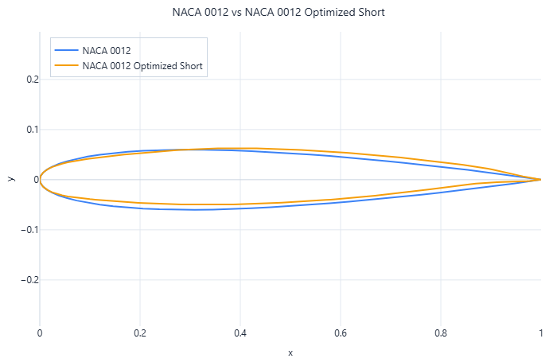
Before and After – NACA 0012 short

Slide 22
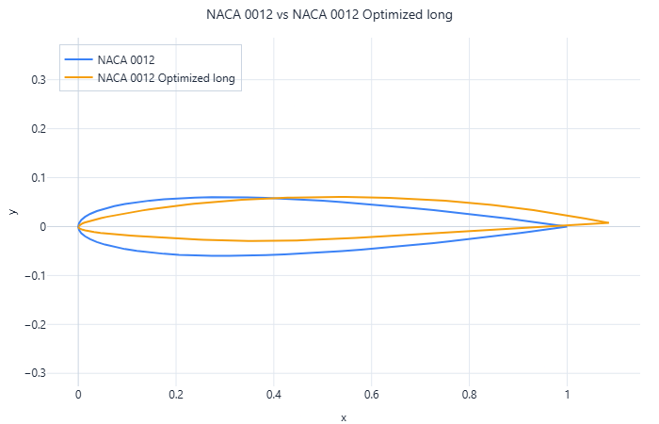
Before and After – NACA 0012 long

Slide 23
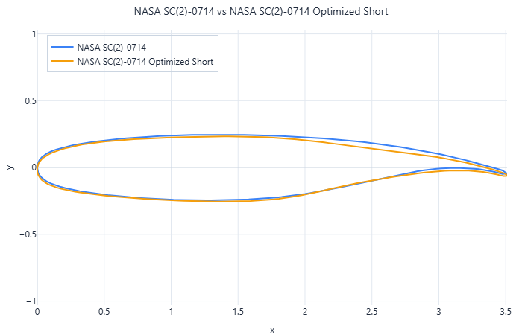
Before and After – NASA SC(2)-0714 – Transonic Flow – Short

Slide 24
Before and After – NASA SC(2)-0714 – Transonic Flow – Long

Slide 25
Before and After – NASA SC(2)-0714 – Supersonic Flow – Short

Slide 26
Before and After – NASA SC(2)-0714 – Supersonic Flow – Long

Slide 27
Boundary conditions for each case
Airfoil | nickname | altitude (m) | aoa (deg) | chord_len (m) | mach_num
NACA_0012 | act_3D | 2,675 m | 1.55° | 1.00 | 0.72
NACA_0012 | ref_3D | 0 m | 4.00° | 1.00 | 0.26
NACA_2412 | act_3D | 4,115 m | 0.00° | 1.49 | 0.20
NACA_2412 | ref_3D | 0 m | 0.00° | 1.00 | 0.26
BACXXX | act_3D | 10,577 m | 2.00° | 8.33 | 0.85
BACXXX | ref_3D | 9,000 m | 2.00° | 14.34 | 0.85
NASA_SC2_0714 | act_3D | 11,582 m | 2.00° | 3.51 | 0.85
NASA_SC2_0714 | ref_3D | 0 m | 0.00° | 1.00 | 0.80
NASA_SC2_0714 | act_3D_faster | 13,715 m | 0.00° | 3.51 | 1.80
NASA_SC2_0714 | ref_3D_faster | 0 m | 0.00° | 1.00 | 1.20

Slide 28
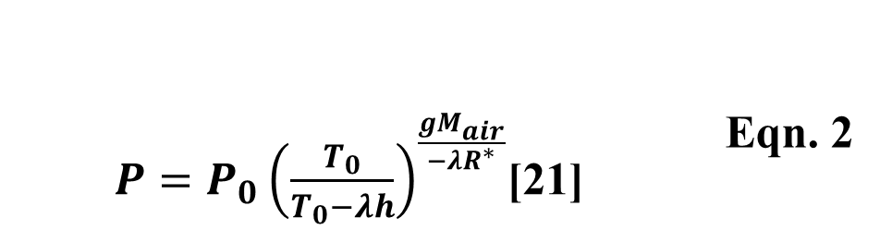
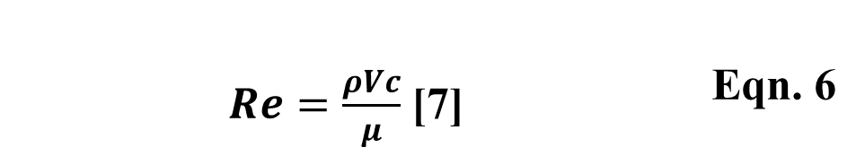
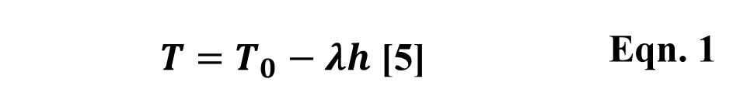
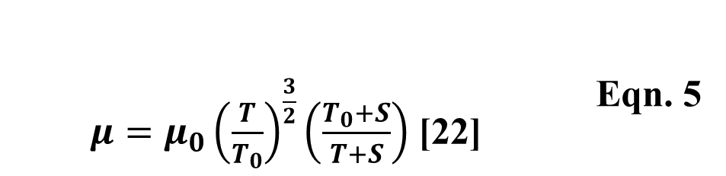
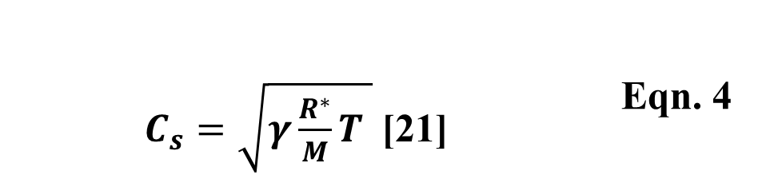
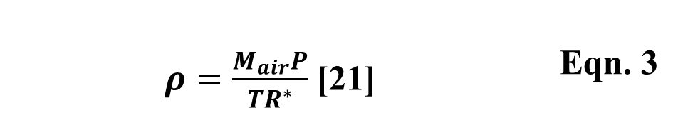
Equations
$C_{s}=\sqrt{γ\frac{R^{∗}}{M}T }$ [21] | Eqn. 4
$T=T_{0}−λh$ [5] | Eqn. 1
$P=P_{0}{\left(\frac{T_{0}}{T_{0}−λh}\right)}^{\frac{gM_{air}}{−{λR}^{∗}}}$[21] | Eqn. 2
$μ=μ_{0}{\left(\frac{T}{T_{0}}\right)}^{\frac{3}{2}}\left(\frac{T_{0}+S}{T+S}\right)$ [22] | Eqn. 5
$Re=\frac{ρVc}{μ}$ [7] | Eqn. 6
$ρ=\frac{M_{air}P}{{TR}^{∗}}$ [21] | Eqn. 3

Slide 29
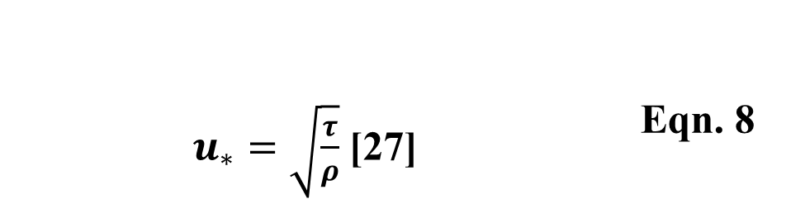
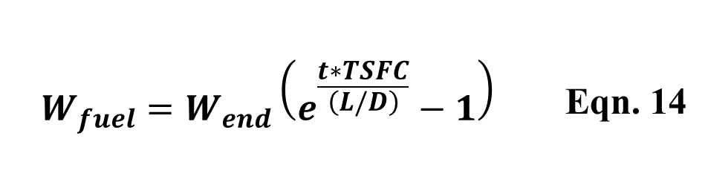
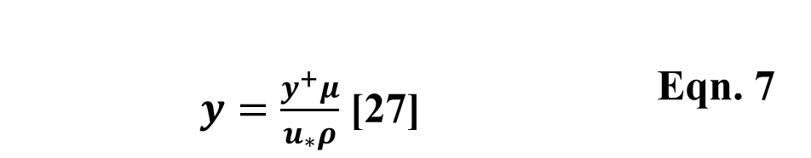
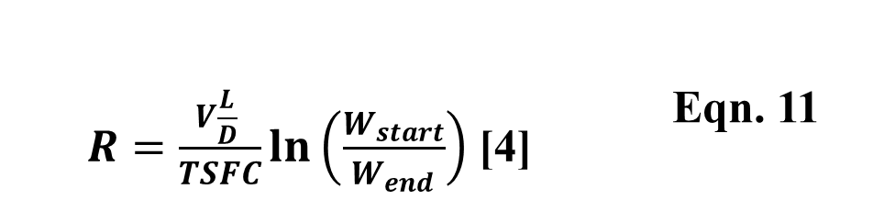
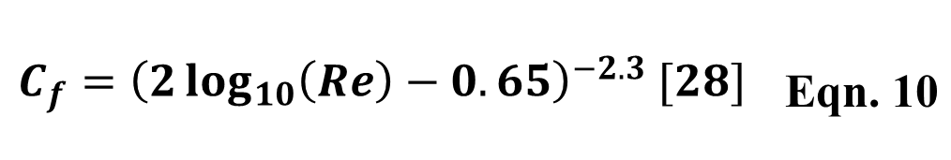

Equations
$y=\frac{y^{+}μ}{u_{∗}ρ}$ [27] | Eqn. 7
$$C_{f}={\left(2\log_{10}\left(Re\right)−0.65\right)}^{−2.3} [28]$$ | Eqn. 10
$u_{∗}=\sqrt{\frac{τ}{ρ}}$ [27] | Eqn. 8
$R=\frac{V\frac{L}{D} }{TSFC}\ln\left(\frac{W_{start}}{W_{end}}\right)$ [4] | Eqn. 11
$τ=\frac{C_{f}ρ U_{∞}}{2}$ [28] | Eqn. 9
$$W_{fuel}=W_{end}\left(e^{\frac{t∗TSFC}{\left(L/D\right)}}−1\right)$$ | Eqn. 14

Slide 30
NACA 0012
Variable | Test |  | Reference
Nickname | act_3D | act_2D | ref_3D | ref_2D
Dimensions | 3D | 2D | 3D | 2D
Altitude (m) | 2,675.17 | 2,675.17 | 0.00 | 0.00
AoA (°) | 1.55 | 1.55 | 4.00 | 4.00
Chord Length (m) | 1.00 | 1.00 | 1.00 | 1.00
Mach Number | 0.716 | 0.716 | 0.258 | 0.258
C_d | 0.01018 | 0.00887 | 0.01001 | 0.00958
C_l | 0.23587 | 0.24282 | 0.43443 | 0.43862
Lift to Drag Ratio | 23.18 | 27.37 | 43.38 | 45.77
Iterations Needed | 133 | 518 | 119 | 2,000
y+ | 1.40 | 1.40 | 1.00 | 0.95
Cell Count | 678,703 | 24,336 | 678,703 | 24,336
Time Taken (s) | 1,329.90 | 215.50 | 1,408.57 | 566.09
Time per iteration (s) | 10.00 | 0.42 | 11.84 | 0.28
Reynolds Number | 1.30E+07 | 1.30E+07 | 6.01E+06 | 6.01E+06
Variable | NACA_0012 | NACA_0012_2D
Maximum Skewness | 0.64
Min Orthogonal Quality | 0.15 | 0.138759
Face Count | 63,968
Cell Count | 678,703 | 24,336
Time Taken (s) | 336.28 | 308.75
Mesh File Size (bytes) | 61,533,698 | 650,541
NACA 0012 | C_d | C_l | Lift to Drag Ratio
Original | 0.01017664 | 0.23586677 | 23.17727364
Short | 0.01071617 | 0.35804555 | 33.41170866
Long | 0.00865 | 0.42111 | 48.68116024
Change Short | 5.30% | 51.80% | 44.16%
Change Long | -15.00% | 78.54% | 110.04%

Slide 31
NACA 2412
Variable | Test |  | Reference
Nickname | act_3D | act_2D | ref_3D | ref_2D
Dimensions | 3D | 2D | 3D | 2D
Altitude (m) | 4,114.80 | 4,114.80 | 0.00 | 0.00
AoA (°) | 0.00 | 0.00 | 0.00 | 0.00
Chord Length (m) | 1.49 | 1.49 | 1.00 | 1.00
Mach Number | 0.197 | 0.197 | 0.258 | 0.258
C_d | 0.00913 | 0.00875 | 0.00890 | 0.00843
C_l | 0.19987 | 0.21663 | 0.20174 | 0.21993
Lift to Drag Ratio | 21.89 | 24.77 | 22.67 | 26.09
Iterations Needed | 373 | 179 | 82 | 91
y+ | 0.55 | 0.58 | 0.70 | 0.70
Cell Count | 679,485 | 24,254 | 679,485 | 24,254
Time Taken (s) | 2,072.00 | 71.46 | 497.98 | 73.69
Time per iteration (s) | 5.55 | 0.40 | 6.07 | 0.81
Reynolds Number | 4.65E+06 | 4.65E+06 | 6.01E+06 | 6.01E+06
Variable | NACA_2412 | NACA_2412_2D
Maximum Skewness | 0.64
Min Orthogonal Quality | 0.15 | 0.138332
Face Count | 64,170
Cell Count | 679,485 | 24,254
Time Taken (s) | 362.62 | 300.24
Mesh File Size (bytes) | 62,675,351 | 649,453
NACA 2412 | C_d | C_l | Lift to Drag Ratio
Original | 0.00913238 | 0.19987044 | 21.88590926
Short | 0.01035371 | 0.48186869 | 46.54067866
Long | 0.01489452 | 0.82690445 | 55.51736142
Change Short | 13.37% | 141.09% | 112.65%
Change Long | 63.10% | 313.72% | 153.67%

Slide 32
BACXXX
Variable | Test |  | Reference
Nickname | act_3D | act_2D | ref_3D | ref_2D
Dimensions | 3D | 2D | 3D | 2D
Altitude (m) | 10,576.56 | 10,576.56 | 9,000.00 | 9,000.00
AoA (°) | 2.00 | 2.00 | 2.00 | 2.00
Chord Length (m) | 8.33 | 8.33 | 14.34 | 14.34
Mach Number | 0.850 | 0.850 | 0.850 | 0.850
C_d | 0.05844 | 0.08122 | 0.05838 | 0.07862
C_l | 0.36741 | 0.61110 | 0.36604 | 0.60108
Lift to Drag Ratio | 6.29 | 7.52 | 6.27 | 7.65
Iterations Needed | 750 | 500 | 750 | 1,000
y+ | 0.40 | 0.40 | 0.73 | 0.73
Cell Count | 1,361,805 | 20,970 | 1,361,805 | 20,970
Time Taken (s) | 5,904.74 | 210.83 | 11,826.47 | 481.45
Time per iteration (s) | 7.87 | 0.42 | 15.77 | 0.48
Reynolds Number | 5.62E+07 | 5.62E+07 | 1.16E+08 | 1.16E+08
Variable | BACXXX | BACXXX_2D
Maximum Skewness | 0.64
Min Orthogonal Quality | 0.213 | 0.234809
Face Count | 113,260
Cell Count | 1,361,805 | 20,970
Time Taken (s) | 2333.83 | 148.63
Mesh File Size (bytes) | 125,781,263 | 545,173
BACXXX | C_d | C_l | Lift to Drag Ratio
Original | 0.058444341 | 0.367406172 | 6.286428467
Short | 0.03250261 | 0.60611258 | 18.64812026
Long | 0.00670604 | 0.3196861 | 47.6713679
Change Short | -44.39% | 64.97% | 196.64%
Change Long | -88.53% | -12.99% | 658.32%

Slide 33
NASA SC(2)-0714 Transonic
Variable | Test |  | Reference
Nickname | act_3D | act_2D | ref_3D | ref_2D
Dimensions | 3D | 2D | 3D | 2D
Altitude (m) | 11,581.83 | 11,581.83 | 0.00 | 0.00
AoA (°) | 2.00 | 2.00 | 0.00 | 0.00
Chord Length (m) | 3.51 | 3.51 | 1.00 | 1.00
Mach Number | 0.850 | 0.850 | 0.800 | 0.800
C_d | 0.07842 | 0.07471 | 0.02001 | 0.01813
C_l | 0.19462 | 0.08484 | 0.23339 | 0.20521
Lift to Drag Ratio | 2.48 | 1.14 | 11.66 | 11.32
Iterations Needed | 2,665 | 483 | 315 | 2,000
y+ | 2.00 | 2.00 | 1.20 | 1.20
Cell Count | 456,363 | 24,262 | 456,363 | 24,262
Time Taken (s) | 3,624.66 | 178.40 | 1,892.46 | 517.07
Time per iteration (s) | 1.36 | 0.37 | 6.01 | 0.26
Reynolds Number | 2.10E+07 | 2.10E+07 | 1.86E+07 | 1.86E+07
Variable | NASA SC(2)-0714 | NASA SC(2)-0714_2D
Maximum Skewness | 0.64
Min Orthogonal Quality | 0.111 | 0.600745
Face Count | 52,488
Cell Count | 456,363 | 24,262
Time Taken (s) | 218.16 | 1170.9
Mesh File Size (bytes) | 42,668,564 | 649,988
NACA 2412 | C_d | C_l | Lift to Drag Ratio
Original | 0.07842316 | 0.19462367 | 2.481711653
Short | 0.03486004 | 0.68061969 | 19.52435195
Long | 0.03481286 | 0.68170404 | 19.58196023
Change Short | -55.55% | 249.71% | 686.73%
Change Long | -55.61% | 250.27% | 689.05%

Slide 34
NASA SC(2)-0714 Supersonic
Variable | Test |  | Reference
Nickname | act_3D | act_2D | ref_3D | ref_2D
Dimensions | 3D | 2D | 3D | 2D
Altitude (m) | 13,715.33 | 13,715.33 | 0.00 | 0.00
AoA (°) | 0.00 | 0.00 | 0.00 | 0.00
Chord Length (m) | 3.51 | 3.51 | 1.00 | 1.00
Mach Number | 1.800 | 1.800 | 1.200 | 1.200
C_d | 0.12941 | 0.12695 | 0.08475 | 0.08345
C_l | 0.02985 | 0.02744 | 0.03699 | 0.03466
Lift to Drag Ratio | 0.23 | 0.22 | 0.44 | 0.42
Iterations Needed | 508 | 2,000 | 304 | 190
y+ | 2.75 | 2.75 | 1.50 | 1.50
Cell Count | 456,363 | 24,262 | 456,363 | 24,262
Time Taken (s) | 940.81 | 517.07 | 2,268.71 | 389.48
Time per iteration (s) | 1.85 | 0.26 | 7.46 | 2.05
Reynolds Number | 3.42E+07 | 3.42E+07 | 2.80E+07 | 2.80E+07
Variable | NASA SC(2)-0714 | NASA SC(2)-0714_2D
Maximum Skewness | 0.64
Min Orthogonal Quality | 0.111 | 0.600745
Face Count | 52,488
Cell Count | 456,363 | 24,262
Time Taken (s) | 218.16 | 1170.9
Mesh File Size (bytes) | 42,668,564 | 649,988
NACA 2412 | C_d | C_l | Lift to Drag Ratio
Original | 0.12940847 | 0.02984689 | 0.230640931
Short | 0.176917 | 0.14721263 | 0.832099968
Long | 0.10656289 | 0.15569199 | 1.461033855
Change Short | 36.71% | 393.23% | 260.78%
Change Long | -17.65% | 421.64% | 533.47%

Slide 35
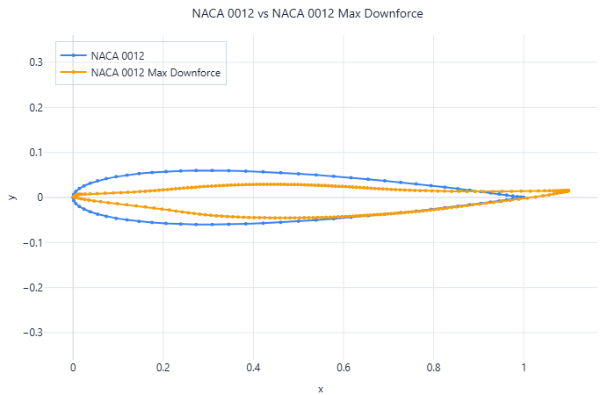
Downforce Trial
Variable | Test
Dimensions | 2D
Altitude (m) | 2,675.17
AoA (°) | 0.00
Chord Length (m) | 1.00
Mach Number | 0.716
C_d | 0.01064
C_l | -0.45670
Lift to Drag Ratio | -42.93
Reynolds Number | 1.30E+07

Slide 36
Fuel Saving Calculations
Variable | Value | Unit
(L/D)_1 | 21.89
(L/D)_2 | 46.54
Amount | 20000
Flight Hours Per Flight | 4 | h
Flight Seconds Per Flight | 14,400.00 | s
Number of Flights | 25
R | 918,720 | m
TSFC | 0.00005 | s^-1
V | 63.8 | m/s
Weight | 7,396.74 | N
ln(W_1/W_2)_1 | 0.032891731
ln(W_1/W_2)_2 | 0.015470563
(W_1/W_2)_1 | 1.033438644
(W_1/W_2)_2 | 1.015590852
m_fuel_1 | 25.21 | kg
m_fuel_2 | 11.76 | kg
Savings | 13.46 | kg
Total Fuel Savings: | 6,728.62 | Tonnes
Total Carbon Savings: | 21,195.15 | Tonnes
Variable | Value | Unit
(L/D)_1 | 6.286428467
(L/D)_2 | 18.64812026
Amount | 255
Flight Hours Per Flight | 10 | h
Flight Seconds Per Flight | 36,000 | s
Number of Flights | 200
R | 9,074,722 | m
TSFC | 0.000016 | s^-1
V | 252.0756 | m/s
Weight | 1,790,128.80 | N
ln(W_1/W_2)_1 | 0.091625953
ln(W_1/W_2)_2 | 0.030887832
(W_1/W_2)_1 | 1.095954807
(W_1/W_2)_2 | 1.03136981
m_fuel_1 | 17,509.83 | kg
m_fuel_2 | 5,724.36 | kg
Savings | 11,785.47 | kg
Total Fuel Savings: | 601,058.98 | Tonnes
Total Carbon Savings: | 1,893,335.78 | Tonnes

