Slide 1
ALFIRT
Automated Loop For Image Recognition Testing

Slide 2
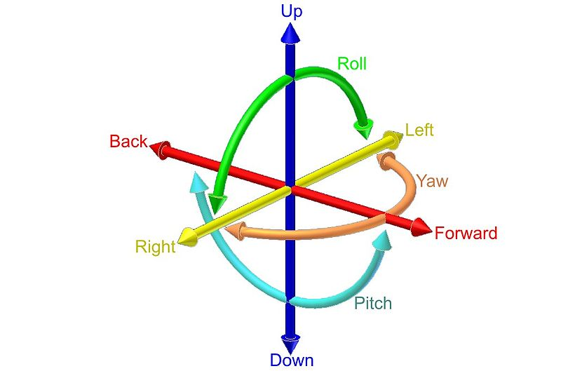
Object Pose Problem
Object Pose – 6 DOF representation.

Slide 3
Why it can be useful?
How we test that object positioning works well ?
How different researchers test theirs algorithms?
Is there a universal way to test objects in constant conditions ?
How to find advantageous conditions for your image recognition algorithm ?

Slide 4
Main conception
Generator
Detector
Verifier

Slide 5
Main conception
Generator
Scene
Image1
ImageN
ImageTest
Config
learn
Detector
test
ImageTest
Pose
Verifier
Pose Test
result

Slide 6
Technology used
Used technology
CPython 2.7
OpenCV 2.2 nightly build
Blender 2.57b OMP
Lot of python stuff:
Mockito
Unittest
…

Slide 7
Configuration File
[PolarCoordinates]
AlfaStart: 20
AlfaStop: 50
BetaStart: 100
BetaStop: 150
RadiusStart: 10
RadiusStop: 10
[File]
InputFileName : myFileName
InputFormat : .collada
OutputFormat: .jpg

Slide 8
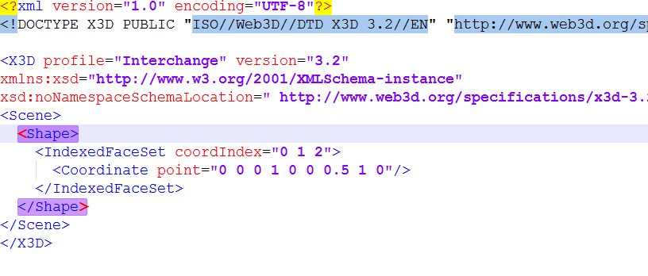
Scene File – x3d

Slide 9
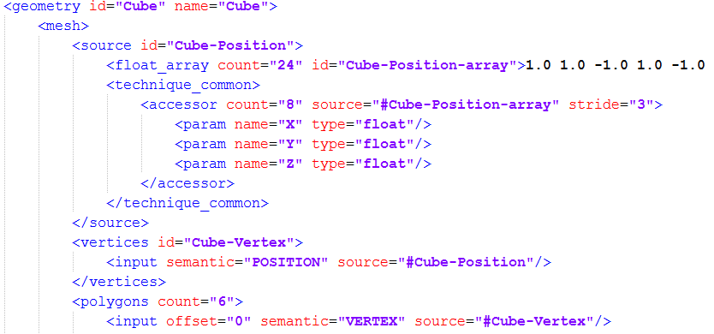
Scene File – COLLADA

Slide 10
Alfirt TAGs

Slide 11
Rendering
Various engines used for blender rendering pipe:
Built-in OpenGL render
LuxRender

Slide 12
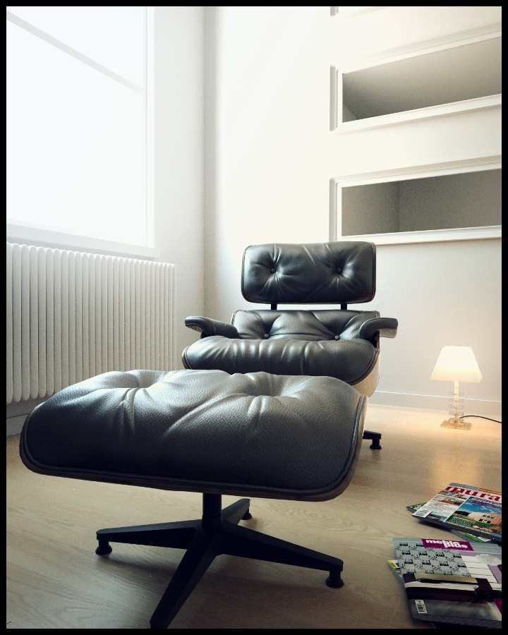
Rendering

Slide 13
State of implementation
TODO: ten sam smart art ale z kolorkami co jest zaimplementowane a co nie?

Slide 14
Planned experiments
simple object rotation
simple object with occlusion
multiple objects in various lights
multiple objects with foggy occlusion

Slide 15

Source Code
https://github.com/Dzess/ALFIRT
MIT License !

Slide 16
Thank you for your attention!
Any Questions?

