Slide 1
ALFIRT
Automated Loop For Image Recognition Testing

Slide 2
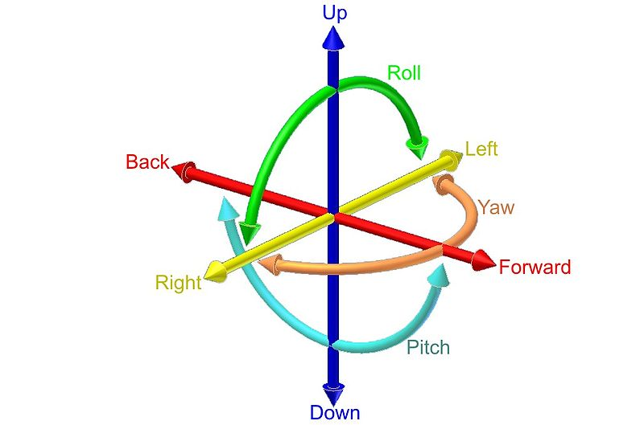
Object Pose Problem
Object Pose – 6 DOF representation.

Slide 3
Why it can be useful?
How we test that object positioning works well ?
How different researchers test theirs algorithms?
Is there a universal way to test objects in constant conditions ?
How to find advantageous conditions for your image recognition algorithm ?

Slide 4
Main conception
Generator
Detector
Verifier

Slide 5
Main conception
Generator
Scene
Image1
ImageN
ImageTest
Config
learn
Detector
test
ImageTest
Pose
Verifier
Pose Test
result

Slide 6
Technology used
Used technology
CPython 2.7
OpenCV 2.2 nightly build
Blender 2.57b OMP
Lot of python stuff:
Mockito
Unittest
PyLint
…

Slide 7
Configuration File
[PolarCoordinates]
AlfaStart: 20
AlfaStop: 50
BetaStart: 100
BetaStop: 150
RadiusStart: 10
RadiusStop: 10
[File]
InputFileName : myFileName
InputFormat : .collada
OutputFormat: .jpg

Slide 8
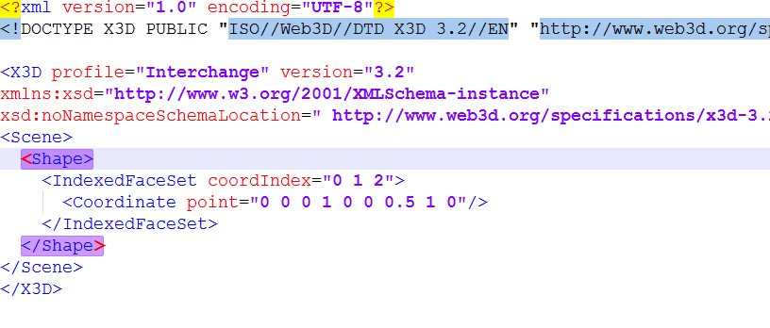
Scene File – X3D

Slide 9
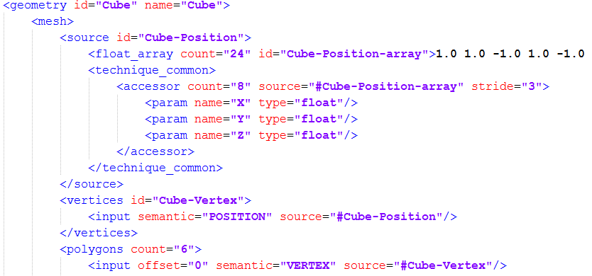
Scene File – COLLADA

Slide 10
Alfirt TAGs
How to add information about position of object ?
How to add information about the camera?
Answer: XML Namespace Attributes
What kind of granularity ?

Slide 11
Rendering
Various engines used for blender rendering pipe:
Built-in OpenGL render
LuxRender

Slide 12
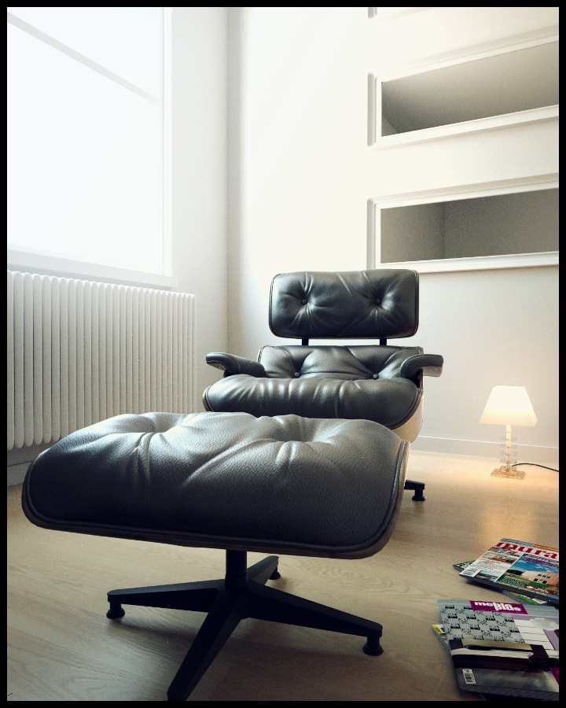
Rendering

Slide 13
State of implementation
Generator
Scene
Image1
ImageN
ImageTest
Config
learn
Detector
test
ImageTest
Pose
Verifier
Pose Test
result

Slide 14
Planned experiments
simple object rotation
simple object with occlusion
multiple objects in various lights
multiple objects with foggy occlusion

Slide 15

Source Code
https://github.com/Dzess/ALFIRT
MIT License !

Slide 16
Thank you for your attention!
Any Questions?

