Slide 1
Bitmap Index Compression
Piotr Jessa

Slide 2
Agenda
What is bitmap index?
Where is it used?
Column indexes for OLTP databases
OLAP fact tables and data mining algorithms
Why compress it?
How can we compress it efficiently ?
What does efficient compression really mean ?
Typical Algorithms of Compression:
RLE
Delta / Gamma codes
BBC
WAH
Sorting values
What about: Huffman, Arithmetic Coding, LZ77 ?

Slide 3
Sources
Daniel Lemire presentations about OLAP and indices / indexes
US Patents: US6831575, US5363098
Some Articles: Kesheng Wu et al.
Fast Bit
Wikipedia
Oracle Documentation ;)

Slide 4
Bitmap Index
RowID | Value | B0 | B1 | B2 | B3
0 | 1 | 0 | 1 | 0 | 0
1 | 2 | 0 | 0 | 1 | 0
2 | 0 | 1 | 0 | 0 | 0
3 | 3 | 0 | 0 | 0 | 1
4 | 2 | 0 | 0 | 1 | 0
5 | 1 | 0 | 1 | 0 | 0
6 | 2 | 0 | 0 | 1 | 0
n values for L distinct values
nL bits
L = 10⁴ , n = 10⁶

Slide 5
OLTP
Where used:
joins between tables on the dense attribute
searching for exact attribute value in complex queries
Constraints:
The amount of values of indexed column should be < 1% of rows (by Oracle documentation)
Slow DML operations
Very slow alter table stuff

Slide 6
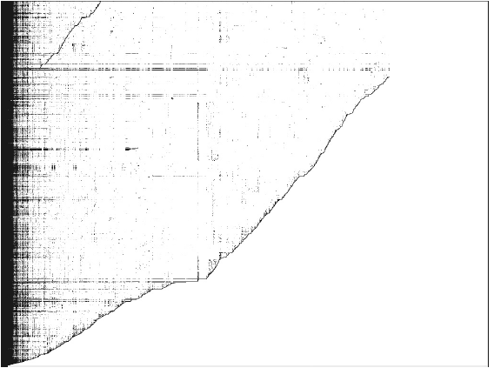
OLAP

Slide 7
Challenges
What is the goal of the compression ?
Size
Efficiency
OLTP versus OLAP goals differ
OLTP withstands with B+ tree indices
OLAP can not

Slide 8
RLE
Basic Run Length Encoding:
0001111100010111
3 5 3 113
Can be worse than no encoding:
11 -> [00000010]1

Slide 9
Elias Gamma Encoding
Use no more than c log x bits to represent value
1 = 2⁰ + 0 1 1/2
2 = 2¹ + 0 010 1/8
3 = 2¹ + 1 011 1/8
4 = 2² + 0 00100 1/32
5 = 2² + 1 00101 1/32
6 = 2² + 2 00110 1/32
7 = 2² + 3 00111 1/32
8 = 2³ + 0 0001000 1/128
9 = 2³ + 1 0001001 1/128
10 = 2³ + 2 0001010 1/128
11 = 2³ + 3 0001011 1/128
12 = 2³ + 4 0001100 1/128
13 = 2³ + 5 0001101 1/128
14 = 2³ + 6 0001110 1/128
15 = 2³ + 7 0001111 1/128
16 = 2⁴ + 0 000010000 1/512
17 = 2⁴ + 1 000010001 1/512

Slide 10
Elias Delta Encoding
On top of gamma encoding
Not actually worth mentioning
According to Lemire in some weak meaning the Delta Encoding is optimal

Slide 11
Aligned RLE like algorithms
BBC (Byte aligned Bitmap Code):
Used by Oracle (1 – sided version)
Invented in Oracle Corp
Example should go here !!!
WAH (Word Aligned Hybrid):
Uses processor word instead of byte
Optimizes speed not size
Up to 12 times faster query return time than BBC
VLC (Variable Length Coding):
Adaptive WAH
Might be faster
Position List WAH:
Smaller than WAH equally fast

Slide 12
Efficiency definition
Operation such as: B₁ v B₂ or B₁ ^ B₂
Go in time: O(|B₁| + |B₂|)
All RLE – like indices are sorting aware
Finding the best sorting is NP-hard [Lemire et al. 2009]

Slide 13
Some tricks
K of N encoding
Hierarchical indexes
Sorting orders:
Lexicographical order
Grey order

Slide 14
Software
Lemur Bitmap Index: http://code.google.com/p/lemurbitmapindex
FastBit: http://crd-legacy.lbl.gov/~kewu/fastbit/
JavaEWAH: http://code.google.com/p/javaewah/

