Slide 1
Bitmap Index Compression
Piotr Jessa

Slide 2
Agenda
What is bitmap index?
Where it is used?
Column indexes for OLTP databases
OLAP fact tables and data mining algorithms
Why compress it?
How we can compress it efficiently ?
What does efficient compression really mean ?
Typical Algorithms of Compression:
RLE
Delta / Gamma codes
BBC
WAH
Sorting values
What about: Huffman, Arithmetic Coding, LZ77 ?

Slide 3
Sources
Daniel Lemire presentations about OLAP and indices / indexes
Fast Bit
Wikipedia
Oracle Documentation

Slide 4
Bitmap Index
Compute the union of two sets of rowID – Bitwise OR
Search for rowID in database – Bitwise AND
n values for L distinct values
nL bits
L = 10⁴ , n = 10⁶

Slide 5
OLTP
Where used:
joins between tables on the dense attribute
searching for exact attribute value in complex queries
Constraints:
The amount of values of indexed column should be < 1% of rows (by Oracle documentation)
Slow DML operations
Very slow alter table stuff

Slide 6
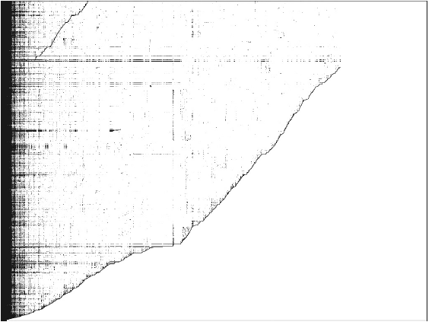
OLAP

Slide 7
Challenges
What is the goal of the compression ?
Size
Efficiency
OLTP versus OLAP goals differ
OLTP withstands with B+ tree indices
OLAP can not

Slide 8
RLE
Basic Run Length Encoding:
0001111100010111
3 5 3 113
Can be worse than no encoding:
11 -> [00000010]1

Slide 9
Delta & Gamma Encoding
Use no more than c log x bits to represent value
Gamma Code:
TODO: opisac najlepiej na obrazku
Delta Code:
TODO: opisac najlepiej na obrazku

Slide 10
Word aligned RLE
Machine word aligned
Trade compression for speed
BBC:
TODO opisc najlepiej na obrazku
WAH:
TODO opisac najlepiej na obrazku

Slide 11
Efficiency definition
Operation such as: B₁ v B₂ or B₁ ^ B₂
Go in time: O(|B₁| + |B₂|)
All RLE – like indices are sorting aware
Finding the best sorting is NP-hard [Lemire et al. 2009]

Slide 12
Some tricks
K of N encoding
Hierarchical indexes
Sorting orders:
Lexicographical order
Grey order

Slide 13
Software
Lemur Bitmap Index: http://code.google.com/p/lemurbitmapindex
FastBit: http://crd-legacy.lbl.gov/~kewu/fastbit/
JavaEWAH: http://code.google.com/p/javaewah/

