Slide 1

JVM Basics
Apache Tomcat
Apache HTTPD
September 1, 2016

Slide 2
What is JVM
A java virtual machine (JVM) is an abstract computer architecture
Software on top of a real hardware
Can run the same application on different machines where the JVM is available

Slide 3
JDK vs JRE and how JVM works
JDK contains everything that will be required to develop and run Java application.
JRE contains everything required to run Java application which has already been compiled. It doesn’t contain the code library required to develop Java application.
JRE = JVM + Required Library to run Application.
JDK = JRE + Required Library to develop Java Application.
Java program compiles into byte code (.java -> .class)
JVM interprets and converts byte code into machine code
http://javabeginnerstutorial.com/core-java-tutorial/java-virtual-machine-basics/
-Xms – initial java heap size
-Xmx – maximum java heap size
http://blog.sokolenko.me/2014/11/javavm-options-production.html

Slide 4
Apache Tomcat Installation
Tomcat server is servlet container running on top of JVM (JRE is required)
JRE install: sudo yum install java-1.8.0-openjdk
Installation is simple: sudo yum install tomcat tomcat-webapps tomcat-admin-webapps
Startup: sudo systemctl start tomcat (http://localhost:8080)
Restart: sudo systemctl enable tomcat (enable for auto start)
Webapps folder in /usr/share/tomcat

Slide 5
Apache HTTPD installation
Simple install: sudo yum install httpd
To start:
sudo systemctl enable httpd
sudo systemctl start httpd (http://localhost:80)
Home dir: /etc/httpd
Open firewall port:
firewall-cmd --zone=public --add-port=80/tcp --permanent
firewall-cmd –reload
systemctl stop firewalld (stop firewall)

Slide 6
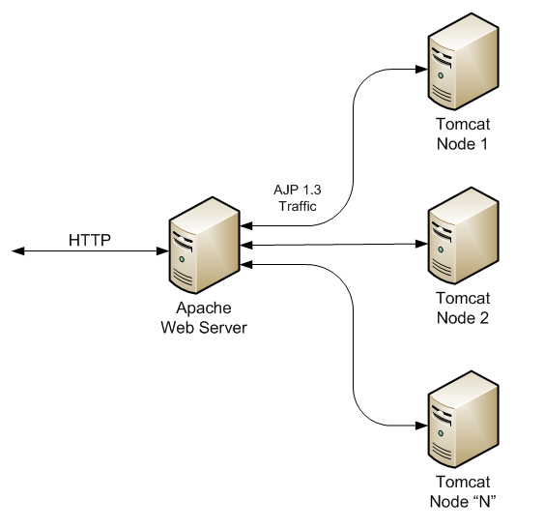
Apache HTTPD + Tomcat
Mostly used way to connect HTTPD with tomcat is mod_jk connector
Copy mod_jk connector
sudo cp /vagrant/mod_jk.so /etc/httpd/modules/
Create /etc/httpd/conf/workers.properties with content
worker.list=lb
worker.lb.type=lb
worker.lb.balance_workers=myworker, other
worker.myworker.host=localhost
worker.myworker.port=8009
worker.myworker.type=ajp13

Slide 7
Apache HTTPD + Tomcat (Continuation)
Edit /etc/httpd/conf/httpd.conf
Add to the end of file
LoadModule jk_module modules/mod_jk.so
JkWorkersFile conf/workers.properties
JkShmFile /tmp/shm
JkLogFile logs/mod_jk.log
JkLogLevel info
JkMount /test* lb
Restart apache
Monitoring: workers.properties: worker.list=status, worker.status.type=status
Httpd.conf: JkMount /jk-status status

Slide 8
Useful links
Apache HTTP server, Apache Tomcat, protocols:
http://www.wellho.net/mouth/1549_http-https-and-ajp-comparison-and-choice.html
https://www.youtube.com/watch?v=1ZioHruINOA
https://www.youtube.com/watch?v=Hb8RMiFK4z8

Slide 9
Task for Module 2
Create Vagrantfile (in “task2” branch) based on Centos7 distributive.
Vagrantfile should bring up and provision three VMs:
1 with with Apache httpd
2 with with JRE + Apache tomcat
Create index.html (in both tomcat VMs) in usr/share/tomcat/webapps/<some_fodler>
Configure load balancing
Note: possible workaround to get IP address:
systemctl restart network

