Slide 1
Spending PATTERNS AS INDICATORS FOR BUSINESS OPPORTUNITIES: PROVINCE BASED ANALYSIS
Presented By: Bernice Buafor
Data Source: Survey of Household Spending (SHS) 2019, Statistics Canada
Notes:
---

Slide 2
Unlocking canada's consumer markets
The Challenge: Businesses lack knowledge on spending patterns within households and how income levels affect purchasing of goods and services
The Solution: A data-driven analysis of provincial household spending
The Outcome: A clear strategy answering the 3 W's:
WHERE to expand
WHO to target
WHAT to offer

Slide 3

Project Objectives
Identify provinces leading in consumer spending across major categories
Compare and analyze spending patterns to tailor regional business strategies
Explore income-level based spending differences for targeted segmentation
Notes:
---
This slide references information from the following file: https://generationye-my.sharepoint.com/personal/berniceb_genstudents_org/Documents/Microsoft%20Copilot%20Chat%20Files/Bernice_Buafor_DA_Project.pdf
The project is guided by three main objectives: First, to identify provinces with the highest spending across various categories, helping businesses pinpoint regions with strong market potential. Second, to compare spending patterns across provinces, enabling companies to tailor their offerings to regional preferences. Third, to understand how spending behavior changes with income levels, which is crucial for segmenting customers and designing targeted products and services. These objectives collectively support strategic decision-making and market expansion.

Slide 4
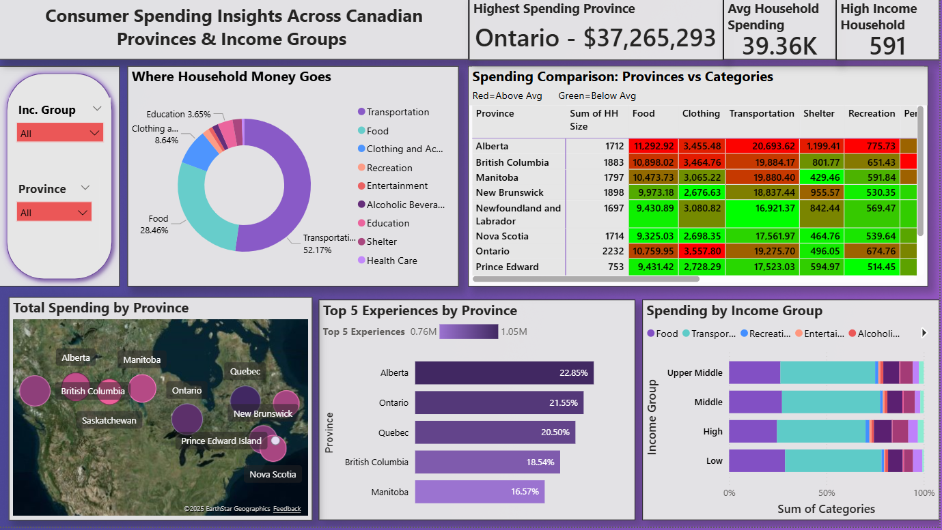

DASHBOARD OVERVIEW

Slide 5
Strategic Business Recommendations
Market Prioritization:
  Focus on Ontario and Alberta for high luxury consumer spend
Income-Based Segmentation:
  Premium segment: Households earning $200K+ for luxury products
  Value segment: Households under $200K for essentials
Category Prioritization:
  Transportation and Food receive the largest spend share—optimize pricing here
Marketing Focus:
  Allocate 80% of marketing effort to top 2 spending provinces
Timing and Rollout:
  Phased approach to market entry and expansion
Notes:
Based on the dashboard insights, several strategic recommendations can be made. First, businesses should target high-spending provinces like Ontario and Alberta for marketing and product launches. Second, products should be tailored to income groups: essentials for low-income households and luxury or experience-based offerings for high-income segments. Third, expanding leisure and entertainment offerings in provinces with high spending in these categories, such as British Columbia, can capture more market share. Fourth, optimizing pricing strategies for dominant categories like Shelter and Food can improve competitiveness. Lastly, businesses should leverage seasonal trends in categories like Recreation and Entertainment to plan effective promotional campaigns.

Slide 6

Expansion Timeline & Execution Phases
Phase 1 (0-3 months): Ontario launch; focus on Transportation, Food, Clothing with premium pricing
Phase 2 (3-6 months): Expand to British Columbia with customized offerings and holiday season campaigns
Phase 3 (6-12 months): Pricing refinement and broad scaling based on success metrics
Notes:
To support ongoing business decisions, several key performance indicators (KPIs) are recommended. These include: Total Household Spending by Province, which helps identify high-value markets; Average Household Spending, providing a benchmark for pricing and market sizing; Top Spending Category Share, indicating which categories dominate consumer budgets; Spending by Income Group, showing how different income levels allocate their resources; and Entertainment & Recreation Growth Rate, useful for tracking trends in lifestyle spending. These KPIs enable businesses to monitor changes over time and adjust strategies accordingly.

Slide 7
Key Performance Indicators (KPIs)
Total household spending by province and category
Average household spending per income group
Share of top spending categories in the market
Growth rate in Entertainment and Recreation expenditures

Slide 8
THANK YOU

