Slide 1
CI/CD
Mantas Boronilščikovas (Mantelis),
Software Engineer
mantas.boronilscikovas@swedbank.lt

Slide 2
Agenda
CI/CD explanation
How it looks in practice?
Tools
Practice

Slide 3

1. What is CI/CD?
Notes:
Ask how many have heard something about it and what

Slide 4
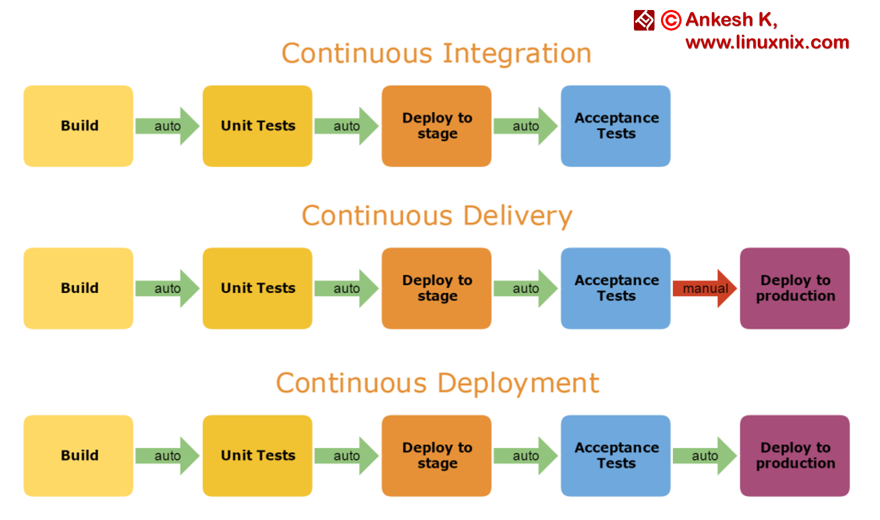
CI/CD
Linux
sudo apt-get install git
sudo yum install git
Mac
http://git-scm.com/download/mac
Windows
http://git-scm.com/download/win
Notes:
Continuous integration and Continuous Delivery are the processes in which your development team involves frequent code changes that are pushed in the main branch while ensuring that it does not impact any changes made by developers working parallelly. The aim of it is to reduce the chance of defects and conflicts during the integration of the complete project.

Slide 5

Why we need Continuous Integration?
Many developers
Shared repository
Frequent integration of code
Notes:
There could be many developers, who is working on one shared repository, and they are pushing they code several times per day.
All points leads to high cost of integrations.

Slide 6
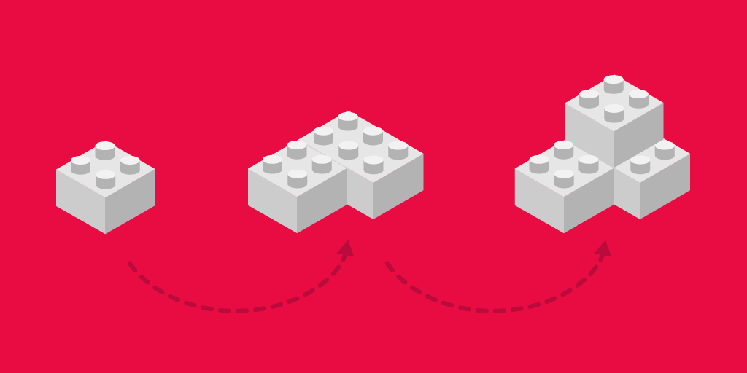
How Continuous Integration work?
As often as you want
Automated test cases
Automated builds
Notes:
The integration may occur several times a day, verified by automated test cases and a build sequence. It should be kept in mind that automated testing is not mandatory for CI. It is only highly recommended for ensuring a bug-free code.
Saves time and Money!

Slide 7
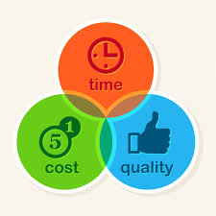
Benefits of Continuous Integration
Reduces bug detection
Automating the process
The process becomes transparent
Cos-effective process
Confidency
Notes:
Reduces Bug Count: the risk is reduced a lot since bugs are now easier to detect and fix early.
Automating the Process: The Manual effort is reduced a lot since CI automates build and a few other tests.
The Process Becomes Transparent: The team gets a clear idea when a test fails, what is causing the failure and whether there are any significant defects.
Cost-Effective Process: Since the bug count is low, manual testing time is greatly reduced and the clarity increases on the overall system, it optimizes the budget of the project.
Confidency: it gives confident after all automated stuff passes

Slide 8

Why Continuous Deployment is needed?
Deliver software with lower risk and money
Notes:
Continuous delivery is the process of getting all kinds of changes to production. Changes may include configuration changes, new features, error fixes etc. They are delivered to the user in a safe, quick and sustainable manner.

Slide 9
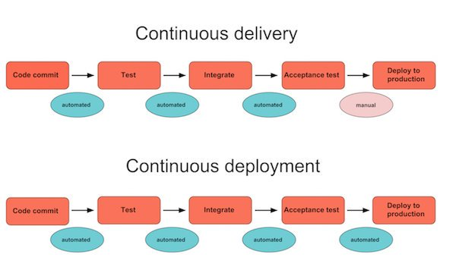
How Continuous Deployment works?
Software build will automatically deploy if it passes all tests
Notes:
Continuous deployment extends continuous delivery so that the software build will automatically deploy if it passes all tests. In such a process, there is no need for a person to decide when and what goes into production. The last step in a CI/CD system will automatically deploy whatever build components/packages successfully exit the delivery pipeline. Such automatic deployments can be configured to quickly distribute components, features, and fixes to customers, and provide clarity on precisely what has is presently in production.

Slide 10
Benefits of Continuous Deployment
Time to market
Reducing the risk
High quality application
Reduced cost
Happier team and better product
Notes:
Time to market: deployment easier, smaller and faster
Reducing the Risk: more smaller releases, almost no downtime, totally undetectable to the users.
High-Quality Application: Most of the process is automated, testers now have a lot of time to focus on important testing phases like exploratory, usability, security and performance testing.
Reduced Cost: When an investment is made on testing, build and deployment, the product evolves quite a lot throughout its lifetime. The cost of frequent bug fixes and improvements are reduced since release is faster and automatic.
Happier Team and Better Product: the team can work in a relaxing manner. Because of frequent release, the team works closely with users and learn what ideas work and what new can be implemented to delight the users.

Slide 11
2. How it looks in practice?

Slide 12
How To Perform Continuous Delivery (1)
The developer builds their code on the local system that has all the new changes or new requirements.
Once coding is completed, the developer needs to write automated unit testing scripts that will test the code. This process is optional, however, and can be done by the testing team as well.
A local build is executed which ensures that no breakage is occurring in the application because of the code.

Slide 13
How To Perform Continuous Delivery (2)
After a successful build, the developer checks if any of his team members or peers have checked-in anything new. If there are any incoming changes, they should be accepted by the developer to make sure that the copy he is uploading is the most recent one.
Because of the newly merged copies, syncing the code with the main branch may cause certain conflicts.
In case there is any conflict, they should be fixed to make sure the changes made are in sync with the main branch.

Slide 14
How To Perform Continuous Delivery (3)
The changes are now ready to be checked in. This process is known as a “code commit.”
After the code is committed, another build of the source code is run on the integration system.
The new and updated code is finally ready for the next stage, i.e. testing or deployment. In the next section, we shall discuss some basic checklist for continuous delivery.

Slide 15
3. Tools

Slide 16


Notes:
Tip: Heroku goes to sleep after 30 seconds

Slide 17
Practice!!!

Slide 18
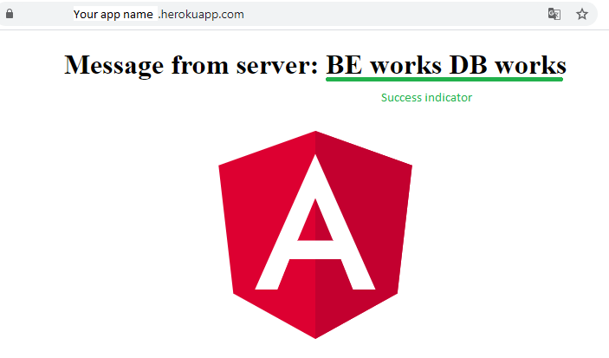
Expected result

