Slide 1
CI/CD
Mantas Boronilščikovas
Software Engineer
mantas.boronilscikovas@swedbank.lt

Slide 2
Agenda
CI/CD explanation
How it looks in practice?
Tools
Practice

Slide 3

1. What is CI/CD?
Notes:
Ask how many have heard something about it and what

Slide 4
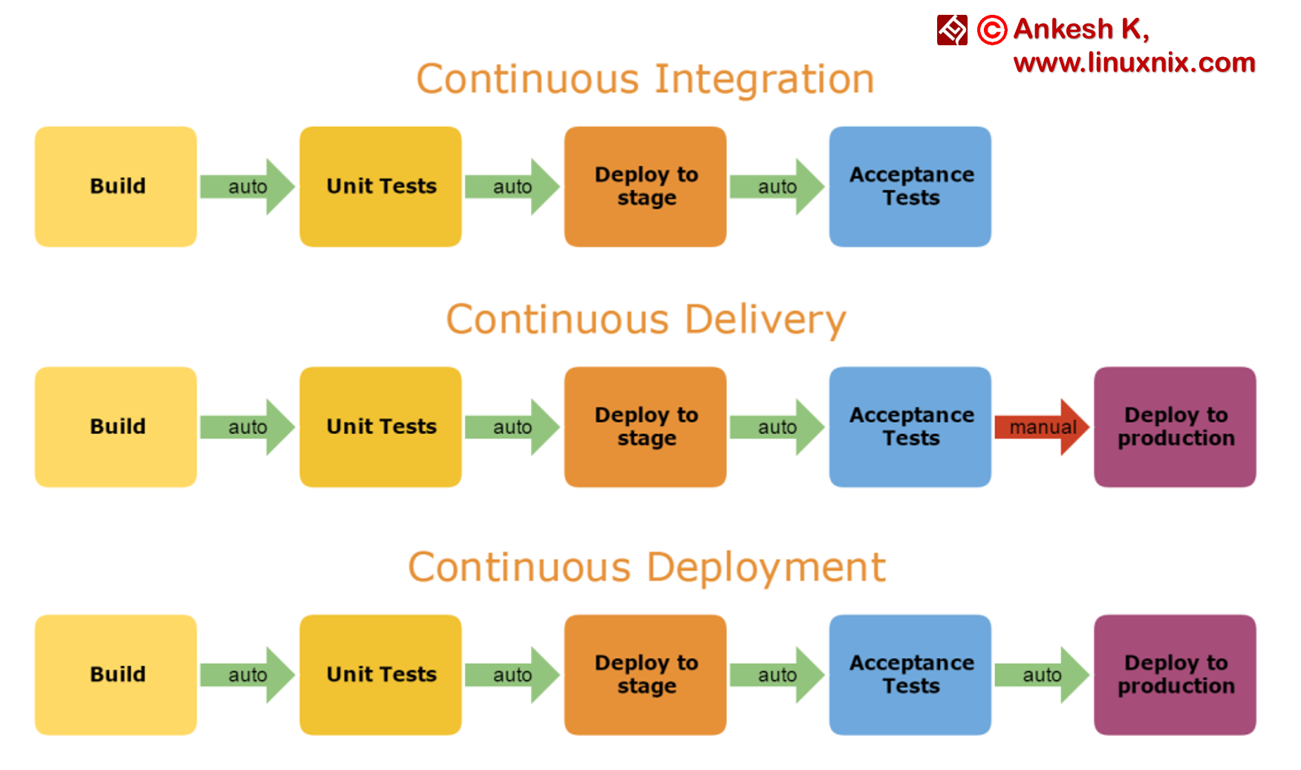
CI/CD
Linux
sudo apt-get install git
sudo yum install git
Mac
http://git-scm.com/download/mac
Windows
http://git-scm.com/download/win
Notes:
Geras dalykas procesu automatizavimui, ypac kai daug developeriu, dirba prie vieno projekto.
CI/CD are the processes in which your development team involves frequent code changes that are pushed in the main branch while ensuring that it does not impact any changes made by developers working parallelly. The aim of it is to reduce the chance of defects and conflicts during the integration of the complete project.

Slide 5

Why we need Continuous Integration?
Many developers
Shared repository
Frequent integration of code
Notes:
Manual budas: manual leidi build komanda, testus, kodo formatavimo checka
Automatizavimas sumazina projekto kastus, tiek del to kad nereikia manual daryti, tiek del to kad sumazeja klaidu tikimybe

Slide 6

How Continuous Integration work?
As often as you want
Automated test cases
Automated builds
Notes:
Kelis kart per diena
Automatizuoti testai ir buildai
Saugo laika ir pinigus!

Slide 7

Benefits of Continuous Integration
Reduces bug detection
Automating the process
The process becomes transparent
Cost-effective process
Confidence
Notes:
Sumazina bugu kieki: pastoviai sukami testai, neleist merginti failinancio kodo
Automatiniai procesai: sumazeja manual darbas, nes paspaudi viena mygtuka ir lauki kol prasisuks visi darbai
Aiskus procesai: aiskiai matomi buildu progresai, ar failinimo priezastys
Efektyvus procesai: visi pries tai isvardinti privaluymai taupo projekto pinigus
Pasitikejimas: implementavus net dideli change, jei visi buildai prasisuko gerai, gali jaustis ramiau zinodamas kad daugiau maziau viskas yra gerai

Slide 8

Why Continuous Deployment is needed?
Deliver software with lower risk and money
Notes:
Mygtuko paspaudimu viskas padaroma, nes kitaip reiketu paciam prisijungti I serveri, pullintis gito changus, paleisti/restartuoti reikalingus servisus.

Slide 9
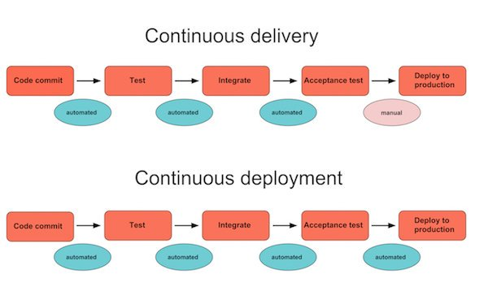
How Continuous Deployment works?
Software build will automatically deploy if it passes all tests
Notes:
Paskutinis zingsnis CI/CD procese, yra padeplointi nauja funkcionaluma ar pataisyma vartotojui, jeigu visi checkai sekmingai prasisuko.

Slide 10
Benefits of Continuous Deployment
Time to market
Reducing the risk
High quality application
Reduced cost
Happier team and better product
Notes:
Time to market: trumpesnis laikas nuo idejos, iki productiono
Reducing the Risk: su automatiniais procesais, galima dazniau releasinti koda, ir buti visada pasiekiamu vartotojui
High-Quality Application: Jeigu parasyti kokybiski auto testai, tai ne tik kodas bus saugesnis nuo bugu, taciau ir testuotojams nereikes savo laiko gaisti ties regression testai, o gales vis daugiau ir daugiau funkcionalumo automatizuoti
Reduced Cost: Kadangi mazeja klaidu tikimybe, tai mazeja ir projekto kaina
Happier Team and Better Product: viskas susiveda kad development komandai nereikia daryti paprastu tasku kaip build/deploy rankiniu budu, ir kuo daugiau kokybisko funkcionalumo production, tuo geresnis produktas

Slide 11
2. How it looks in practice?

Slide 12
How To Perform Continuous Delivery (Manual part)
New code writing
Covering new code with unit tests
Local build checks if new code is working
Pull newly merge code, and resolve conflicts if any
Push your code to git
Notes:
Parasomas naujas kodas
Naujas kodas padengiamas unit testais
Patikrinima ar naujas kodas veikia
Jeigu atsirado naujo sumerginto kodo ji reikia parsipullinti
Kodas supushinamas i gito repositorija

Slide 13
How To Perform Continuous Delivery (Automated part)
Code format checks
Unit test
Build and deploy to stage
Integration/API/E2E tests
Code deploying in produdction
Notes:
Kodo formatavimo checkai
Leidziami unit testai
Bandoma subuildinti ir padeplointi koda
Leidziami integration/api/e2e testai
Kodas dedamas I production serveri

Slide 14
How It looks in the bank
Confidential demo
Notes:
TDE: RTC -> Jenkins -> slot
Mono: git -> Jenkins -> slot
Andromeda: git -> Jenkins -> openshift

Slide 15
How It looks in personal projects
Demo

Slide 16
3. Tools

Slide 17


Notes:
Tip: Heroku goes to sleep after 30 seconds
Travis CI
Heroku CD
Travis ir Heroku demo

Slide 18
Practice!!!
https://github.com/mantelisb/CICD-lecture/blob/master/instructions.md

Slide 19
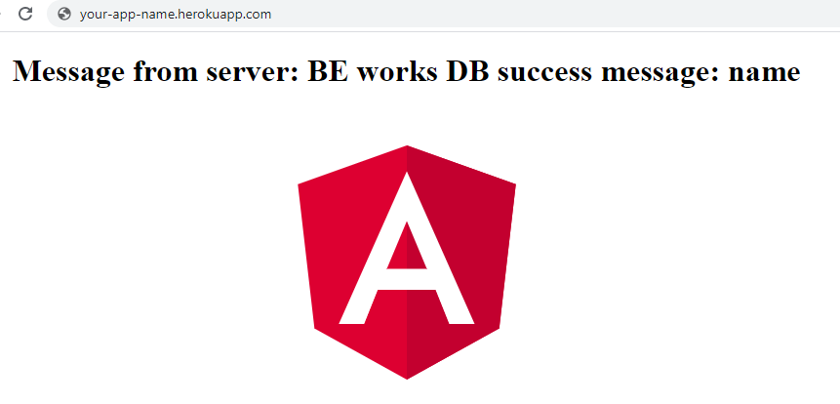
Expected result

