Slide 1
MCP
MCP Assistant
Personal Productivity Server
19+ AI-Callable Tools | Multi-Model Chat | Per-User Isolation | React Frontend
Hackathon Project 2026
Built with FastMCP + Python + React

Slide 2
What is MCP Assistant?
A personal productivity platform that exposes 19 AI-callable tools through the Model Context Protocol (MCP).
MCP Server (port 8000)
Single-user, local IDE clients like Claude Desktop or Cursor
Users interact via a React chat interface backed by OpenRouter for multi-model LLM support. The assistant can check weather, manage notes and tasks, track time, set reminders, read news, and manage calendar events.
Chat API (port 8001)
Multi-user, per-user data isolation, React frontend
React Frontend (port 3000)
Two access paths: a local MCP server for IDE clients, and a multi-user Chat API for the web frontend.
Modern chat UI with model switching and tools panel
2

Slide 3
19+ AI-Callable Tools
WEATHER
TIME
NOTES
get_weather
get_world_time
create_note
Current weather by city or coords
Current time in any timezone
Save persistent notes (SQLite)
get_forecast
convert_timezone
search_notes
Multi-day forecast (1-5 days)
Convert between timezones
Full-text search across notes
convert_temperature
Celsius / Fahrenheit conversion
TASKS
PRODUCTIVITY
INFORMATION
create_task
track_time
get_news
Create with priority and due date
Start/stop project time tracking
Latest headlines by topic
list_tasks
get_time_summary
Filter by status and priority
Daily/weekly time reports
set_reminder
Schedule time-based alerts
list_reminders
View active reminders
SMART ASSISTANT
summarize_day
Combined daily briefing
plan_meeting
Find slots across timezones
3

Slide 4
Architecture
React Frontend
Tool Auto-Discovery
Port 3000 | Vite + React
@mcp.tool() decorator + pkgutil import
Chat UI, model selector, tools panel
Add a file = tool is live. No registration.
v
Data Tenancy
MCP path: global shared DB
Chat API path: data/user_id/ isolation
Chat API (Starlette)
LLM Integration
Port 8001 | Multi-user auth
OpenRouter multi-model switching
OpenRouter LLM | Per-user DB isolation
Claude, GPT-4o, Gemini, Llama, DeepSeek
v
Storage
aiosqlite per domain (notes, tasks, etc.)
Pydantic-Settings for config (.env)
MCP Server (FastMCP)
Port 8000 | Streamable HTTP
19 auto-discovered tools
4

Slide 5
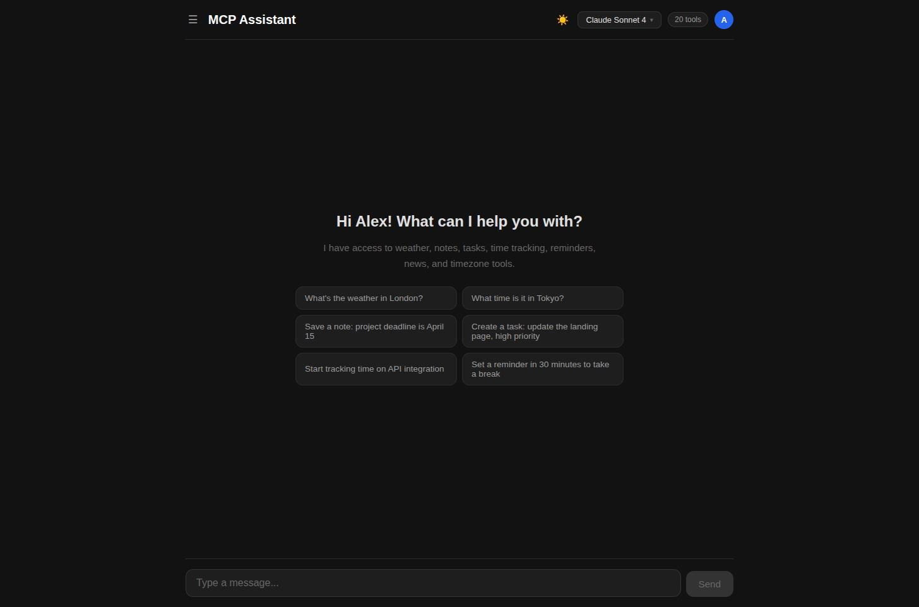
UI: Login & Welcome
Simple Login
Name-based auth with per-user data isolation. API key generated on first login.
Welcome Screen
Personalized greeting with 6 template prompts covering weather, notes, tasks, time tracking, and reminders.
Quick Actions
One-click suggestion chips let users instantly try common workflows without typing.
Dark / Light Theme
5

Slide 6
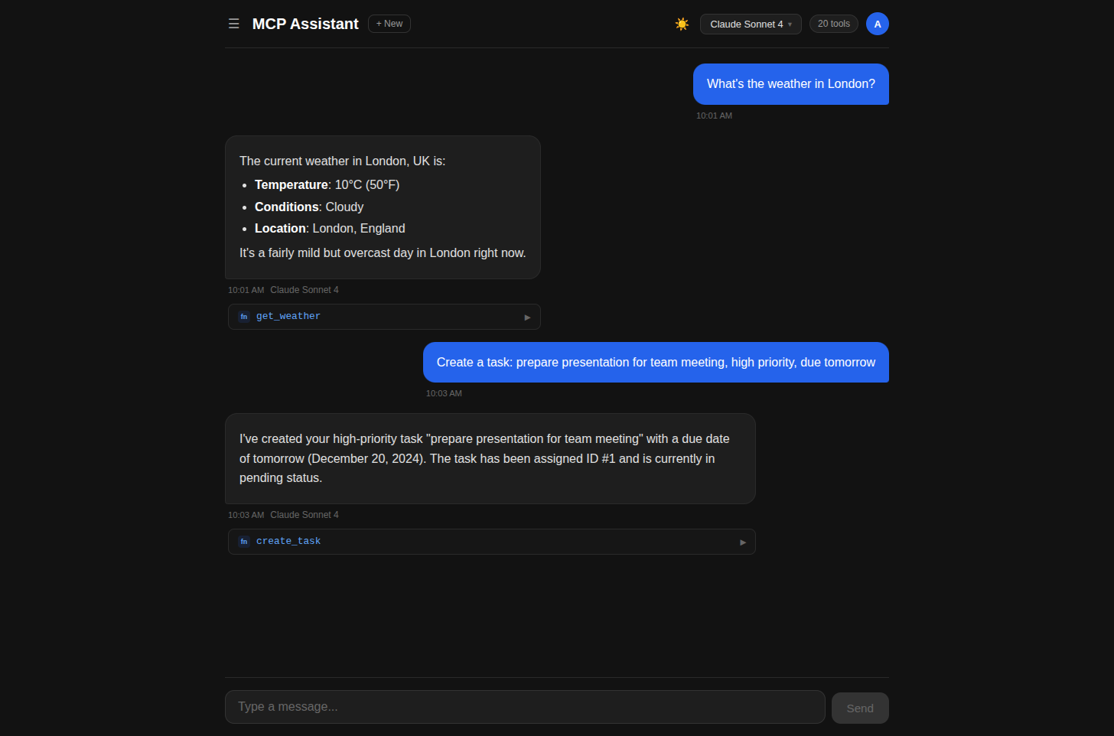
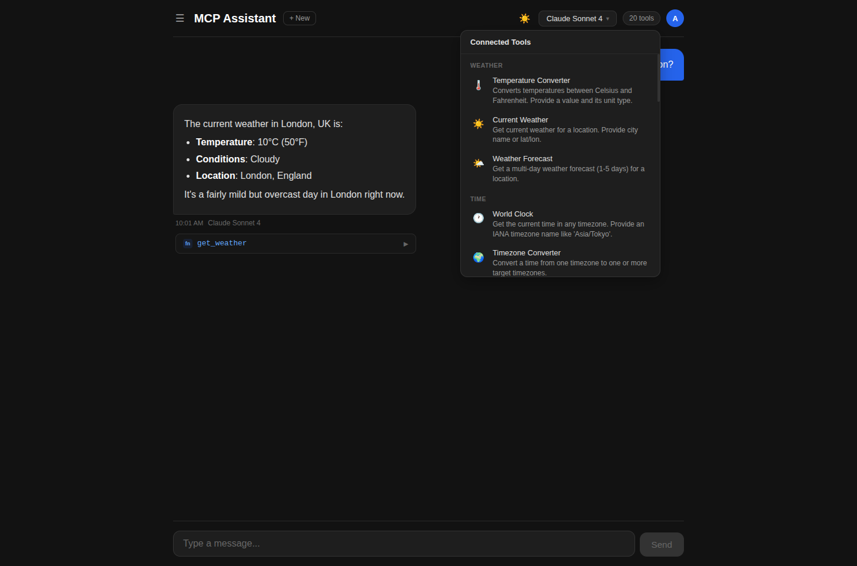
UI: Chat & Tool Calls
Multi-Turn Chat with Tool Execution
Connected Tools Panel
Weather query via get_weather, then task creation via create_task — both with tool call badges and formatted responses
20 tools organized by category (Weather, Time, Notes, Tasks, Productivity) with descriptions and icons
6

Slide 7
Tech Stack
19+
8
101
8
AI Tools
LLM Models
Tests
Tool Domains
BACKEND
FRONTEND
Python 3.12+ / FastMCP
React 19 + Vite
Starlette / Pydantic v2
react-markdown / CSS Variables
aiosqlite / httpx
TESTING
AI / LLM
pytest-asyncio / pytest-mock
OpenRouter (multi-model)
101 tests across all tools, auth + Chat API
Claude, GPT-4o, Gemini, Llama, DeepSeek
DEVOPS
Docker Compose / uv
MCP Inspector for dev testing
7

Slide 8
Security & OWASP
IMPLEMENTED PROTECTIONS
AI-SPECIFIC SAFETY
Authentication & Isolation
LLM Tool Guardrails
✓ Per-user SQLite databases (data/{user_id}/)
✓ READ/WRITE tool separation in system prompt
✓ API keys hashed at rest (SHA-256)
✓ Side-effect dedup (prevents duplicate writes)
✓ Re-login invalidates old key
✓ Tool loop capped at 5 rounds
✓ Auth required on all endpoints
✓ ToolAnnotations (readOnly/destructive hints)
Input & Query Safety
OWASP TOP 10 COVERAGE
✓ Parameterized SQL everywhere (A03 Injection)
Assessed & Documented
✓ Pydantic validation + max_length
A01 Broken Access Control — mitigated (per-user DB)
✓ 512KB request size limit
A02 Crypto Failures — mitigated (hashed keys)
✓ react-markdown sanitizes HTML (XSS)
A03 Injection — mitigated (parameterized SQL)
A05 Misconfiguration — mitigated (localhost, CORS)
Network & Config
A07 Auth Failures — known: name-based (demo)
✓ Localhost-only binding (127.0.0.1)
HARDENING ROADMAP
✓ CORS restricted to localhost:3000
✓ Secrets in .env (gitignored)
Phase 1 → 2 → 3
✓ SQLite WAL mode + busy timeout
Rate limiting → OAuth login → MCP auth
Key expiry → Audit logging → TLS/HTTPS
Full roadmap in SECURITY.md
8

Slide 9
Thank You!
Questions & Demo
MCP Server
Chat API
Frontend
localhost:8000
localhost:8001
localhost:3000
Built with FastMCP + Python + React | Hackathon 2026

