Slide 1


Dapr in Action
From Core Concepts to AI Agents
Dana Arsovska
Community Manager @Dapr
Marc Duicker
Community Manager @Dapr

Slide 2






Workshop Goals
Very short intro (we promise)!
What are LLMs?
Create agent using Dapr Agents
Implement the ReAct pattern (Reasoning + Action)
Build custom tools for agents to use
Create multi agent workflow

Slide 3
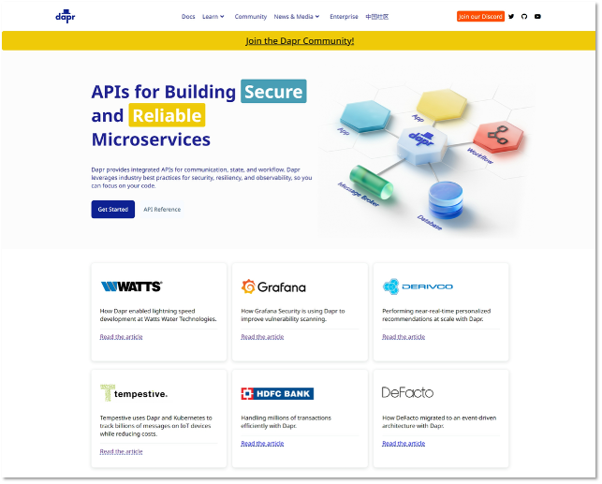


Distributed Application Runtime
dapr.io
Graduated project

Slide 4
Speeds up application development by providing an integrated set of APIs for communication, state, and workflow.

Slide 5



Dapr Goals
Provide an integrated set of APIs
Any language or framework
Includes best practices & standards
Platform agnostic
Extensible and pluggable
Community driven, vendor neutral

Slide 6

Dapr Agents
https://dapr.github.io/dapr-agents/

Slide 7
Dapr Agents
Dapr Agents is a developer framework designed to build production-grade resilient AI agent systems that operate at scale.
Built on top of Dapr
Kubernetes-Native
Data-Driven Agents
Multi-Agent Systems

Slide 8







Agent Interactions
Planning
Memory
Interaction
Environment
User
Observation
Delegate tasks
Tools
Outside world
Notes:
Dapr Agents is designed to place agents, powered by LLMs, at the core of task execution and workflow orchestration. This principle emphasizes:
LLM-Powered Agents: Dapr Agents enables the creation of agents that leverage LLMs for reasoning, dynamic decision-making, and natural language interactions.
Adaptive Task Handling: Agents in Dapr Agents are equipped with flexible patterns like tool calling and reasoning loops (e.g., ReAct), allowing them to autonomously tackle complex and evolving tasks.
Seamless Integration: Dapr Agents’ framework allows agents to act as modular, reusable building blocks that integrate seamlessly into workflows, whether they operate independently or collaboratively.

Slide 9


Dapr Agents
AI Agent
Response
{
Reasoning
Prompt
Action
User
LLM
Planning
Observation
Tools
Outside world
Notes:
Agents in Dapr Agents are autonomous systems powered by Large Language Models (LLMs), designed to execute tasks, reason through problems, and collaborate within workflows. Acting as intelligent building blocks, agents seamlessly combine LLM-driven reasoning with tool integration, memory, and collaboration features to enable scalable, agentic systems.

Slide 10

ReAct flow
User
LLM
Thought
Act
Act
Obs
Obs
Tool A
Tool B
Final answer
Notes:
The ReAct (Reason + Act) pattern was introduced in 2022 to enhance the capabilities of LLM-based AI agents by combining reasoning with action. This approach allows agents not only to reason through complex tasks but also to interact with the environment, taking actions based on their reasoning and observing the outcomes. ReAct enables AI agents to dynamically adapt to tasks by reasoning about the next steps and executing actions in real time.

Slide 11
Workshop Overview
https://github.com/pyladiesams/dapr-in-action-may2025

Slide 12
The Use Case
Let’s build an AI tool that:
Automatically collects and summarizes daily news.
Provides clear explanations and insights.
Checks real-time stock prices for specific companies.
Analyzes sentiment behind the news to help you make informed decision
Too busy to track news and market trends?
Let’s create a productivity bot!

Slide 13


Our Stack
Dapr Agents
Framework to build AI Agent Systems
HuggingFace API
API access to various LLMs
Tools
CurrentsApi (Daily News)
Yahoo Stock Market API

Slide 14

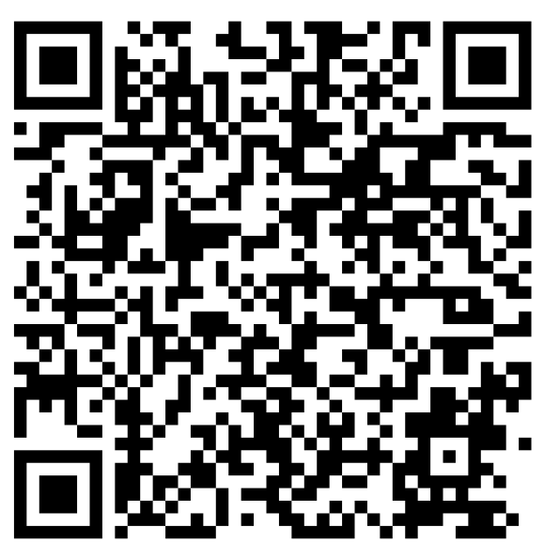
Let’s get started
Option 1: Jupyter Lab
Clone this git repo
Set the API keys and install the dependencies based on the instruction in the README
Open “workshop/introductory_workshop/ 1_ask_llm.ipynb”
You are ready to start!
Option 2: Google Colab
In Google Colab > Open notebook > Github > paste the repository link > click on “workshop/introductory_workshop/1_ask_llm.ipynb”
Set the API keys and install the dependencies based on the instruction in the notebook.
You are ready to start!
Github repo
Slides

Slide 15
Dapr Agents
AI Agent
Response
{
Reasoning
Prompt
Action
User
LLM
Planning
Observation
News API
Stocks API
Tools
Outside world
Notes:
Agents in Dapr Agents are autonomous systems powered by Large Language Models (LLMs), designed to execute tasks, reason through problems, and collaborate within workflows. Acting as intelligent building blocks, agents seamlessly combine LLM-driven reasoning with tool integration, memory, and collaboration features to enable scalable, agentic systems.

Slide 16
Advanced Workshop: Multi-Agent Workflow
Local setup
Clone this git repo
Navigate to “workshop/advanced_workshop/04-multi-agent-workflow-dapr-workflows/”
Follow the instructions in the README.
You are ready to start!
Github repo
Slides

Slide 17
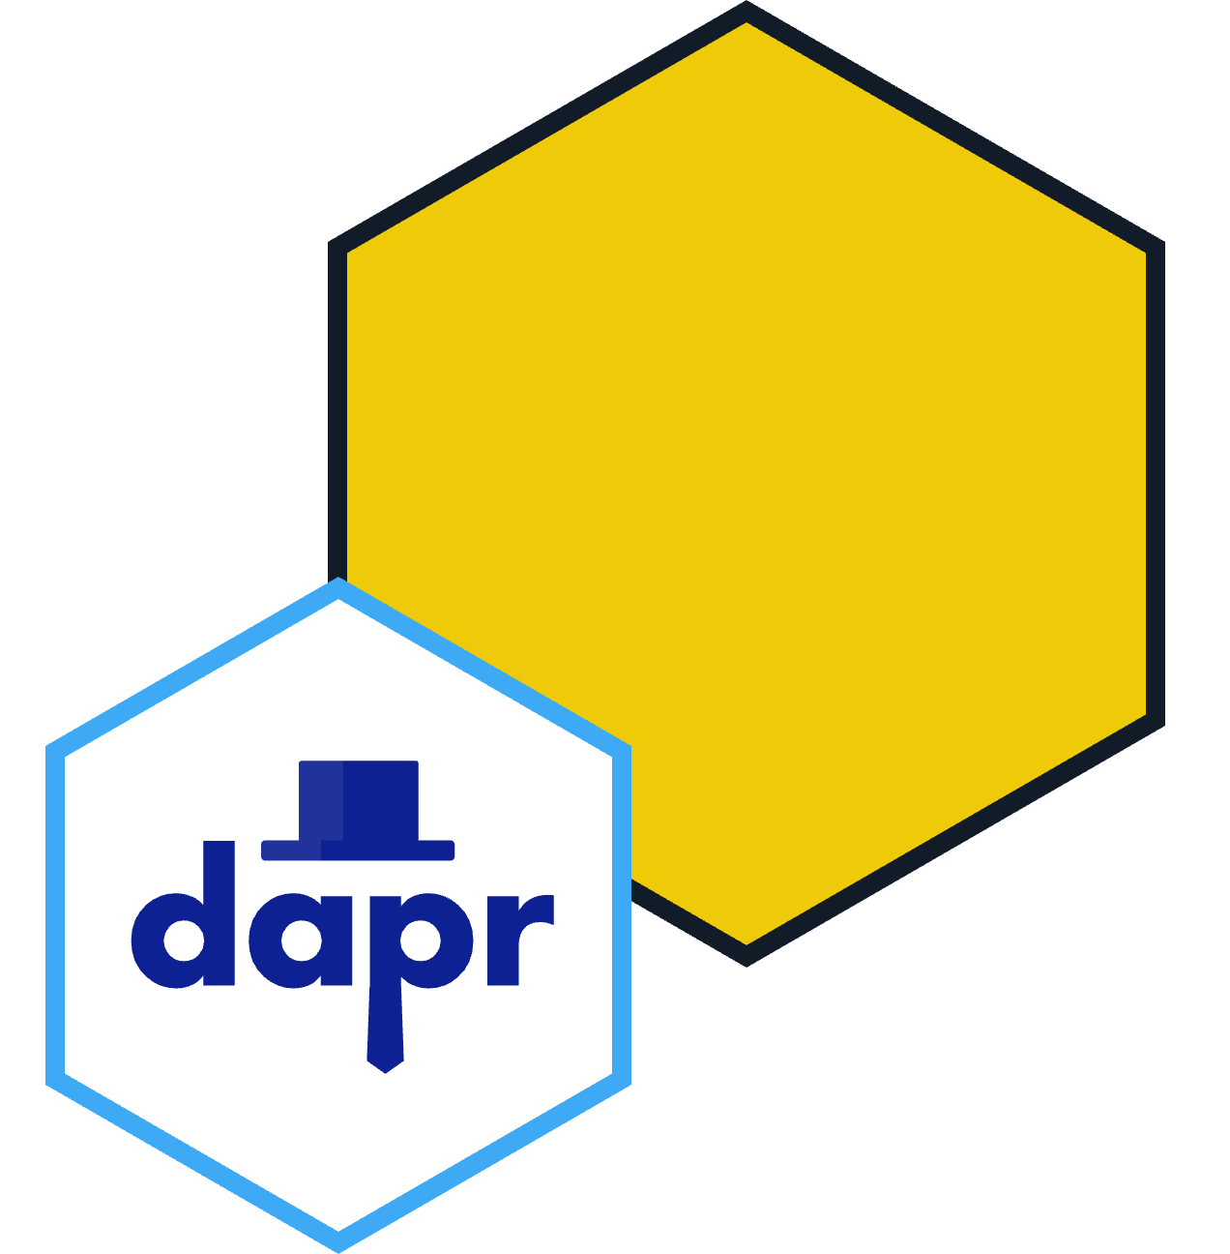






Advanced Workshop: Multi-Agent Workflow
Agent
State store
How to get to Mordor? We all need to help!
User
App label
LLM Random RoundRobin
Agent
State store
Orchestrator
Agent
State store
Agent
Message
Broker (pub/sub)

Slide 18



Advanced Workshop: Multi-Agent Workflow
Agent
State store
How to get to Mordor? We all need to help!
User
App label
LLM Random Round Robin
Agent
State store
Orchestrator
Agent
State store
….
Agent
Message
Broker (pub/sub)
Task: Add more agents

Slide 19







Dapr Resources
dapr.io
bit.ly/dapr-youtube
bit.ly/dapr-quickstarts
bit.ly/dapr-discord
@daprdev
dapr.io
@daprdev.bsky.social

Slide 20


Claim the Dapr Community Supporter badge!
bit.ly/dapr-supporter

