Slide 1


Dapr in Action
Event-Driven AI Agents with Dapr
Dana Arsovska
Community Manager @Dapr
Marc Duiker
Community Manager @Dapr

Slide 2
Agenda
What is Agentic AI?
Challenges of productionizing Agentic AI
Dapr & Dapr Agents
Workshop
Q&A

Slide 3

Agentic AI

Slide 4
What are Agentic Systems?
Agentic systems are systems where Large Language Models (LLMs), with varying degrees of autonomy, maintain control over how they accomplish complex tasks.

Slide 5
Rule-Based Automation
Start
System that executes predefined, rule-based tasks automatically
✅ Highly deterministic
❌ Cannot adapt to new scenarios automatically
Task A
Task B
Task C
Output

Slide 6




What Powers Agentic Systems
LLMS: Brain of the Agent (pretrained knowledge)
Tools: Real-time, proprietary, or specialized data
Memory: Use past data to improve decision making
User
Prompt
Memory
LLM
Tools
Output

Slide 7
Evolution of Agentic AI: AI Agents
Systems where LLMs dynamically direct their own processes and tool usage, maintaining control over how they accomplish tasks*
✅ Capable of reasoning in novel situations
✅ Probabilistic
✅ Adaptive
❌ Less reliable
AI Agent
Response
Reasoning
Prompt
{
Action
User
LLM
Planning
Observation
Tools
*Anthropic - Building effective agents: https://www.anthropic.com/engineering/building-effective-agents

Slide 8
Evolution of Agentic AI: AI Agents
Incoming Support Ticket
Message: "Hi, Your system charged my card 5,000 instead of 500, now my account is locked, and I can't access the reports."
AI Agent
Response
Reasoning
Prompt
{
Action
User
LLM
Planning
Observation
Tools
→ Routed to multiple teams

Slide 9

Evolution of Agentic AI: Agent Mesh
Group of Agents with varying autonomy collaborating to achieve complex goals
✅ Can solve complex, interdependent tasks
❌ Complexity in coordination
❌ Harder to debug and predict outcomes

Slide 10
Evolution of Agentic AI: Agent Mesh
Intake Agent gathers customer history, previous tickets, account status
Technical Agent runs initial diagnostics, checks system logs
Account Agent pulls billing history, subscription details
Resolver agent suggests solution
→ Customer support gets: Complete customer profile + preliminary analysis instead of starting from scratch

Slide 11
Productionizing Agentic AI

Slide 12
Productionizing Agentic AI
LLM Integrations
Agentic Workflows
AI Agent
Agent Mesh

Slide 13
Why Productionizing Agentic AI is Hard
Scalability: run hundreds of agents reliably
Fault tolerance: recovering from network or task failures
❌
Collaboration: asynchronous communication, agent discoverability
State: persist memory across conversations and sessions

Slide 14

Why Productionizing Agentic AI is Hard
Scalability: run hundreds of agents reliably
Fault tolerance: recovering from network or task failures
Collaboration: asynchronous communication, agent discoverability
State: persist memory across conversations and sessions
Observability: understanding outcomes and performance

Slide 15
Dapr Agents

Slide 16
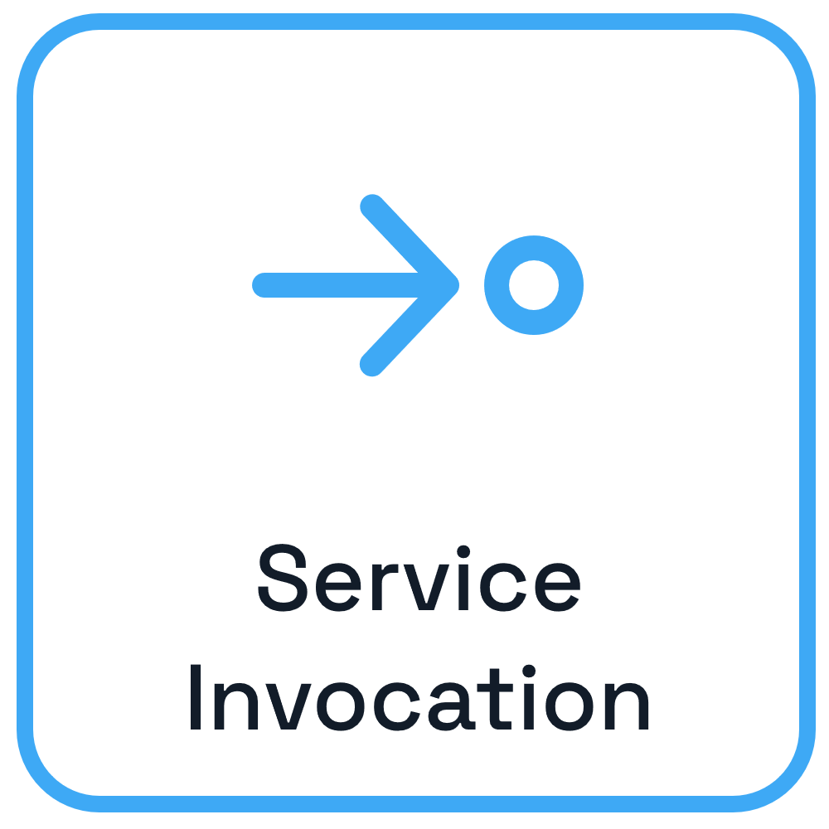

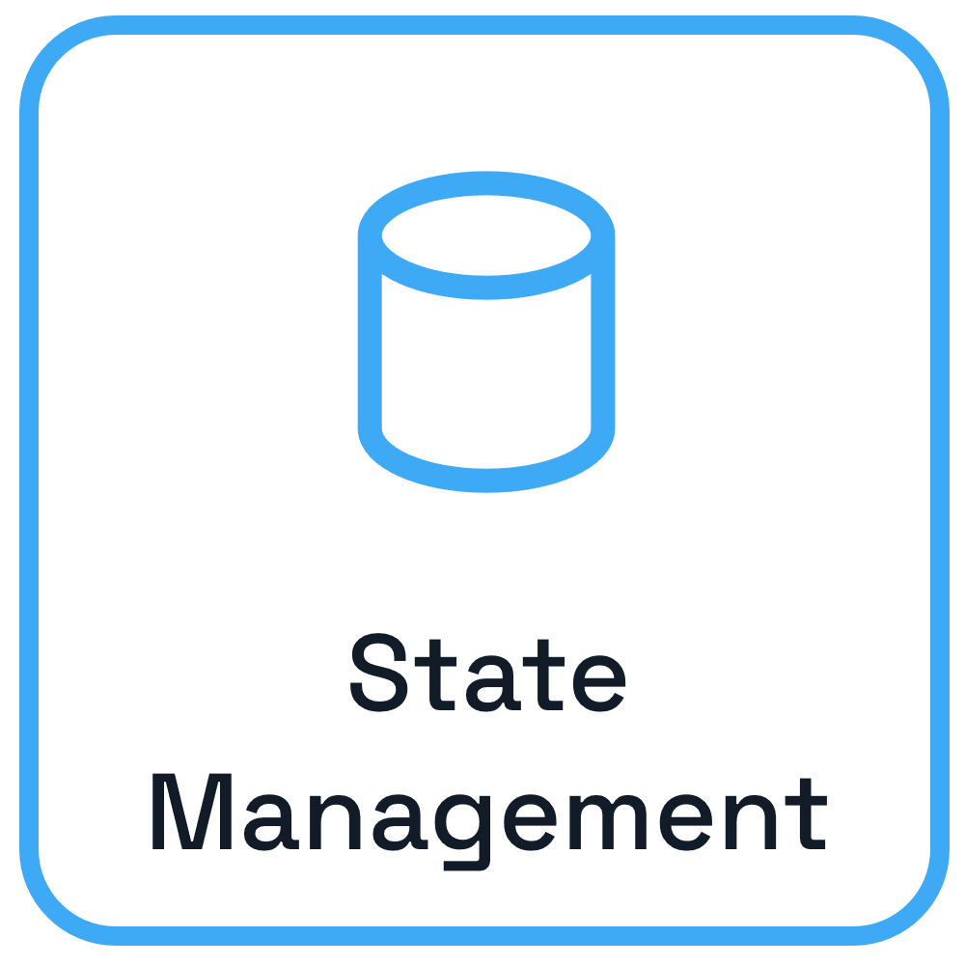
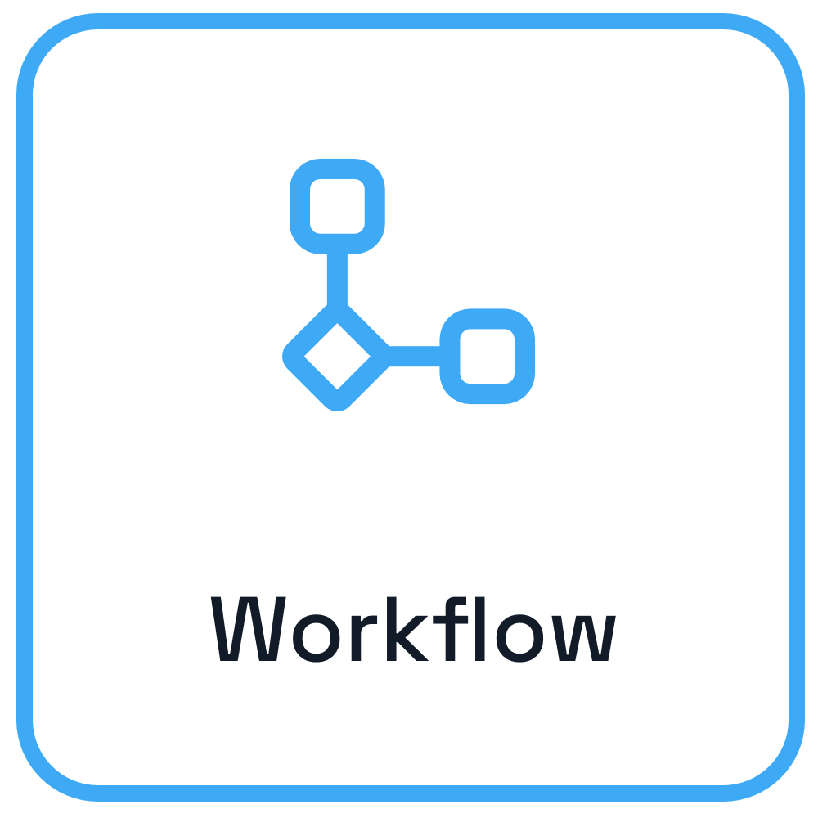

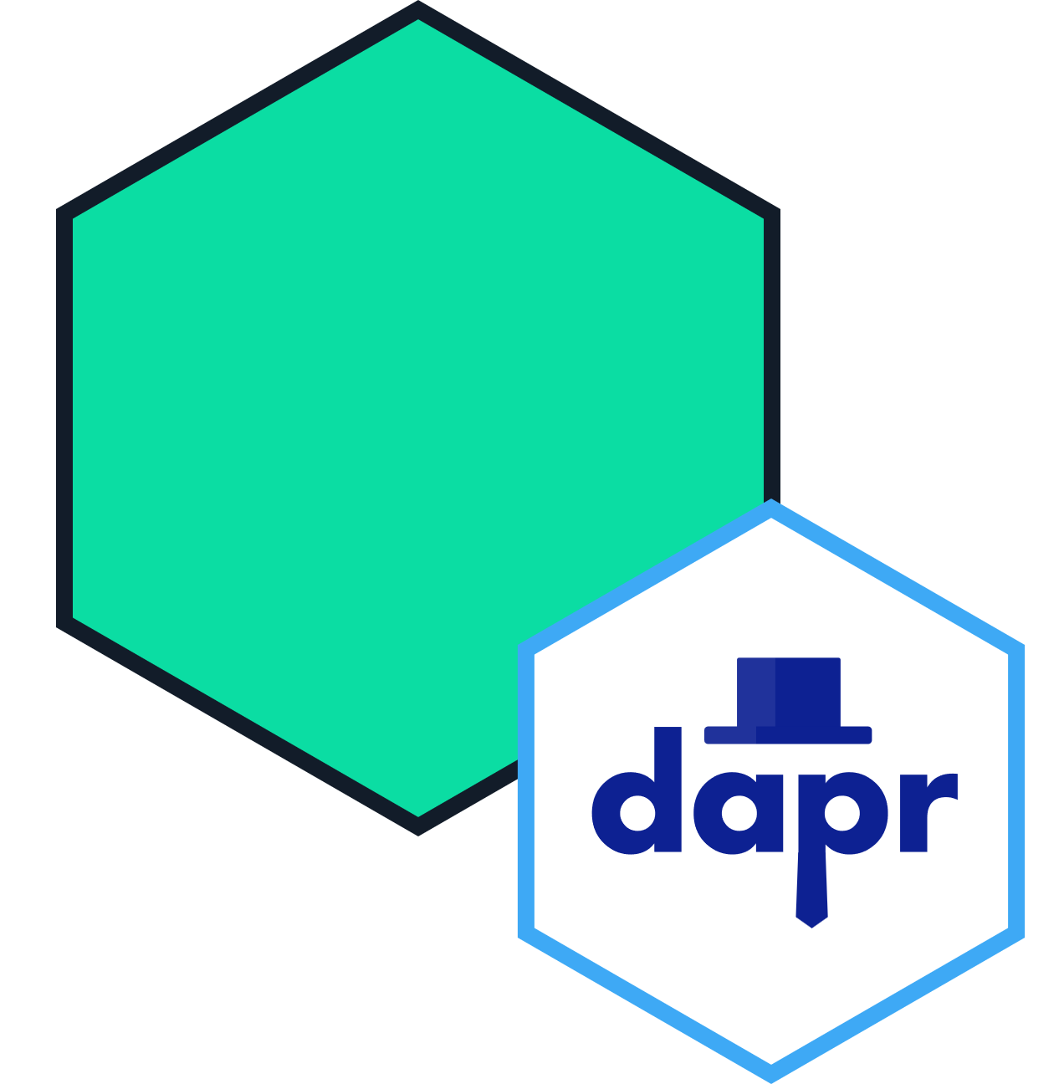
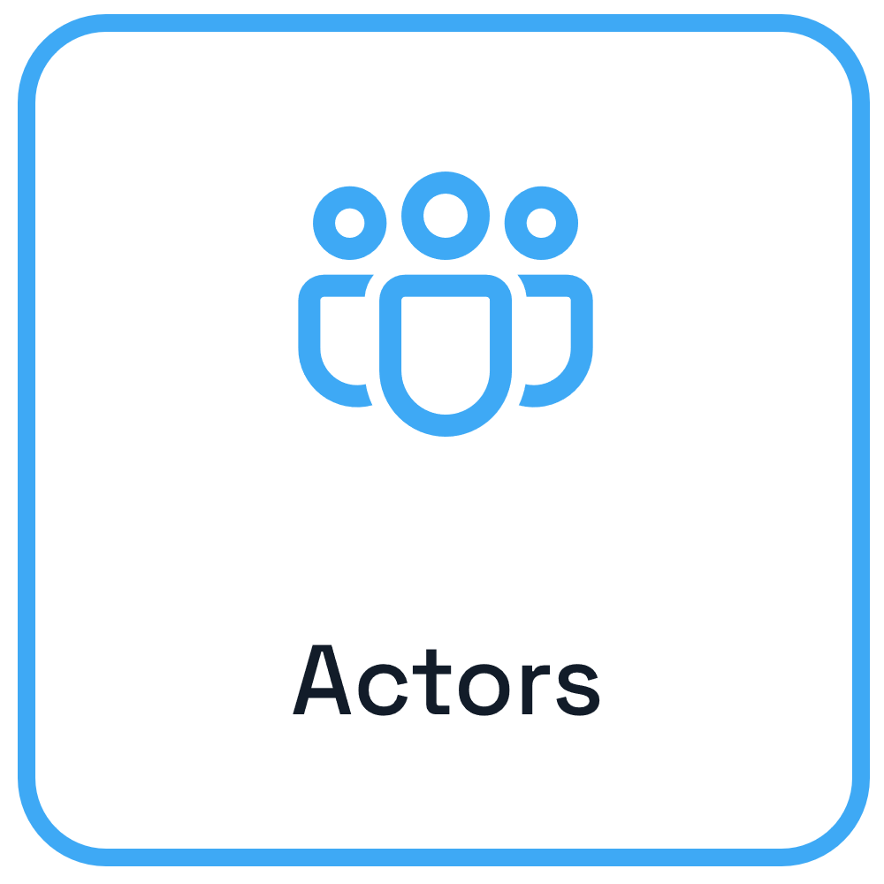
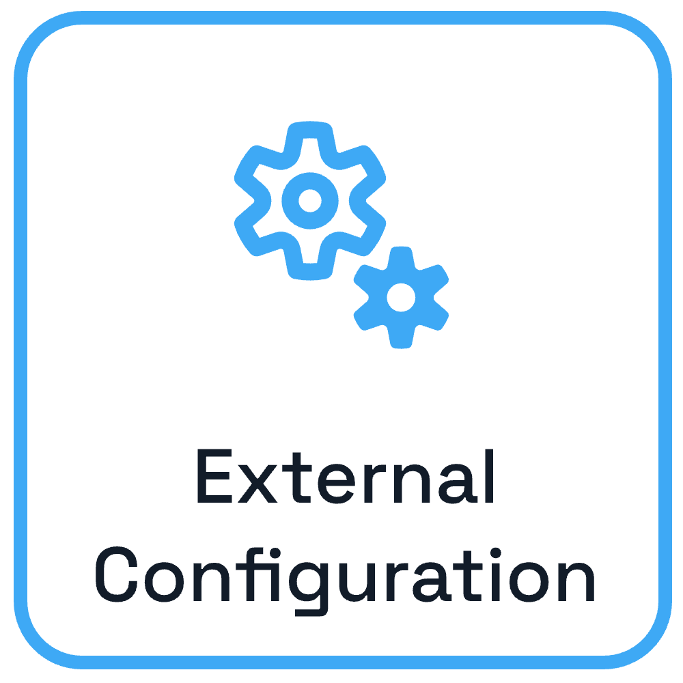
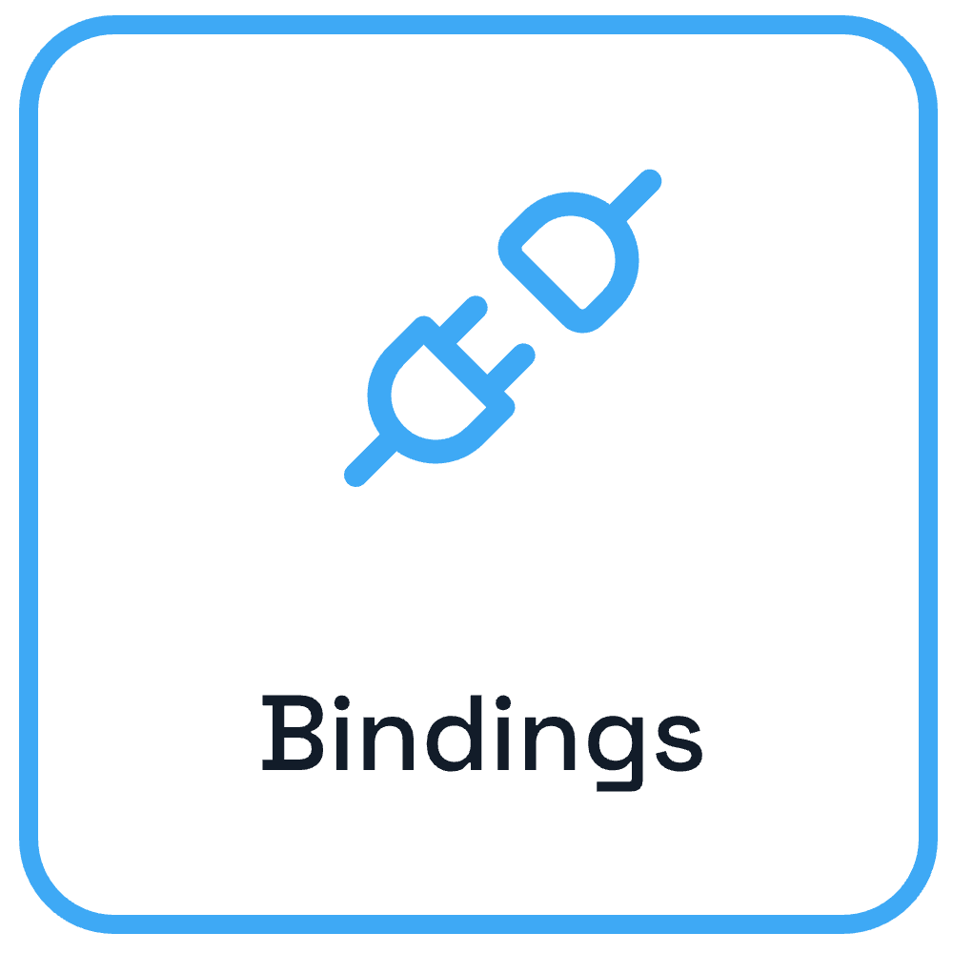



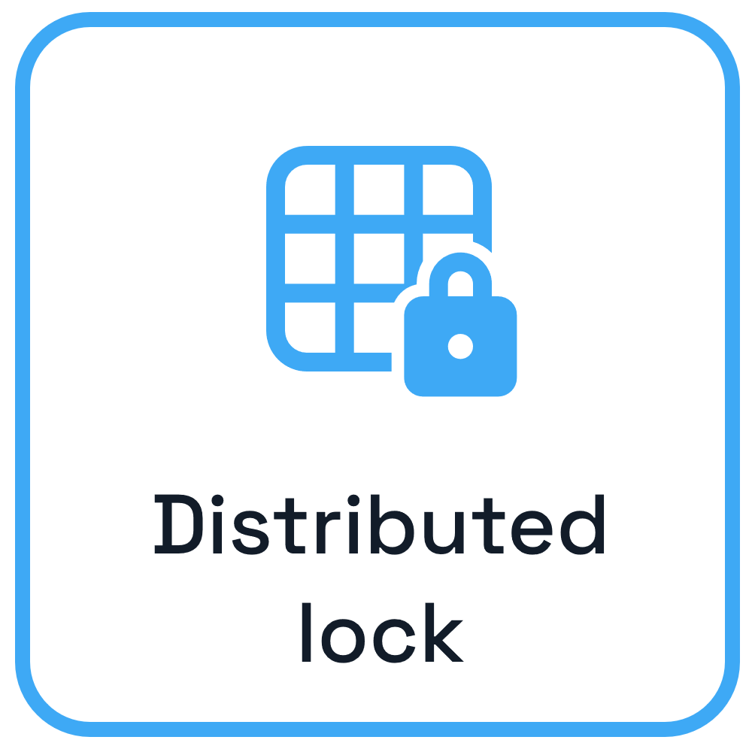





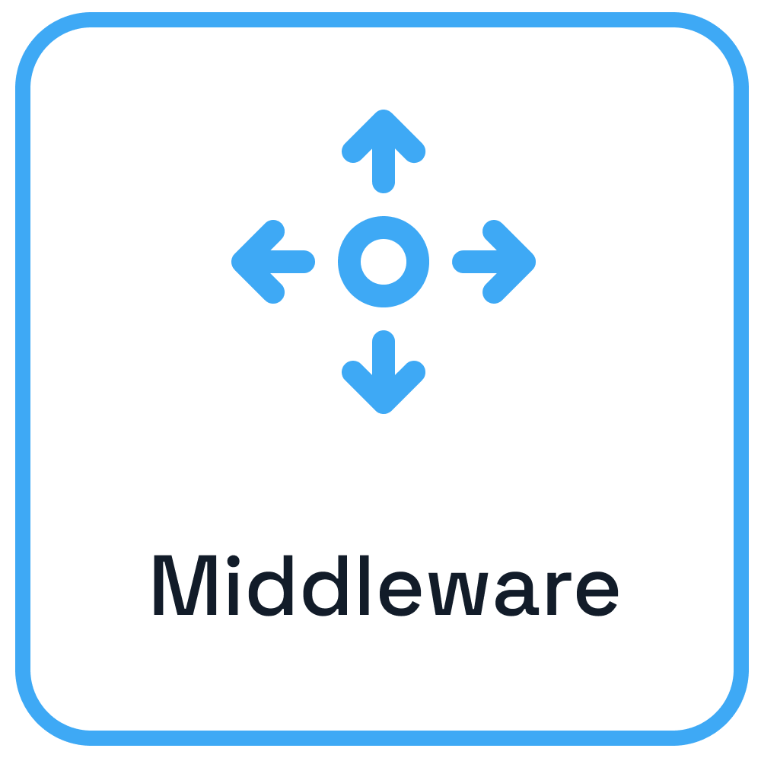
Dapr – Application Developer Platform
App B
App A
App C

Slide 17
Where does Dapr fit in?
authentication, rate limiting
memory
durability
stateful execution
collaboration
communication

Slide 18
Where does Dapr fit in?
authentication, rate limiting
memory
durability
stateful execution
collaboration
communication
data access
LLM interactions

Slide 19
Where does Dapr fit in?
authentication, rate limiting
memory
durability
stateful execution
collaboration
communication
control, governance, and safety
data access
LLM interactions

Slide 20
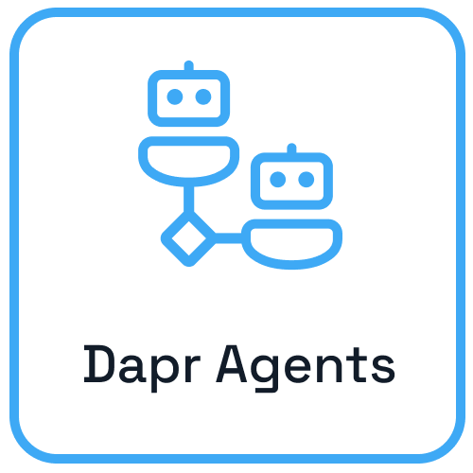
Dapr Agents
Run thousands of agents efficiently on a single core
Automatic retries
Direct databases integration
Observable by default
Vendor-neutral & open source
Built-in RBAC and access scopes
Dapr Agents is a developer framework designed to build production-grade resilient AI agent systems that operate at scale.
https://github.com/dapr/dapr-agents

Slide 21
import dapr.ext.workflow as wf
from openai import OpenAI
wfr = wf.WorkflowRuntime() # Initialize Workflow runtime
client = OpenAI() # Initialize OpenAI client
def call_openai(prompt: str, model: str = "gpt-4o") -> str:
"""Reusable function to call OpenAI's chat completion API."""
response = client.chat.completions.create(
messages=[{"role": "user", "content": prompt}],
model=model,
)
return response.choices[0].message.content.strip()
# Activity 1: Pick a random LOTR character
@wfr.activity(name="pick_character")
def pick_character(ctx):
character = call_openai( "Return a random Lord of the Rings character's name.")
return character
# Define Workflow logic
@wfr.workflow(name="lotr_workflow")
def task_chain_workflow(ctx: wf.DaprWorkflowContext):
character = yield ctx.call_activity(pick_character))
return quote
Initializations
Create an activity
Create a durable workflow

Slide 22
import dapr.ext.workflow as wf
from openai import OpenAI
client = OpenAI() # Initialize OpenAI client
wfr = wf.WorkflowRuntime() # Initialize Workflow runtime
def call_openai(prompt: str, model: str = "gpt-4o") -> str:
"""Reusable function to call OpenAI's chat completion API."""
response = client.chat.completions.create(
messages=[{"role": "user", "content": prompt}],
model=model,
)
return response.choices[0].message.content.strip()
# Activity 1: Pick a random LOTR character
@wfr.activity(name="pick_character")
def pick_character(ctx):
character = call_openai( "Return a random Lord of the Rings character's name.")
return character
# Define Workflow logic
@wfr.workflow(name="lotr_workflow")
def task_chain_workflow(ctx: wf.DaprWorkflowContext):
character = yield ctx.call_activity(pick_character))
return quote
from dapr_agents.workflow import WorkflowApp, workflow, task
from dapr.ext.workflow import DaprWorkflowContext
# Task 1: Pick a random LOTR character
@task(description="Return a random Lord of the Rings character's name.")
def get_character() -> str:
pass
# Define Workflow logic
@workflow(name='lotr_workflow')
def task_chain_workflow(ctx: DaprWorkflowContext):
character = yield ctx.call_activity(get_character)
return character

Slide 23
Durable Agents
Define a Durable Agent
from dapr_agents import DurableAgent
weather_agent = DurableAgent(
role="Weather Assistant",
name="Stevie",
goal="Help humans get weather and location info using smart tools.",
instructions=[
"Respond clearly and helpfully to weather-related questions.",
"Use tools when appropriate to fetch real-time weather data."],
tools=tools
)

Slide 24



Multi-Agent Collaboration
POST /broadcast/agent1
Agent
State store
App label
POST /broadcast/agent2
Agent
State store
Orchestrator
POST /broadcast/agent3
Agent
State store
POST /v1.0/publish/broadcast
Message
Broker (pub/sub)
Agent

Slide 25
Workshop Overview
https://github.com/Dzvezdana/pydata_workshop_september2025

Slide 26



Collaborative Multi-Agent Workflow
Agent
State store
How to get to Mordor? We all need to help!
User
App label
LLM Random Round Robin
Agent
State store
Orchestrator
Agent
State store
Agent
Message
Broker (pub/sub)

Slide 27



Collaborative Multi-Agent Workflow
Agent
State store
How to get to Mordor? We all need to help!
User
App label
LLM Random Round Robin
Agent
State store
Orchestrator
Agent
State store
….
Agent
Message
Broker (pub/sub)
Task: Add more agents

Slide 28


Our Stack
Dapr Agents
Framework to build AI Agent Systems
HuggingFace API
API access to various LLMs

Slide 29
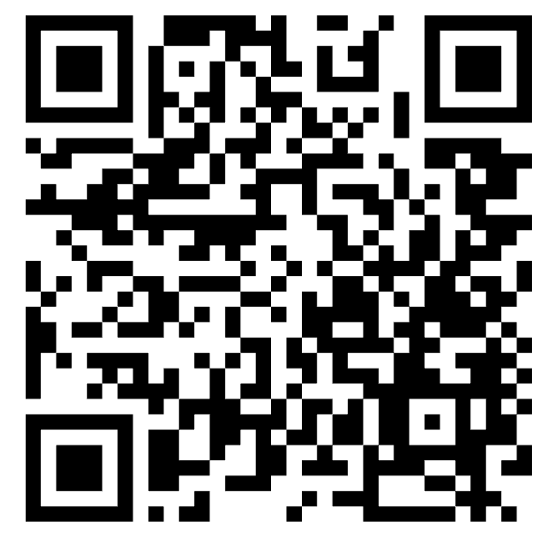
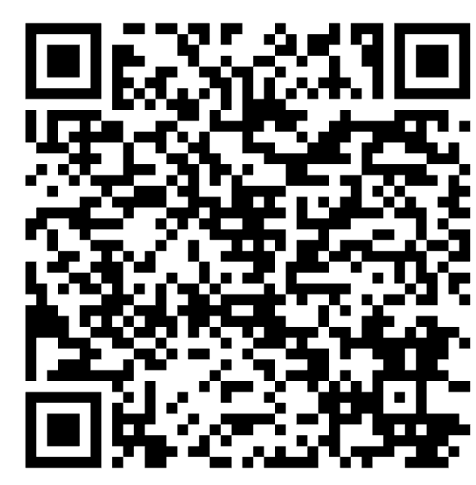

Collaborative Multi-Agent Workflow
Local setup
Clone this git repo
Follow the instructions in the README.
You are ready to start!
Github repo
Slides
Privatebin password: pydata_ams2025_dapr

Slide 30
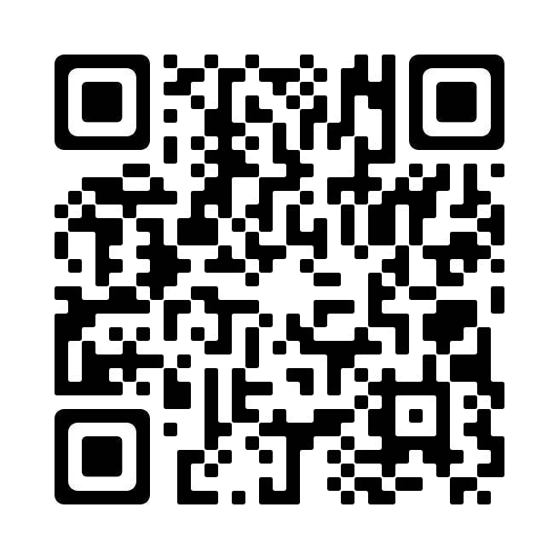






Dapr Resources
dapr.io
bit.ly/dapr-youtube
bit.ly/dapr-quickstarts
bit.ly/dapr-discord
@daprdev
dapr.io
@daprdev.bsky.social

Slide 31
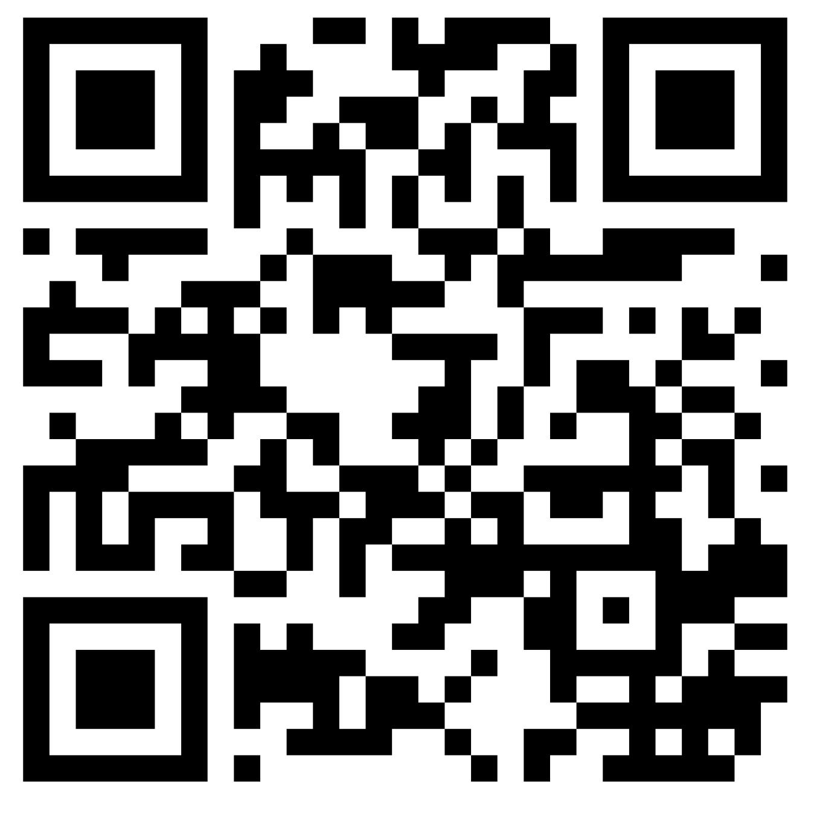
Dapr University
diagrid.io/dapr-university

Slide 32
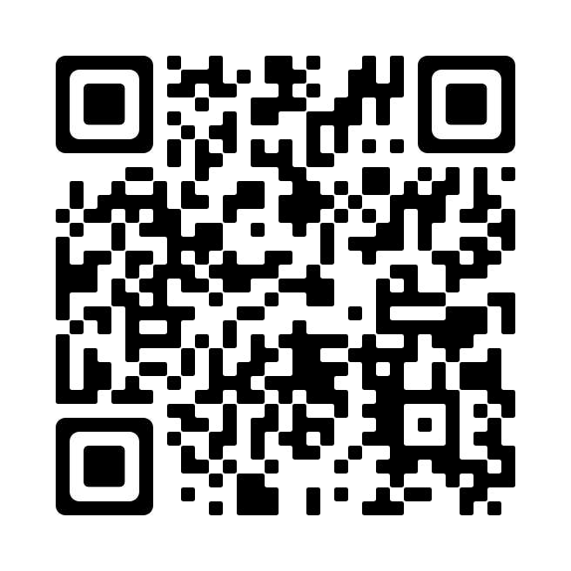

Claim the Dapr Community Supporter badge!
bit.ly/dapr-supporter

