Slide 1
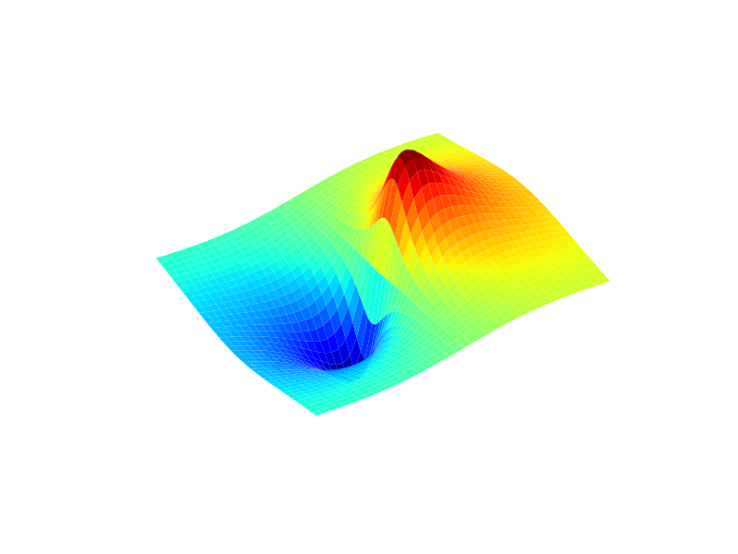
Graphics Lies
https://faculty.ucmerced.edu/jvevea/classes/Spark/readings/Cairo2015_Chapter_GraphicsLiesMisleadingVisuals.pdf

Slide 2
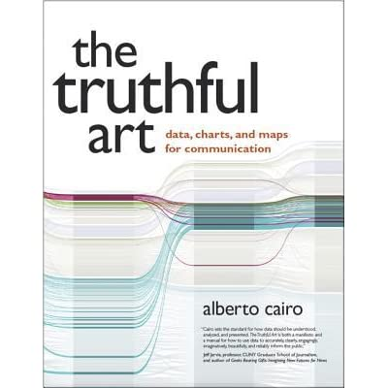
Five Qualities of Great Visualizations
Truthful
Functional
Beautiful
Insightful
Enlightening

Slide 3
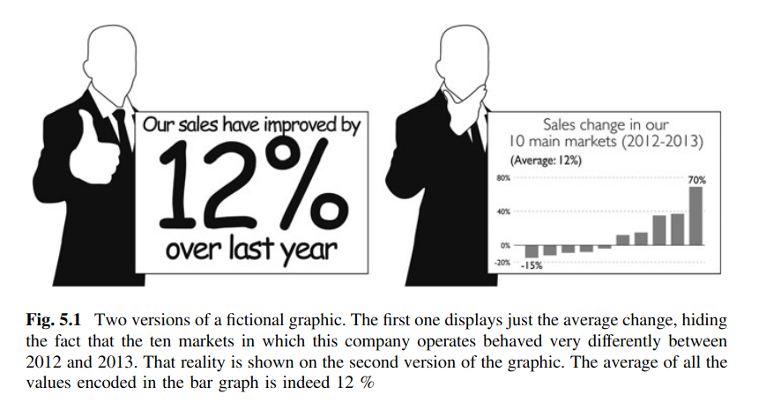
Misleading statistic

Slide 4
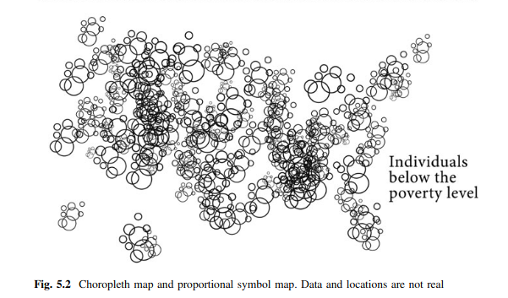
Obscure data

Slide 5
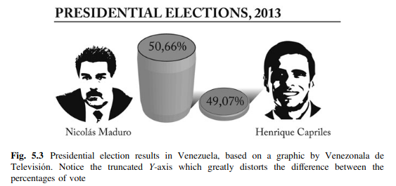
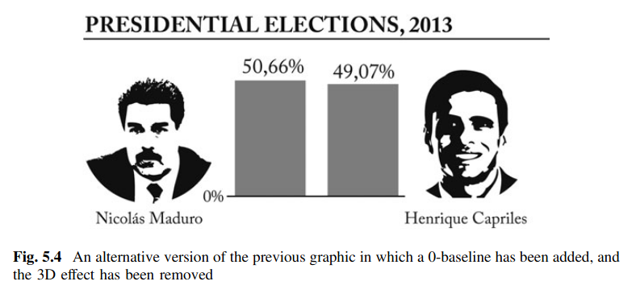
Know you zero

Slide 6
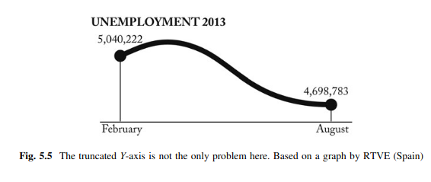
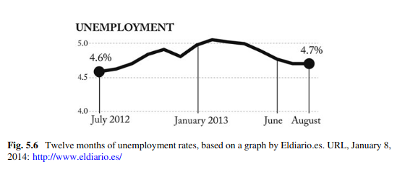
Choose the data range
‘

Slide 7
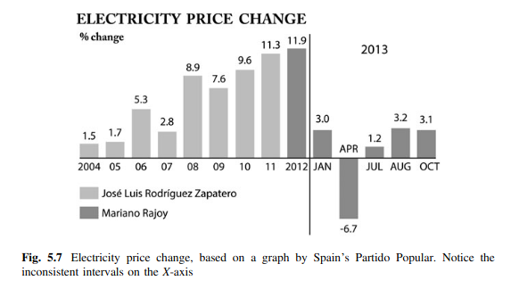
Do not mix intervals

Slide 8
Visualization is beautiful
https://rafalab.github.io/dsbook/data-visualization-principles.html

Slide 9
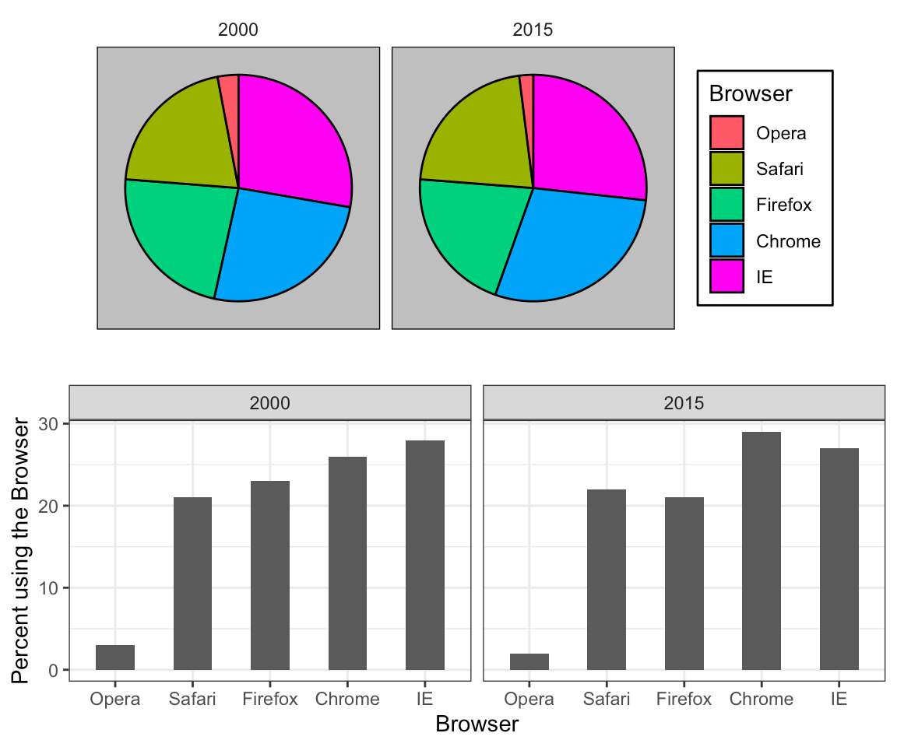
Encoding data using visual cues

Slide 10
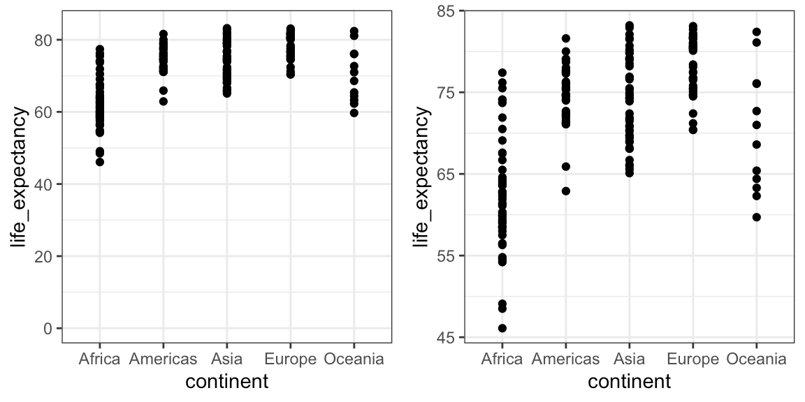
Know when to include 0

Slide 11
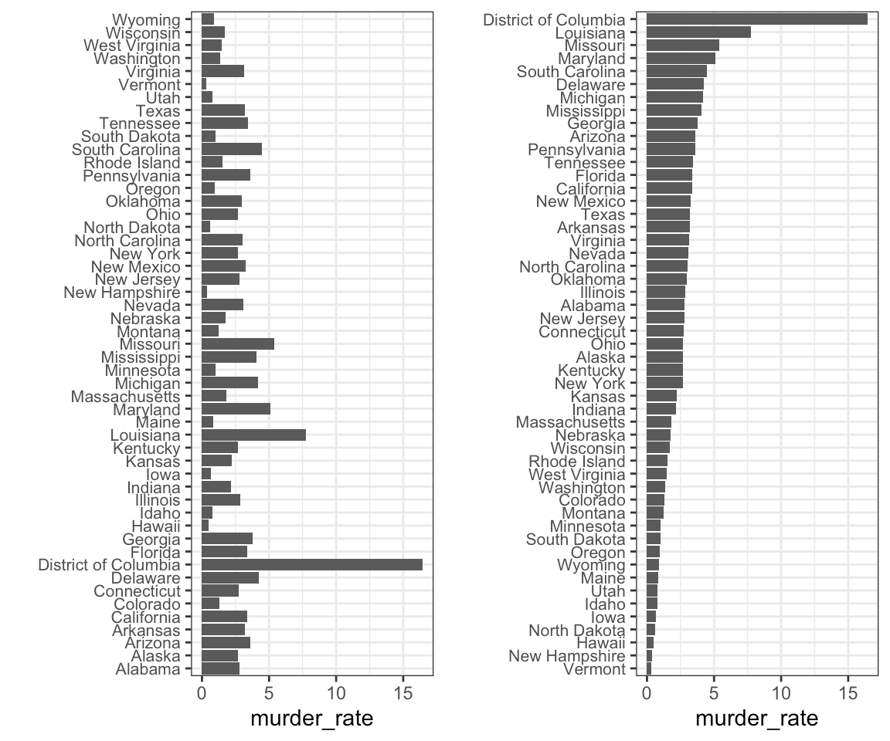
Order categories by a meaningful value

Slide 12
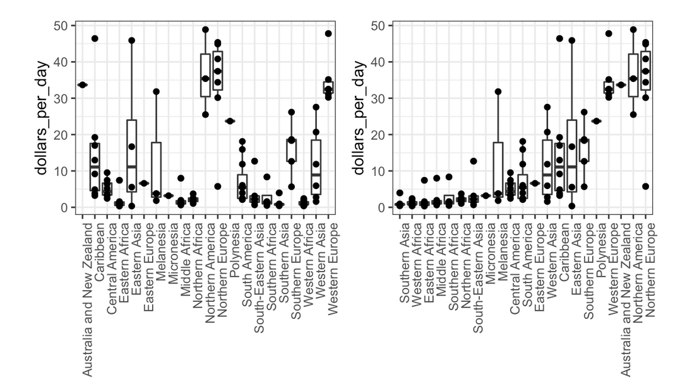

Slide 13
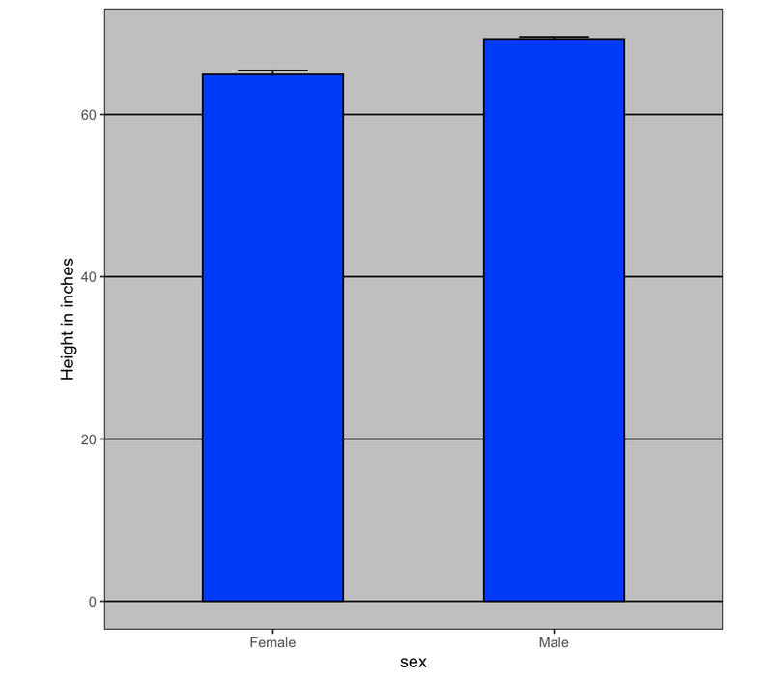
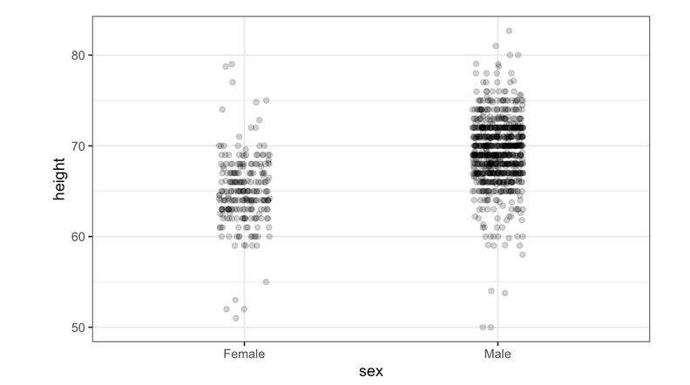

Slide 14
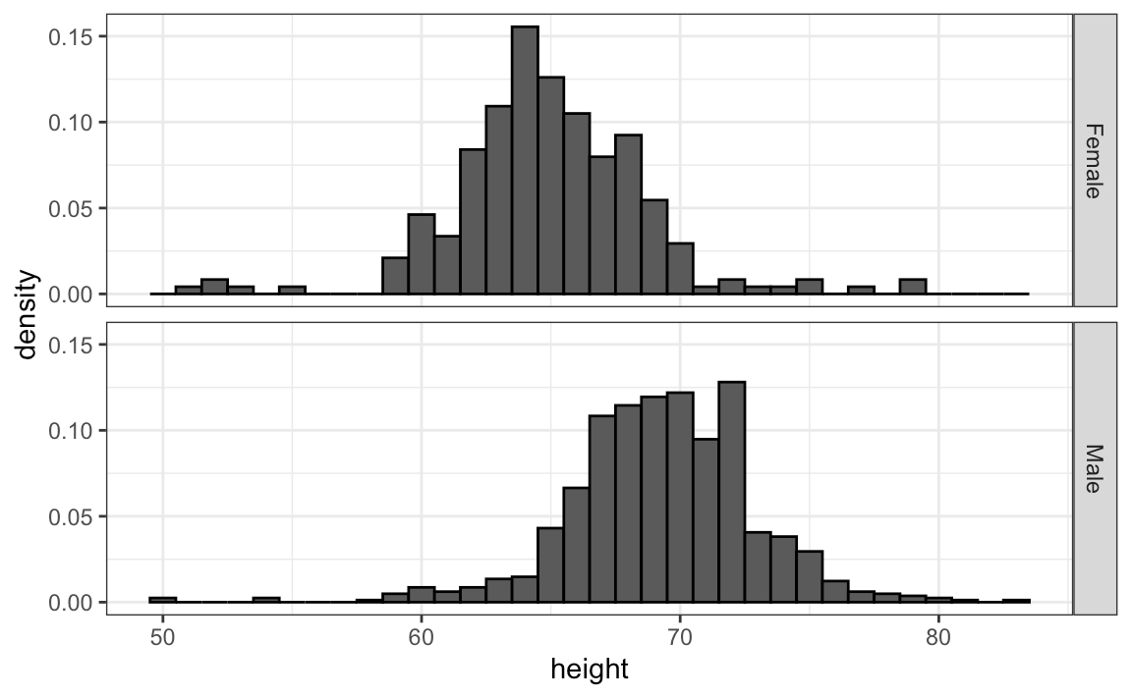
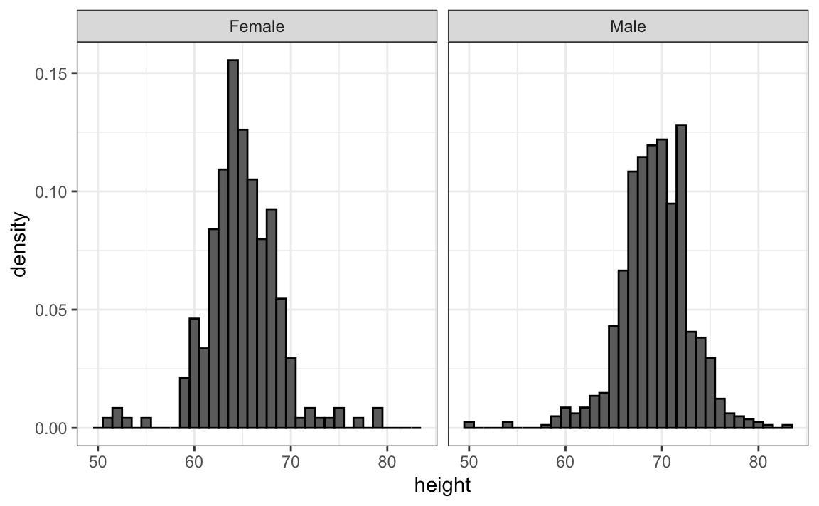
Ease comparisons

Slide 15
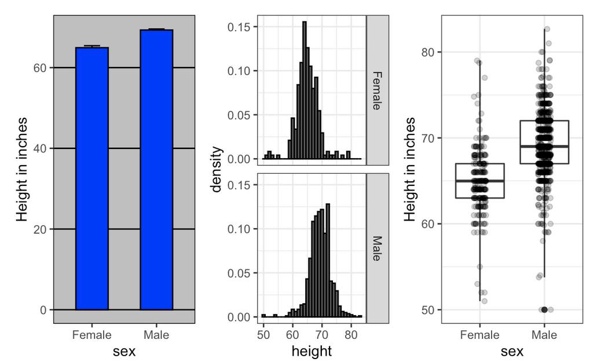

Slide 16
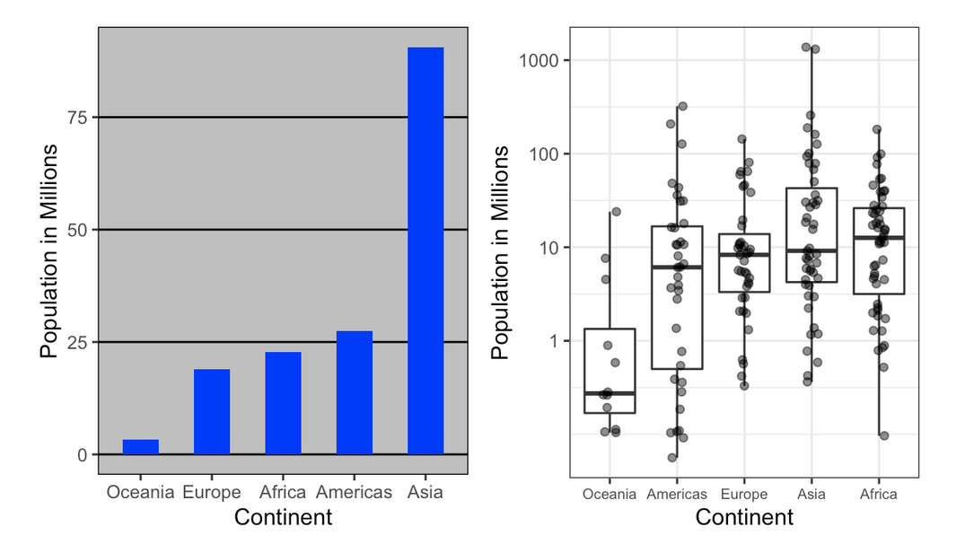

Slide 17
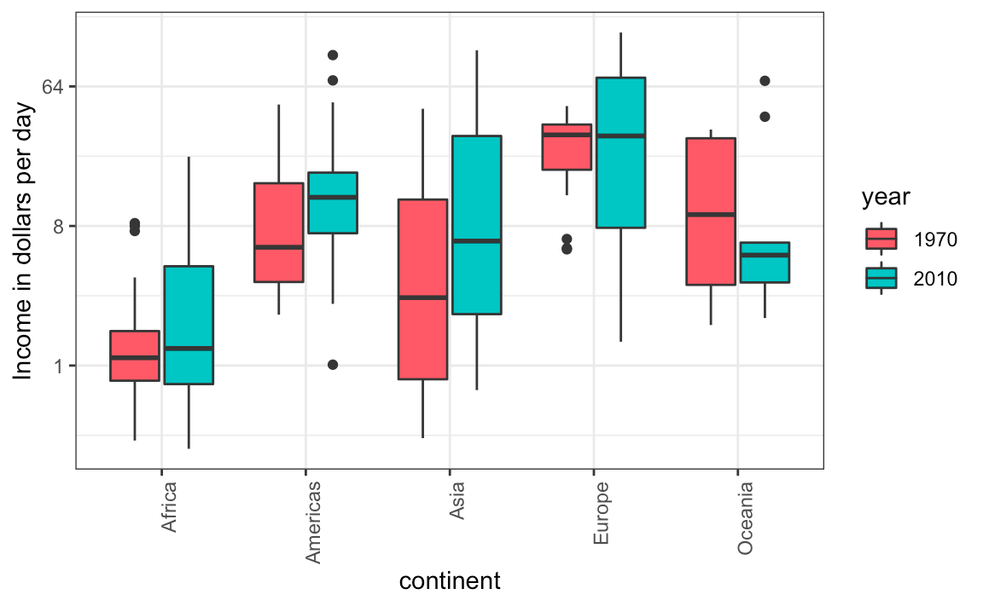
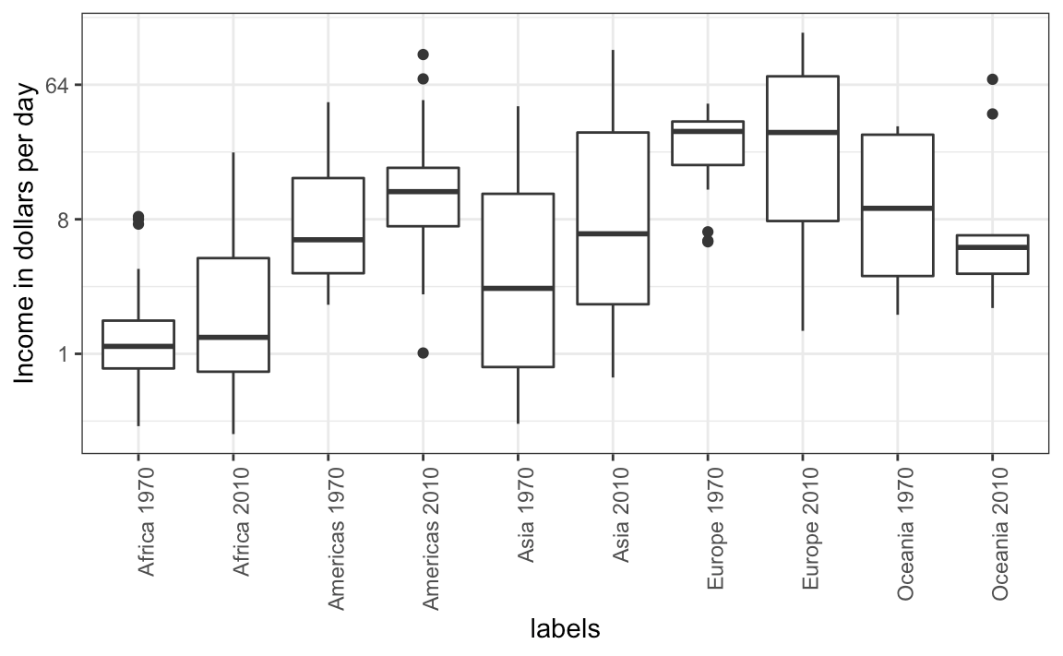
Use color

Slide 18
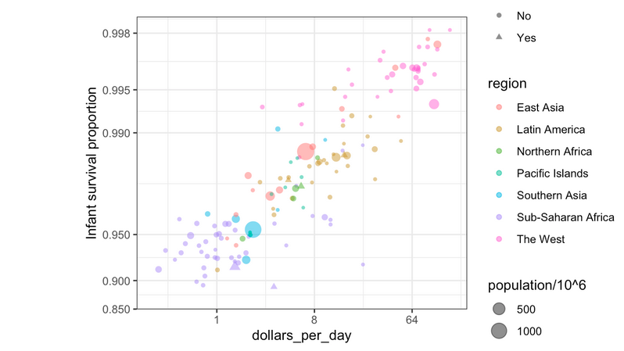

Slide 19
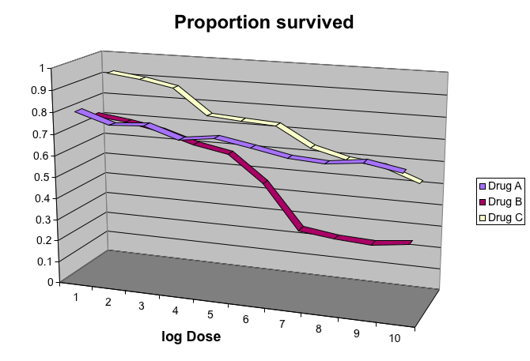
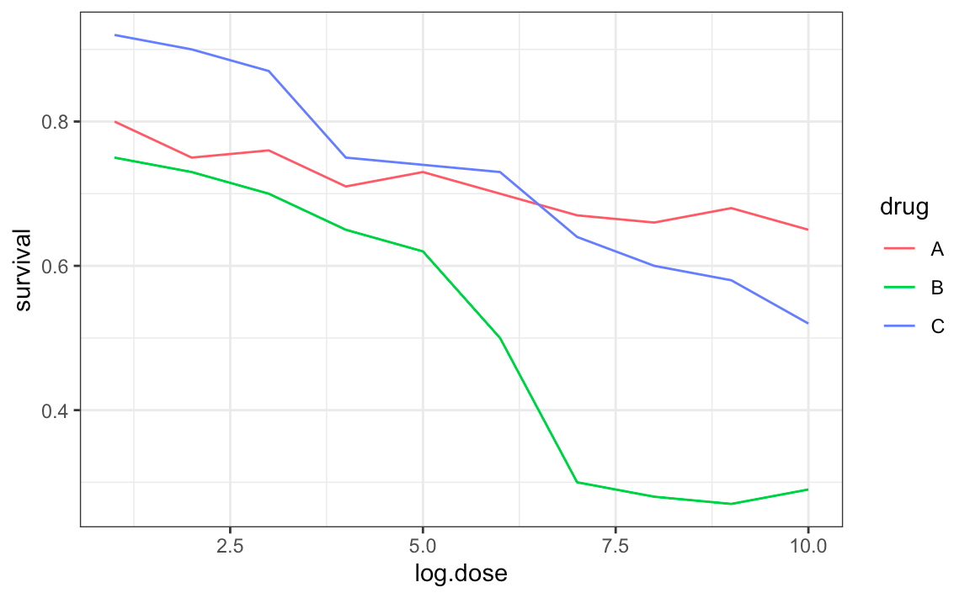
Avoid pseudo-three-dimensional plots

Slide 20
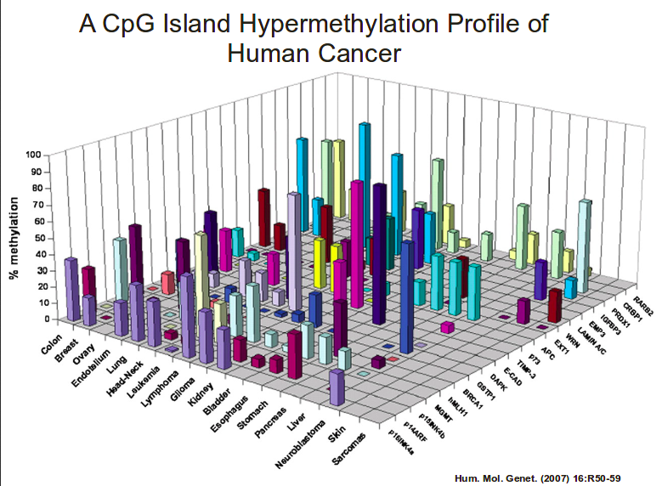
Really bad visualization

Slide 21
Now it’s your turn

