Slide 1
Machine learning

Slide 2
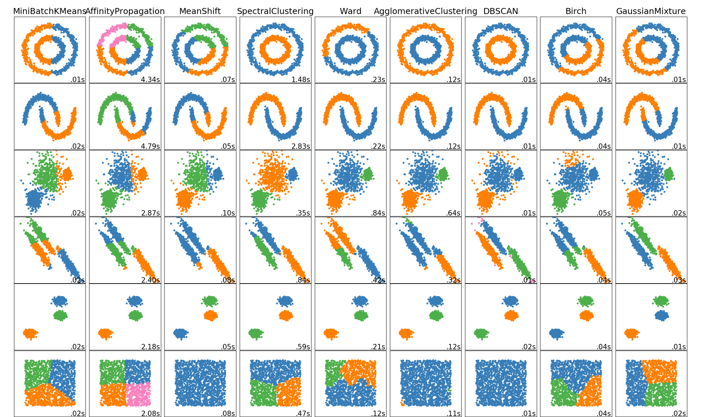
Clustering
https://towardsdatascience.com/the-5-clustering-algorithms-data-scientists-need-to-know-a36d136ef68

