Slide 1
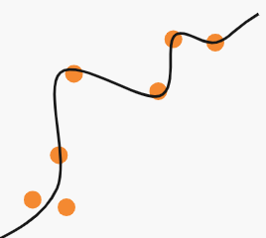
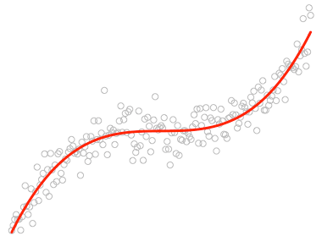
Machine Learning
Intro

Slide 2
Today we will:
- get know what is classical ML
- understand basic concepts
- learn terminology
- get familiar with Scikit-learn

Slide 3
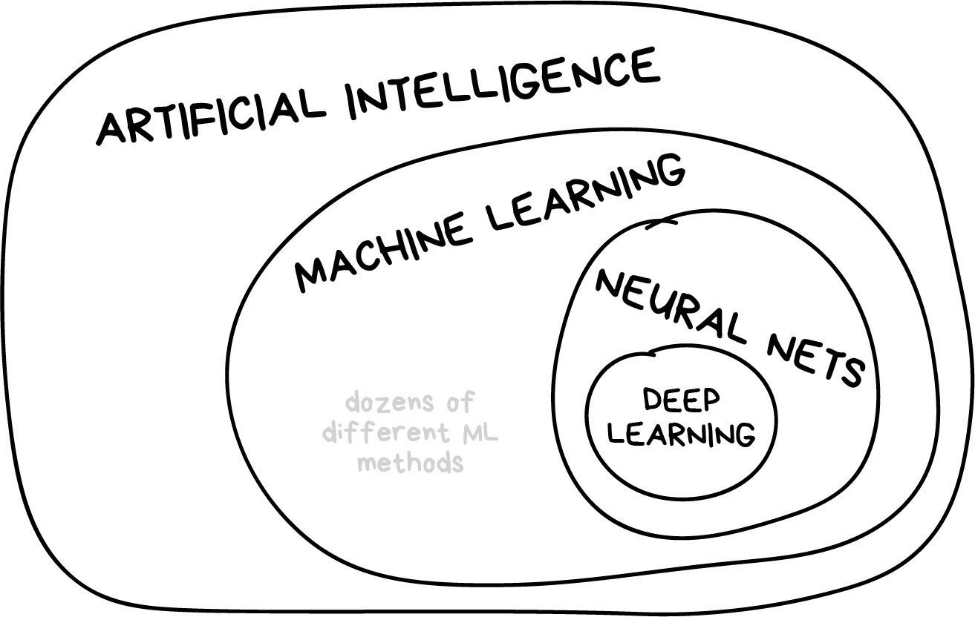

Classical Machine Learning
https://vas3k.com/blog/machine_learning/

Slide 4
Why “Learning”?
Algorithm: data → model → result
ML: data → result → model

Slide 5
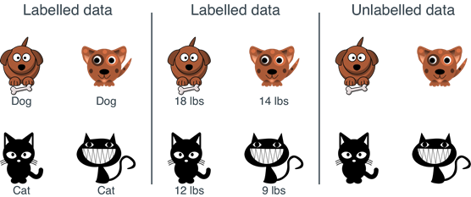
Data

Slide 6
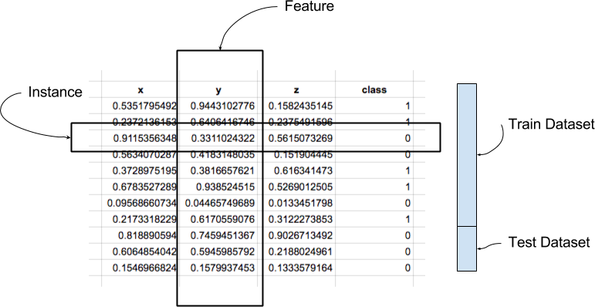
Labeled Data
https://machinelearningmastery.com/data-learning-and-modeling/

Slide 7
Evaluation metrics
The metric explains the performance of a model:
- Classification Metrics (accuracy, precision, recall, F1-score, ROC, AUC, …)
- Regression Metrics (MSE, MAE)
- Ranking Metrics (MRR, DCG, NDCG)
- Statistical Metrics (Correlation)
- Computer Vision Metrics (PSNR, SSIM, IoU)
- NLP Metrics (Perplexity, BLEU score)
- Deep Learning Related Metrics (Inception score, Frechet Inception distance)

Slide 8
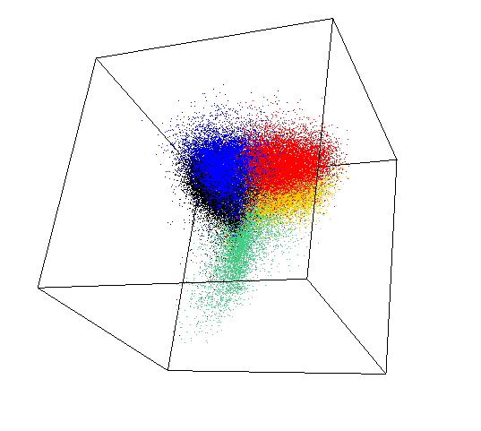
Feature space
Features (parameters or variables):
- tabular data
- pixels
- intensity on frequencies
- visual descriptors
- words of word collocations
- sounds on frequencies
- … and many more

Slide 9
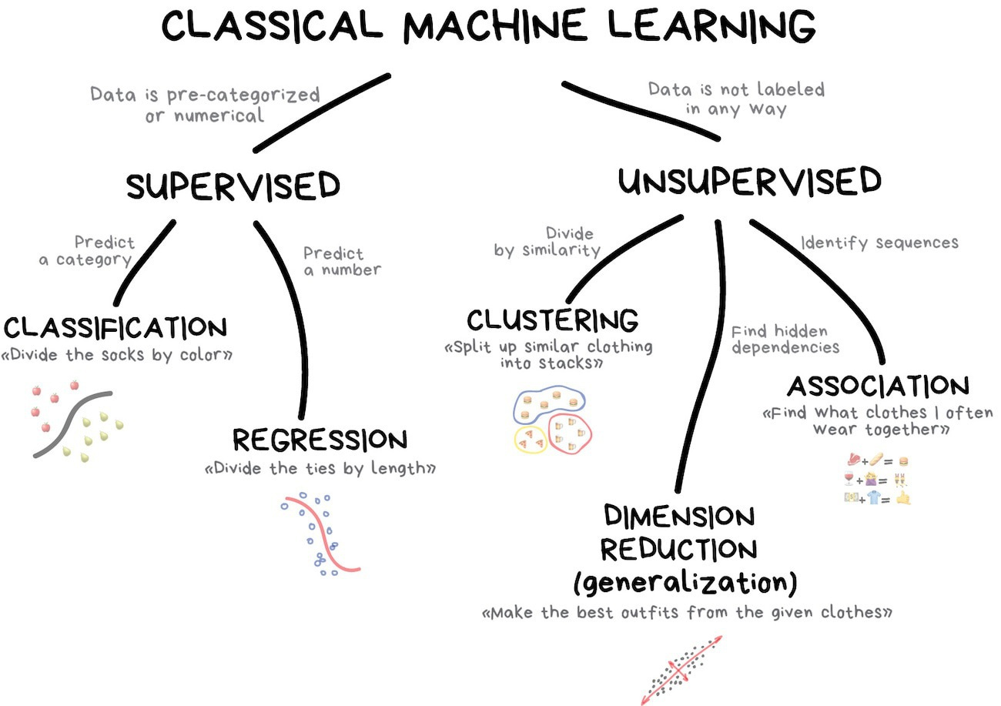
Algorithm
https://vas3k.com/blog/machine_learning/

Slide 10
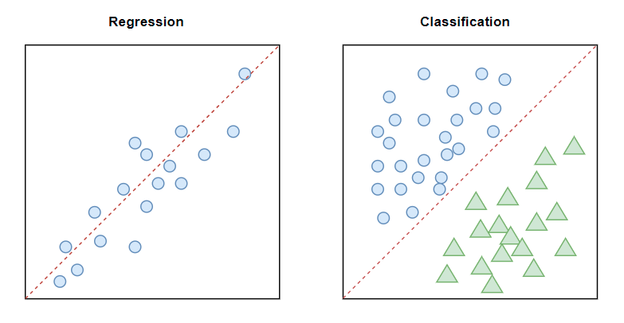
Supervised learning
We teach or train the machine using labeled data

Slide 11
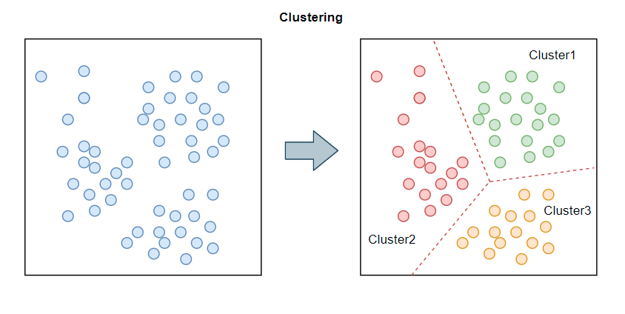
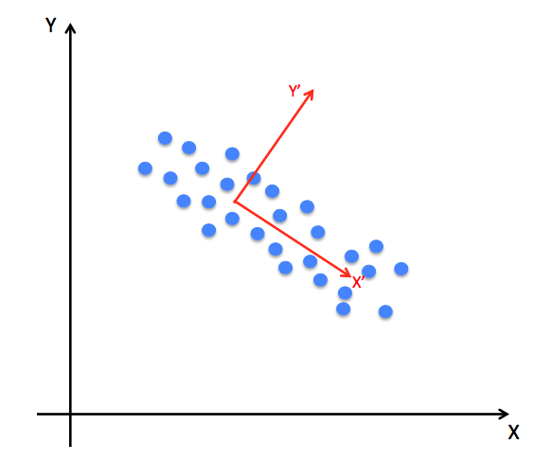
Unsupervised learning
Machine groups unsorted information according to similarities without any prior training of data.
Clustering
Dimension reduction

Slide 12

Scikit-learn

