Slide 1
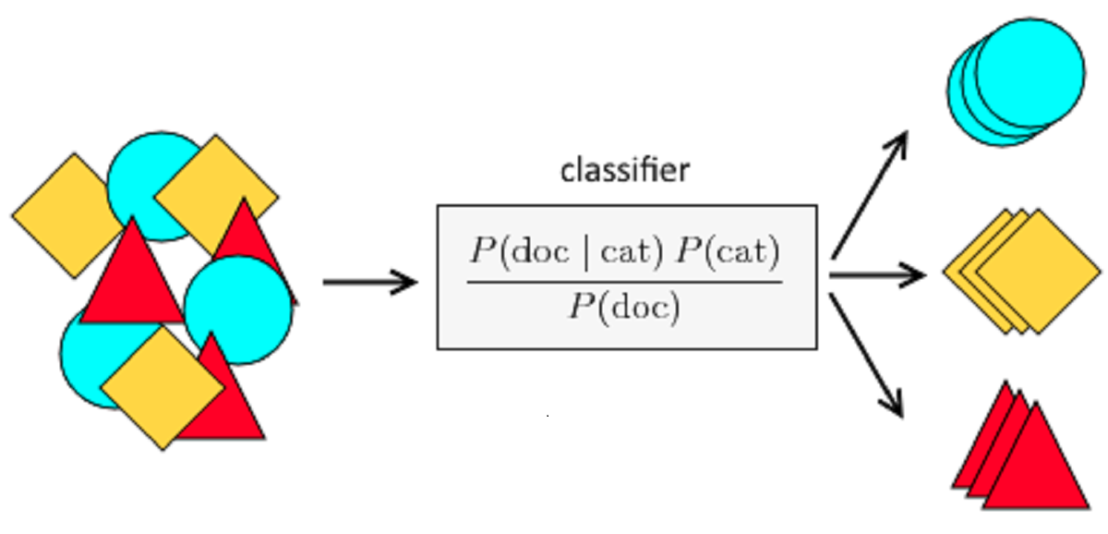
Naive Bayes Classifier
https://insightimi.wordpress.com/2020/04/04/naive-bayes-classifier-from-scratch-with-hands-on-examples-in-r/

Slide 2
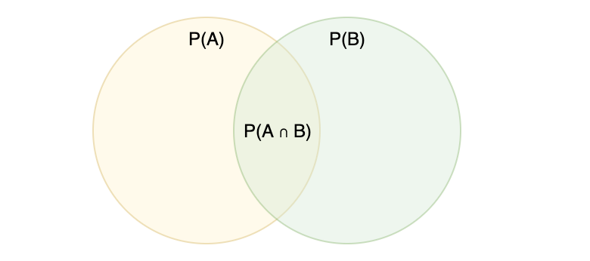
Bayes Theorem

Slide 3
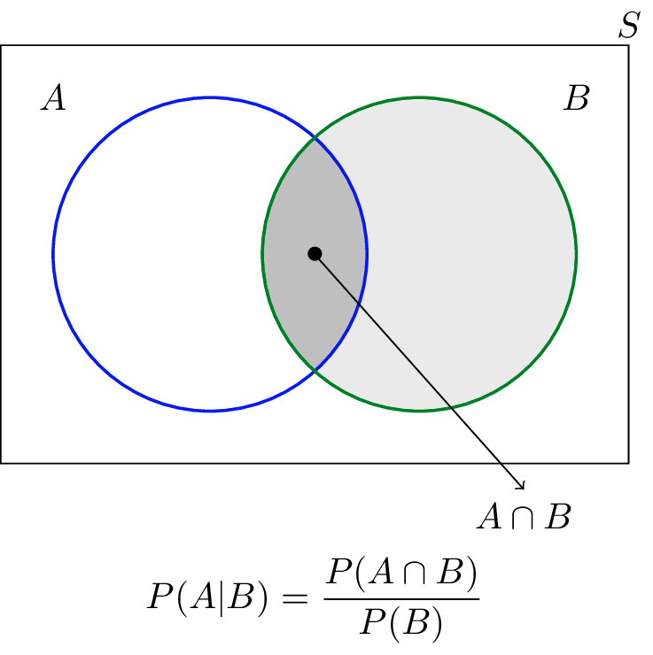
Probability of intersection:
P(A∩B) = P(A|B)P(B) = P(B|A)P(A)

Slide 4
Probability of intersection:
P(A∩B) = P(A|B)P(B) = P(B|A)P(A)
conditional probability

Slide 5
Probability of intersection:
P(A∩B) = P(A|B)P(B) = P(B|A)P(A)
conditional probability
Bayes Theorem

Slide 6
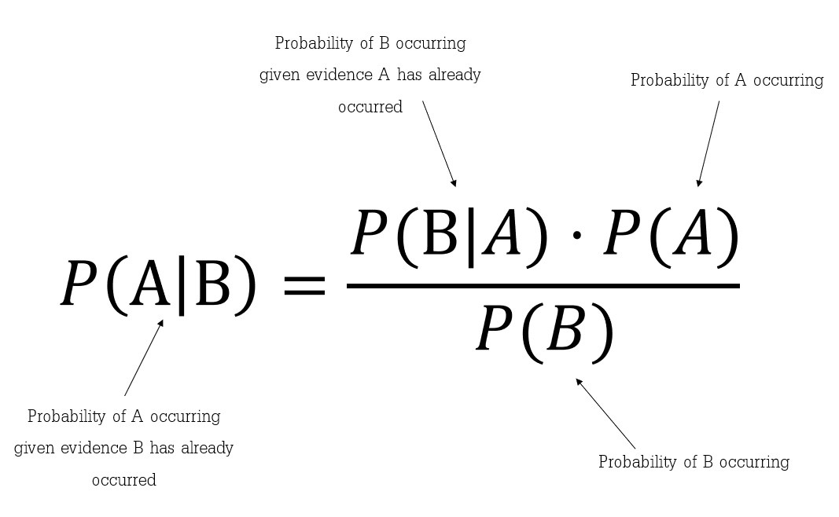
Bayes Theorem

Slide 7
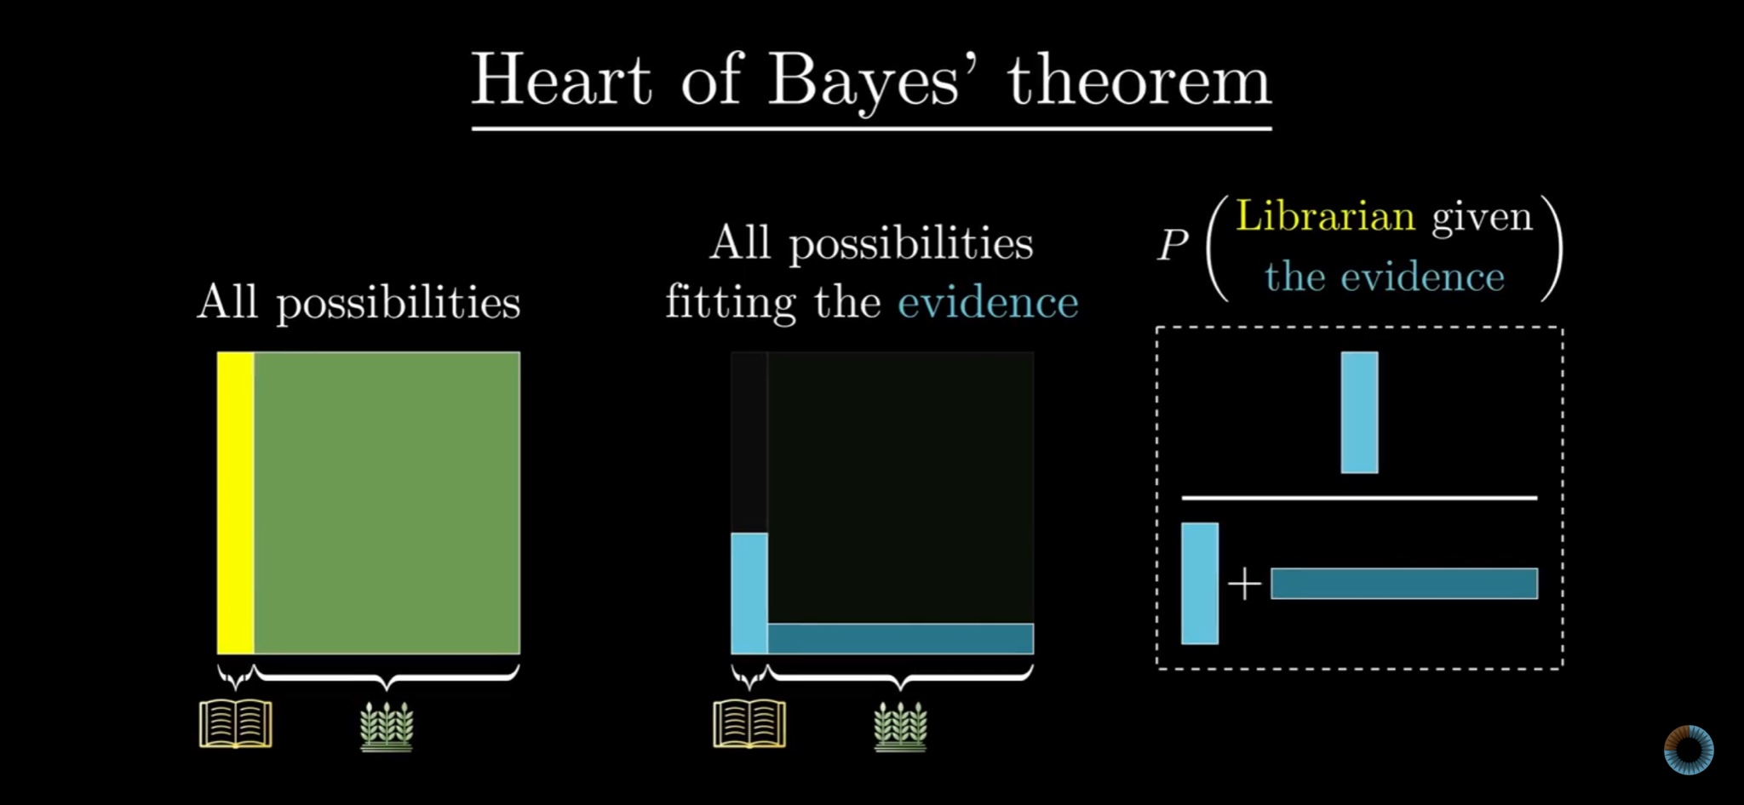
https://www.youtube.com/watch?v=HZGCoVF3YvM

Slide 8
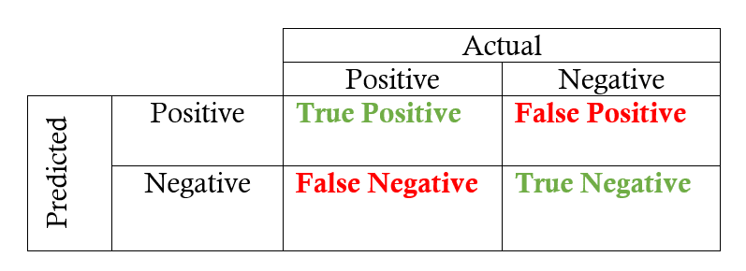
Confusion matrix
https://research.aimultiple.com/machine-learning-accuracy/

Slide 9
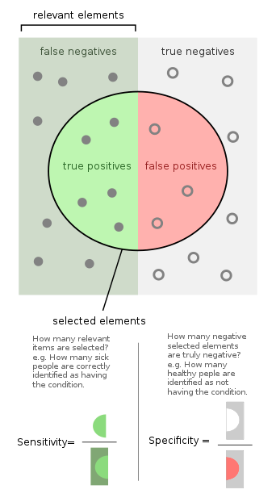
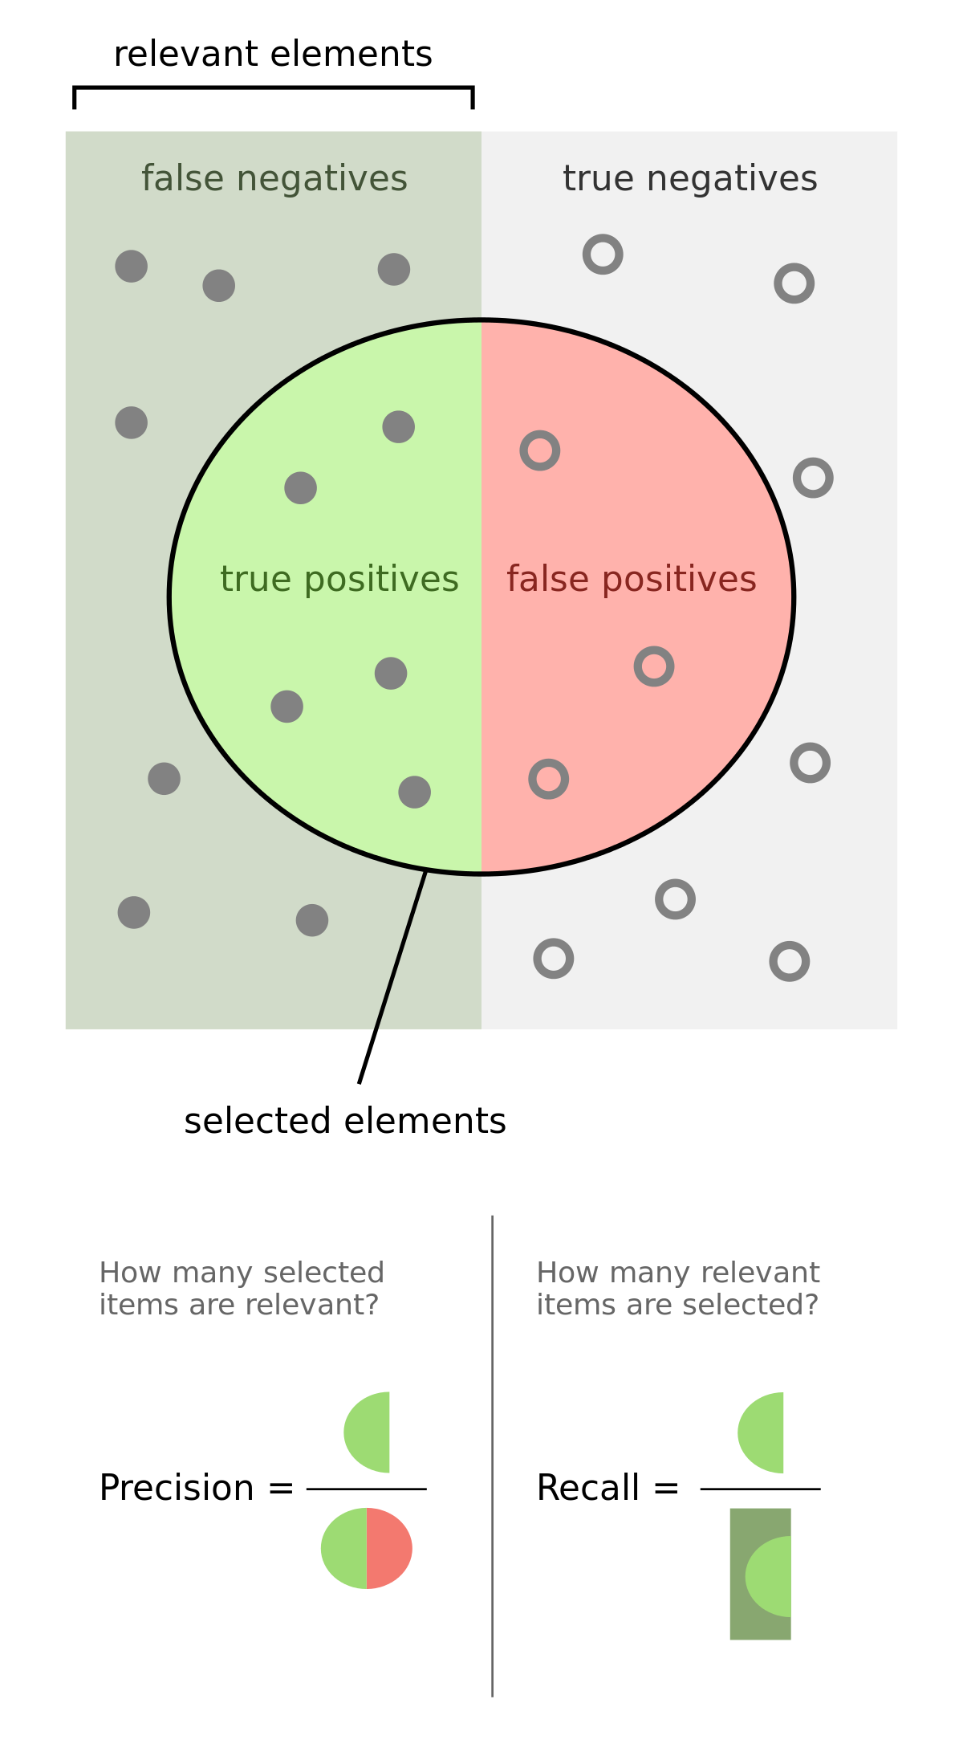
Classification Metric
https://en.wikipedia.org/

Slide 10
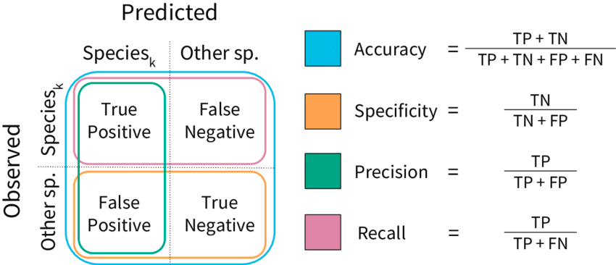

Slide 11
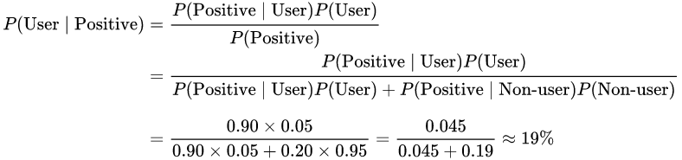
Examples: drug testing
TPR = 0.90
TNR = 0.80
FPR = 0.20
Assuming 0.05 prevalence, meaning 5% of people use cannabis, what is the probability that a random person who tests positive is really a cannabis user?
https://en.wikipedia.org/wiki/Bayes%27_theorem

Slide 12
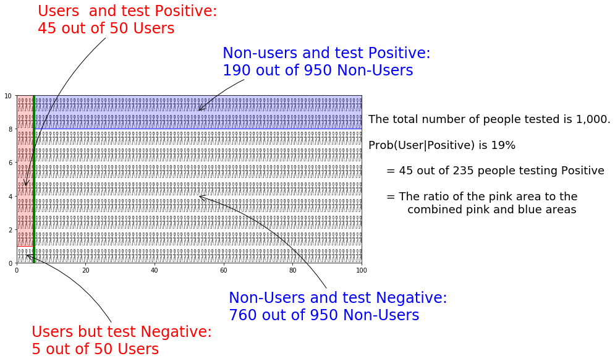

Slide 13
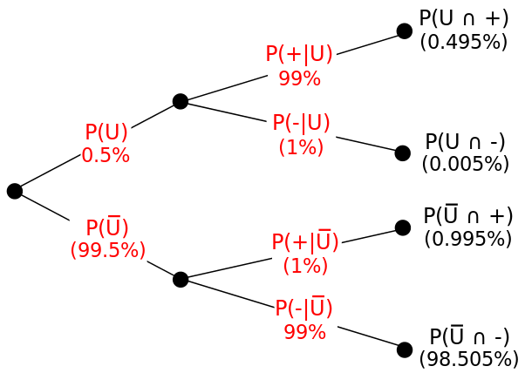

Slide 14
Naive Bayes Classifier
https://insightimi.wordpress.com/2020/04/04/naive-bayes-classifier-from-scratch-with-hands-on-examples-in-r/

Slide 15
Naive Bayes Classifier
… go to scikit-learn.org
https://insightimi.wordpress.com/2020/04/04/naive-bayes-classifier-from-scratch-with-hands-on-examples-in-r/

Slide 16
To be done...

Slide 17
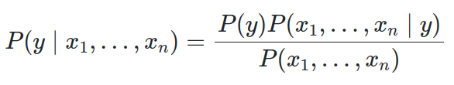
Math Behind

Slide 18
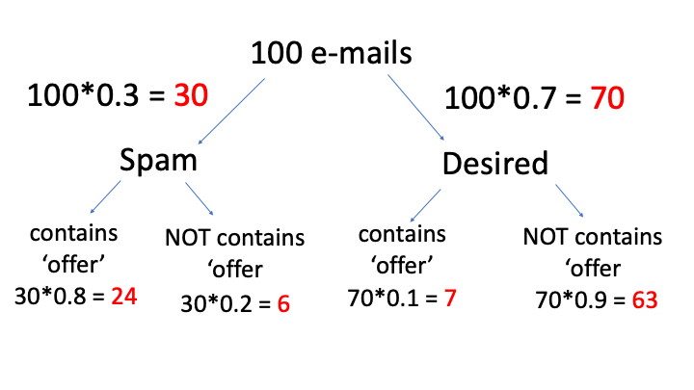

Slide 19
