Slide 1
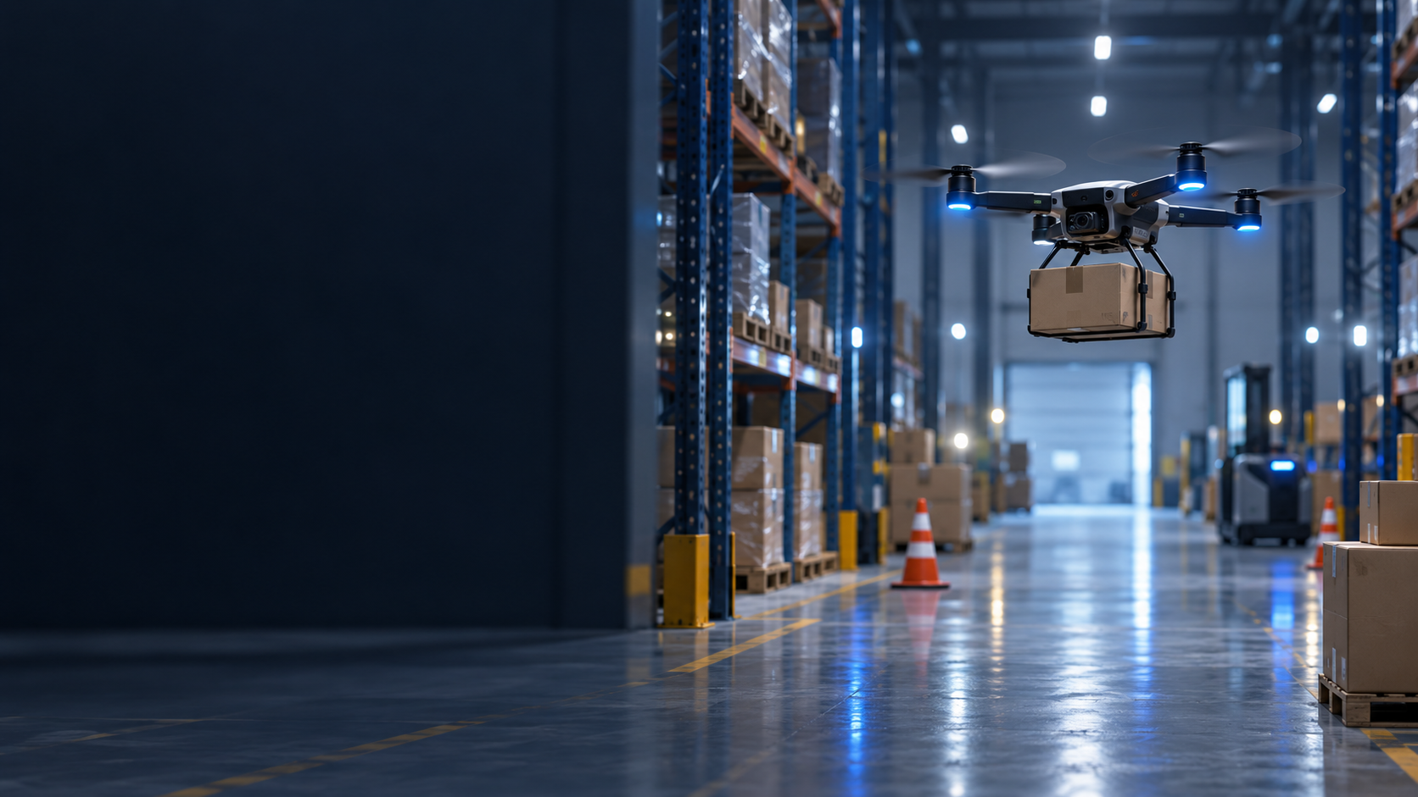
UC9 WEEKLY REPORT
Drone
Obstacle
Avoidance
Camera-guided package delivery
Weekly update / 14 October 2026
Simulation
RGB + Depth
YOLO11 Nano
Previously: fixed pickup coordinates
Now: YOLO + RGB-depth package detection
Notes:
Opening (25 seconds): Previously, pickup used manually entered package coordinates. This week, we added YOLO and RGB-depth sensing to estimate pickup locations. The destination remains configured. The cover artwork is inherited from last week and is illustrative, not a screenshot of the running simulation.
Sources: /home/dzzz83/Downloads/09_WeeklyReport_06102026.pptx; /home/dzzz83/Documents/code/DroneSortingProject/README.md

Slide 2
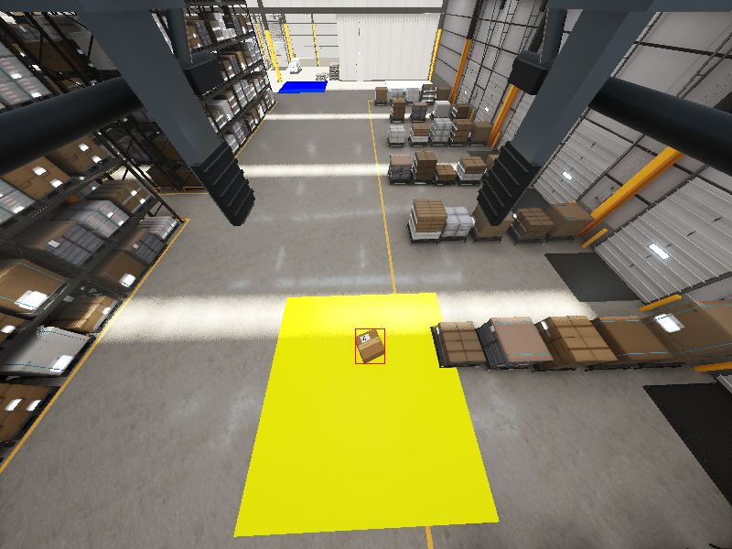
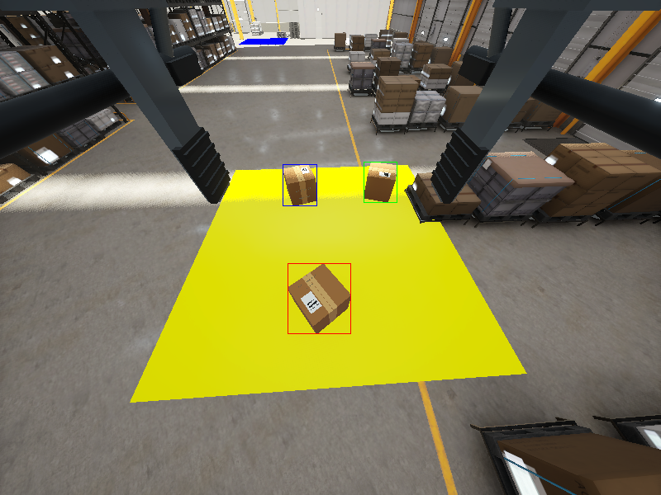
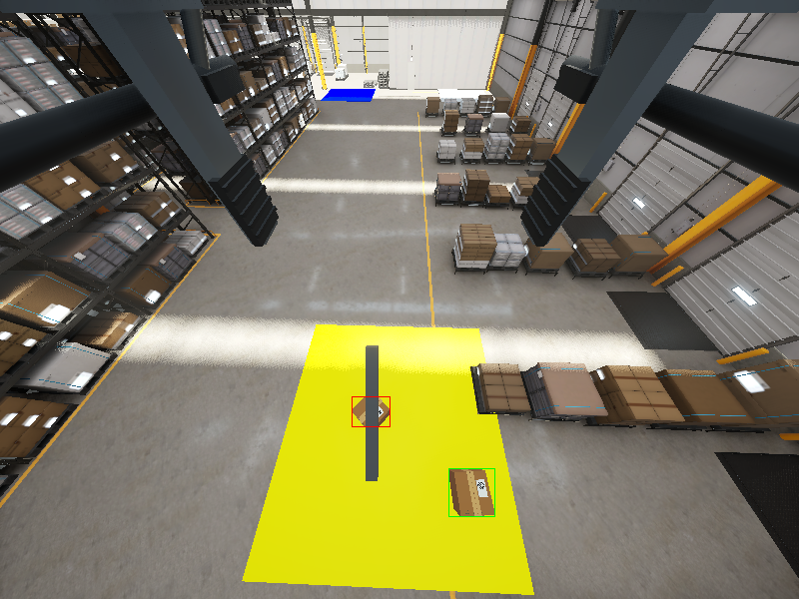
Dataset and model training
200 images captured and automatically labeled in Unity
YOLO11 Nano
Fine-tuned for one class: package
Observation view
Closer pickup view
Partial occlusion
Varied package placements and rotations. Colored boxes are training labels.
UC9 Drone Sorting / Weekly Report / 14 October 2026
2/5
Notes:
Training (45 seconds): We captured simulated camera images with different placements, rotations, heights and occlusion. Unity automatically generated bounding-box labels. We fine-tuned COCO-pretrained YOLO11n for 50 epochs on 200 RGB images: 140 training, 30 validation and 30 test. We grouped images by package configuration so related views stay in one split. Validation selected the best checkpoint. Depth is used during localization, not as YOLO training input. These examples are training labels, not detector predictions. This dataset tests the current simulated warehouse.
Sources: /home/dzzz83/Documents/code/DroneSortingProject/docs/verification.md, Package detector training trial; /home/dzzz83/Documents/code/DroneSortingProject/ROS1/build/package-training-trial/dataset/overlays/train

Slide 3
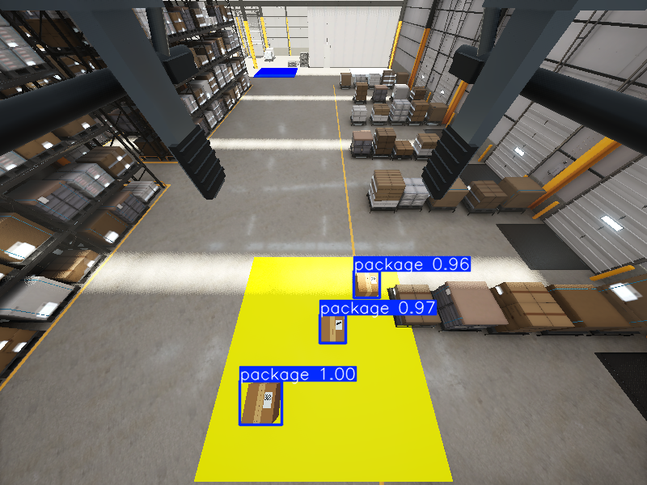
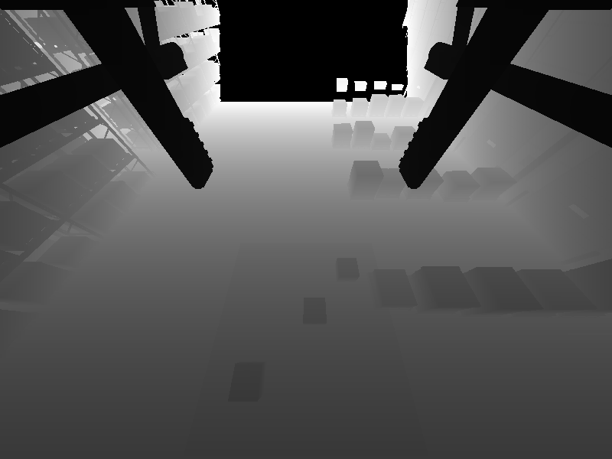
How the drone locates a package
Color shows the package. Depth provides distance.
RGB + YOLO
Depth camera
Pickup position
The system combines detection and depth to estimate a 3D position.
ROS guides the drone to pick it up.
Identifies packages in the image
Measures distance to surfaces
UC9 Drone Sorting / Weekly Report / 14 October 2026
3/5
Notes:
Localization (40 seconds): RGB captures appearance. YOLO identifies packages and returns image bounding boxes. Synchronized depth, camera calibration and pose turn those observations into a 3D surface estimate. The demo fits the top of an upright 0.6 m package to estimate its grasp center. ROS uses that accepted target for pickup. The RGB detection and grayscale depth shown here come from the same saved camera observation. The RGB visual uses the local fine-tuned checkpoint, confidence 0.25. This illustrates the sensing pipeline, not a new end-to-end mission test.
Sources: /home/dzzz83/Documents/code/DroneSortingProject/docs/project_context.md; /home/dzzz83/Documents/code/DroneSortingProject/ROS1/src/drone_sorting/src/drone_sorting/perception/package_perception.py; /tmp/drone-rgb-depth-verification/observation-rgb.png; /tmp/drone-rgb-depth-verification/observation-depth.png

Slide 4
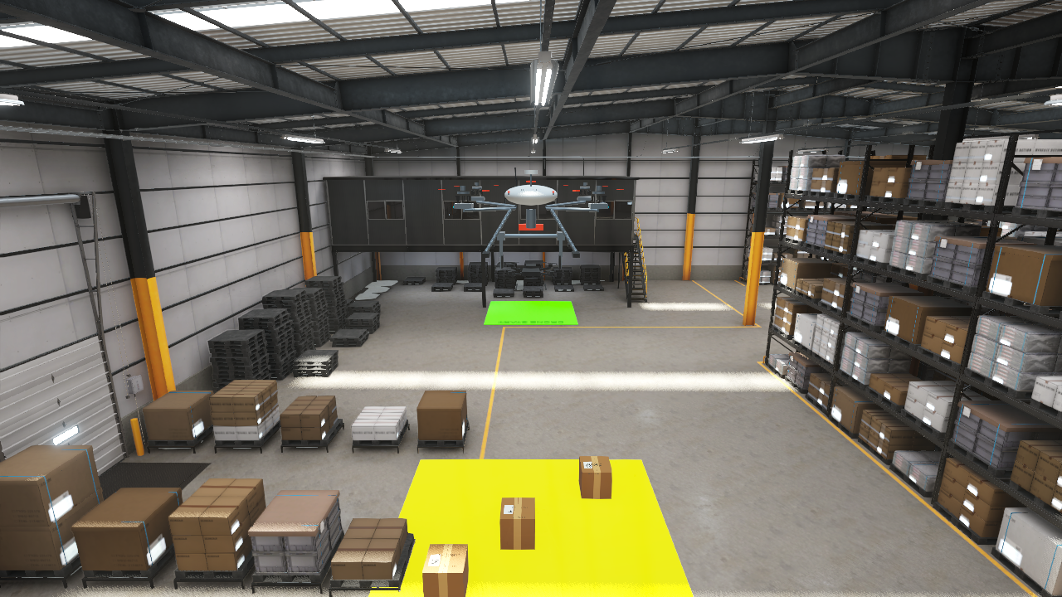
Current delivery demo
One package from the pickup area to a configured destination
01
Start
02
Observation hover
03
Detect and locate
04
Pick up and lift
05
Carry
06
Release and settle
Unity confirms pickup and release.
UC9 Drone Sorting / Weekly Report / 14 October 2026
4/5
Notes:
Demo introduction (30 seconds): The drone starts in the warehouse, ascends and travels to observation, hovers, selects a package from fresh camera observations, approaches and picks it up. It lifts only after Unity confirms attachment. It carries to the configured destination, lowers and releases, waits for Unity confirmation, and holds for settling. The current demo completes one delivery. Independent batch evaluation checked physical attachment and placement. This image is a warehouse spectator preview, not a claim about the live demo outcome. Switch to the live demo here and reserve 6–7 minutes.
Sources: /home/dzzz83/Documents/code/DroneSortingProject/README.md, Camera-guided single-package delivery; /home/dzzz83/Documents/code/DroneSortingProject/docs/verification.md, Full workflow from DroneStart; /home/dzzz83/Documents/code/DroneSortingProject/ROS1/build/spectator-views/view-2.png

Slide 5
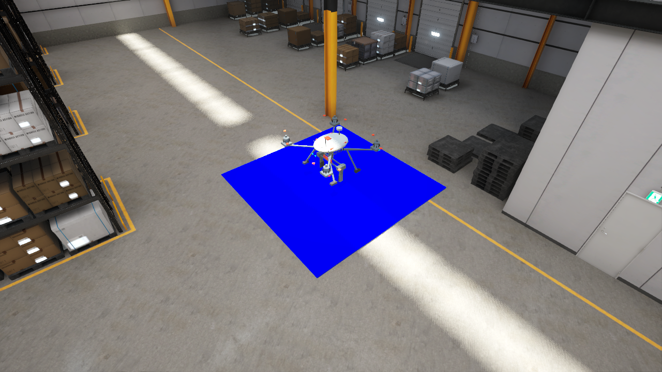
Next: LiDAR obstacle avoidance
Distance sensing for the surrounding warehouse
Add simulated LiDAR
Measure surrounding obstacles
Adjust the route in ROS
Test obstacle avoidance during delivery
Current demo: configured route with obstacle avoidance disabled.
UC9 Drone Sorting / Weekly Report / 14 October 2026
5/5
Notes:
Close after the demo (20 seconds): The next step is to add simulated LiDAR, validate its distance measurements and use them in ROS to detect obstacles and adjust movement during delivery. This is planned work. The current camera delivery route has avoidance disabled. The warehouse image shows existing simulation geometry, not implemented LiDAR scan output.
Sources for current behavior: /home/dzzz83/Documents/code/DroneSortingProject/README.md; /home/dzzz83/Documents/code/DroneSortingProject/docs/PLAN.md. Planned LiDAR milestone: user request in this conversation.

