Slide 1
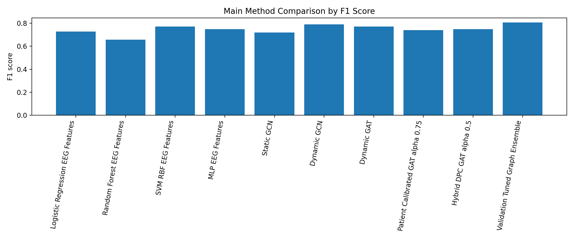
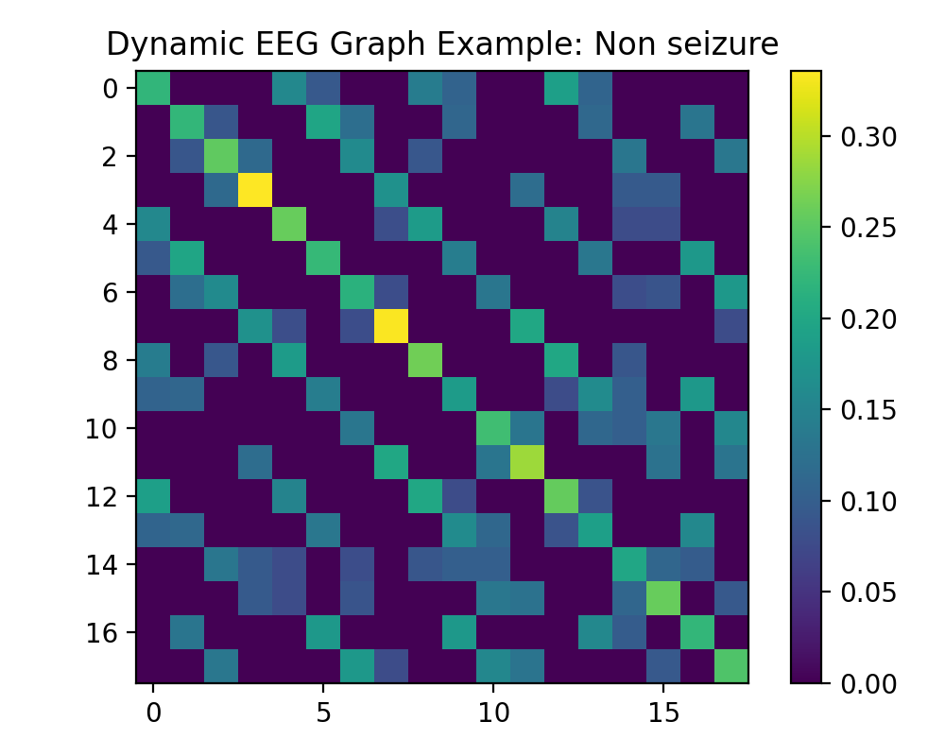
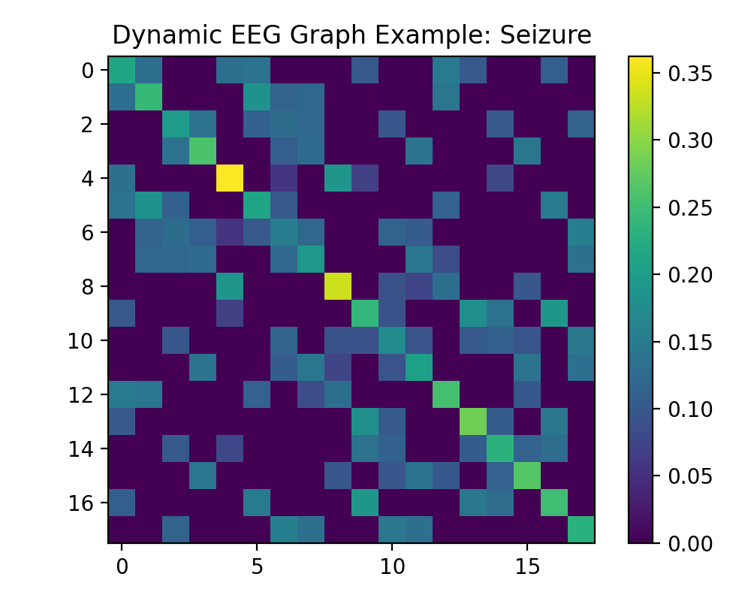
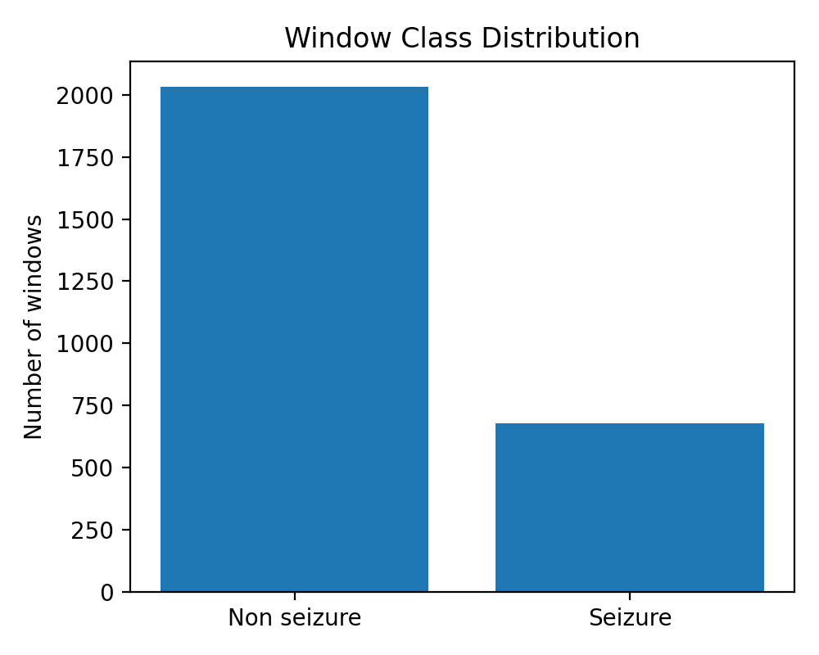
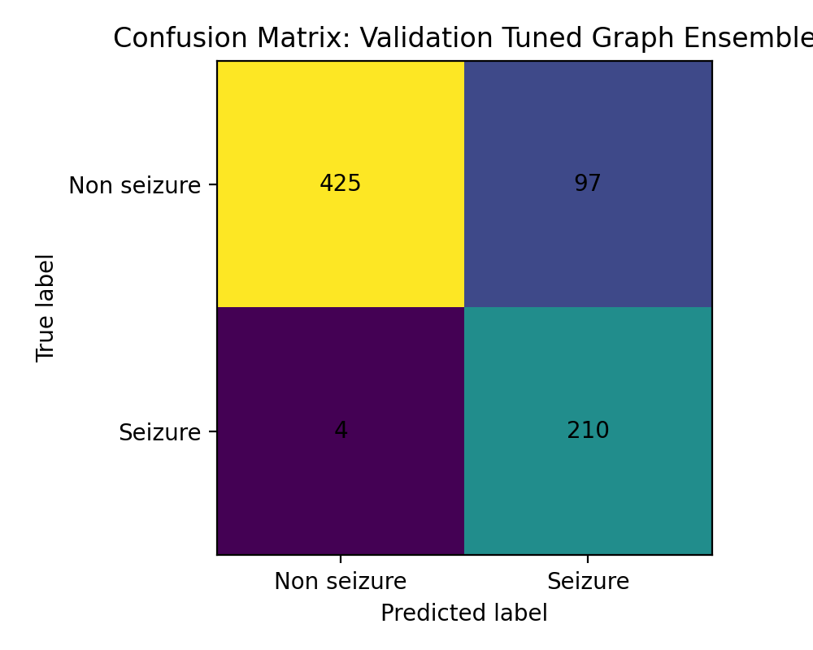
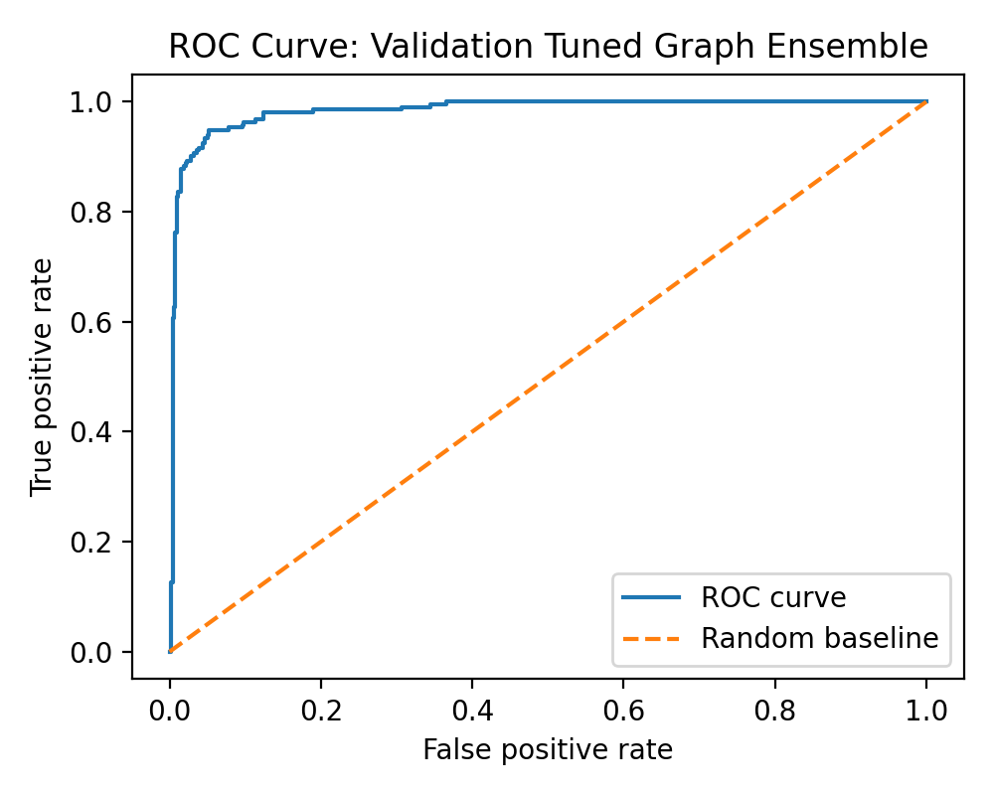
Patient Calibrated Dynamic Graph Fusion for Cross-Patient EEG Seizure Detection
ESMAIL IBRAHIM MOHAMMED AL-NAKEEB | ID: 2598555 | Bahçeşehir University, M.Sc. Artificial Intelligence
Research poster for ARI5004 Deep Learning Final Project
1. Motivation and Challenge
4. Methodology
5. Main Results
EEG seizure detection is difficult because seizure patterns are noisy, nonstationary, and highly patient dependent. Random window splits can leak patient-specific patterns, so this project uses patient-level train, validation, and test splits.
Raw EDF recordings → filtering and resampling → EEG windows → node features → dynamic correlation graph → patient baseline calibration → GCN/GAT models → validation tuned graph ensemble → unseen patient testing
Final method: Validation Tuned Graph Ensemble
Accuracy 0.8628 | F1 0.8061 | Recall 0.9813 | ROC AUC 0.9836 | FPR 0.1858
Compared with Dynamic GCN, the final ensemble improved F1 and reduced false positives from 109 to 97, while keeping seizure sensitivity very high.
2. Dataset
Dynamic EEG Graph Representation
CHB-MIT scalp EEG database
8 selected patients, 18 bipolar channels
4 second windows with 2 second stride
2,712 processed windows: 678 seizure and 2,034 non seizure
Each EEG window becomes a graph: channels are nodes and correlation-based functional connectivity forms the edges. This captures how seizure activity changes relationships between brain regions.
F1 score comparison across main methods
Processed seizure and non seizure window distribution
Non seizure example graph
Seizure example graph
3. Contributions
Patient Calibration
Patient calibrated dynamic graph representation for EEG seizure detection. Normal baseline graph estimated from reserved non seizure calibration windows. Comparison with classical ML, MLP, Static GCN, Dynamic GCN, Dynamic GAT, calibrated GAT, and Hybrid DPC GAT. Robust evaluation using bootstrap testing and repeated patient split analysis.
For each patient, a normal baseline graph is estimated from reserved non seizure windows. Current graphs are recalibrated by their deviation from the patient baseline so abnormal connectivity changes become more visible to the model.
Mathematical idea
Baseline graph: Bp = average normal graph for patient p
Deviation: Δi = |Ai − Bp|
Calibrated graph: Aical = Ai ⊙ (1 + αΔi)
Why this is beyond a simple CNN task
Confusion matrix: 210 detected seizure windows, 4 missed
ROC curve: AUC 0.9836
The main work is not image classification or transfer learning. The project builds patient-level EEG graphs, models functional connectivity with GNNs, calibrates graphs against patient baselines, and tests the result with repeated patient splits.
Models Compared
6. Robustness and Limitation
Logistic Regression, Random Forest, SVM RBF, MLP, Static GCN, Dynamic GCN, Dynamic GAT, Patient Calibrated GAT, Hybrid DPC GAT, and Validation Tuned Graph Ensemble.
Bootstrap analysis supported the improvement trend on the main test split: higher F1 in 93.8% of resamples and lower false positive rate in 96.0% of resamples. However, repeated patient splits showed the gain is patient dependent, so the method should not be overclaimed as universally superior.
Testing Strategy
Primary patient-level split was used for final comparison. Bootstrap testing compared the final ensemble against Dynamic GCN. Repeated patient splits tested whether the improvement remained stable across different unseen patient assignments.
7. Conclusion
Patient calibrated graph information can improve the main cross-patient EEG seizure detection result when combined with dynamic graph learning and validation tuned fusion. The final model achieved the best primary-split F1 score and reduced false positives, but robustness across patients remains the main challenge.
Future Work
Use more patients, test more recordings, improve calibration stability, add temporal graph modeling, and optimize for lower false alarm rates while preserving high seizure sensitivity.
Keywords: EEG seizure detection • graph neural networks • patient calibration • dynamic connectivity • cross-patient testing

