Slide 1
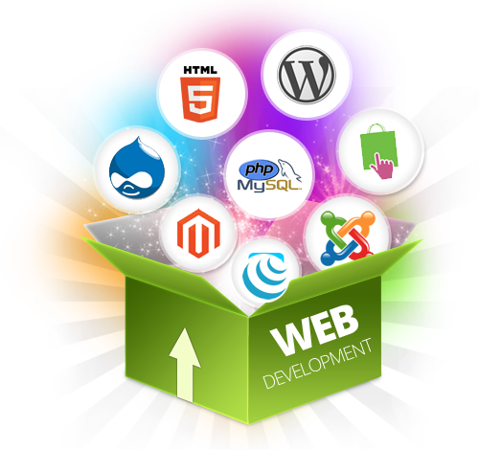
LECTURE 32: INTRO TO WEB DEVELOPMENT
Objectives:
Basic Web Application Model Web Development Frameworks/Languages
Resources:
Web Frameworks
Popular Frameworks
10 Things to Know
Angular
React
Knockout
Videos:
Rest
Postman
Chrome Developer Tools

Slide 2
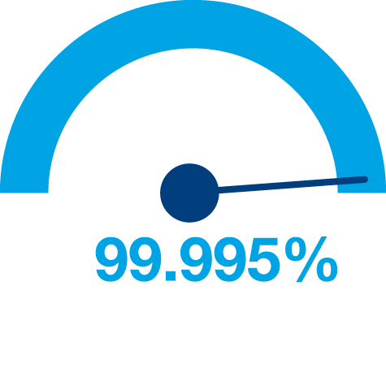

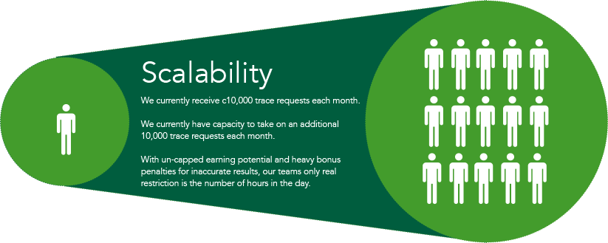


Principles of Web Design
Availability
Performance
Reliability
Scalability
Manageability
Cost
Notes:
Availability: The uptime of a website is absolutely critical to the reputation and functionality of many companies. For some of the larger online retail sites, being unavailable for even minutes can result in thousands or millions of dollars in lost revenue, so designing their systems to be constantly available and resilient to failure is both a fundamental business and a technology requirement. High availability in distributed systems requires the careful consideration of redundancy for key components, rapid recovery in the event of partial system failures, and graceful degradation when problems occur.
Performance: Website performance has become an important consideration for most sites. The speed of a website affects usage and user satisfaction, as well as search engine rankings, a factor that directly correlates to revenue and retention. As a result, creating a system that is optimized for fast responses and low latency is key.
Reliability: A system needs to be reliable, such that a request for data will consistently return the same data. In the event the data changes or is updated, then that same request should return the new data. Users need to know that if something is written to the system, or stored, it will persist and can be relied on to be in place for future retrieval.
Scalability: When it comes to any large distributed system, size is just one aspect of scale that needs to be considered. Just as important is the effort required to increase capacity to handle greater amounts of load, commonly referred to as the scalability of the system. Scalability can refer to many different parameters of the system: how much additional traffic can it handle, how easy is it to add more storage capacity, or even how many more transactions can be processed.
Manageability: Designing a system that is easy to operate is another important consideration. The manageability of the system equates to the scalability of operations: maintenance and updates. Things to consider for manageability are the ease of diagnosing and understanding problems when they occur, ease of making updates or modifications, and how simple the system is to operate. (I.e., does it routinely operate without failure or exceptions?)
Cost: Cost is an important factor. This obviously can include hardware and software costs, but it is also important to consider other facets needed to deploy and maintain the system. The amount of developer time the system takes to build, the amount of operational effort required to run the system, and even the amount of training required should all be considered. Cost is the total cost of ownership.

Slide 3
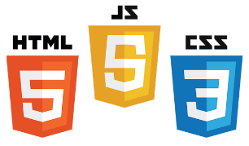

Core Components of Web Applications
UI (Front End (DOM, Framework))
Request Layer (Web API)
Back End (Database, Logic)
Server
Client
API
Front End
Database
Browser
Internet
Logic
JSON
Media Cache
Notes:
Break down into front end and back end

Slide 4
Frontend development

Slide 5
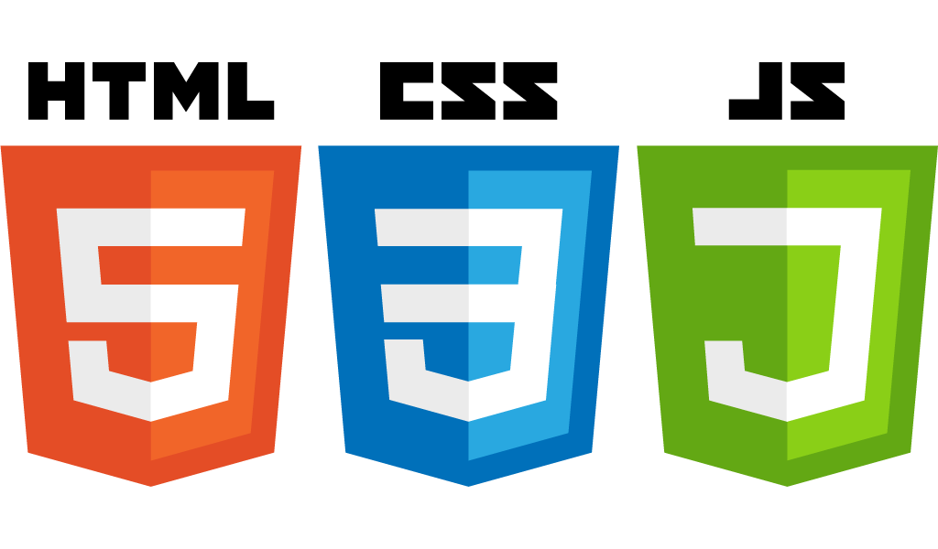
Front End Languages
HTML/CSS
Javascript
Java (applets)
What is the most popular?
Answer: Javascript/HTML/CSS is the only real option for front-end native languages and is basically the standard. But there are many variations on JavaScript that are used.
Notes:
Javascript adoption with ES6, ‘don’t forget about babel’
Node.js:
Swift 2: Apples vision for modern web programming
Go: growing in popularity with startups
TypeScript: Beauty of statically type Javascript (PS: Microsoft Technology)

Slide 6

DOM (Document Object Model)
Document Object Model makes every addressable item in a web application an Object that can be manipulated for color, transparency, position, sound and behaviors.
Every HTML Tag is a DOM object

Slide 7
DOM (Document Object Model)
CSS
DOM
JavaScript
HTML
Notes:
HTML: Creates the DOM
CSS: Decorates the DOM
JavaScript: Modifies the DOM Dynamically
Back End Language: (PHP, Python, Ruby, F#): Generates the DOM on the fly

Slide 8
What is a Framework?
Software Framework designed to reduce overhead in web development
Types of Framework Architectures
Model-View-Controller (MVC)
Push vs Pull Based
Most MVC Frameworks user push-based architecture “action based” (Django, Ruby on Rails, Symfony, Stripes)
Pull-based or “component based” (Lift, Angular2, React)
Three Tier Organization
Client (Usually the browser running HTML/Javascipt/CSS)
Application (Running the Business Logic)
Database (Data Storage)
Types of Frameworks
Server Side: Django, Ruby on Rails
Client Side: Angular, React, Vue
Notes:
MVC: separated (data model, logic, user interface)
Push-based frameworks use actions that do the required processing, and then "push" the data to the view layer to render the results
component-based: These frameworks start with the view layer, which can then "pull" results from multiple controllers as needed.

Slide 9
Framework
Framework
CSS
DOM
JavaScript
HTML
Notes:
HTML: Creates the DOM
CSS: Decorates the DOM
JavaScript: Modifies the DOM Dynamically
Back End Language: (PHP, Python, Ruby, F#): Generates the DOM on the fly

Slide 10



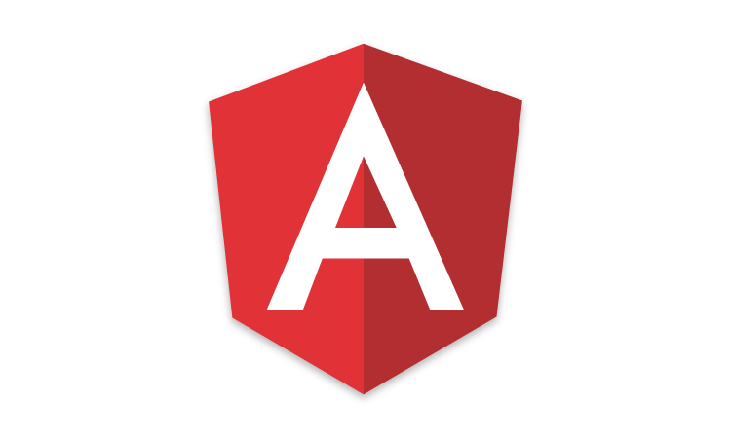

Javascript Frameworks
http://hotframeworks.com
AngularJS/Angular 2
ASP.net
React
Polymer 1.0
Ember.js
Vue.js

Slide 11
MVC (Model View Controller)
A Web Application Development Framework
Model (M):
Where the data for the DOM is stored and handled)
This is where the backend connects
View (V):
Think of this like a Page which is a single DOM
Where changes to the page are rendered and displayed
Control (C):
This handles user input and interactions
Buttons
Forms
General Interface

Slide 12
MVC Model
Controller
Update
Notify
Update
User Action
Model
View

Slide 13
BACKEND development

Slide 14
What is a Backend?
All of the awesome that runs your application.
Web API
Connection layer between the frontend and backend
Connected through API calls (POST, GET, PUT, etc. )
Transmit Content from the Backend to the Frontend commonly in JSON Blobs
Service Architecture that drives everything (Where all the logic is)

Slide 15
What is a WebAPI?
The intermediate layer between front end and back-end systems
A “must have” if your APIs will be consumed by third-party services
Attention to details:
How consumable is the API (signature, content negotiation)?
Does it comply with standards (response codes, etc.)?
Is it secure?
How do you handle multiple versions?
Is it truly RESTful?

Slide 16
Representational State Transfer (REST)
Client-server
Stateless
Resource-based (vs. remote procedure call)
HTTP methods (GET, POST, PUT, DELETE)
Side Effects
It’s a style, not a standard
Don’t hate on HATEOAS

Slide 17
WebAPI Terms
GET – “read”
POST – “insert” (collection)
PUT – “replace”
DELETE – “remove”
PATCH – “update”
Custom (proceed with caution)

Slide 18
Web Status Codes
200 – OK – things are great (return the item)
201 Created – after POST (HATEOAS – return location)
204 No Content (i.e. successful DELETE)
400 – Bad Request (validation error, missing parms, etc.)
401 – Unauthorized – Who are you?
403 – Forbidden – No soup for you
404 – Not Found

Slide 19







Popular Tools
Development Tools:
Chrome/Firefox Developer Tools
Postman (API)
Dreamweaver
Git / SourceTree
Analytics Tools:
Google/Adobe Analytics

Slide 20
Chrome Development Tools Demo
Demo Time!

Slide 21
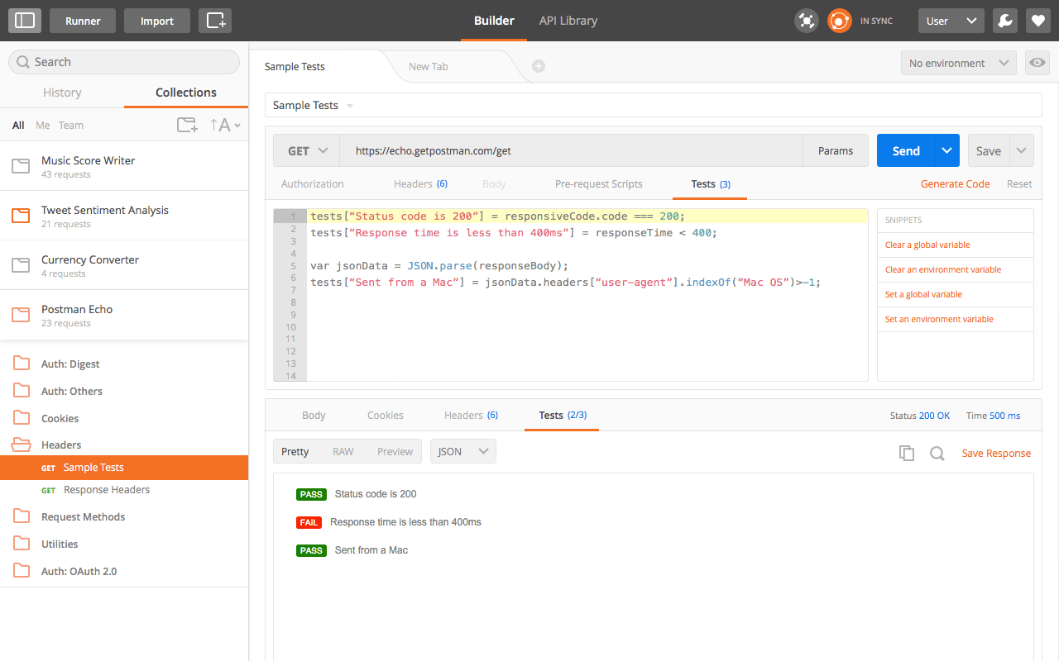
Tools for Testing WebAPI
Postman Chrome extension
http://bit.ly/postmanext
Fiddler by Telerik
http://www.Telerik.com/fiddler

Slide 22
WebAPI Demo
Demo Time!

Slide 23
Appendix

Slide 24
Hypermedia as the Engine of Application State (HATEOAS)
Hypermedia is the key
It all starts at a URL
Resources are returned
Media types and locations are included
References based on state

Slide 25
What is Angular
MVC Structure
Framework
Single Page Application (SPA)
Client Side Template
Testing

Slide 26
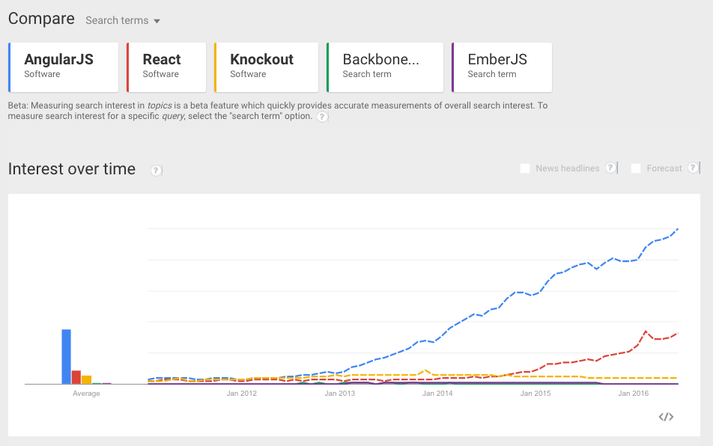
Why Angular?
New Developers
Popularity
Demand
Support and Resources
Front End
Seasoned Developers
Structured and Opinionated Framework
Productivity
Consistency
Team Leads
Efficiency
Longevity

Slide 27
Angular vs. Angular 2
Angular 1
Structured MVC Framework
Separation of HTML and Logic
Client Side Templating
Angular 2
Component Based UI
More Modular Design
TypeScript
Backwards Compatible
Faster

Slide 28
Angular vs. Angular2
angular.module('myModule')
.controller('myController',function(){
})
<body>
<div ng-controller="myController">
</div>
</body>
import { Component } from '@angular/core'
@Component({
selector: 'my-app',
template: ``
})
export class MyAppComponent {
}
<my-app></my-app>

Slide 29
Typescript
JavaScript
var num = 5;
var name = "Speros";
var something = 123;
var list = [1,2,3];
function square(num) {
return num * num;
}
TypeScript
var num: number = 5;
var name: string = "Speros"
var something: any = 123;
var list: Array<number> = [1,2,3];
function square(num: number): number {
return num * num;
}

Slide 30
Typescript
JavaScript
var Person = (function () {
function Person(name) {
this.name = name;
}
return Person;
}());
var aPerson = new Person("Ada");
TypeScript
class Person {
constructor(public name: string){
}
}
var aPerson = new Person("Ada Lovelace");

Slide 31
Building Blocks
Directives
Component – Templates (HTML), Styles (CSS), & Logic (JavaScript)
Attribute – Styling HTML
Structural – Manipulating HTML
Data Flow
Interpolation – Variable Printing in Templates
Event Binding – Trigger Events
2-Way Binding – Variables updated in real time
Providers
Services
Reusable Logic
Data Storing and Manipulation
Libraries

Slide 32
Component Directives
"…reusable building blocks for an application"
Components have:
HTML
CSS
JavaScript
Component
Template (HTML)
Styles (CSS)
Class (JavaScript)
Notes:
"…reusable building blocks for an application"

Slide 33
Learn Angular/Angular2
http://www.learn-angular.org/
http://learnangular2.com/

Slide 34
How does React fit MVC?
Controller
Update
Notify
Update
User Action
Model
View

Slide 35
Flux Model
Data Flow
Action
Dispatcher
Store
View
Action Flow
Action
Action
Dispatcher
Store
View
Notes:
Action:
Every action is sent to all stores via the callbacks
After stores update they emit a change event
Controller view listen for change events then retrieve updates from stores

Slide 36
React Components
// Create a component name MessageComponent
var MessageComponent = React.createClass({
render: function() {
return (
<div>{this.props.message}</div>
);
}
});
// Render an instance of MessageCoponent into document body
ReactDOM.render(
<MessageComponent message=“Hello!” />
document.body
);

Slide 37
React Components
// Create a component name MessageComponent
var MessageComponent = React.createClass({
render: function() {
return (
<div>{this.props.message}</div>
);
}
});
// Render an instance of MessageCoponent into document body
ReactDOM.render(
<MessageComponent message=“Hello!” />
document.body
);
What is JSX?

Slide 38
React Components
// Create a component name MessageComponent
var MessageComponent = React.createClass({
render: function() {
return (
<div>{this.props.message}</div>
);
}
});
// Render an instance of MessageCoponent into document body
ReactDOM.render(
<MessageComponent message=“Hello!” />
document.body
);
What is JSX?

Slide 39
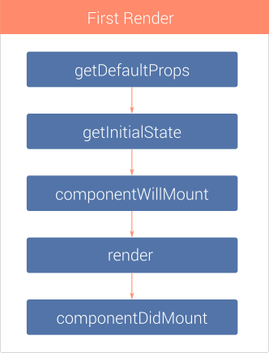
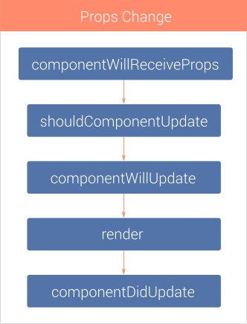
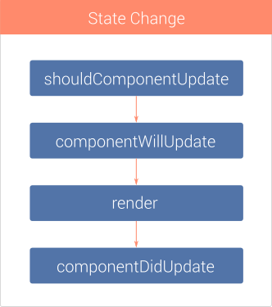
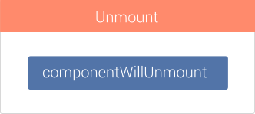
React

Slide 40
Learn React
https://www.codecademy.com/lrn/react-101
https://css-tricks.com/learning-react-redux/

Slide 41
Intro to Knockout
An MVVM library
Automatic UI refresh and updates
Reusable templates
Can be used with nearly any framework
Focused on data binding
Small library size
jQuery
Angular
Knockout
Ember
Notes:
Lightweight vs. full frameworks jQuery most lightweight

Slide 42
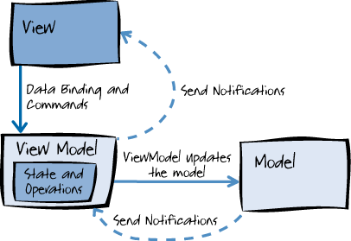
MVVM (Model, View, View-Model)
View
Defines structure and layout of UI
Model
Domain Model
Data Model
Business logic
View Model
Intermediary between M/V
Handles View Logic
Deals with State Change

Slide 43
Learn Knockout
http://learn.knockoutjs.com/#/?tutorial=intro

