Slide 1
Choose the best predictive model
X_train
X_test
Model_1
Model_3
fit
Model_2
fit
Evaluate
fit
Evaluate
Evaluate
Compare & Choose the best

Slide 2
Cross Validation for Model Evaluation
For example: 5-fold cross validation
Step 1.
Split the data set into 5 subsets called fold
Fold 1
Fold 2
Fold 3
Fold 4
Fold 5
Step 2.
Fit & Evaluate the models on this train/test split
X_test
X_train
X_train
X_train
X_train
Step 3.
Fit & Evaluate the models on this train/test split
X_train
X_test
X_train
X_train
X_train
5-fold Cross Validation
Step 4.
Fit & Evaluate the models on this train/test split
X_train
X_train
X_test
X_train
X_train
Step 5.
Fit & Evaluate the models on this train/test split
X_train
X_train
X_train
X_test
X_train
Step 6.
Fit & Evaluate the models on this train/test split
X_train
X_train
X_train
X_train
X_test
Step 7.
Compute the average of the evaluation metrics for each model in steps 2 to 6 and choose the best model.

Slide 3


Slide 4
K-Nearest Neighbor
Class A
K=1
Class B
K=n_neighbors
K=3

Slide 5
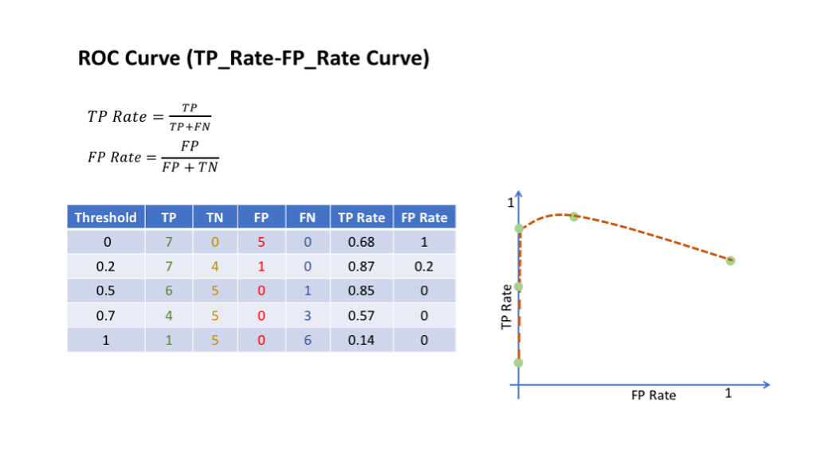

Slide 6
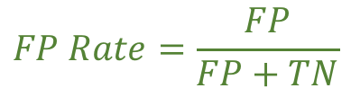
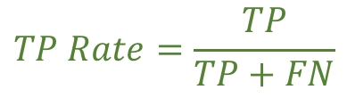
ROC Curve: TP_rate by FP_rate
$$TP Rate=\frac{TP}{TP+FN}$$
$$FP Rate=\frac{FP}{FP+TN}$$
Threshold | TP | TN | FP | FN | TP Rate | FP Rate
0 | 7 | 0 | 5 | 0 | 1 | 1
0.2 | 7 | 4 | 1 | 0 | 1 | 0.2
0.5 | 6 | 5 | 0 | 1 | 0.85 | 0
0.7 | 4 | 5 | 0 | 3 | 0.57 | 0
1 | 1 | 5 | 0 | 6 | 0.14 | 0

Slide 7
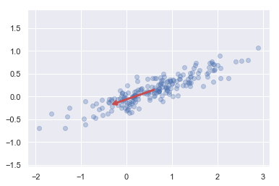
pca.components_=
[[-0.94446029 -0.32862557]]
pca.mean_=
[0.60218493, 0.14714276]
pca.explained_variance_=
[0.7625315]
A=[0.60218493, 0.14714276]
-0.32862557
-0.94446029

