Slide 1

Deep Learning Software installation & Code implementation
Lu Lu
Department of Chemical and Biomolecular Engineering
Penn Institute for Computational Science
University of Pennsylvania
Tianyuan Mathematical Center in Southeast China
Dec 8, 2021

Slide 2
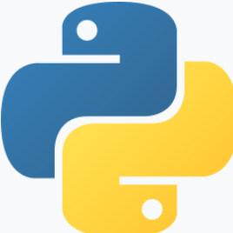


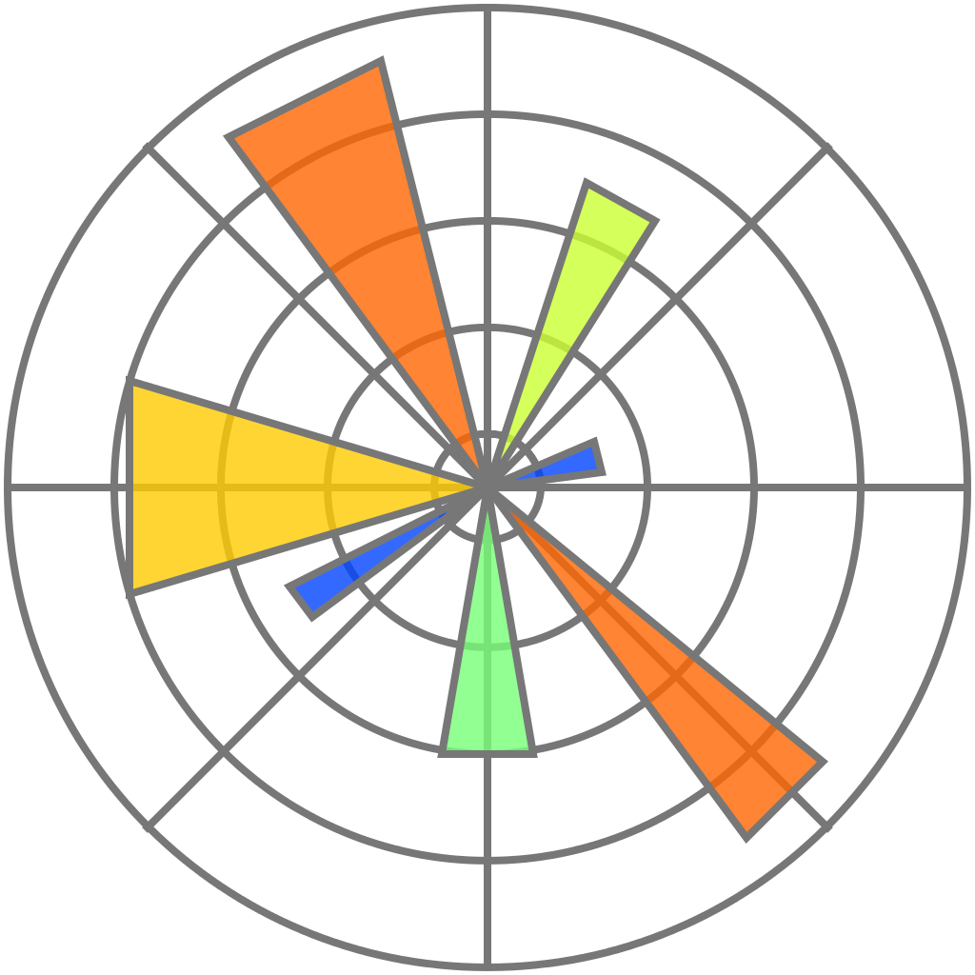
Softwares
Python
Python libraries: NumPy, SciPy, Matplotlib, DeepXDE, etc.
Deep learning frameworks: TensorFlow, PyTorch, etc.

Slide 3

Python
Anaconda
https://www.anaconda.com
Linux
Windows Subsystem for Linux

Slide 4
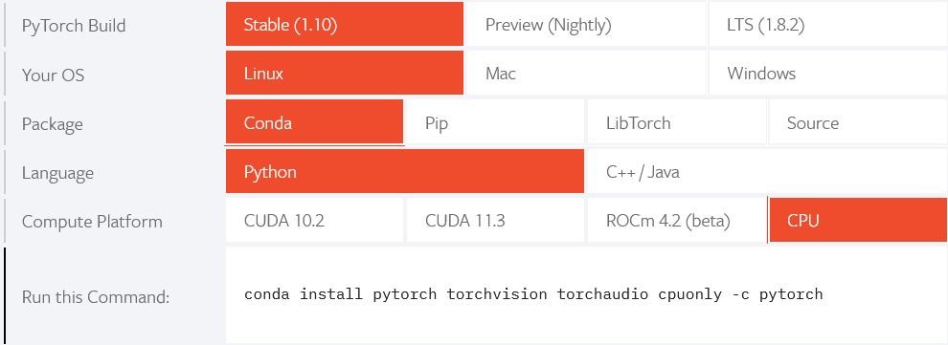
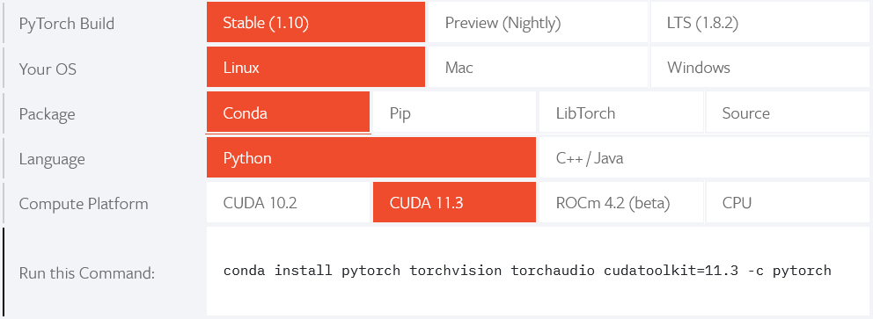
PyTorch
CPU
https://pytorch.org
GPU

Slide 5

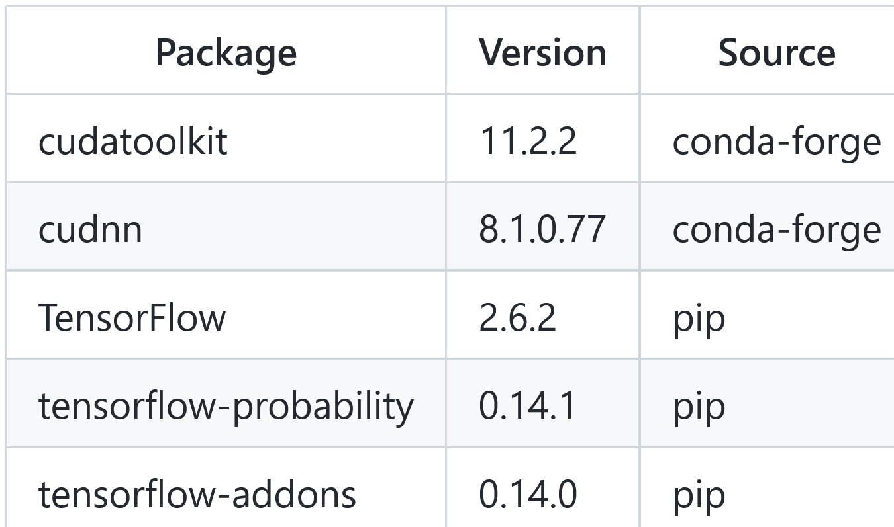
TensorFlow
https://www.tensorflow.org
GPU: compatible versions of NVIDIA driver, CUDA, cuDNN
Can be directly installed on OS
Install CUDA and cuDNN in Anaconda
Updated on 11/17/2021

Slide 6
DeepXDE
https://github.com/lululxvi/deepxde
https://deepxde.readthedocs.io

Slide 7
GPU
Monitor GPU status
$ nvidia-smi
$ gpustat https://github.com/wookayin/gpustat
Run on GPU 0
$ CUDA_VISIBLE_DEVICES=0 python nn.py
Run on CPU
$ CUDA_VISIBLE_DEVICES=-1 python nn.py

Slide 8

$∑∑$_{Job}
ΣΣ_{Job} or Sums_{Job} (Simple Utility for Multiple-Servers Job Submission) is a simple Linux command-line utility which submits a job to one of the multiple servers each with limited resources.
https://github.com/lululxvi/sumsjob

Slide 9
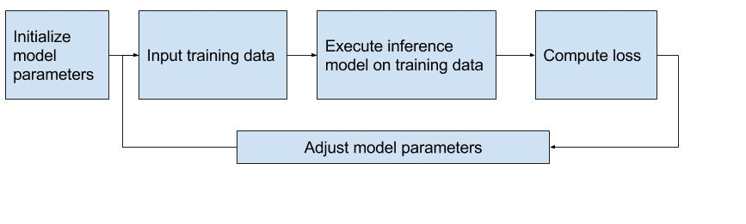
Training loop

Slide 10

Hands-on

