Slide 1





Annotation of how to estimate the shape of the continuum manipulator
Continuum manipulator
Bending joint
75mm
Yawing joint
25mm
Rigid part
138mm
6mm
5mm
How to implement the data table
Bending
Yawing
$$z$$
$$y$$
$$y$$
$$x$$
Bending data
Yawing data
(* These data have been interpolated through motor resolution)
$$x$$

Slide 2
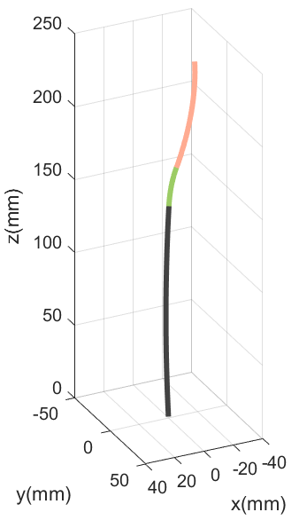
Annotation of the codes for calculating FK and IK
(csv files)
Inverse kinematics
1
2
3
bend_data/yaw_data/bend_base_data
Row = how much the motor move
1st column = orientation of end-effector
2nd and 3rd columns = position of end-effector
Example(MATLAB)
Input
(Desired position)
Forward kinematics
Current position
1
Until (error < threshold)
2
3
Rotation and translation
(next step)
Error comparison
Rotation
Output
(Motor motion)
Bending data
$$y$$
Yawing data
$$x$$
+ Bending base data

