Slide 1


Customer Segmentation using RFM Clustering
Evangelos Tzimopoulos
London, Feb 2020

Slide 2
Contents
Project Overview
Exploratory Data Analysis (EDA)
Key Performance Indicators (KPIs)
Modelling
Summary

Slide 3
Coming up next
Project Overview
Exploratory Data Analysis (EDA)
Key Performance Indicators (KPIs)
Modelling
Summary

Slide 4

Project Overview
Objective
Identify customer segments based on the overall buying behaviour of the client
Stakeholders
Product/Services/Ops team
Marketing/Sales team
Dataset
Online E-Commerce Business Data Set in CSV format
http://archive.ics.uci.edu/ml/datasets/online+retail
Outcome
Create an unsupervised model that generates the optimum number of segments for the customer base
Success Criteria
Segments generated can be interpreted and transposed into business actions

Slide 5
Coming up next
Project Overview
Exploratory Data Analysis (EDA)
Key Performance Indicators (KPIs)
Modelling
Summary

Slide 6
Exploratory Data Analysis
Data Overview
Data Engineering
Data Processing

Slide 7
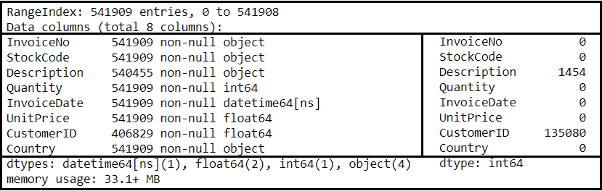
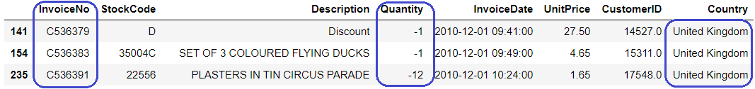
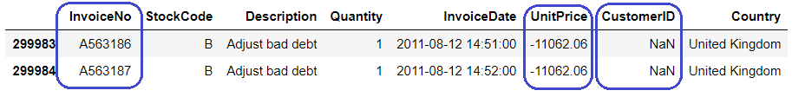
Data Overview
8 key features
Empty rows
Description ~1.5k
CustomerID ~135k
Negative values
Quantity ~ 10k
Unit price ~2
Invoice
C-type – Cancellation
A-type – Adjustment
Null – Normal
Country
United Kingdom ~ 495k

Slide 8
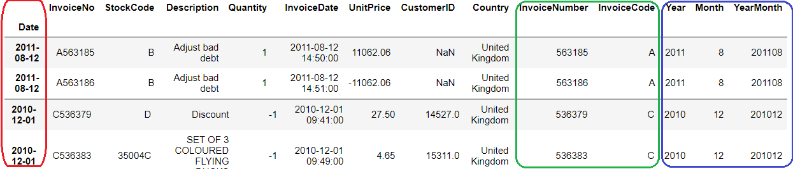
Feature Engineering
Break down InvoiceNo to
InvoiceNumber – New Feature
InvoiceCode – New Feature
C – Cancellation
A – Adjustment
Null – Rename to “N” – Normal
Break down InvoiceDate to
InvoiceYearMonth - new feature
InvoiceYear - new feature
InvoiceMonth - new feature
Date – Use as index
Date
Invoice

Slide 9
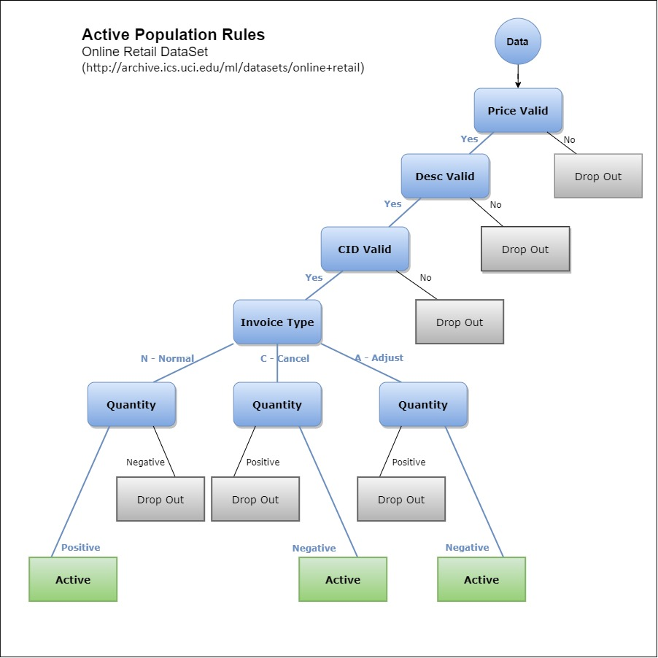
Pre-processing & Analysis
Active population definition based on Business Rules

Slide 10
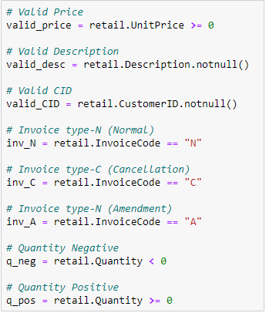

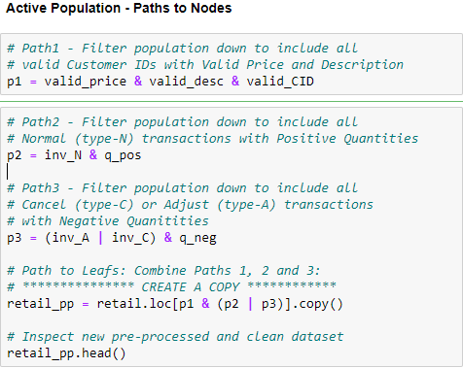

Pre-processing & Analysis
Masks implementing Business Rules
Active population derivation

Slide 11
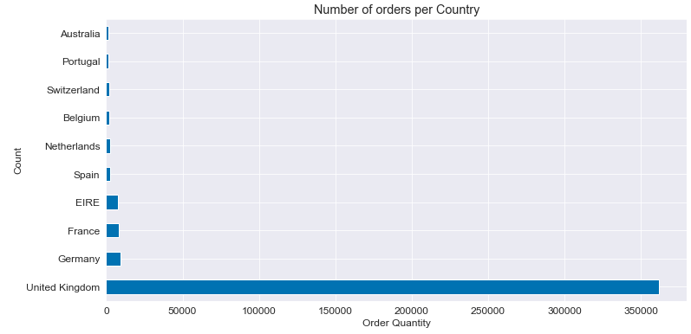
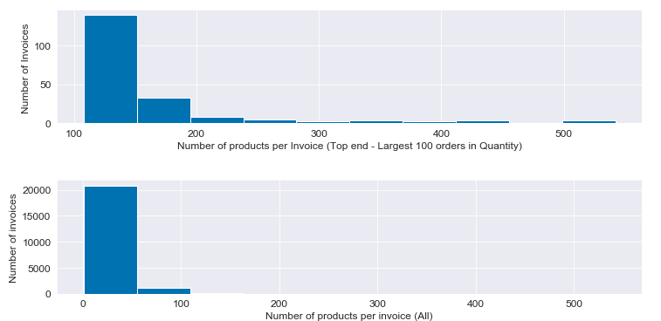
Pre-processing & Analysis
Visualising features:
Countries
Number of Products per invoice

Slide 12
Coming up next
Project Overview
Exploratory Data Analysis (EDA)
Key Performance Indicators (KPIs)
Modelling
Summary

Slide 13
Key Performance Indicators
Transactional KPIs
Customer KPIs
Product KPIs

Slide 14
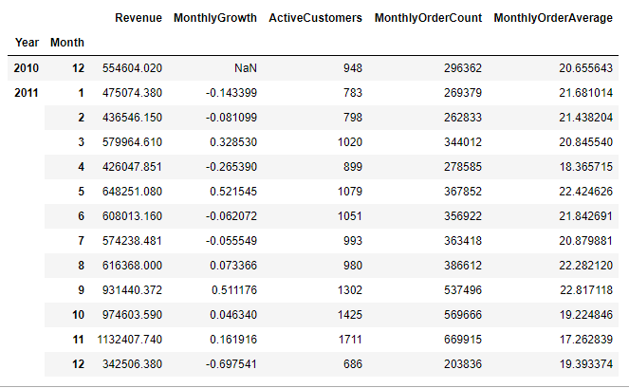
Monthly Revenue
Monthly Revenue Growth
Active Customers
Monthly Order Count
Average revenue per order
Transactional KPIs

Slide 15
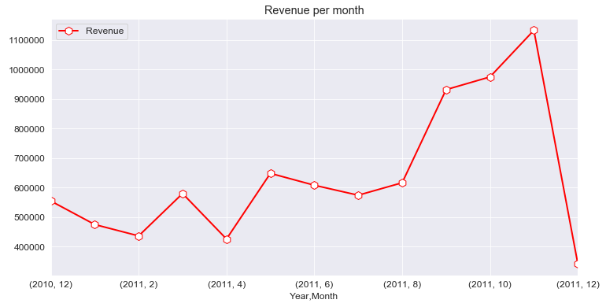
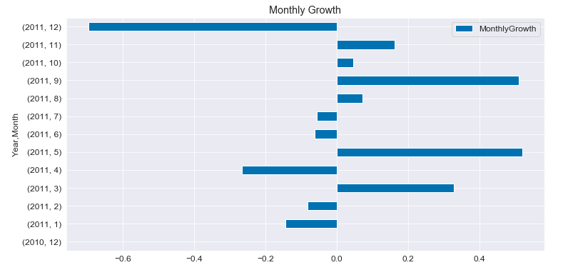
Transactional KPIs
Revenue per month
Revenue growth

Slide 16
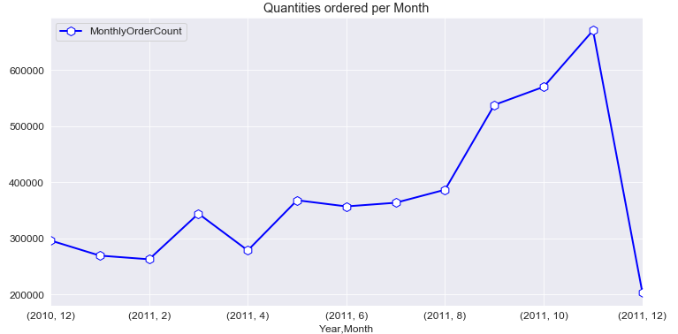
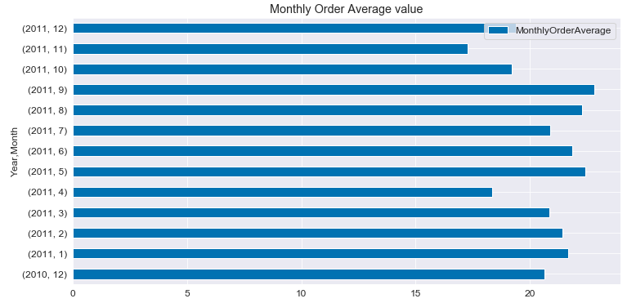
Transactional KPIs
Number of orders per month
Monthly order value

Slide 17
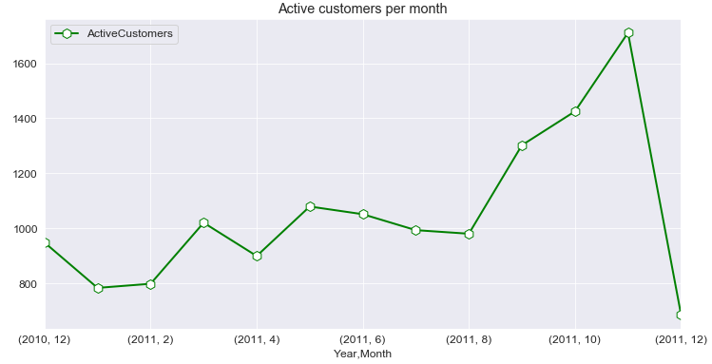
customer KPIs
Active Customers

Slide 18
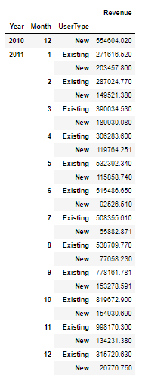
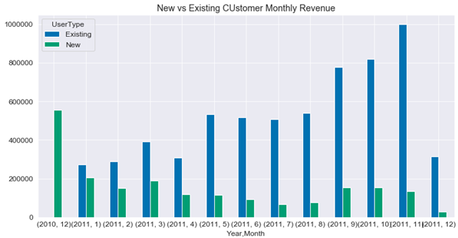
Customer KPIs
New vs Existing Customers

Slide 19
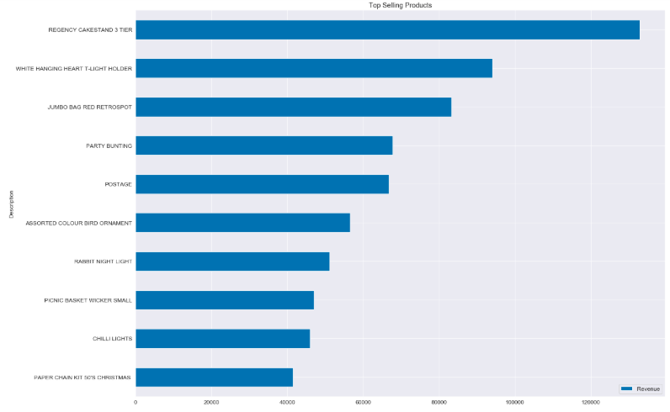
Product KPIs
Top selling product

Slide 20
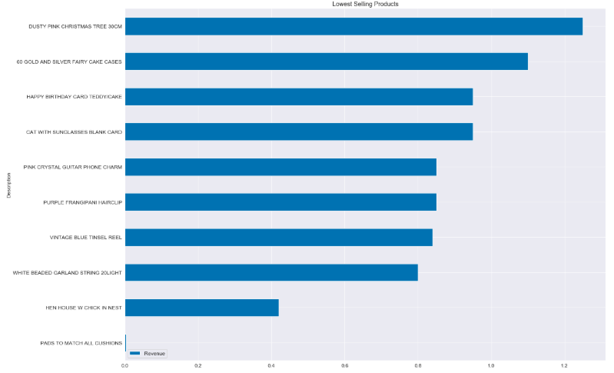
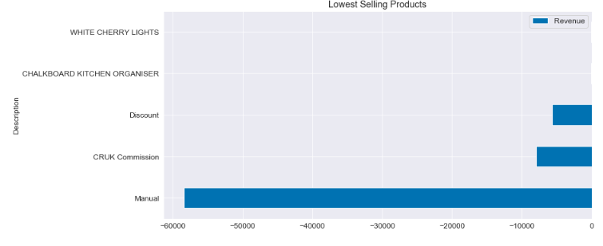
Product KPIs
Lowest selling product

Slide 21
Coming up next
Project Overview
Exploratory Data Analysis (EDA)
Key Performance Indicators (KPIs)
Modelling
Summary

Slide 22
Modelling & Evaluation
K-Means Clustering
Optimization & Metrics
RFM Analysis
Segments Mapping & Business Actions

Slide 23
RFM Analysis
Recency - Given a current or specific date in the past, when was the last time that the customer made a transaction
Frequency - Given a specific time window, how many transactions did the customer do during that window
Monetary Value or Revenue - Given a specific window, how much did the customer spend

Slide 24
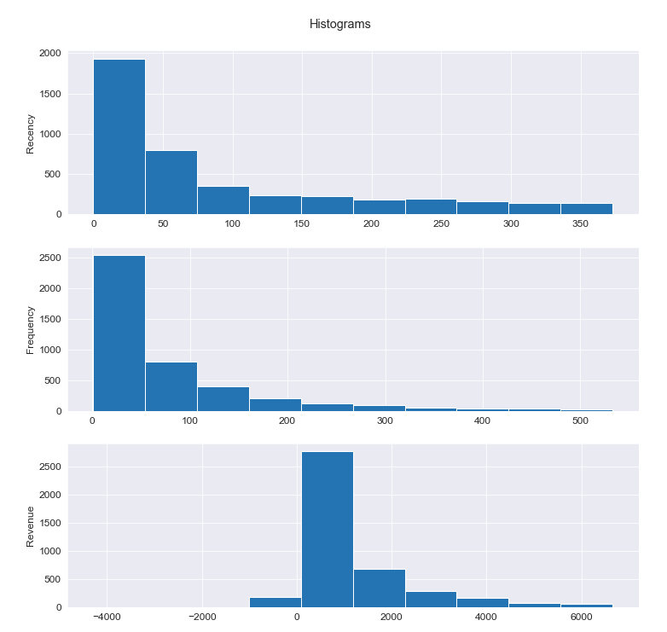
RFM Analysis
Histograms
Recency
Frequency
Revenue

Slide 25
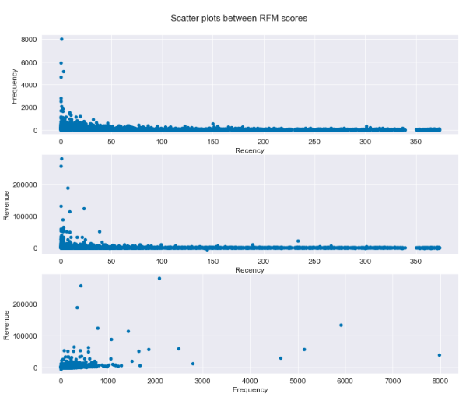
RFM Analysis
Scatter Plots
Recency vs Frequency
Recency vs Revenue
Frequency vs Revenue

Slide 26
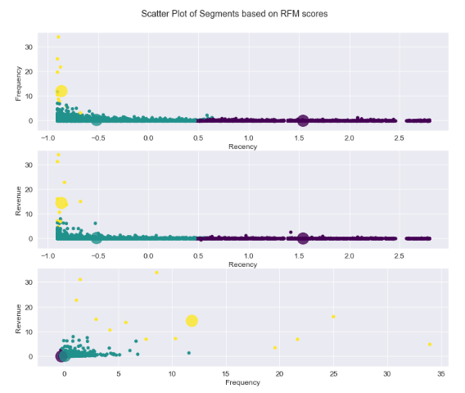
K-Means Clustering
Input X
Recency
Frequency
Revenue
Initial configuration
K=3

Slide 27
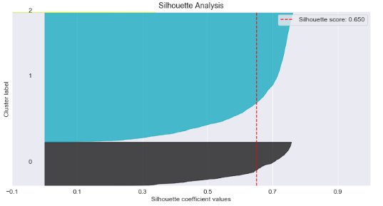
K-Means Clustering
Inertia Score - 5408.4046
Silhouette Score - 0.650

Slide 28
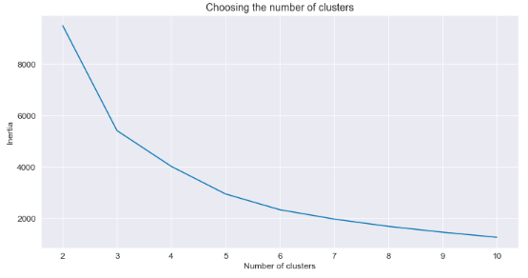
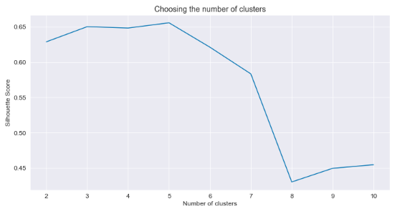
Optimization & Metrics
Minimal Scores
Inertia – 1255.5644
Silhouette – 0.454
K = 8
Optimal K
K = 3-5

Slide 29
Segments Mapping
Initial 3 Segment approach
Low value
Mid value
High value
Optimal 8 Segments Approach
Low Segment: 0-2
Mid Segment: 3-5
High Segment: 6-8

Slide 30
Business Actions
High Value:
Improve Retention of these customers as they are the most valuable asset
Mid Value:
Increase Retention and Frequency and bring them closer to the brand and the product so eventually they become High Value
Low Value:
Increase Frequency and understand if there are any potential issues around the product or service

Slide 31
Coming up next
Project Overview
Exploratory Data Analysis (EDA)
Key Performance Indicators (KPIs)
Modelling
Summary

Slide 32
Summary
Data Review & Understanding
Feature Engineering & Processing
KPIs & Visualizations
RFM analysis & new features
Unsupervised learning K-Means clustering
Optimization & Evaluation
Business Actions & Segments Mapping
Next Steps

Slide 33
Next Steps
Customer Lifetime Value (CLTV) Prediction
Supervised learning
Classification based on RFM analysis (input features) and Revenue (output label) on specified windows

Slide 34

Questions?

