Slide 1


Social Buzz Analysis

Slide 2


Today's agenda
Project recap
Problem
The Analytics team
Process
Insights
Summary

Slide 3

Social Buzz is a fast growing business that has had some challenges scaling to adapt to its Global scale.
Accenture begun a month POC Focusing on these tasks:
An Audit of Social Buzz Big Data Practice
Recommendations for a successful IPO
Analysis to find Social Buzz’s top 5 most popular categories of content
Project Recap

Slide 4

Problem
Over 100000 Posts a Day!
36,500,000 pieces of content per year!
How can we capitalize on this?
Analysis to find Social Buzz’s top 5 most popular categories of content

Slide 5



ANDREW FLEMING
Chief Technical Architect
The Analytics team
MARCUS ROMPTON
Senior Principle
CHEMWENO EVANS
Data Analyst

Slide 6
Process
1
DATA UNDERSTANDING
2
DATA CLEANING
3
DATA MODELLING
4
DATA ANALYSIS
5
UNCOVER INSIGHTS

Slide 7
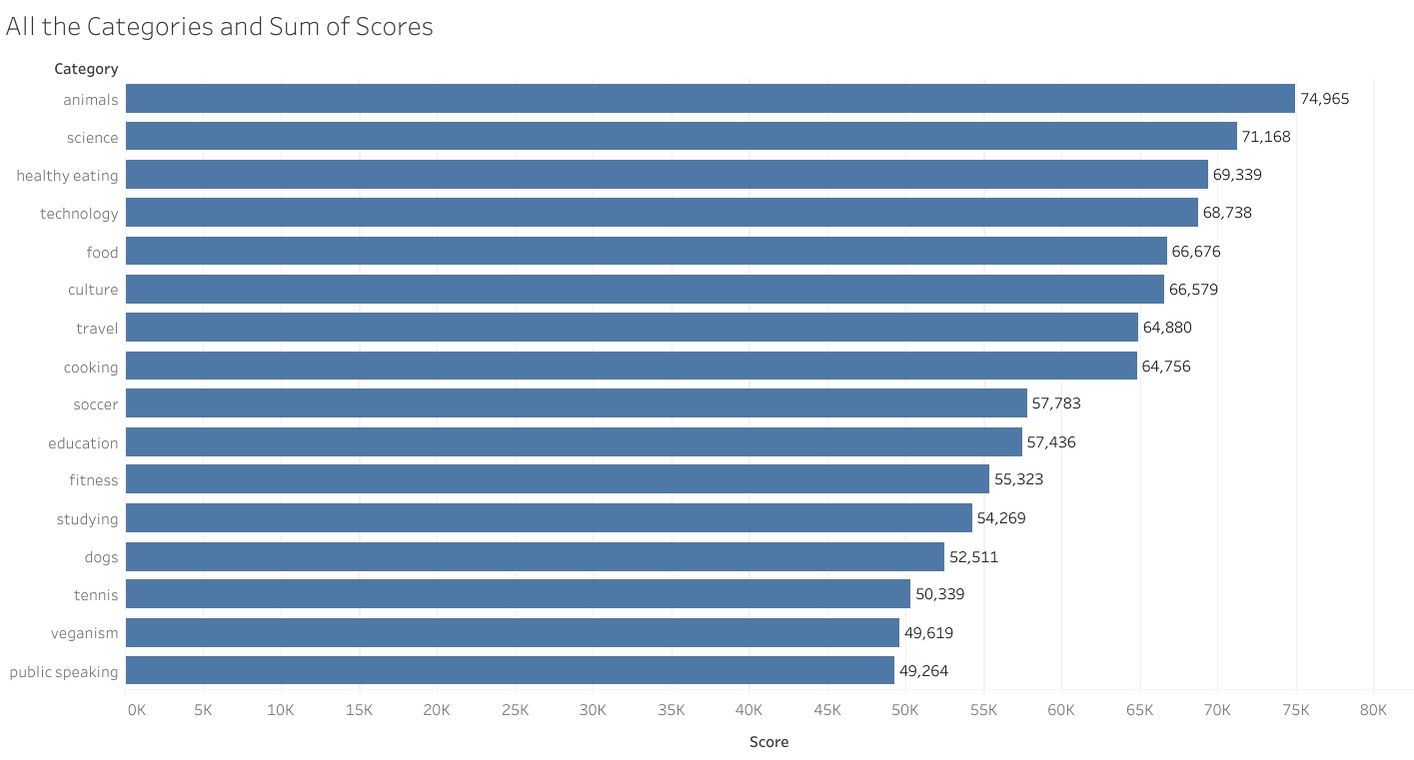

Insights
From the Data, we found that there are 16 different Categories with Animals leading with a score of 74,965. The category with the least score was Public Speaking with a score of 49,264

Slide 8
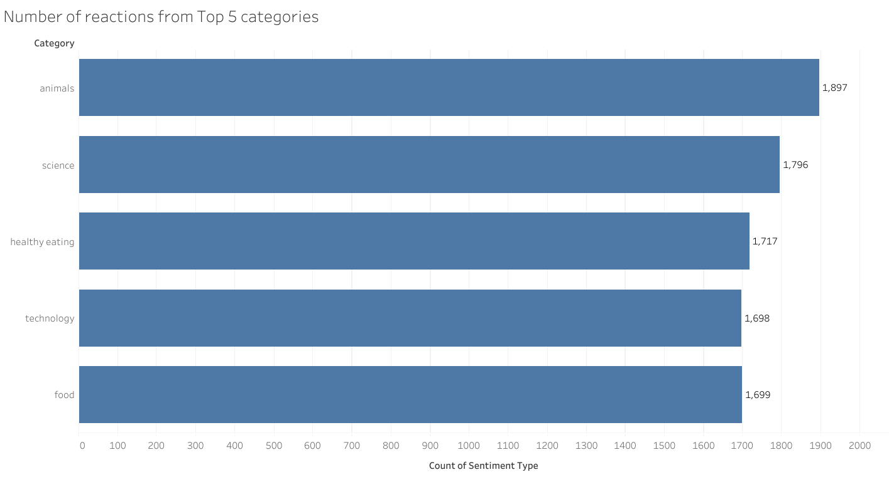
The Most popular Categories in terms of number of reactions include:
Animals - 1,897
Science – 1,796
Healthy Eating – 1,717
Technology – 1,698
Food – 1699

Slide 9
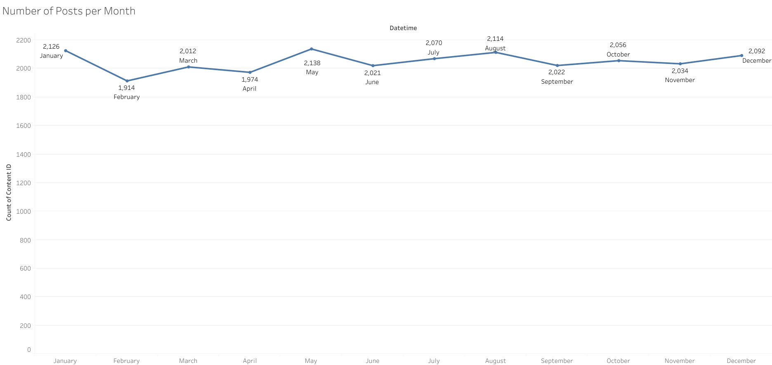
The month of May had the most posts: 2138 posts.
It was followed by January that had 2,126 posts and Finally August had the 3rd most with 2114 posts

Slide 10
Thank you!
ANY QUESTIONS?

