Slide 1
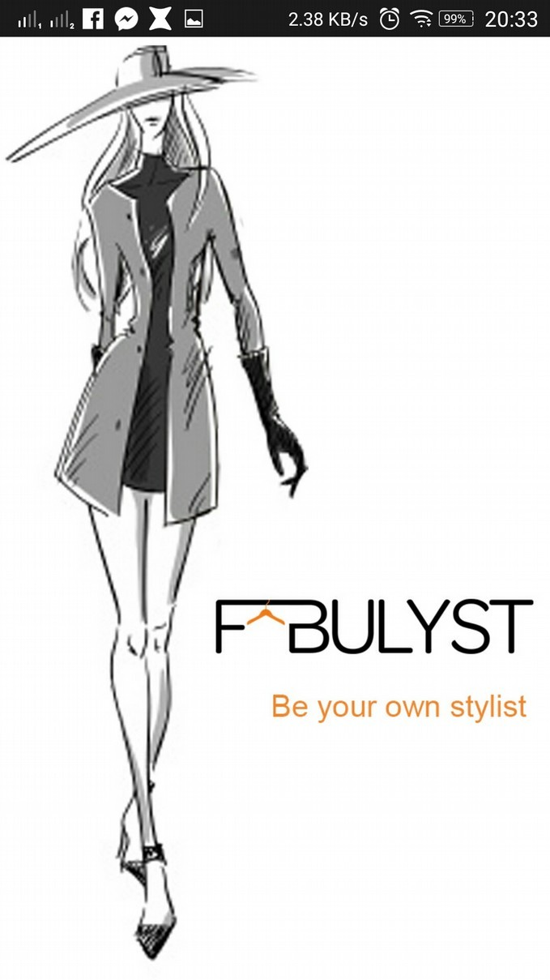
Fabulyst App:
General: This app is meant for women styling. There are different women products sorted according to their needs, intrests etc.
The user can aks questions about the items, their size, their color, etc to a stylist which is provided after they log in.
The user is also asked several question in the beginning about their perfect choice of clothes, color, size and the products are shown to them according to their selected choices
Their are different tags which sort the products by name which makes it easy to find products.
To buy any item the user taps on the item and is then redirected to another page from where the item was scrapped. All the billing related stuff happens here.
Frontend views: The app has 3 main pages:
Login
Handpicked
Collections
Find
a) Login page: This page asks the user to login to the app by using Facebook.

Slide 2
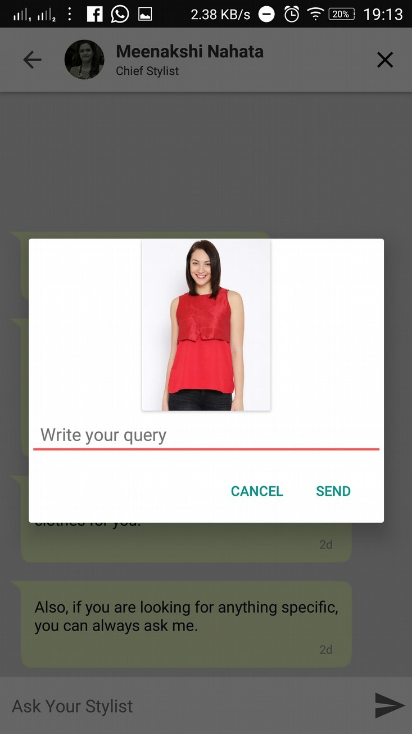
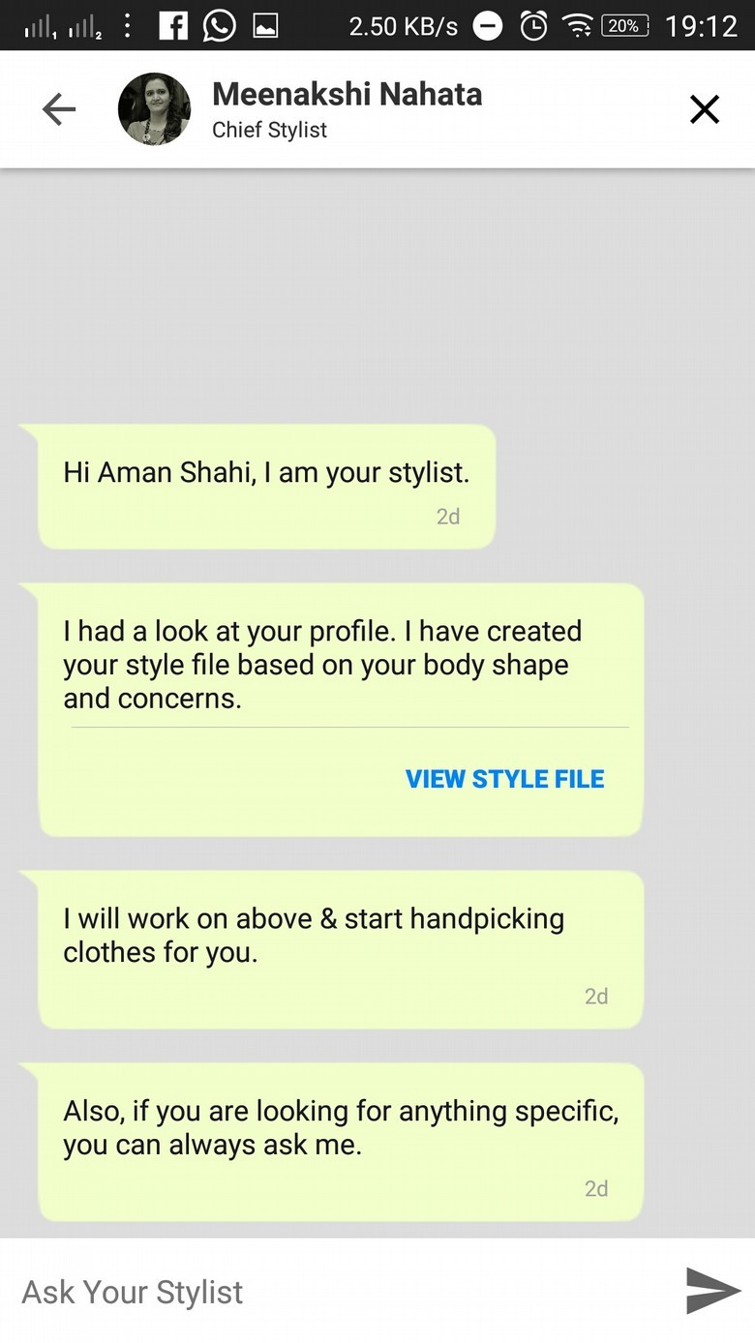
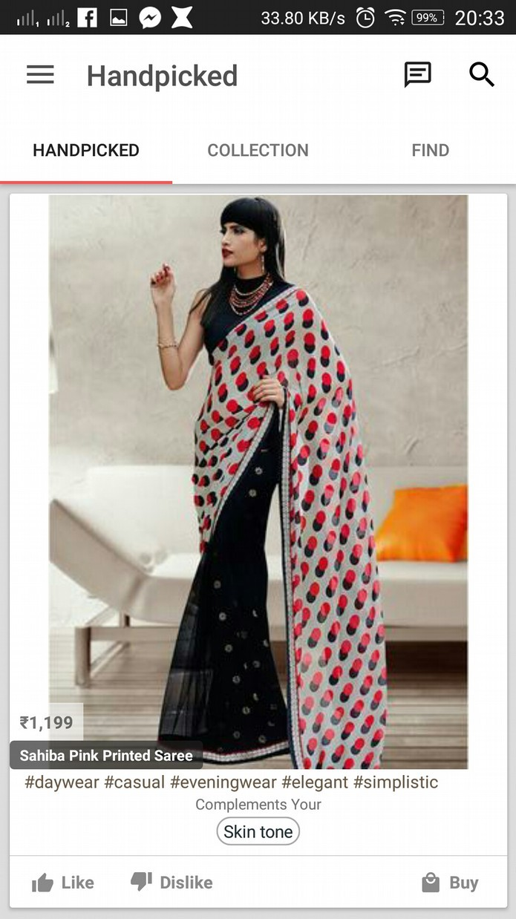
After tapping on the login button, the user is directed to another page where the app asks the login and password.
Then the user is directed to another page where the app asks the user to continue without posting anythin on facebook.
Now the user is successfully signed in.
After that the user is asked several questions about his/her intrests and desires of how his/her wadrobe should like and other queries about his/her profile. The user can change this afterwards if required.
Chat with stylist: After logging in successfully, the user is then introduced to a stylist who suggests about the style that would suit him/her.
There is a chat with stylist button on the top right corner which he can tap and ask anything about the clothing, styling, color, size, etc.
Handpicked page: After opening the app the page to which the user is directed is Handpicked.

Slide 3
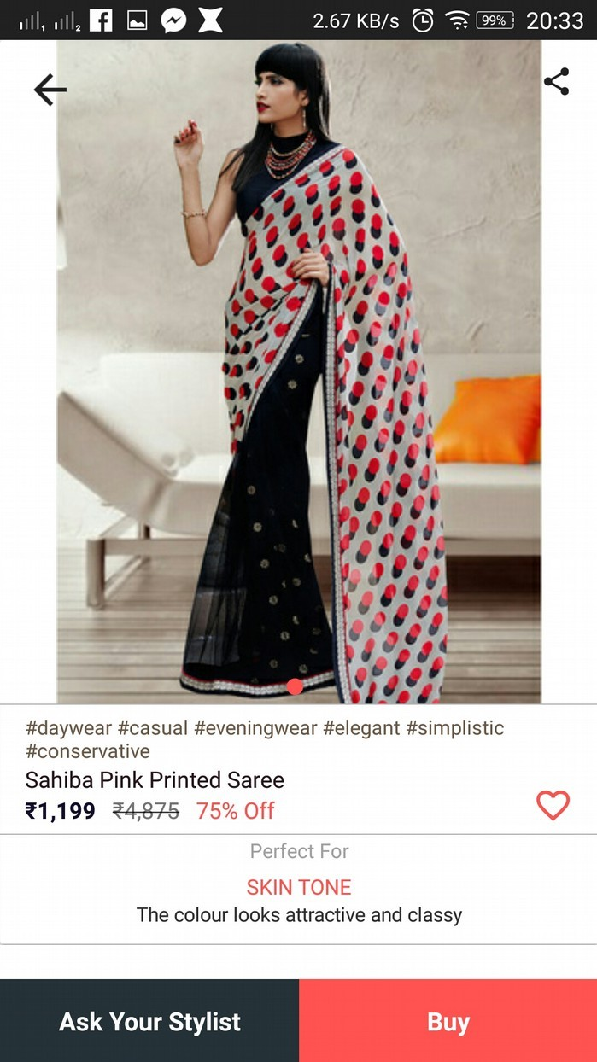
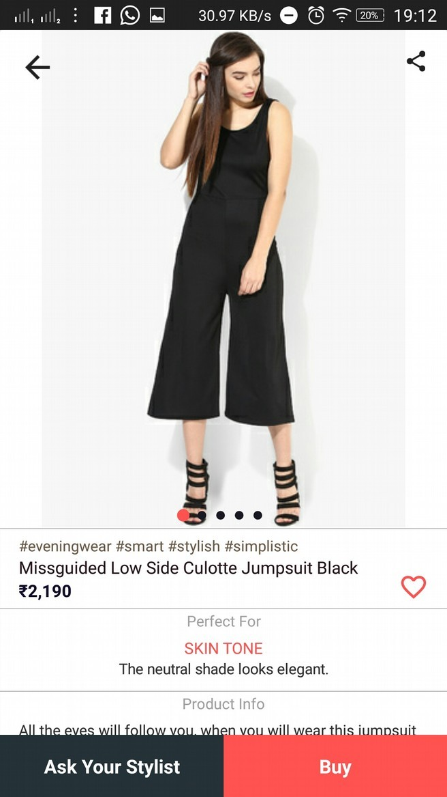
This page consists of the items sorted by their hashtags. You can like/dislike the item, can buy the item
There is a buy button and you can also buy by tapping on the image of the item
Then you are directed to another page where you can add the item to whishlist. There is also a share button on the right corner of the page where you can share the item on facebook or with anyone on whatsapp etc.
Horizontal left and right scroll will show the item in different angles. There is also a button named Ask your stylist. You can directly chat or talk with your stylist and discuss about the item you selected.
The buy button opens the site from which the item could be bought and all the transaction takes place there. Also a small description of the item is provided at the end of the page.
Again coming back to the handpicked page you can scroll down to see more items.
At the bottom there are few tags like Fittings, Necklines, Sleeves, Pattern, Lengths. Tapping on any of the tag would open the items of the tag in a new page. This page would consist of images of items and a button to add the item to whishlist. You can also like the theme and there is also a button named Explore products which opens up all the items under the specific tag.
Opening any of the item would open a page where you can buy the item and ask your stylist about the item. There is

Slide 4
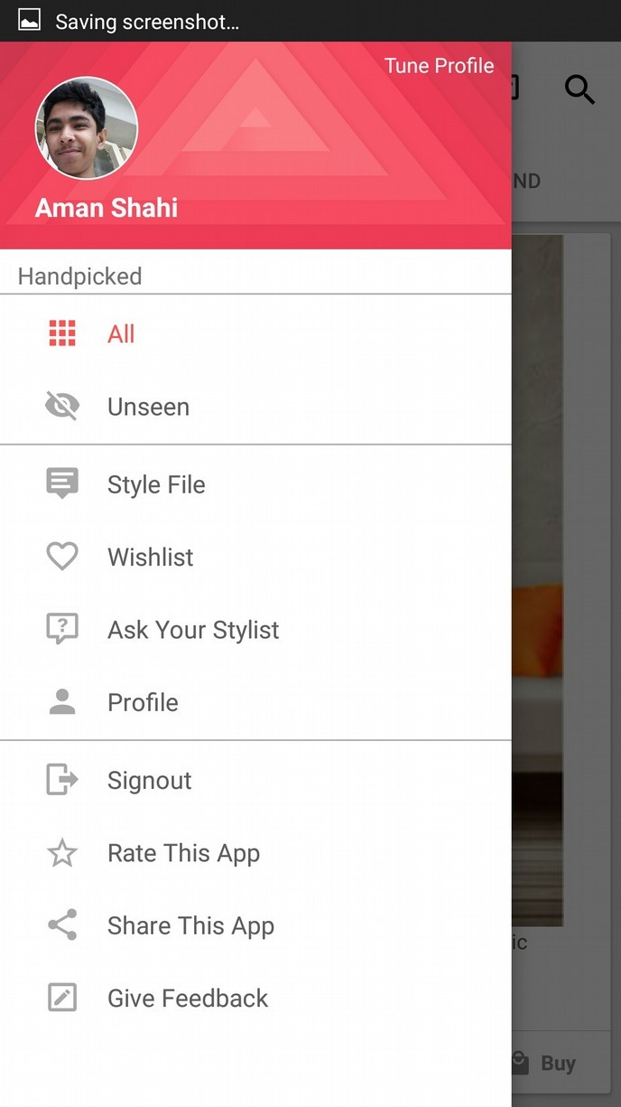
also a share button on the right corner of the page where you can share the item on facebook or with anyone on whatsapp etc.
Also a small description of the item is provided at the end of the page. The buy button opens the site from which
the item could be bought and all the transaction takes place there.
Left scrolling on this page would go to the collections page and right scrolling on this page would open a hamburger menu which would contain all the user related information like his whishlist, feedback, profile, style file, ask your stylist button, rate app, share app etc. You can also update your profile in this section. This can also be opened using the hamburger menu at the top.
There is also a search button on the top right which searches the items based on tags, themes etc. Also there is a chat with stylist button left of the search button which opens a chat with your stylist.
d) Collections page: The collection page consists of items with different themes like quick casuals, ripped rocks, open button, look at me, cross ways. Maxima, cover up, trendy cool etc.

Slide 5
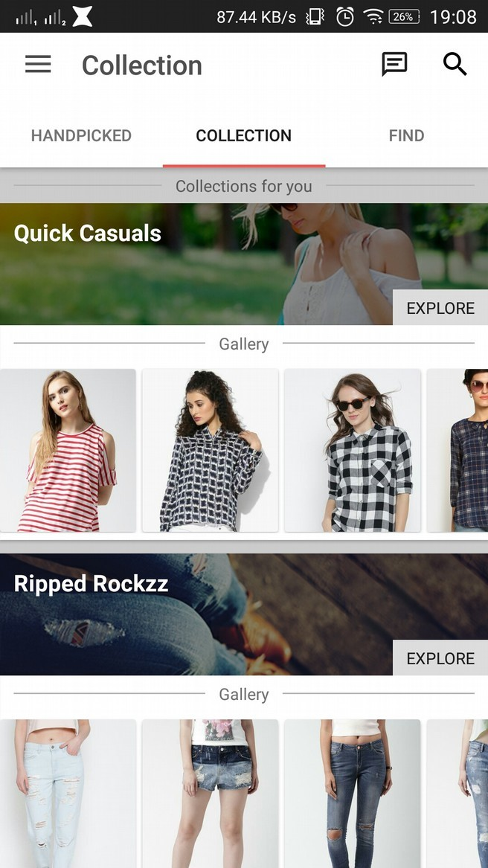
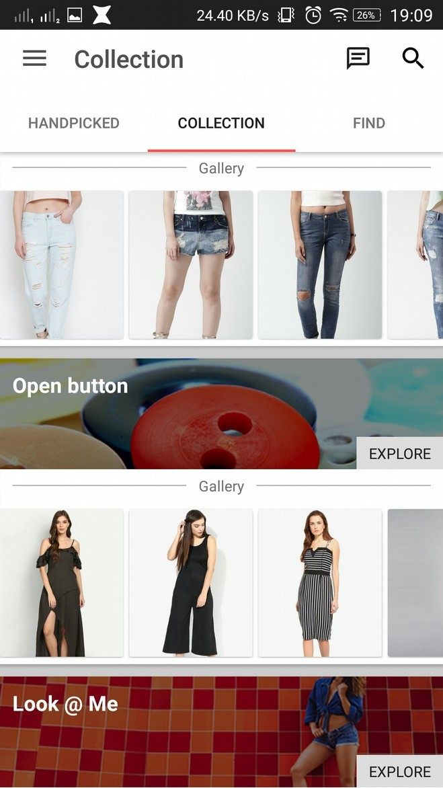
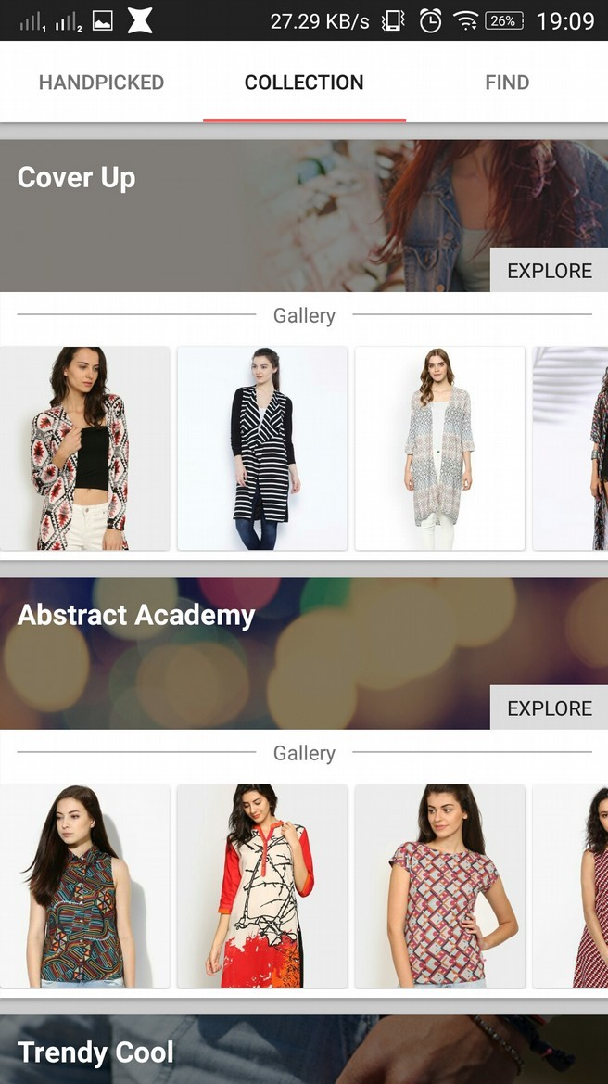
The top navigation part of the app remains the same in all pages like hamburger navigation, search and ask your stylist.
The themes are written on the top and images of some of the items are projected below. Clicking on any of the images would open the item and you are directed to the buy page which consists of several images of the item which acn be scrolled horizontally, the buy button which redirects to the website where all the payment related stuff happens, ask your stylist button, share with friends button, add to whishlist and a small description of the product etc.
Also there is an explore button at the corner of the theme name which opens all the items of the particular theme. This contains the image of the items twenty by default and a button at the corner of the image to add the item to wishlist. Scrolling the page down would load another twenty items which are sorted according to their delivery time and so on.
Selecting any of the item would redirect to the buy page of the
item.
Similary all the themes are displayed one below the other scrollable vertically.

Slide 6
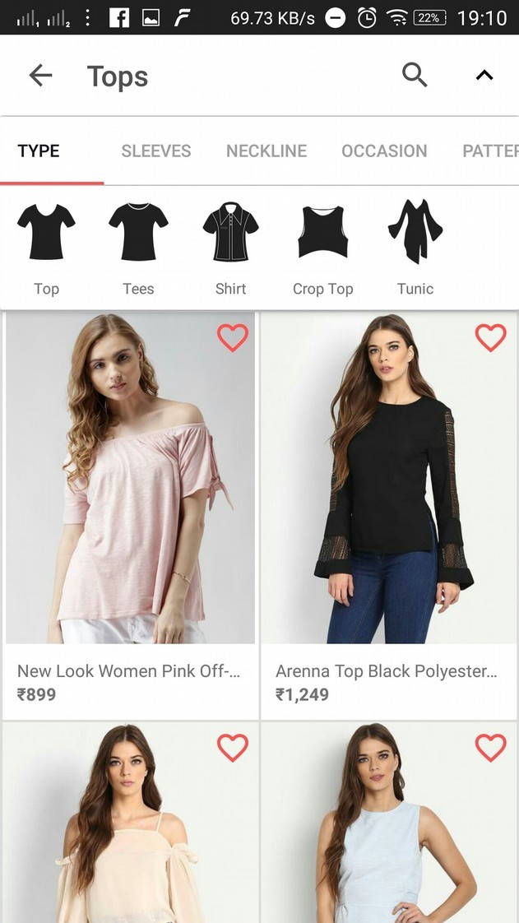
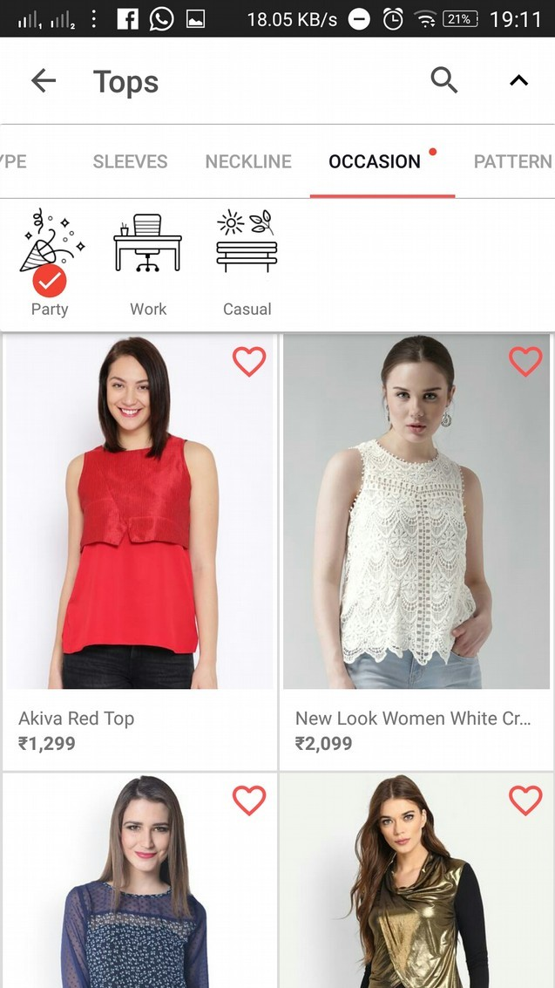
vi) Scrolling left in this page would go to the Handpicked section and scrolling right would go to the last page i.e Find.
Find page: The find page is the last page of this app.
The top navigation bar is the same for this page too.
There are several tags at the top of the page like western wear,
tops, bottom wear, skirts, ethnic, winter wear.
There are also items displayed below these tags with add to wishlist option at the top rigth corner of each item.
Selecting any of the item would redirect to buy page of the respective item
On selecting any of the tag, it would open another page with different inner tags like type of dress, length of dress, sleeves, fitting, neckline, occasion, pattern.
On selecting any of these inner tags would open another list of tags like dress, jumpsuit, dungaree etc.
Vii) Items will displayed according to the tags selected by the user.

Slide 7
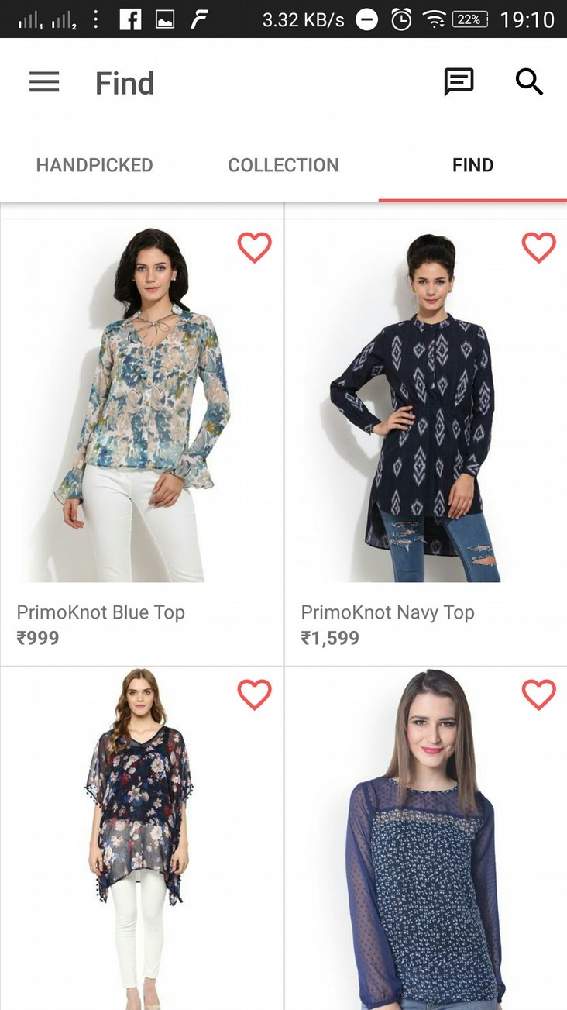
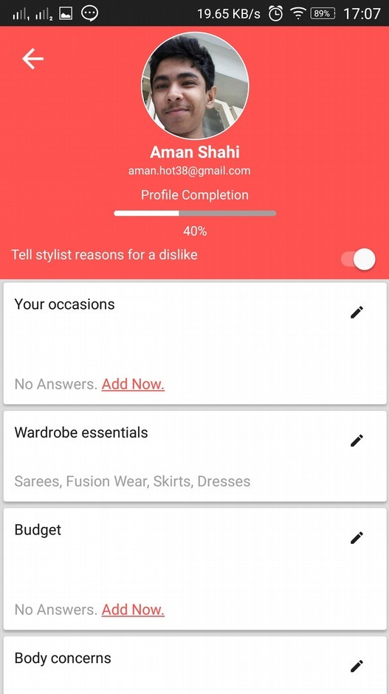
On selecting any of the tag, it would redirect to the buy page of the item.
Viii) Scrolling down would load twenty more items which are sorted according to their delivery time.
Scrolling left would go to collections page and scrolling
right would do nothing.
User’s profile: This tab contained in the hamburger menu
In this page the user can update his profile and change his intrests which were asked to him/her in the beginning.

Slide 8
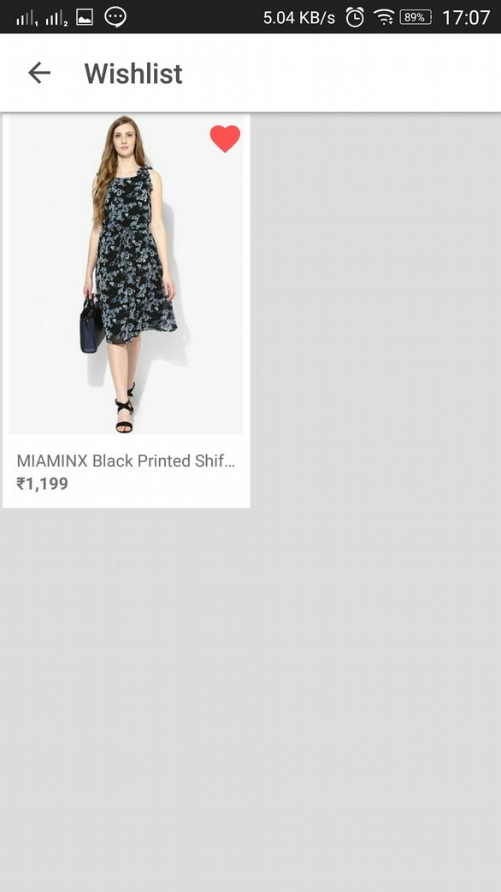
g) Wishlist: This tab stores all the items which were added to the wishlist. This tab is contained in the hamburger menu.

