Slide 1
R1 Report: iOS app for Fabulyst
Team Members - M. Vishnu, Ekansh Purohit, Amandeep Shahi, Nakul Vaidya.
Mentors - Professor Raghu Reddy, Vishal Chitravanshi (client), Akanksha (T.A.)

Slide 2
About Fabulyst
Fabulyst is a personal stylist app which aims to provide the following services -
Search through various online retail websites based on personal preferences and provide a more personalised list of products to browse.
Interactions with your own personal stylist through chat.
Recommendations from friends and other users.
Collections based on Trending fashion.
The Main advantage of this is that it saves on the user effort and time.

Slide 3
Consumer Base
The Primary target consumer base for this application as it stands now is young females.
Consumers who would like to keep up with fashion trends.
Consumers who predominantly shop online.
Consumers who would like personalised shopping compared to browsing retail stores.
However, this app could also in future be extended to a much wider audience.

Slide 4
Requirements
The primary aim of this project is to create an iOS Application for Fabulyst.
The Features required for the scope of our project include -
User Login/Profile.
Personalized User recommendations, Trends, Search.
Navigation through the various views.
Buying various items from different categories.
User Wishlist and Personalized handpicked collection.

Slide 5
Use case diagram

Slide 6
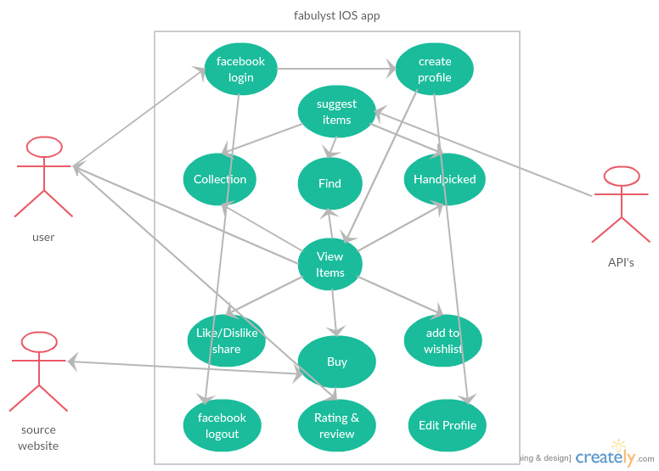

Slide 7
Software Development Method
The software development method that we used for this project is Feature Driven Development (FDD).
The Reasoning behind this decision is due to the following -
Most features work independently, therefore it is easier to design and implement working iterations while adding new features at each iteration.
Allows a part of the testing to be done simultaneously.

Slide 8
15/08/16 To 25/08/16
25/08/16 To 05/09/16
5/09/16 To 20/10/16
20/10/16 To 10/11/16
Requirements Analysis
Build Feature List and plan
Design Individual Feature
Current Stage
Build Individual Feature
Final Testing
Iterate over all Features to implement
(also test every feature added)

Slide 9
Design Diagrams

Slide 10
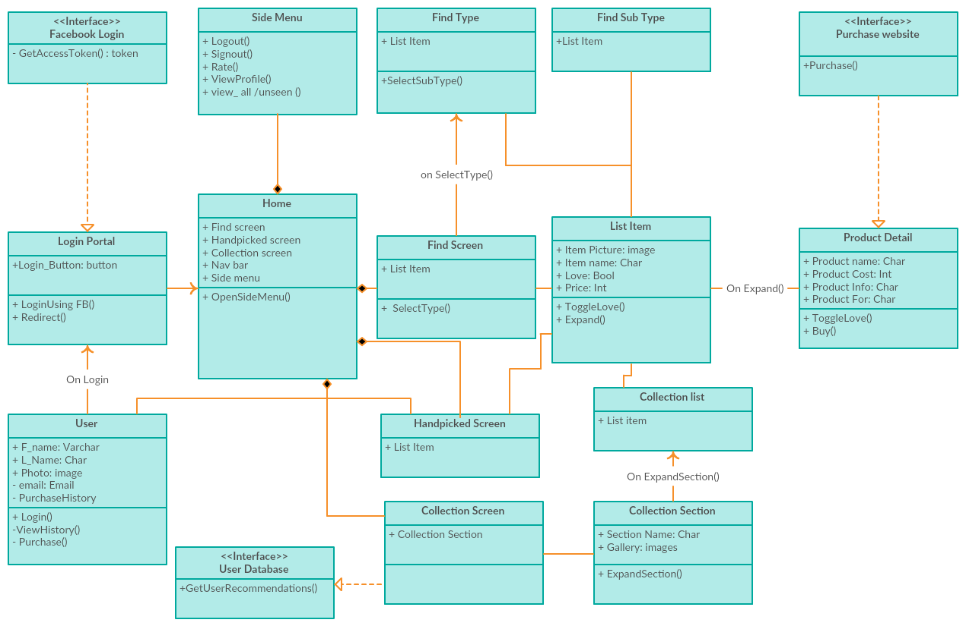
*

Slide 12
Basic User workflow
Notes:
Is the title correct?

Slide 13
Handpicked Screen
User Login
Collection Screen
View Product
Redirect to Retail Website
Find Screen
Screen to view product descriptions and details like price etc. and to allow user to proceed with purchase.
Users can login through their facebook accounts.
Primary views of the app. User can switch between these using the tab bar navigation.
Redirect the user to the relevant product on an online retail store so as to make purchase.

Slide 14
Development Environment
Back-End | REST APIs
Primary Programming Language | Swift (Objective C for Libraries)
IDE/UI development | XCode 8
App Platform | iOS

Slide 15
Current Status of Project

Slide 16
Currently, the features that have been implemented include:
Login through Facebook using Facebook SDK in Swift language.
Extensive user profile for personalized recommendations of clothes.
Navigation through the various views that include : Handpicked section, Collection & Search Tab.
Personalised categories in Collection according to the user profile, i.e. user’s likes and dislikes for certain types of clothes, physical body structure of user, skin tone, budget, brands preferred, work style etc.
Style Report with suggestions on what to wear according to user’s profile.

Slide 17
Future Releases

Slide 18
Goals for R2
Implementation of personal stylist chat.
Adding items to wishlist
Like/dislike, share app
Buy or purchase item
Rating, reviewing the app

Slide 19
Future prospects of this project
Men’s styling
This app can be extended to men’s dressing and styling.
Personal stylist
Chatting with personal stylist about dressing styles, fitting, color, size etc.
User preference
Some questions can be asked to user about his preferences on styling, interested themes and items to the user can be displayed in that manner. This can be editted by the user at any point of time.

