Slide 1


The Politics of Reddit in Sentiment
Elizabeth Fitzgerald

Slide 2
The General Premise
Two facts about me: I’m a big Reddit user, and I personally take a very neutral stance to politics. My internet savviness and general political neutrality is something I pride myself on.
However, this is definitely not the case for most other Redditors! Over the course of the past four years, I’ve wondered how conservative users and liberal users on Reddit differ in their expressed emotion: is it negative, positive, or neutral?
That is what this project seeks to discover: the overall sentiment of r/The_Donald and r/politics (a conservative subreddit and liberal subreddit, respectively), both across the last four years, and relative to each other.

Slide 3
The Process
Step One: Scraping Reddit Comments
I scraped randomly selected posts from r/The_Donald and from r/politics. I then collected all comments from the selected posts.
Step Two: Preprocessing Collected Comments
Each comment was preprocessed (junk characters removed, stopwords removed, lemmatized, and emojis handled).
Step Three: Comments labeled for sentiment using an existing lexicon
Each comment was labeled for sentiment based on existing subreddit lexicons.
Step Four: Results were visualized
The distributions of comment sentiment was plotted. Significance tests were also completed for each subreddit’s sentiment in comparison to the other.

Slide 4
To Run My Code
To run and view my code, you simply need to run main.py. However, it will prompt you for personal Reddit info in order to use praw, which scrapes Reddit. Since I do not want to provide my personal account details, it will be necessary to make an account, along with an application.
However, if this is not to your liking, then you can review my code, and simply look at the results that were achieved at each step in the Fitzgerald_Data_Results folder in the submission ☺

Slide 5
Step One: Scraping Reddit Comments
Both subreddits were scraped across the years of 2016, 2017, 2018, and 2019.
Posts were randomly selected from each of the four years, and then all the comments from these posts were scraped.
Ultimately, because r/politics has a much larger user base, at most 400 posts could be scraped from r/politics for any given year, while at most 1000 posts could be scraped from r/The_Donald.
The comments are in the non-processed .csv files in the data folder.

Slide 6
Step Two: Preprocessing Collected Comments
The collected comments from all four years were preprocessed and then output to files in the data folder.
Preprocessing included:
Cleaning junk characters
Removing stop words (provided by the NLTK library)
Lemmatizing
Handling the few emojis present in the text

Slide 7
Step Three: Comments labeled for sentiment using an existing lexicon
The SocialSent lexicon from https://nlp.stanford.edu/projects/socialsent/ was used. Specifically, the reddit lexicons for r/politics and r/TheRedPill (the vocabulary of r/TheRedPill is similar enough to be generalizable to r/The_Donald).
Each comment was then categorized based on the words it contained from it’s given subreddit. To generate the score this is based on, the following process was used:
The numbers of positive and negative words were calculated, as well as the total number of words.
I summed the mean sentiment of the positive words, and then summed the mean sentiment of the negative words (mean sentiment values provided by the lexicon).
The proportions of positive/negative words in a comment were multiplied by their respective summed mean sentiment.
If these difference between the extremity of the positive score and the negative score was less than .5, then the comment was considered neutral. Otherwise, if the strength of the positive score was greater, then it was labeled as positive, and vice versa for negative comments.

Slide 8
Step Four: Results were visualized
The distributions of comments as Negative, Neutral, or Positive for both subreddits across all four years was visualized as bar charts (as found in the Results folder).
The exact numbers and percentages are represented in the DistributionsResults.txt file, in the Results folder.
The DistributionsResults.txt file also contains two significance tests, to determine whether there is a significant difference in expressed sentiment between the two subreddits. The Significance tests performed were Two-Proportion Z-Tests.

Slide 9
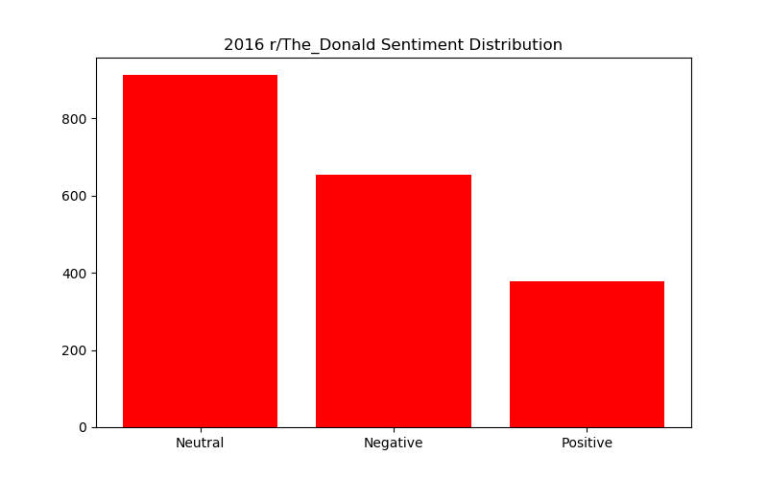
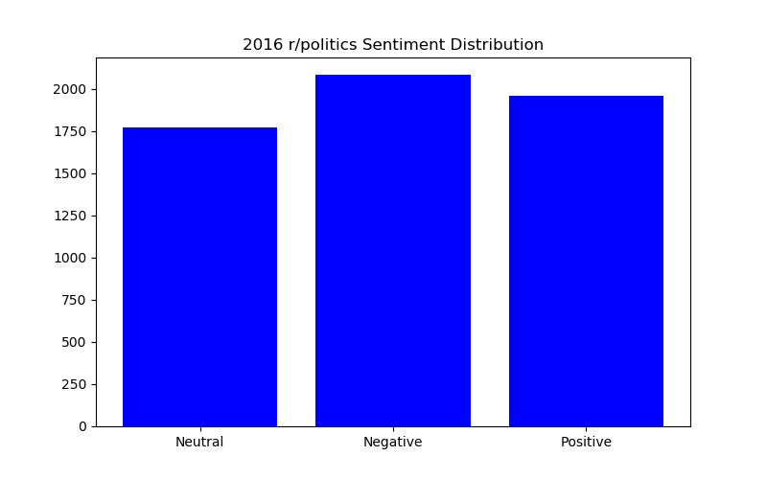
Results for 2016
2016 r/The_Donald Sentiment Distribution
-- Negative:655
-- Neutral: 912
-- Positive: 378
Negative Proportion: 0.33676092544987146
Neutral Proportion: 0.46889460154241647
Positive Proportion: 0.19434447300771207
2016 r/politics Sentiment Distribution
-- Negative:2082
-- Neutral: 1770
-- Positive: 1958
Negative Proportion: 0.35834767641996557
Neutral Proportion: 0.3046471600688468
Positive Proportion: 0.3370051635111876

Slide 10
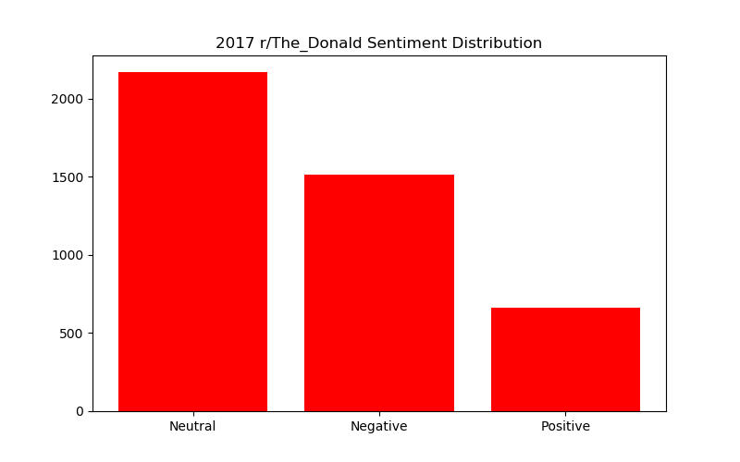
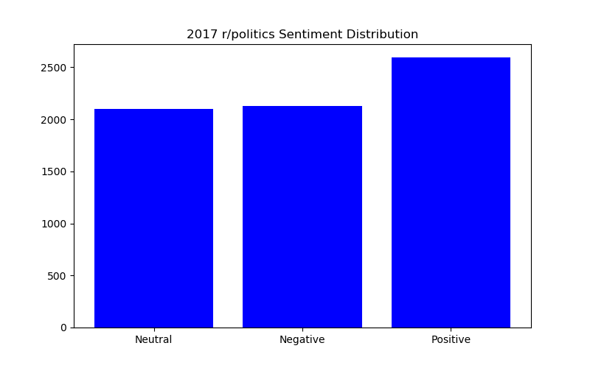
Results for 2017
2017 r/The_Donald Sentiment Distribution
-- Negative:1513
-- Neutral: 2167
-- Positive: 661
Negative Proportion: 0.3485372034093527
Neutral Proportion: 0.49919373416263535
Positive Proportion: 0.15226906242801197
2017 r/politics Sentiment Distribution
-- Negative:2132
-- Neutral: 2102
-- Positive: 2593
Negative Proportion: 0.3122894389922367
Neutral Proportion: 0.30789512230848104
Positive Proportion: 0.37981543869928225

Slide 11
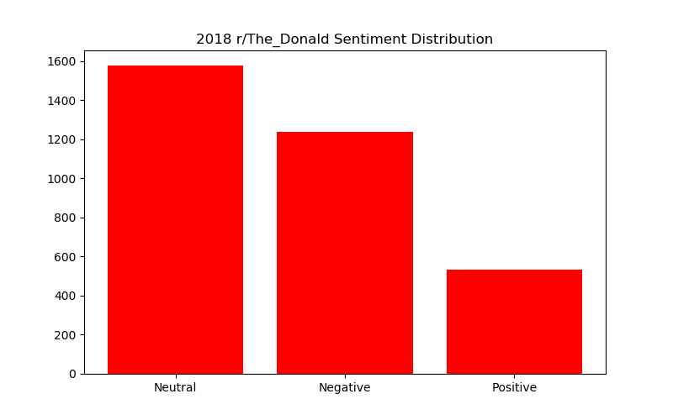
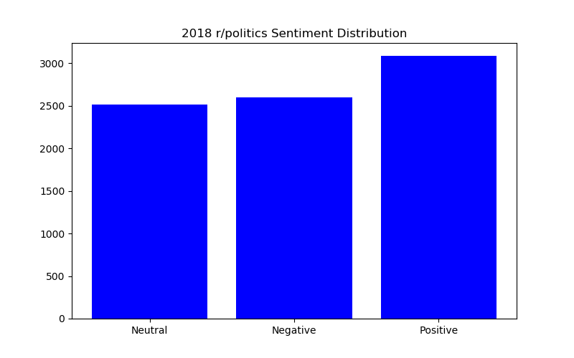
Results for 2016
2018 r/The_Donald Sentiment Distribution
-- Negative:1238
-- Neutral: 1577
-- Positive: 532
Negative Proportion: 0.36988347774126085
Neutral Proportion: 0.4711682103376158
Positive Proportion: 0.15894831192112338
2018 r/politics Sentiment Distribution
-- Negative:2599
-- Neutral: 2516
-- Positive: 3083
Negative Proportion: 0.3170285435472066
Neutral Proportion: 0.30690412295681874
Positive Proportion: 0.37606733349597465

Slide 12
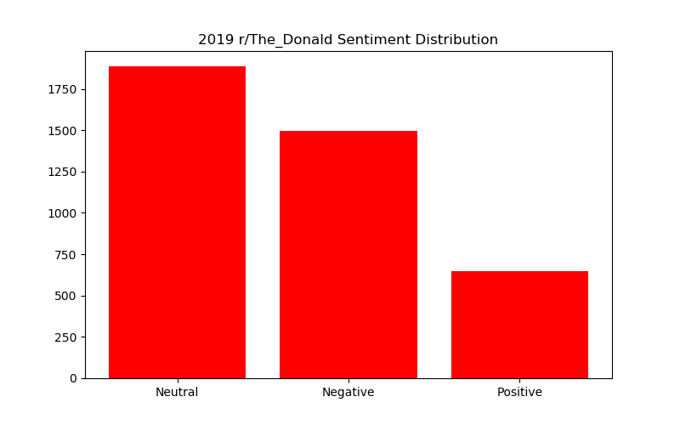
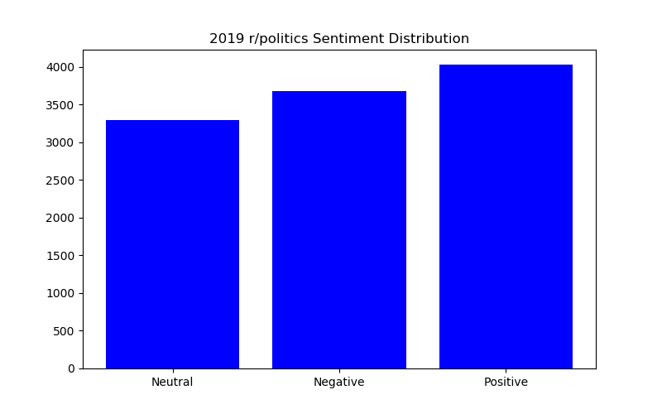
Results for 2016
2019 r/The_Donald Sentiment Distribution
-- Negative:1494
-- Neutral: 1885
-- Positive: 646
Negative Proportion: 0.37118012422360247
Neutral Proportion: 0.4683229813664596
Positive Proportion: 0.1604968944099379
2019 r/politics Sentiment Distribution
-- Negative:3673
-- Neutral: 3293
-- Positive: 4025
Negative Proportion: 0.33418251296515333
Neutral Proportion: 0.29960877081248294
Positive Proportion: 0.36620871622236373

Slide 13
Results of Significance Tests
Negative Sentiment Tests
Total Proportion of Negative r/The_Donald comments: 0.35876409430370476 (4900 / 13658)
Total Proportion of Negative r/politics comments: 0.3294790422924653 (10486 / 31826)
The p-value = 9.584456923006846e-10, and is less than .05, so we may conclude that the sentiment of r/The_Donald is more negative than that of r/politics.
The p-value = 0.9999999990415543, and is greater than .05, so we may conclude that the sentiment of r/politics is not more negative than that of r/The_Donald.
Positive Sentiment Tests
Total Proportion of Positive r/The_Donald comments: 0.1623224483819007 (2217 / 13658)
Total Proportion of Positive r/politics comments: 0.366335700370766 (11659 / 31826)
The p-value = 1.0, and is greater than .05, so we may conclude that the sentiment of r/The_Donald is not more positive than that of r/politics.
The p-value = 0.0, and is less than .05, so we may conclude that the sentiment of r/politics is more positive than that of r/The_Donald.

