Slide 1

Colonial Pipeline Ransomware Incident
Cyber Threat Intelligence Analysis
PRESENTED BY
2410030019-EADUNUR HARINI SRI REDDY
2410030246-DEVARSHETTY PRAVALIKA
2410030298-V.TANUSRI
2410030060-MAHITHA VARMA

Slide 2
Project Extension

Slide 3
System Overview
What we did
From Analysis -> Implementation!
AI system for automated malware detection
Bridges CTI with real-time defense
Input: Memory Dump Data
Processing: Feature extraction and Scaling
Model: Deep Neural Network
Output: Threat Classification

Slide 4
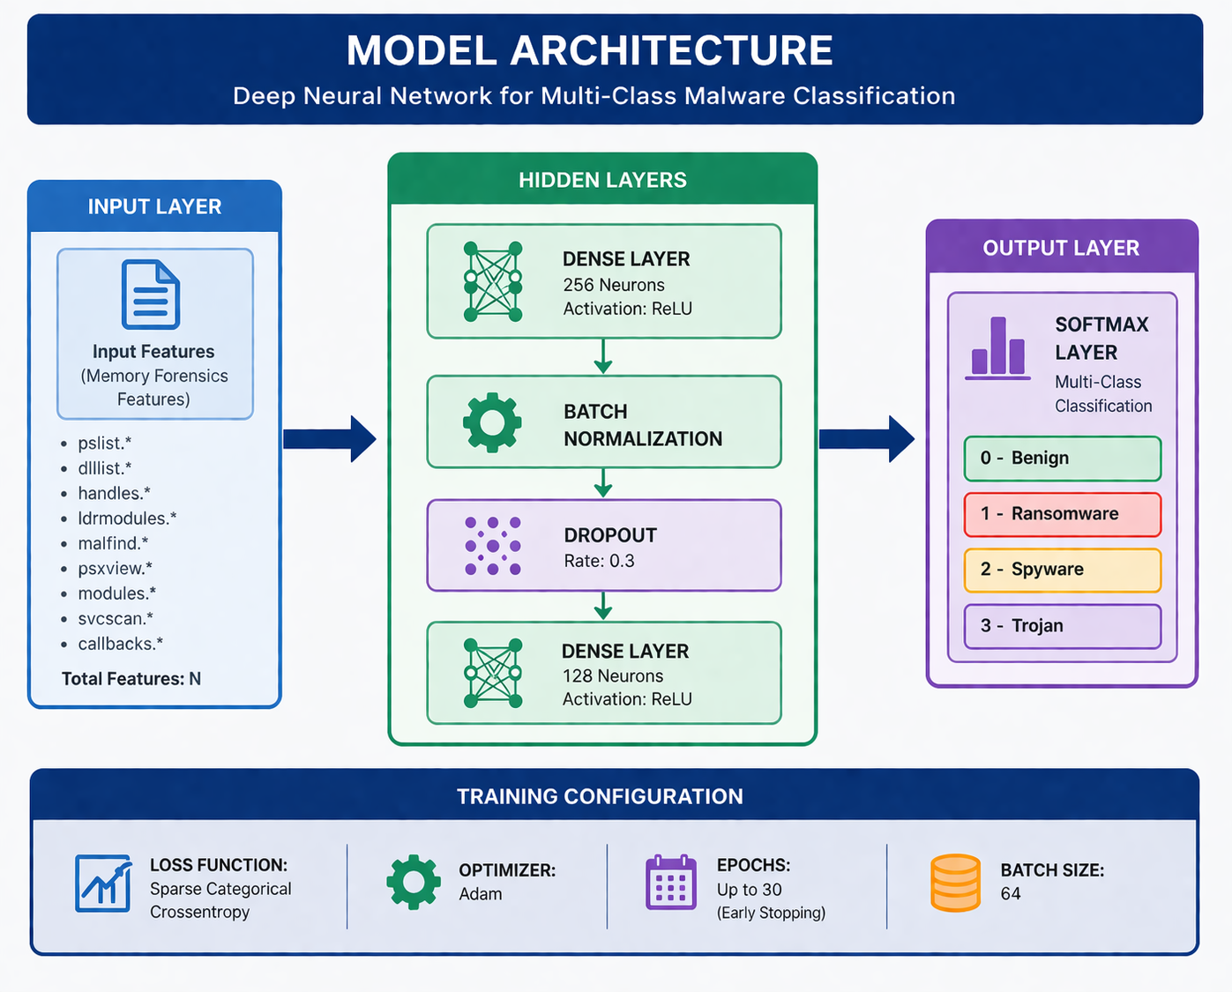
Model Architecture
Dense (256) → BatchNorm → Dropout
Dense (128) → Softmax
Loss: Crossentropy | Optimizer: Adam

Slide 5
Technical Competence
TensorFlow/Keras Model:Deep Neural Network for multi-class malware detection with ~75–80% accuracy.
Streamlit Dashboard:Interactive UI for uploading data, visualizing threat distribution, and viewing confidence metrics.
psutil Real-Time Monitoring:Live process scanning with whitelist filtering and heuristic noise reduction.
End-to-End ML Pipeline:Data → Preprocessing → Model Training → Deployment → Real-time Prediction & Visualization.

Slide 6
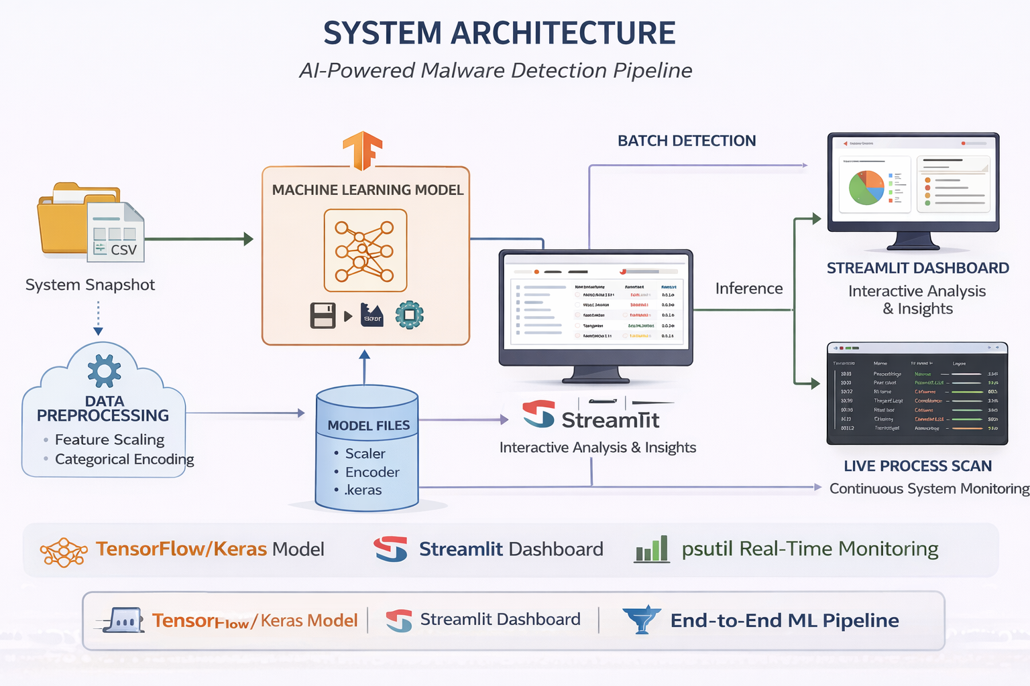

Slide 7
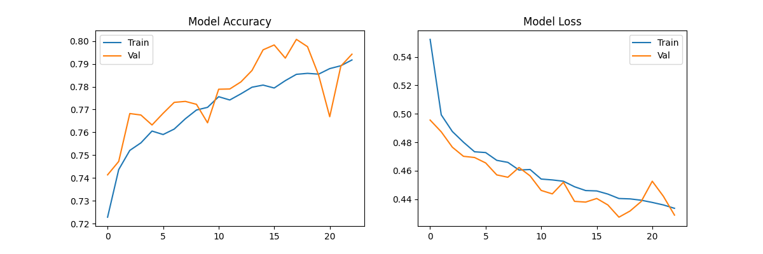
Model Accuracy: 75–80%
Multi-class classification
Confusion Matrix & ROC-AUC used
Accuracy of Results

Slide 8
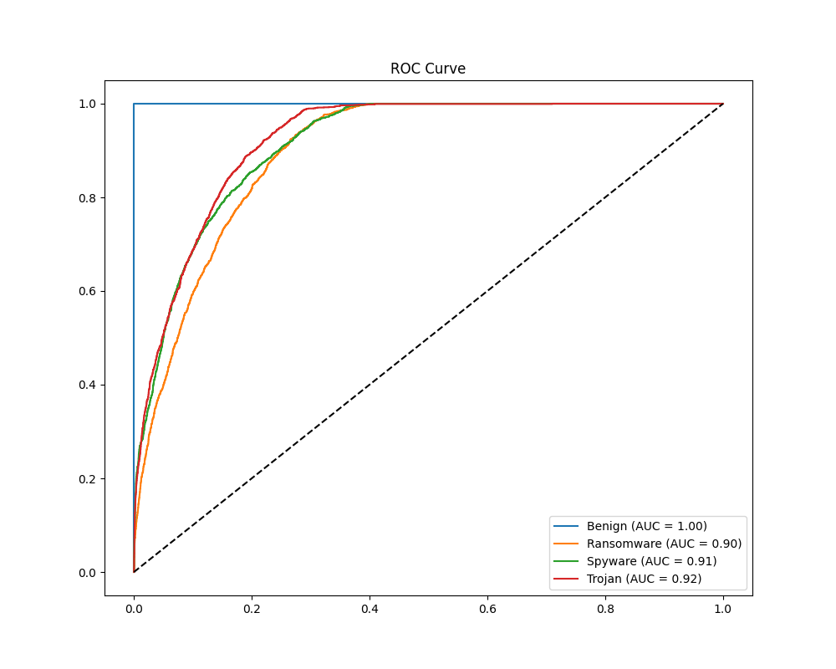

Slide 9
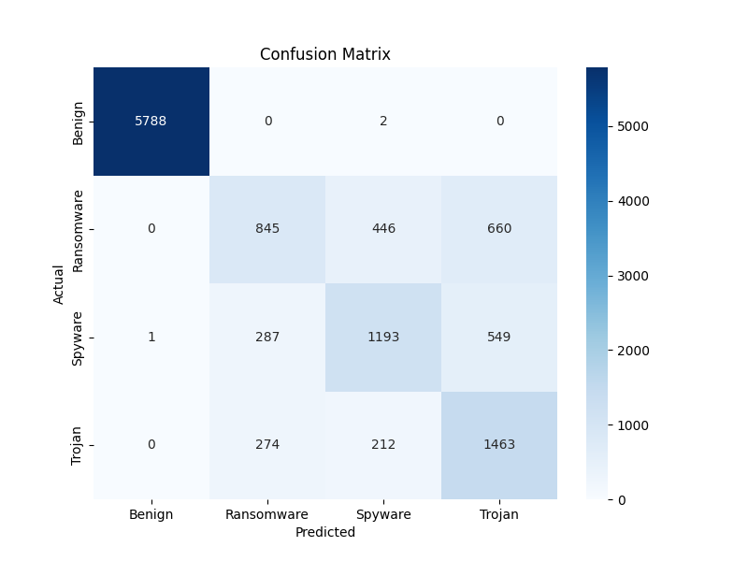

Slide 10
Live Detection System

Slide 11
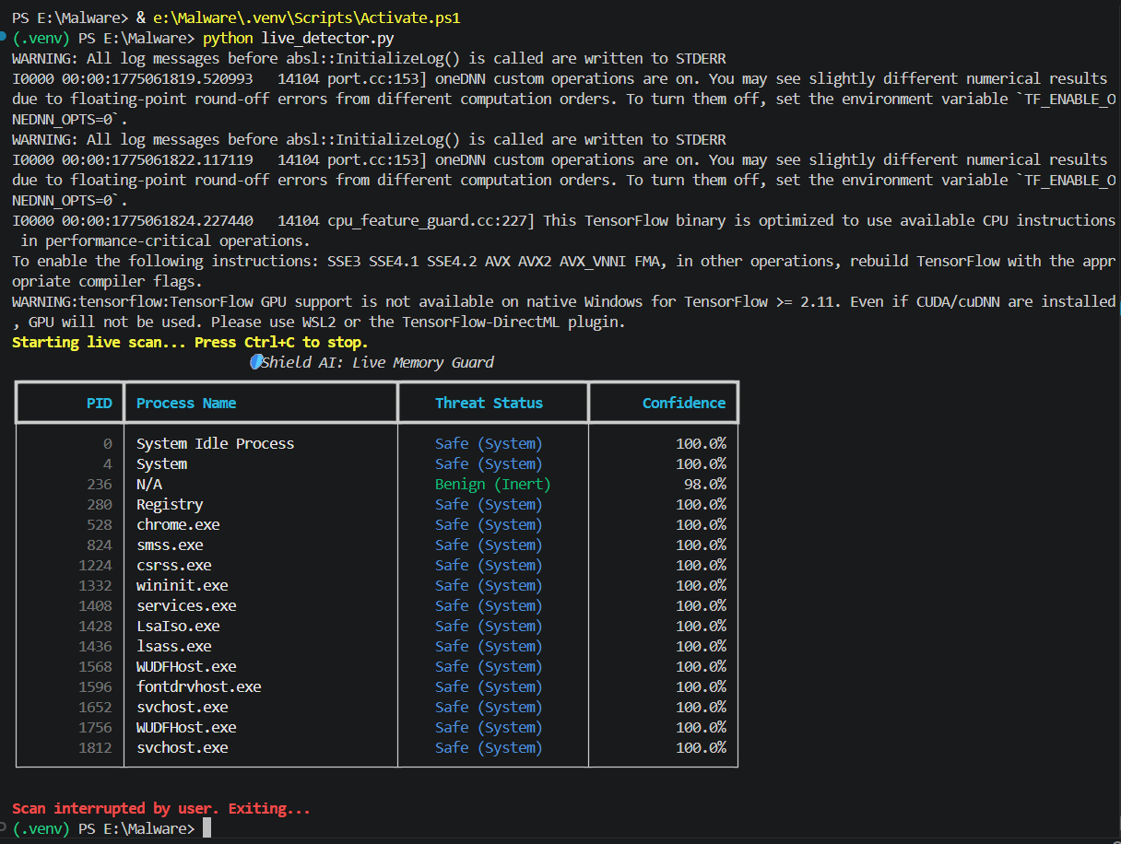
Real-time process scanning, Whitelist for system processes, Heuristic noise reduction

Slide 12
Dashboard Features

Slide 13
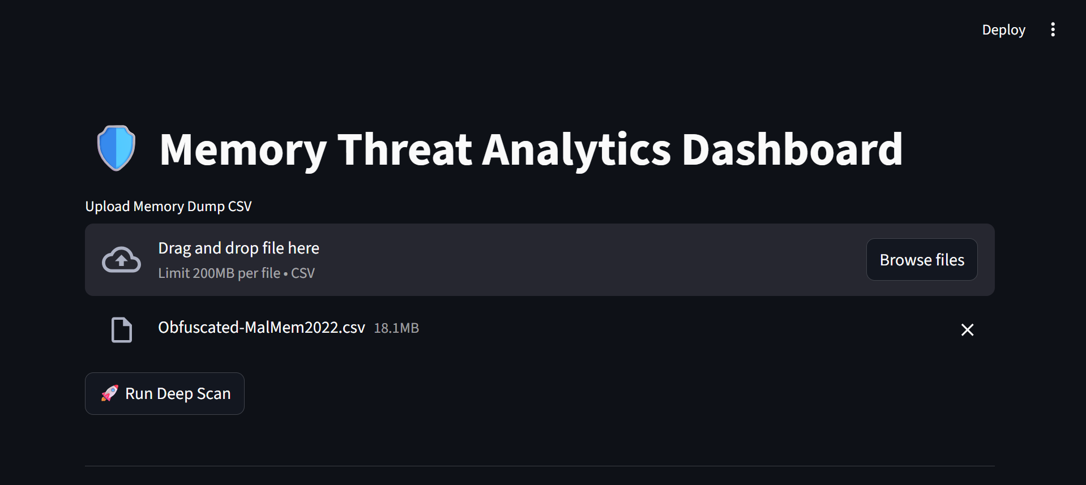

Slide 14
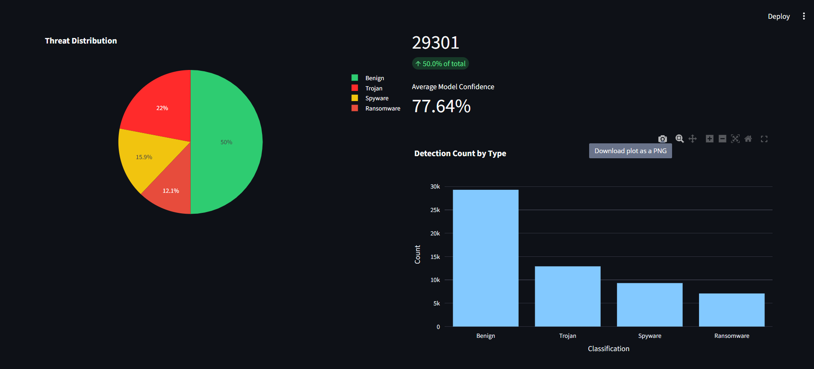

Slide 15
Innovative and Sustainable Features

Slide 16
Innovative Features
Sustainable Features
CTI + AI integration
Memory-based malware detection
Real-time classification
Hybrid ML + heuristics
Lightweight deployment
Scalable architecture
Can integrate with SIEM tools
Low runtime cost

Slide 17
Innovative and Sustainable Features

Slide 18
Innovative Features
Sustainable Features
CTI + AI integration
Memory-based malware detection
Real-time classification
Hybrid ML + heuristics
Lightweight deployment
Scalable architecture
Can integrate with SIEM tools
Low runtime cost

Slide 19
Utility to Society & Future Scope

Slide 20
Utility to Society
Future Scope
Prevents ransomware attacks
Supports SOC analysts
Protects critical infrastructure
Reduces financial losses
Cloud deployment
Transformer models
Automated threat response
SIEM integration

